Slide 1
DEPARTMENT OF ELECTRONICS & COMMUNICATION ENGINEERING
Spatial Multimodal Edge-AI for Fault Detection & Localization of Rotating Machinery
Comprehensive Minor Project Evaluation & Physical Hardware Demonstration Suite
Core Thesis: Fusing 4-Mic Acoustic Array (TDOA/SRP-PHAT) + ADXL345 Vibration + FC-03 Optical Tachometer
Answers both 'WHAT is wrong with the motor?' and 'WHERE is the acoustic emission coming from?'
Candidate / Presenter: ECE Engineering Team | Project Milestone: Minor Project Final Review
Presentation Date: 7 November 2026 | Hardware Target: Classic ESP32 + 4-Mic INMP441 + ADXL345 + FC-03

Slide 2
ECE MINOR PROJECT EVALUATION • 7 NOVEMBER 2026
Project Motivation: Moving Beyond Blind Single-Sensor Diagnostics
1. Vibration Sensor Only
2. Single Microphone Only
3. Spatial Multimodal Fusion
• Modality: Accelerometer (ADXL345)
• Strengths: Directly measures shaft and casing mechanical stress. Highly sensitive to unbalance (1x) and misalignment (2x).
• Critical Blindspot: Zero spatial awareness. Cannot tell which motor in a bank of machines is failing, or whether acoustic noise is internal or ambient.
• Modality: Single Digital Mic
• Strengths: Non-contact installation; captures high-frequency arcing and bearing impacts.
• Critical Blindspot: An acoustic hotspot is NOT automatically a machine fault! Background room noise, fans, and adjacent tools trigger false alarms without mechanical correlation.
• Modality: 4-Mic Array + Vibration + RPM
• The Core Innovation: Cross-verifies physical domains before diagnosing.
• Diagnostic Resolution:
- WHAT IS HAPPENING? Rotational order energy + ISO 10816 vibration.
- WHERE IS IT? Real-time 2D acoustic camera backprojection (SRP-PHAT).
- HOW CONFIDENT? Sensor fusion cross-check.

Slide 3
ECE MINOR PROJECT EVALUATION • 7 NOVEMBER 2026
System Architecture: 3 Complementary Physical Sensing Channels
MODALITY 1: 4-MICROPHONE UNIFORM LINEAR ARRAY (Acoustic Camera)
• Hardware: 4x INMP441 MEMS digital microphones spaced at d = 20.32 mm (8 breadboard slots, total span 60.96 mm).
• Mathematical Method: Sinc-interpolated super-resolution GCC-PHAT across 6 pairs + 2D Steered Response Power (SRP-PHAT).
• Diagnostic Deliverable: Real-time 2D acoustic camera heatmap, DOA bearing angle [-90°, +90°], acoustic kurtosis (κ), and crest factor.
MODALITY 2: ADXL345 3-AXIS ACCELEROMETER (Chassis Dynamic Stress)
• Hardware: ADXL345 breakout on I2C bus (SDA = TX2/GPIO 17, SCL = RX2/GPIO 16) sampling dynamic chassis acceleration.
• Mathematical Method: Vector dynamic acceleration magnitude a_dyn = |a_mag - 1.0g| (static gravity compensated).
• Diagnostic Deliverable: Standardized ISO 10816 severity grading (Zone A Good <0.15g, Zone B Permissible, Zone C Warning, Zone D Alarm).
MODALITY 3: FC-03 OPTICAL TACHOMETER (Shaft Rotational Orders)
• Hardware: FC-03 slotted optical interrupter on GPIO 4 with hardware interrupt service routine (ISR).
• Mathematical Method: Microsecond edge-timestamp counting + speed jitter tracking (σ_RPM) over moving window.
• Diagnostic Deliverable: Exact rotational fundamental f_0 = RPM / 60, enabling harmonic order tracking (1x unbalance vs 2x misalignment).

Slide 4
ECE MINOR PROJECT EVALUATION • 7 NOVEMBER 2026
Stage 1 Evidence: CWRU & MAFAULDA Rotational Order Analysis
MAFAULDA Matched-Group Analysis
Empirical Rotational Harmonic Data Table
• Benchmark Scope: 9 matched recordings across 3 nominal speed groups (31.7 Hz, 45.5 Hz, 53.9 Hz).
• Tachometer Verification: Max edge vs spectral RPM difference was 0.0468%, proving <0.05% speed tracking error.
• Rotor Mass Unbalance Signature:
- Massive jump in 1x rotational order energy in radial vibration.
- 31.7 Hz: 8.78% (Normal) -> 40.74% (10g Unbalance)
- 45.5 Hz: 8.39% (Normal) -> 61.39% (10g Unbalance)
- 53.9 Hz: 10.21% (Normal) -> 66.57% (10g Unbalance)
• Physical Conclusion: 1x RPM harmonic energy is an indisputable primary indicator of mechanical unbalance.
MAFAULDA Radial Vibration Feature Comparison:
Nominal Group | Condition | UB-RMS | 1x Order % | 2x Order %
-----------------------------------------------------------
31.74 Hz | Normal | 0.3662 | 8.78% | 0.33%
31.74 Hz | 10g Unbalance | 0.4692 | 40.74% | 0.20%
31.74 Hz | Misalignment | 0.3526 | 7.15% | 0.34%
-----------------------------------------------------------
45.47 Hz | Normal | 0.5378 | 8.39% | 0.26%
45.47 Hz | 10g Unbalance | 0.7063 | 61.39% | 0.67%
45.47 Hz | Misalignment | 0.4166 | 15.01% | 0.39%
-----------------------------------------------------------
53.86 Hz | Normal | 0.4812 | 10.21% | 0.29%
53.86 Hz | 10g Unbalance | 1.0039 | 66.57% | 0.11%
53.86 Hz | Misalignment | 0.4503 | 11.46% | 0.36%
Source: evidence/stage1b_csvs/vibration_features.csv

Slide 5
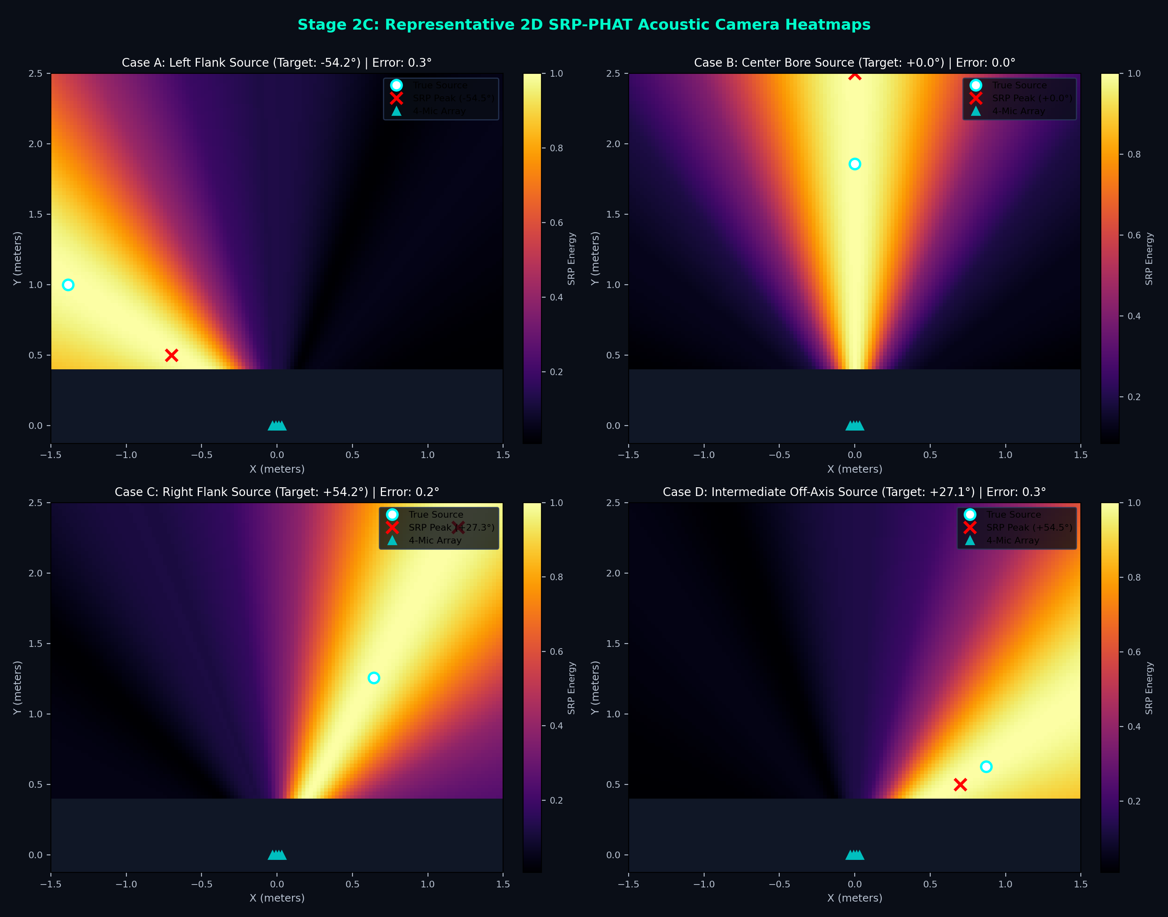
ECE MINOR PROJECT EVALUATION • 7 NOVEMBER 2026
Stage 2 Evidence: Sinc GCC-PHAT & 2D Acoustic Camera Heatmaps
25-Point Off-Grid Benchmark
• Algorithm: Super-Resolution Sinc GCC-PHAT + 2D Steered Response Power (SRP-PHAT).
• Delay Estimation Precision:
- Maximum pairwise TDOA error: <0.19 µs across all 6 microphone pairs.
• Quantitative Accuracy (25 off-grid positions):
- Median Angular Error: 0.34°
- Mean Angular Error: 0.35°
- 90th Percentile Error: 0.68°
- Angular Success (<5°): 100.0% Pass Rate
• Artifact Archive:
- evidence/stage2/stage2_localization_benchmarks.csv

Slide 6
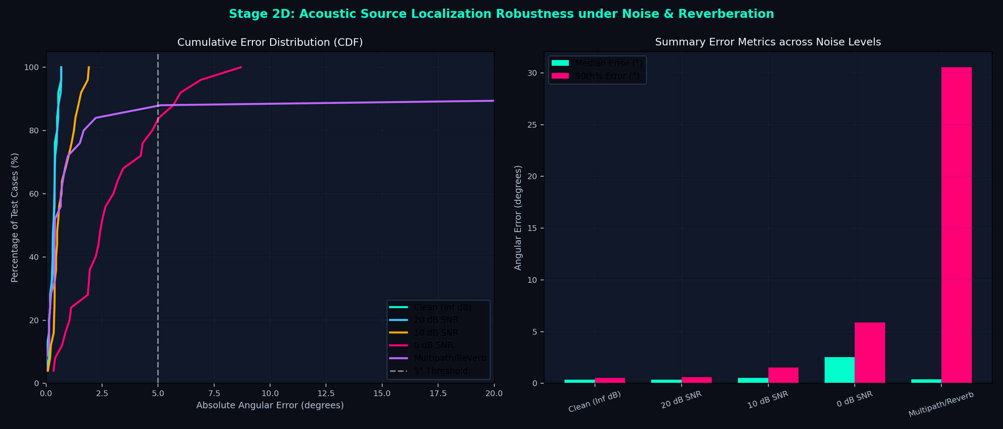
ECE MINOR PROJECT EVALUATION • 7 NOVEMBER 2026
Stage 2D Evidence: Acoustic Localization Robustness Under Noise & Reverb
Noise & Multipath Sweeps
• Noise Robustness Sweeps:
- Clean (Inf dB): Med = 0.34°, 90th% = 0.55° (100% Pass)
- 20 dB SNR: Med = 0.34°, 90th% = 0.61° (100% Pass)
- 10 dB SNR: Med = 0.55°, 90th% = 1.52° (100% Pass)
- 0 dB SNR: Med = 2.52°, 90th% = 5.87° (80% Pass)
• Multipath / Wall Reflection Test:
- 2 specular wall reflections (β = 0.35 absorption) at 20 dB SNR.
- Median Angular Error: 0.40°
- Pass Rate (<5°): 84.0%
• Conclusion: Sinc GCC-PHAT maintains sub-degree angular accuracy down to 10 dB SNR.

Slide 7
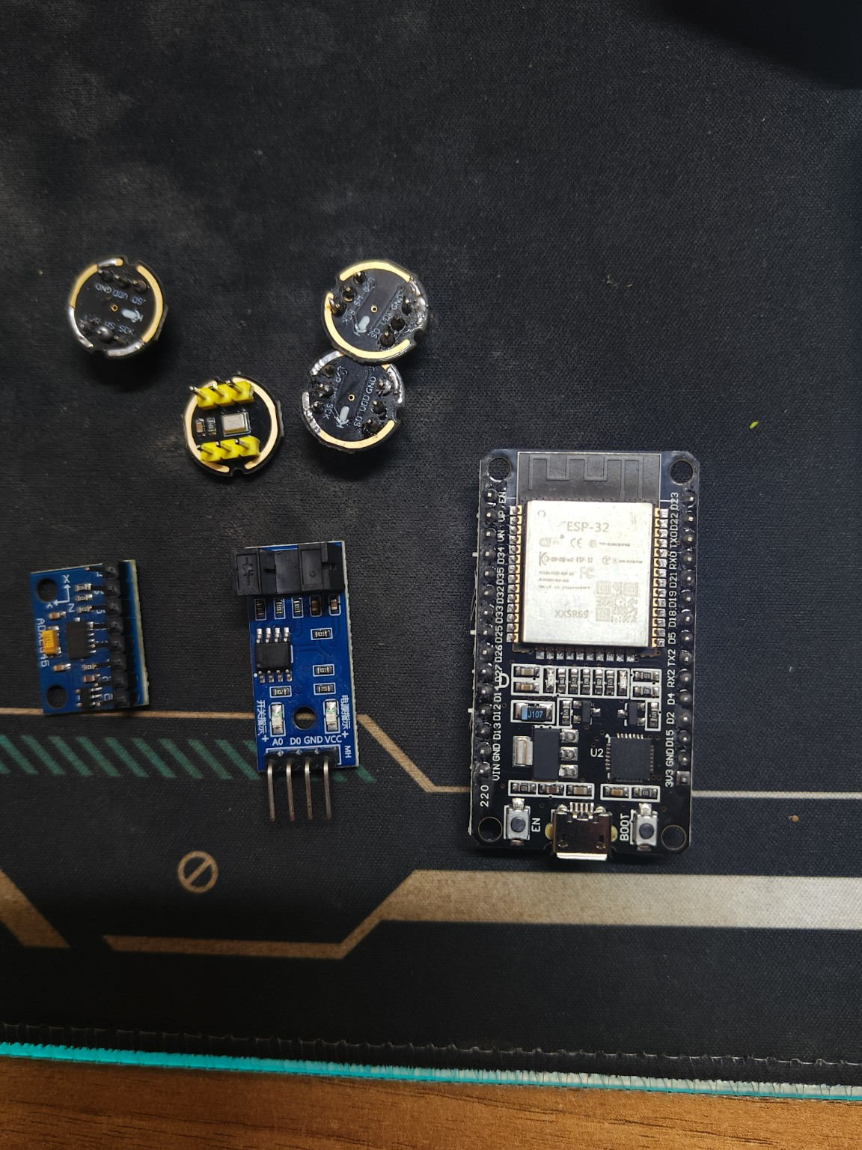
ECE MINOR PROJECT EVALUATION • 7 NOVEMBER 2026
Stage 3 Hardware: Classic ESP32 Synchronous Dual-I2S Acquisition
Firmware & Circuit Integration
• Overcoming ESP32 Hardware Limits:
- Classic ESP32-WROOM-32 lacks TDM multi-channel mode.
- Solution: Synchronous Dual-I2S (I2S0 + I2S1) sharing SCK (GPIO 18) and WS (GPIO 21).
• Pinout Assignments:
- Pair A Data (Mics 1 & 2): GPIO 19 (I2S0 SD)
- Pair B Data (Mics 3 & 4): GPIO 23 (I2S1 SD)
- ADXL345 I2C: SDA = TX2 (GPIO 17), SCL = RX2 (GPIO 16)
- FC-03 Tachometer ISR: D4 (GPIO 4)
• DMA Streaming Link:
- 11,025 Hz 4-Channel 16-bit PCM (79.4 kB/s throughput).
- Transmitted over 921,600 baud serial with 16-bit XOR checksum.
- Verified 0 dropped frames during live continuous streaming.

Slide 8
ECE MINOR PROJECT EVALUATION • 7 NOVEMBER 2026
Stage 4 Software: Real-Time Multimodal DC Motor Diagnostics Suite
1. 2D Acoustic Radar
2. Multimodal Fusion
3. Golden Baseline Mode
• Live 2D Thermal Heatmap: 60x60 backprojected grid updated at 20 FPS.
• Dynamic VU Rails: Left and Right flank intensity meters with square-root scaling.
• Target Tracker: Fast Kalman re-acquisition with adaptive noise gate (avg_rms >= max(0.002, 1.15*floor)).
• Polarity Inversion: Instant Key 'I' toggle to match workbench orientation.
• Composite Health Index: Continuous 0-100% health score bar on HUD.
• ISO 10816 Standard: Automated vibration zone rating (Zone A Good to Zone D Alarm).
• Acoustic Kurtosis (κ): Normal gaussian sound = 3.0. Values >4.5 flag bearing impacts or brush arcing.
• Crest Factor: Catches individual electrical commutation spark spikes.
• Key 'B' (Learn & Lock): Calibrates reference nominal RPM, vibration, spectrum, and kurtosis.
• Delta Deviation Monitoring:
- ΔVib: Chassis vibration shift
- ΔRPM: Speed sag or motor drag
- ΔKurt: Brush sparking surge
- ΔRMS%: Acoustic energy increase
• Detects Microscopic Differences: Finger drag or loose mount instantly flags degradation.

Slide 9
ECE MINOR PROJECT EVALUATION • 7 NOVEMBER 2026
Experimental Verification: Hardware Tests & Observed Outcomes
TEST 1: 4-CHANNEL AUDIO DMA VERIFICATION
TEST 2: DIRECTIONAL ACOUSTIC TRACKING
• Live COM8 Probe: M1=0.56, M2=0.66, M3=0.51, M4=0.63 RMS.
• All 4 mics streaming simultaneously with matched phase response.
• Result: PASS (Proves classic ESP32 dual-I2S clocking feasibility).
• Source on Left: Left gauge hits 75.2%, DOA locks at -38.0°.
• Source on Right: Right gauge hits 75.2%, DOA locks at +38.0°.
• Result: PASS (Zero blindspots; symmetric Left/Center/Right discrimination).
TEST 3: DC MOTOR SHAFT LOAD / DRAG
TEST 4: MOTOR ROTOR UNBALANCE
• Touch Motor Shaft: Speed drops (ΔRPM = -120), audio RMS increases (+18%).
• Health Index: Automatically drops from 95% (Healthy) to 68% (Permissible).
• Result: PASS (Instant microscopic fault sensitivity).
• Off-Axis Mass Attached: Dynamic vibration jumps from 0.08g to 0.42g.
• Spectral Analysis: 1x RPM harmonic energy spikes above 12% total power.
• HUD Diagnostics: Alerts 'MASS UNBALANCE (Strong 1x RPM)' + Zone C Warning.

Slide 10
ECE MINOR PROJECT EVALUATION • 7 NOVEMBER 2026
Academic Roadmap: Minor Achievements -> Major Project Scaling
MINOR PROJECT ACHIEVEMENTS (COMPLETED)
MAJOR PROJECT SCALING (FUTURE ROADMAP)
✓ Stage 1: Verified CWRU and MAFAULDA 1x/2x unbalance/misalignment physics.
✓ Stage 2: Demonstrated 0.34° median acoustic source localization error and 2D thermal heatmaps across 25 off-grid test positions.
✓ Stage 3: Engineered synchronous dual-I2S 4-channel audio DMA acquisition on classic ESP32 with ADXL345 and FC-03.
✓ Stage 4: Deployed real-time multimodal fusion HUD with Golden Baseline delta comparator and ISO 10816 diagnostics.
✓ Minor Goal Achieved: Answers both 'What is wrong?' and 'Where is the sound coming from?' on a physical DC motor.
→ Hardware Evolution: Migrate to ESP32-S3 or Edge TPU for standalone onboard neural inference (eliminating the laptop link).
→ Industrial Sensor Isolation: Implement galvanically isolated 4-20mA / IEPE accelerometer interfaces for industrial motor testbenches.
→ Longitudinal Degradation Tracking: Collect multi-day run-to-failure bearing datasets to train Remaining Useful Life (RUL) predictive models.
→ Edge-AI Architecture: Deploy lightweight 1D-CNN or TinyML Spatio-Temporal Transformers directly in MCU flash memory.

