Slide 1
Digital Portfolio
STUDENT NAME: YOGANITHI R
REGISTER NO AND NMID: 212403888/ DA7445539F74C21AC0345AE108441ED3
DEPARTMENT :BCA(Computer application)
COLLEGE: COLLEGE/UNIVERSITY :Tagore college of arts and science, Chromepet-44 (University of Madras)

Slide 2
PROJECT TITLE
yoganithi portfolio project

Slide 3


AGENDA
Problem Statement
Project Overview
End Users
Tools and Technologies
Portfolio design and Layout
Features and Functionality
Results and Screenshots
Conclusion
Github Link
3/21/2024 Annual Review

Slide 4

PROBLEM STATEMENT
In today’s competitive environment, a traditional resume is often limited in conveying creativity, practical skills, and interactive experience. Recruiters and clients prefer an easy, engaging, and visually appealing way to evaluate candidates.
The challenge is to create a digital platform that not only summarizes academic qualifications and skills but also provides a live demonstration of technical abilities.
My portfolio project was developed to solve this gap – to present my skills and projects in a professional and interactive manner.

Slide 5

PROJECT OVERVIEW
The project is a personal portfolio website that highlights my technical expertise, skills, and projects in a single platform. It is structured into sections such as About Me, Skills, Services, Portfolio, and Contact.
The website is designed with a modern responsive layout to ensure accessibility across devices, and it reflects both my personality and technical knowledge.
Overall, the portfolio serves as a professional showcase and helps in connecting with recruiters, clients, and peers effectively.

Slide 6

WHO ARE THE END USERS?
The portfolio is mainly designed for the following groups:
Recruiters & Employers: To evaluate technical skills, projects, and creativity quickly.
Clients: For freelance opportunities and collaborations.
Peers & Educators: To share knowledge, ideas, and encourage networking.
By targeting these users, the portfolio becomes a versatile tool for career development and professional exposure.

Slide 7

TOOLS AND TECHNIQUES
The portfolio was built using a strong combination of front-end and programming technologies:
Frontend: HTML, CSS, and JavaScript were used to design the user interface and interactivity.
Programming Knowledge: Python, Java, and C++ were applied for logic-building and showcasing coding expertise.
Hosting: GitHub Pages was used to deploy and maintain the website online.
These tools ensure that the portfolio is not only visually appealing but also technically strong and reliable.

Slide 8
POTFOLIO DESIGN AND LAYOUT
The design philosophy focuses on simplicity, modern visuals, and user experience. A blue-themed color scheme is maintained for professionalism and consistency.
The layout is divided into clean sections:
About Me
Skills (with progress bars)
Services offered
Portfolio showcase
Contact form
This structure ensures easy navigation, readability, and engagement for any visitor.
‹#›

Slide 9
FEATURES AND FUNCTIONALITY
The portfolio includes multiple interactive features that improve usability and engagement:
Interactive navigation bar for smooth movement across sections.
Skill progress bars to visually showcase technical strengths.
Portfolio section with projects and categories.
Contact form for direct communication with clients or recruiters.
GitHub integration for direct access to code repositories.
These functionalities make the portfolio a dynamic platform rather than a static resume.

Slide 10

RESULTS AND SCREENSHOTS
The portfolio was successfully deployed at:
👉 yoganithi141.github.io/portfolio_yoganithi
Key results:
Professional Online Presence: An accessible digital identity for recruiters and clients.
Skill Demonstration: Visual proof of coding and designing abilities.
User Experience: Mobile-friendly, responsive, and easy-to-navigate layout.
Screenshots of different sections (Home, Skills, Portfolio, Contact) can be showcased during the presentation to demonstrate its effectiveness.
‹#›

Slide 11
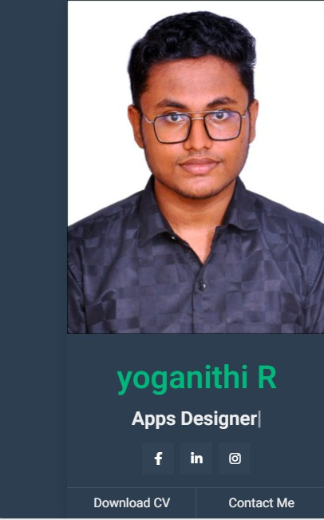
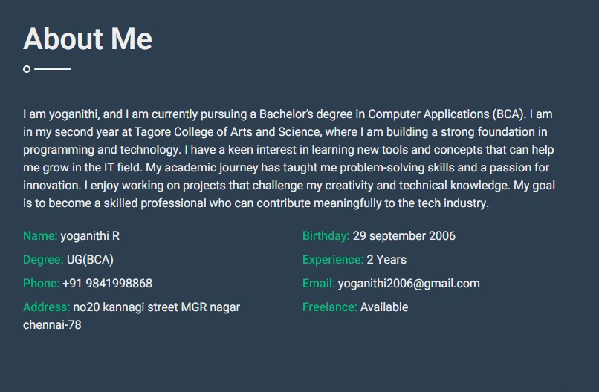

Slide 12
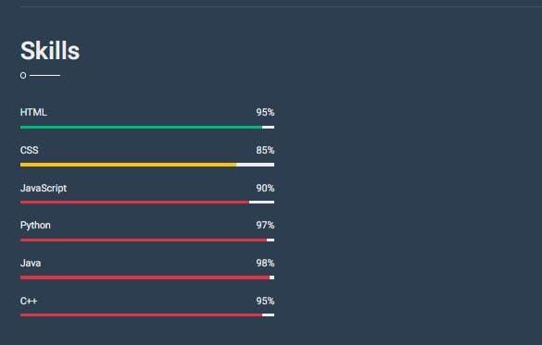

Slide 13
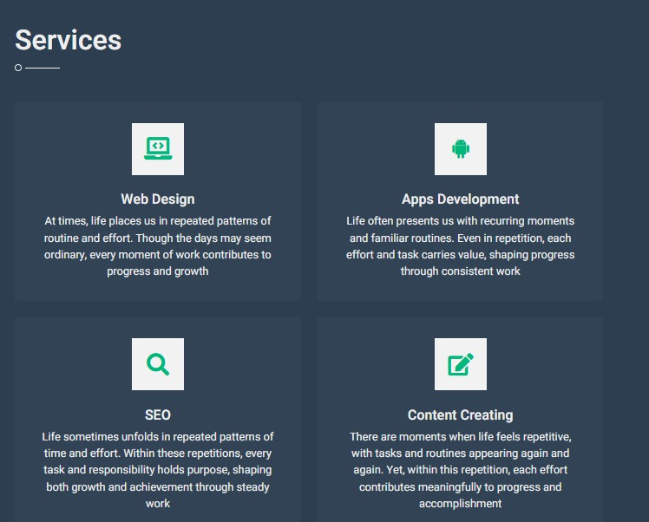

Slide 14
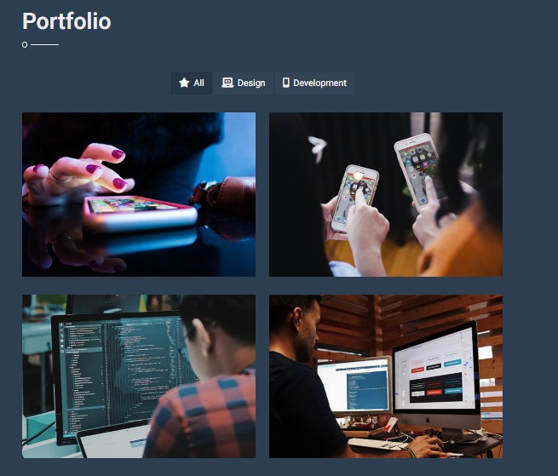

Slide 15
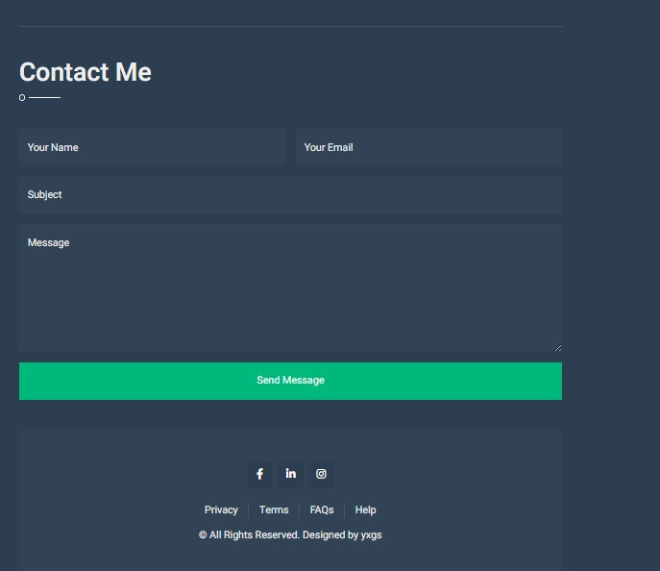

Slide 16

CONCLUSION
The portfolio project proves that a digital resume/portfolio is far more impactful than a static CV. It highlights skills, projects, and creativity in an interactive way.
It also provides me with a strong professional identity, helping me stand out in academic and career opportunities.
🔗 GitHub Repository: https://yoganithi141.github.io/portfolio_yoganithi/
‹#›

