Slide 1


K.RAMAKRISHNAN COLLEGE OF TECHNOLOGY (AUTONOMOUS), TRICHY
Analysing Traffic Accidents by Time of Day and Visualizing the Trends
PRESENTED BY
YOGAPPRIYAN S
(2303811724321125)

Slide 2
PRESENTATION OVERVIEW
Problem Identification
Objective
Proposed system
Block diagram of proposed system
Advantages of proposed system
R concept used
Modules
Module description
Output

Slide 3
PROBLEM IDENTIFICATION
Traffic accidents often occur at specific times of day, but authorities lack tools to analyze these patterns. Without clear insights into when accidents are most frequent, it's hard to plan effective safety measures or allocate resources. This project addresses the issue by analyzing and visualizing accident trends by time using R and Shiny, helping improve road safety through data-driven decisions.

Slide 4
OBJECTIVE
This project aims to analyze traffic accidents by time of day, identify peak accident hours, and present the findings through an interactive R Shiny app to support data-driven traffic safety planning.

Slide 5
PROPOSED SYSTEM
BLOCK DIAGRAM
ROAD TRAFFIC ACCIDENT RAW DATA
DATA VISUALIZATION
FEATURE TRANSFORMATION
PCA AND LDA n_compoonents = 2,3&8
FEATURE REDUCTION
CLASSIFICATION METHHODS
NB,K-NN,LR
EVALUATION OF THE MODELS: ACCURACY AND RMSE

Slide 6
ADVANTAGES OF PROPOSED SYSTEM
Accurate Time-Based Insights: Enables detailed analysis of traffic accidents segmented by hour and time of day, helping identify high-risk periods.
Data-Driven Decision Making: Supports authorities and planners in prioritizing resources and interventions based on temporal accident trends.
Visual and Intuitive: Interactive and clear visualizations make complex data easy to understand for stakeholders.

Slide 7
R CONCEPT USED
Data Import and Cleaning: Using read.csv() to load data and lubridate functions to parse and handle time/date data.
Data Transformation: dplyr functions (group_by(), summarise(), mutate()) for aggregating and creating new variables like hour and time-of-day categories.
Conditional Logic: case_when() to categorize hours into meaningful time periods (e.g., Morning, Afternoon).
Data Visualization: ggplot2 for creating line plots and bar charts to visually represent accident trends.

Slide 8
MODULES
Data Collection and Preprocessing
Time-based Analysis
Visualization Module
User Interface Module

Slide 9
MODULES DESCRIPTION
Data Collection and Preprocessing Load the accident dataset, clean missing or invalid entries, and format date/time fields for analysis.
Time-based Analysis Extract the hour from each accident record and categorize it into time ranges (morning, afternoon, evening, night).

Slide 10
MODULES
Visualization Module Create interactive plots (bar charts, line graphs) showing accident trends by hour and time of day using ggplot2.
User Interface Module Build an R Shiny interface that allows users to upload CSV files and view visualized accident trends in real-time.

Slide 11
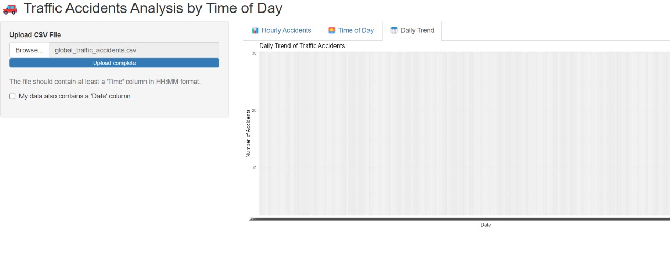
OUTPUT

Slide 12
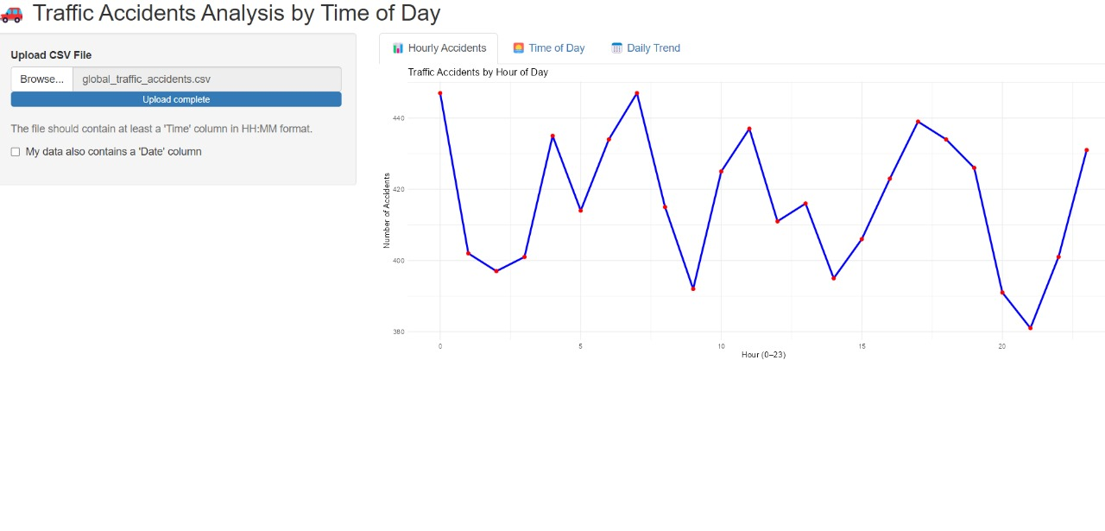
OUTPUT

Slide 13
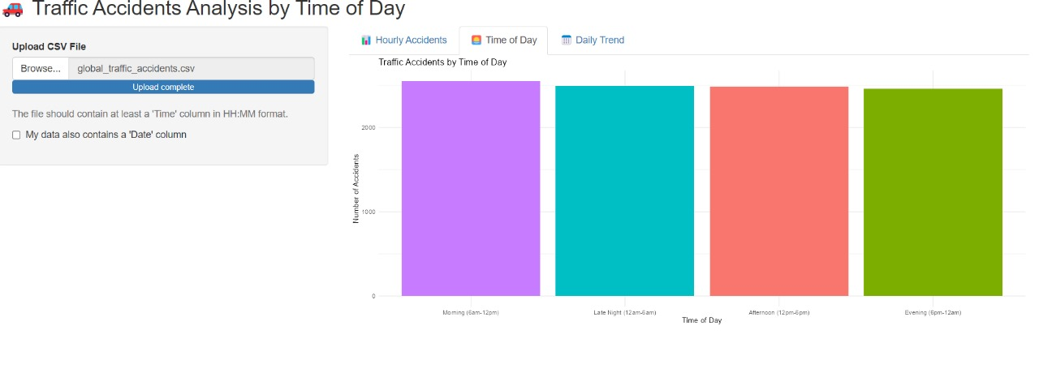
OUTPUT

Slide 14
Thank You

