Slide 1
CGB1201 – JAVA PROGRAMMING
Department of Artificial Intelligence and Data Science
Academic Year: 2024 – 2025 (Odd Semester)
Register Number : 2303811724321125
Name : Yogappriyan S
Year : 2nd Year
Semester : 3rd semester
Section : B
Date : 3.12.2024

Slide 2
TITLE OF THE PROJECT
SUPER MARKET BILLING SYSTEM

Slide 3
Abstract
The Supermarket Billing System is a software application that automates billing operations. It facilitates adding products, calculating totals, applying discounts, and generating bills for customers. This system reduces human error, enhances efficiency, and simplifies inventory management.
Key features include:
Product entry with prices and quantity.
Calculation of bill totals, discounts, and taxes.
Generation of detailed receipts.
Integration with a database for inventory management.
This project demonstrates the application of object-oriented programming (OOP), database connectivity, and GUI development in Java, showcasing its versatility and practical utility.

Slide 4
Introduction
A Supermarket Billing System is a comprehensive software application designed to streamline the billing and inventory management process in retail environments like supermarkets, grocery stores, or shopping malls. This project is particularly useful in scenarios where efficiency, accuracy, and speed are critical, such as during peak shopping hours.
The system aims to replace traditional manual billing with an automated approach, reducing the chances of human error and enhancing the overall customer experience.

Slide 5
Java Programming - Concepts Used
Object-Oriented Programming (OOP):
Classes and Objects: Define products, customers, and bills.
Inheritance and Polymorphism: Reuse and extend functionalities for discounts and billing types.
Swing and AWT:
Used for creating a graphical user interface for product entry and bill generation.
Exception Handling:
Ensures robustness by handling errors like invalid inputs or database failures.
Collections Framework:
Use of ArrayList or HashMap for temporary data storage.
File Handling (Optional):
Generate and store billing receipts as text files.

Slide 6
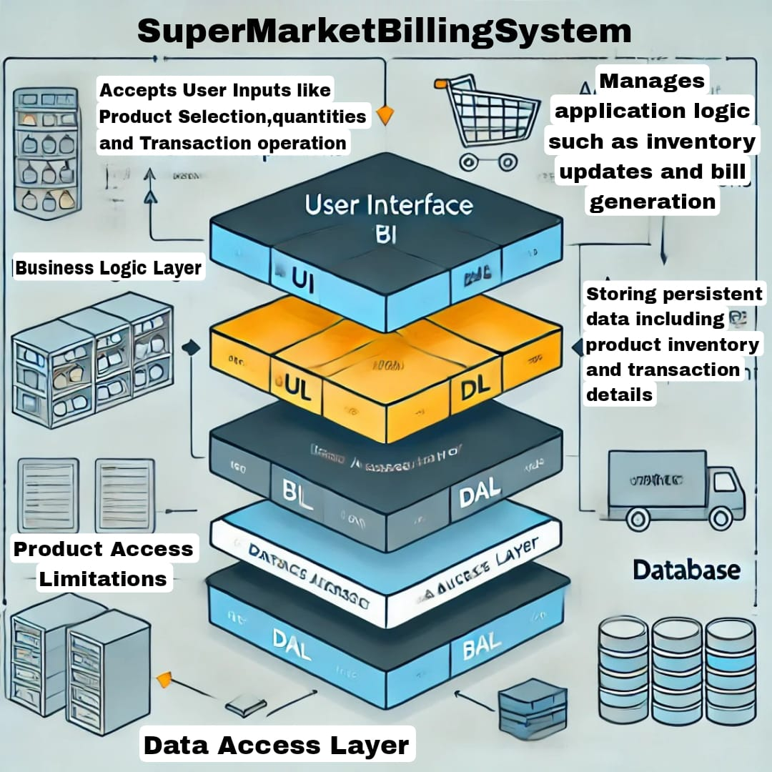
Proposed Architecture

Slide 7
Proposed Architecture - Description
Purpose:
The architecture is designed to manage key supermarket operations, including inventory management, billing, and reporting, with a clear separation of concerns. This modular design ensures scalability and ease of maintenance.
Components:
User Interface (UI):
Interactive console-based interface.
Supports input handling for operations like adding/removing products and generating reports.
Business Logic Layer (BLL):
Core of the application, containing all operational rules and processes.
Ensures that business operations (like inventory checks and bill calculations) are executed correctly.

Slide 8
Proposed Architecture - Description (Cont..)
Data Access Layer (DAL):
Provides methods to access and manipulate the inventory and transaction data.
Abstracts database interaction, ensuring minimal coupling with business logic.
Database:
Maintains records of products, transactions, and stock levels.
Designed to support both temporary data (in-memory storage for testing) and persistent storage (file-based or SQL database).
Modularity and Scalability: The architecture is designed with a modular structure, separating the User Interface (UI), Business Logic Layer (BLL), Data Access Layer (DAL), and Database. This modularity ensures easy maintenance and allows for scalability

Slide 9
List of Modules
User Interface (UI) Module
Product Management Module
Inventory Management Module
Billing and Transactions Module
Report Generation Module
Database Management Module

Slide 10
Module Description
User Interface (UI) Module
Description:
Provides an interactive console interface for users to interact with the system.
Accepts inputs like product selection, transaction quantities, and commands for viewing reports or inventory.
Displays outputs such as bills, inventory status, and transaction summaries.
Product Management Module
Description:
Handles all operations related to products in the system.
Allows adding, updating, and removing products from the inventory.
Inventory Management Module
Description:
Tracks and updates the stock levels of products.
Ensures real-time stock updates based on transactions (additions or deductions).

Slide 11
Module Description (Cont..)
Billing and Transactions Module
Description:
Manages the processing of customer transactions.
Calculates total amounts based on selected products and quantities.
Report Generation Module
Description:
Generates detailed reports on system operations, including sales and inventory updates.
Database Management Module
Description:
Handles all data storage and retrieval operations.
Ensures data consistency and persistence for products, inventory, and transactions.

Slide 12
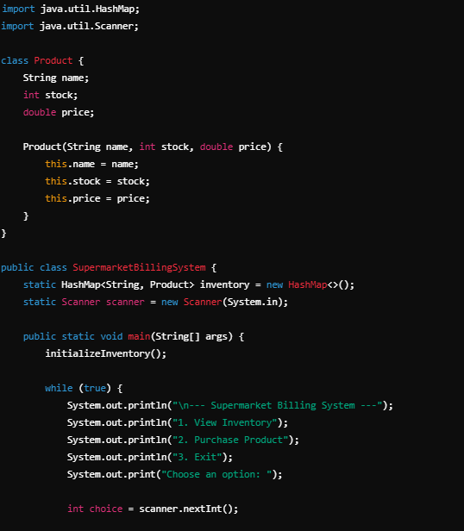
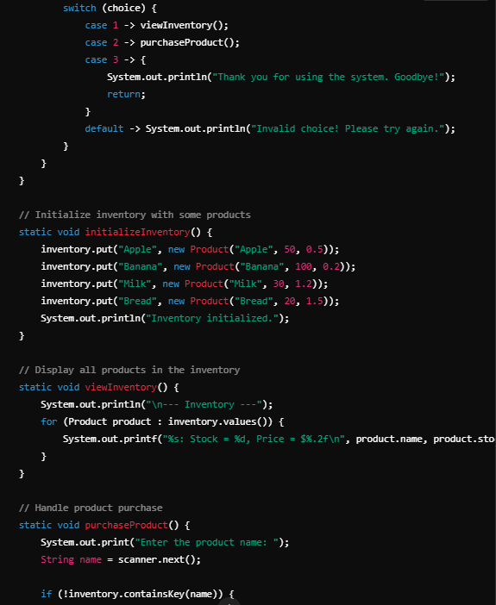
SOURCE CODE

Slide 13
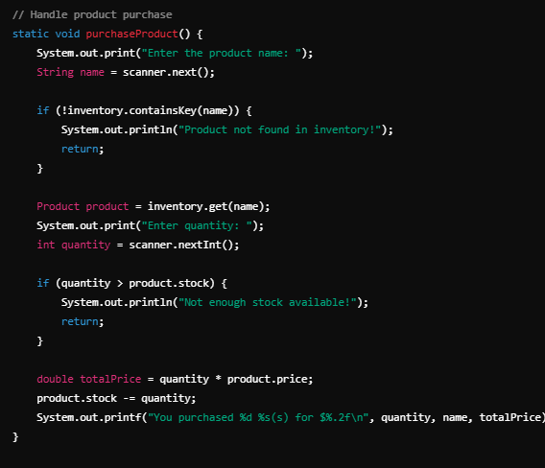
SOURCE CODE

Slide 14
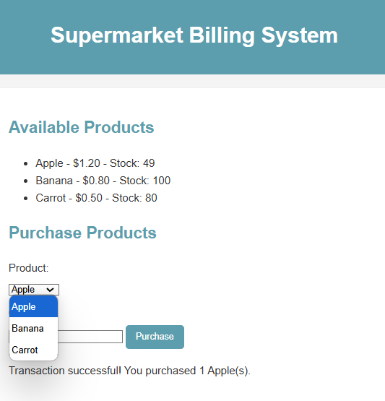
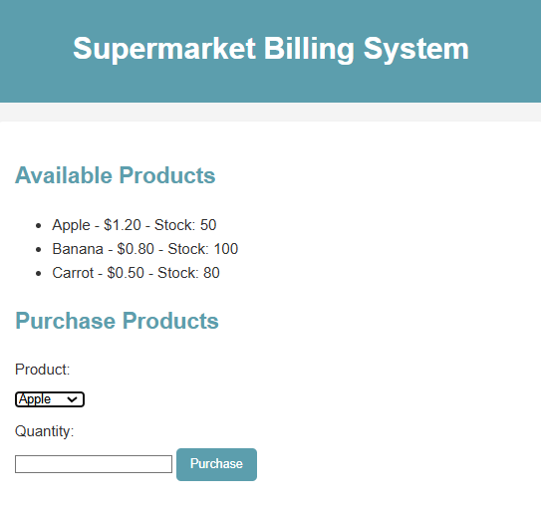
Results and Discussion

Slide 15
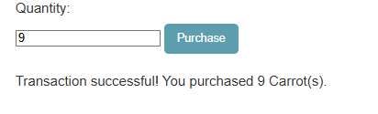
Results and Discussion (Cont..)

Slide 16
Conclusion
The Supermarket Billing System is a robust and efficient solution designed to streamline daily operations in a supermarket. By integrating modules for user interaction, inventory management, billing, and reporting, the system ensures accuracy, scalability, and ease of use.
This project not only simplifies billing and stock tracking but also provides valuable insights through detailed reporting, enabling better decision-making for business growth. With proper implementation, this system can significantly improve operational efficiency, reduce human error, and enhance customer satisfaction.

Slide 17
Thank You
Any queries???

