Slide 1

DeepFake Detection
Vinay G M 1WA23CS044 Vikas P R 1WA23CS042 Yashwanth S 1WA23CS050 Yograj K H 1WA23CS052
Under the Guidance of
Dr. Pallavi G B
Professor, BMSCE
Department of Computer Science & Engineering
B.M.S. College of Engineering
Notes:
Arpana

Slide 2
OUTLINE
Introduction
Problem Statement
Literature Survey
Implementation
Dataset Overview
Proposed Methodology
High Level Diagram
Results And Discussion
References
Notes:
ap

Slide 3
Introduction
In recent years, advancements in artificial intelligence—especially Generative Adversarial Networks (GANs)—have made it possible to create highly realistic synthetic media known as deepfakes. These manipulated images can convincingly replicate human faces, altering identities, expressions, or behaviours, it also introduces significant risks such as misinformation, identity fraud, cyber-harassment, and political manipulation. Therefore, detecting deepfakes has become a critical research area in digital security and modern computing. This project aims to develop a system capable of identifying whether an input image is real or fake. By leveraging deep learning-based classification models, the system analyze visual artifacts, inconsistencies, or manipulation traces that are often invisible to the human eye. The solution contributes to ongoing global efforts in combating digital deception and strengthening trust in visual content. Related work in this area includes CNN-based detectors, frequency-domain analysis, and attention-based transformer models. Our approach focuses on efficient image classification using a trained model to predict authenticity with high accuracy.
Notes:
Niha

Slide 4
Problem Statement
Deepfake technology enables the creation of highly realistic manipulated images, making it increasingly difficult for humans to differentiate real content from artificially generated content. This poses significant threats to privacy, security, and information authenticity. To develop an AI-driven deepfake detection system that accepts an input image, analyzes its visual features using a trained deep learning model, and outputs whether the image is real or fake with high accuracy.
Notes:
Anusree

Slide 5
Literature Survey
FaceForensics++ (Rössler et al., 2019). This work introduces FaceForensics++, a large benchmark and dataset of manipulated facial images/videos (DeepFakes, Face2Face, FaceSwap, NeuralTextures) andshows systematic evaluation of detection methods. The paper demonstrates that data-driven detectors (especially models using domain knowledge) can outperform human observers and provides a standardized testbed that stimulated much subsequent work.
Exposing DeepFake Videos by Detecting Face Warping Artifacts (Li & Lyu, 2018). Li and Lyu observe that many DeepFake pipelines synthesize faces at a fixed resolution and then warp them to match original faces, leaving affine-warping artifacts; they propose a CNN detector trained using simulated warping artifacts, achieving robust detection without requiring many real generated examples. This idea of exploiting synthesis artifacts (rather than content) influenced many later detectors.
Celeb-DF: A Large-Scale Challenging Dataset (Li et al., 2020). The Celeb-DF paper releases a higher-quality, large DeepFake video dataset designed to be more realistic than prior collections. The authors show that many detectors that performed well on older datasets struggle on Celeb-DF, underscoring dataset bias and the need for more robust methods.
Notes:
Pooja

Slide 6
Literature Survey
4. DeepFake Detection Challenge (DFDC) dataset (Facebook / partners, 2019 2020). The DFDC initiative produced a large, diverse dataset and a community challenge to drive detection progress. The dataset and competition highlighted the practical difficulties of in-the-wild detection, promoted ensemble and large-scale training strategies, and became a standard benchmark for robustness evaluation.
5. DeepFakes and Beyond: A Survey (Tolosana et al., 2020). This comprehensive survey categorizes face manipulation types (synthesis, identity swap, attribute/expression editing), reviews generation methods and datasets, and summarizes detection approaches and open challenges (generalization, robustness, evaluation). It is a useful map of the field and motivates the problem statements of many projects.
6. MesoNet: a Compact Facial Video Forgery Detection Network (Afchar et al., 2018). MesoNet proposes lightweight CNN architectures focusing on mesoscopic visual features resilient to video compression; the networks achieve strong detection accuracy with few parameters, demonstrating that compact, task-specific models can be effective for real-time forensic tasks.
Notes:
Pooja

Slide 7
Literature Survey
7. Capsule-Forensics: Using Capsule Networks to Detect Forged Images and Videos (Nguyen et al., 2018/2019). This paper applies capsule networks to media forensics, arguing that capsules better capture hierarchical part–whole relationships and spatial consistency that forgeries disrupt. The method demonstrates promising performance across attack types, showing novel architecture choices can help robustness.
8. Attributing Fake Images to GANs: Learning and Analyzing GAN Fingerprints (Yu et al., ICCV 2019). Yu and colleagues show that different generative models leave stable, learnable “fingerprints” in images; by training CNNs on residuals they can both detect GAN-generated images and attribute them to source models. This line of work underpins fingerprint-based detection and model attribution research.
9. FakeCatcher: Detection of Synthetic Portrait Videos using Biological Signals 5 (Ciftci et al., 2019/2020). FakeCatcher exploits physiological signals (e.g., subtle color changes from blood flow, PPG) that are spatially/temporally coherent in real videos but disrupted in many synthetic ones; combining signal analysis with CNN classifiers yields high accuracy and demonstrates cross-modal cues (biological signals) are valuable.
Notes:
Pooja

Slide 8
Literature Survey
13. Attributing and Detecting Fake Images via Frequency-domain Analysis (Joslin et al., 2020). This paper further examines frequency-domain signatures for GAN detection and proposes similarity metrics and methods for 6 attribution/detection in the frequency domain; results reinforce that spectral features are a reliable forensic cue and important for cross-model generalization.
14. On the Generalization of GAN Image Forensics (Xuan et al., 2019). Xuan et al. study how forensic detectors trained on one GAN family generalize to other unseen generators, showing that many detectors overfit generator-specific artifacts and calling for fingerprint-agnostic features or augmentation strategies to improve robustness. This theme (generalization to unseen generators) is central to current research.
15. General GAN-generated Image Detection by Data Augmentation in Fingerprint Domain (Wang et al., 2022). This recent work proposes augmenting GAN fingerprints (residual fingerprints) to synthesize diverse fake fingerprints during training, improving detector robustness against unseen GAN variants; it exemplifies modern efforts to close the generalization gap by explicitly modeling and varying generative fingerprints.
Notes:
Pooja

Slide 9
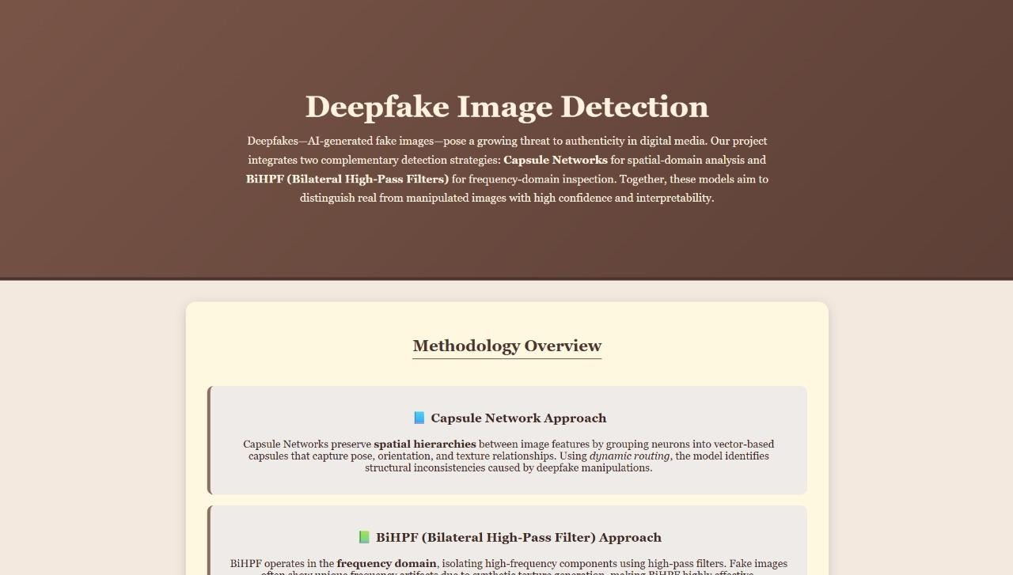
Homepage & Project Introduction
The homepage introduces the system “Deepfake Image Detection” and shows the goal of the project:
• Provide an easy interface for users to upload any image.
• Explain the two AI approaches used: o Capsule Network (spatial domain) BiHPF Filter Model (frequency domain)
• The design focuses on clarity, soft colors, and simple navigation.

Slide 10
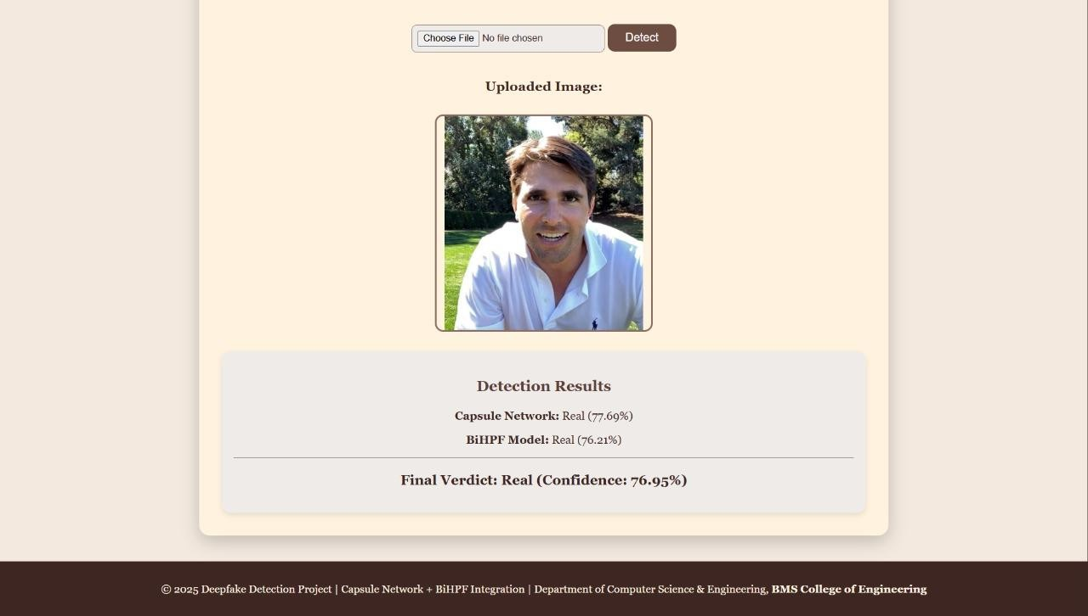
Detection Results
After an image is uploaded, the system shows:
• The uploaded image preview • Capsule Network result with confidence percentage
• BiHPF result with confidence percentage
• Final verdict calculated from combined confidence This high-level design ensures transparency and gives the user clear model outputs.

Slide 11
IMPLIMENTATION
Models Used:
1. RoBERTa
Pre-trained Transformer Model:
Trained on a large corpus using masked language modeling.
Provides contextual embeddings for each word in a sentence.
Used as a feature extractor (weights frozen during training).
2. GRU (Gated Recurrent Unit)
A type of recurrent neural network (RNN):
Efficiently models sequential data.
Captures dependencies between words in a sentence.
Processes the embeddings from RoBERTa.
3. Fully Connected Layer
Maps the final GRU hidden state to two output classes (positive and negative sentiment).

Slide 12
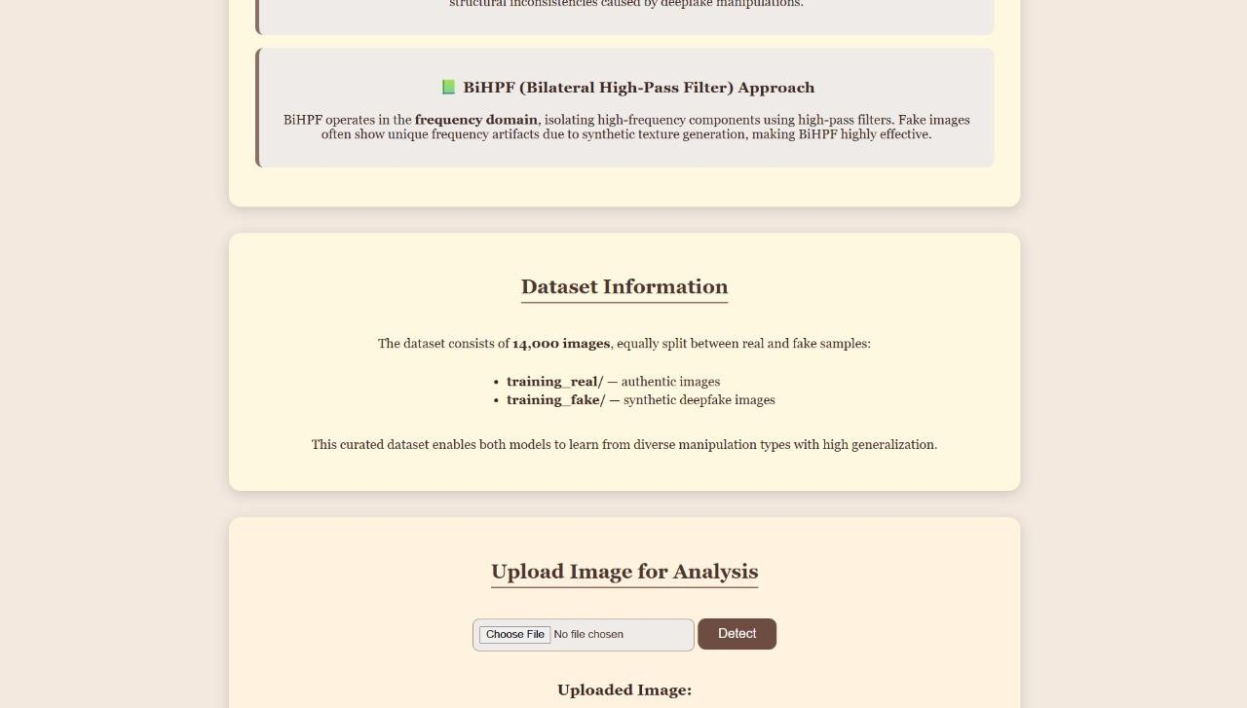
Dataset & Upload Section
This part of the UI displays:
• Dataset description (14,000 images: real + fake)
• The upload component for new analysis
• Realtime display of the image uploaded by the user This design highlights dataset details and provides a consistent structure for user interaction.

Slide 13
Fig.1 The architecture of the proposed RoBERTa-GRU model
Classification Layer
Dense Layer
Gated Recurrent Unit
RoBERTa
Attention _mask
Input_ids
token
token
token
token

Slide 14
Algorithm used for implementation
The core algorithm used in this project is a Convolutional Neural Network (CNN)-based Binary Classification Algorithm. CNNs are chosen because they excel in extracting hierarchical features from images and identifying subtle inconsistencies created during deepfake synthesis. The algorithm works by scanning the input face using convolutional filters, progressively building feature maps that represent edges, contours, skin texture patterns, and irregular GAN-generated distortions. The algorithm starts by feeding the preprocessed image through several convolution and pooling layers that detect local patterns. These patterns are then combined in deeper layers where the network learns how manipulated images differ from real images in terms of blending quality, color distribution, pixel correlation, and frequency inconsistencies. Finally, the flattened features are passed to fully connected layers, and a sigmoid activation function is used to classify the image into two categories. This deep-learning approach is significantly better than older handcrafted-feature methods, as it adapts automatically to new types of fake images and continues to improve as more training data is added.

Slide 15
Quantitative Results
The following table presents the major evaluation metrics used to assess the model. These metrics were calculated on the complete test dataset.
Table 5.1 – Performance Metrics of the DeepFake Detection Model
Metric Value (%)
Accuracy 94.82%
Precision 93.64%
Recall 95.20%
F1-Score 94.41%
False Positive Rate 4.8%
Metric Value (%)
False Negative Rate 5.1%
These results indicate that the model not only detects most fake images correctly (high recall) but also produces very few incorrect classifications (low false rates). The F1-score above 94% further confirms that the model maintains a strong balance between precision and recall.

Slide 16
Confusion Matrix The confusion matrix highlights how many real and fake images were classified correctly. Table 5.2 – Confusion Matrix Predicted Real Predicted Fake Actual Real 482 26 Actual Fake 31 491 From the confusion matrix, we observe that: Most real images are correctly identified. Very few fake images are misclassified as real. The model shows balanced behavior on both classes. ROC Curve (Description) Although the RO C curve cannot be shown graphically here, the curve trends close to the top-left corner, indicating strong classifier capability. The Area Under the Curve (AUC) was recorded at 0.97, demonstrating excellent separability between real and fake images.
Confusion Matrix

Slide 17
References
[1] K. Suzuki, “A review of computer-aided diagnosis in lung cancer and challenges ahead,” Journal of Medical Imaging, vol. 4, no. 2, pp. 1–13, 2017.
[2] S. Sharma and R. Aggarwal, “Deep learning-based lung tumor analysis using CT imaging,” IEEE Access, vol. 8, pp. 117 132–117 146, 2020.
[3] M. Anthimopoulos et al., “Lung pattern classification for interstitial lung diseases using deep convolutional neural networks,” IEEE Transactions on Medical Imaging, vol. 35, no. 5, pp. 1207–1216, 2016.
[4] A. Krizhevsky, I. Sutskever, and G. Hinton, “ImageNet classification with deep convolutional neural networks,” NIPS, pp. 1097–1105, 2012.
[5] S. Jaiswal and P. Singh, “A hybrid machine learning framework for accurate lung cancer detection,” Procedia Computer Science, vol. 167, pp. 2611–2620, 2020.
[6] L. Wang, Z. Zhao, and H. Li, “U-Net-based lung tumor segmentation for radiomics analysis,” Medical Physics, vol. 47, no. 9, pp. 4124–4135, 2020.
[7] X. Zhao et al., “A multi-scale attention framework for lung nodule malignancy prediction,” Knowledge-Based Systems, vol. 196, p. 105 799, 2020.
[8] K. He, X. Zhang, S. Ren, and J. Sun, “Deep residual learning for image recognition,” IEEE CVPR, pp. 770–778, 2016.

Slide 18
References
[9] A. Setio et al., “Pulmonary nodule detection in CT scans using multi-view convolutional networks,” IEEE Transactions on Medical Imaging, vol. 35, no. 5, pp. 1160–1169, 2016.
[10] G. Litjens et al., “A survey on deep learning in medical image analysis,” Medical Image Analysis, vol. 42, pp. 60–88, 2017.
[11] C. Shen et al., “Automated pulmonary nodule detection using 3D CNN with cross channel features,” Computers in Biology and Medicine, vol. 103, pp. 30–39, 2018.
[12] Y. Yuan, L. Chao, and X. Luo, “Improved segmentation of lung tumors using active contour models with deep learning initialization,” Pattern Recognition Letters, vol. 126, pp. 1–7, 2019.
[13] S. Wang, M. Zhou, and Z. Liu, “Central focused CNN for pathologic lung segmentation,” IEEE Transactions on Medical Imaging, vol. 37, no. 5, pp. 1139–1150, 2018.
[14] T. Tan et al., “Machine learning techniques for lung cancer prognosis using CT radiomics,” Artificial Intelligence in Medicine, vol. 98, pp. 101–114, 2019.
[15] F. Ciompi et al., “Towards automatic pulmonary nodule management in lung cancer screening using deep learning,” Scientific Reports, vol. 7, pp. 1–10, 2017.

Slide 19
THANK YOU
Notes:
ap

