Slide 1
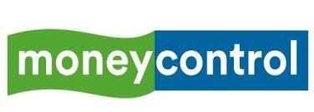
Evaluation the Brokers performance based on the stock Recommendation in money control Website

Slide 2
Evaluation the Brokers performance based on the stock Recommendation in money control Website Under the guidance of : Prof. GOURAB NATH PRAXIS BUSINESS SCHOOL
PRESENTED BY
ASLAM SHAIKH
NIKHIL SONI
NOBLE JOHN
SUJEEVANA MOHAN
YOGASAI SATWIK

Slide 3
Business Problem
Objective: To evaluate the performance of the Brokers in the money control website based on their stock recommendation.
Each recommender updates his recommendation in a duration of time. I.e. He may change his recommended action and target price during the period. Our objective is the evaluate the performance of each broker based on his recommendation. We can do this evaluation by comparing the recommendation Action (Buy and Hold), Target price being met on a particular time period.

Slide 4
Process Flow Diagram
Money Control
NSE
Stock Name
Recommender
Recommendation Date
Target price
Action(Buy /Sell/Hold)
Stock Name
Stock Code
Ticker date
High Price
Target price Met or Not?
No of days taken
Nearest Target Price
yes
No
Calculate Hit rate=No of target met/Total recommendations
Error Rate = Target price-Nearest target price met/Target price
Calculate Top 10 Recommenders

Slide 5
NSE
The National Stock Exchange of India Limited is the leading stock exchange of India, located in Mumbai. The NSE was established in 1992 as the first demutualized electronic exchange in the country.
The NIFTY 50 index is National Stock Exchange of India's benchmark broad based stock market index for the Indian equity market.
It represents the weighted average of 50 Indian company stocks in 12 sectors and is one of the two main stock indices used in India, the other being the BSE sensex.

Slide 6
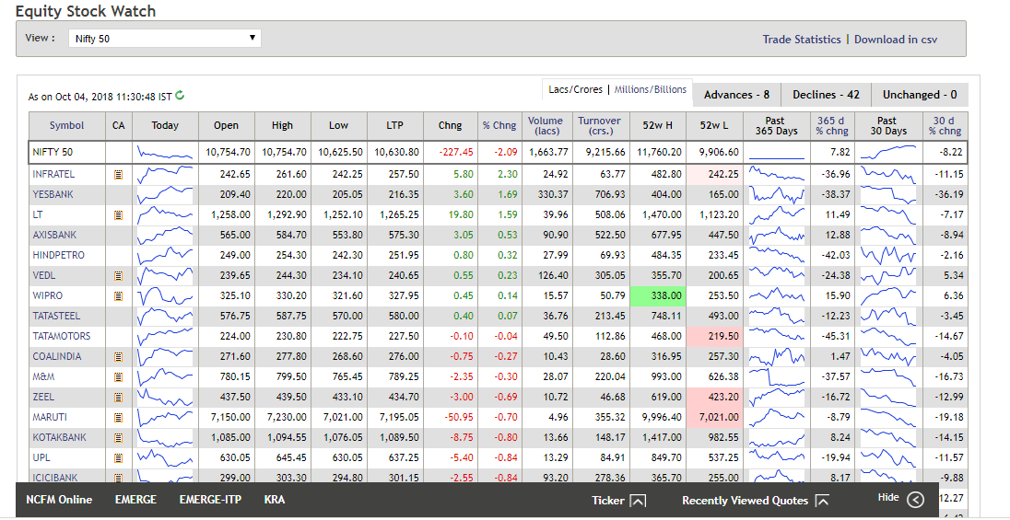
NSE stock trading details

Slide 7
About Money Control
Moneycontrol.com is an Indian online business news website owned by E-EIGHTEEN Dot Com (P) Ltd., a subsidiary of the Mukesh Ambani (Reliance Industries) controlled media house TV 18
This study analyzes the accuracy of forecasted target prices which are recommended by various brokers in the money control website. The money control website has multiple brokers giving different stock recommendation.

Slide 8
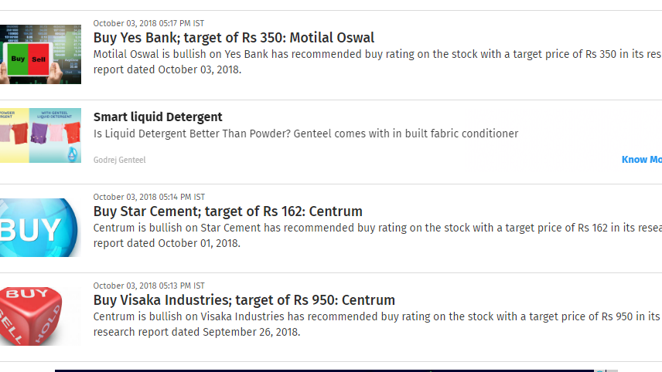
MONEYCONTROL STOCK RECOMMENDATION

Slide 9
Approach
The stock recommendation on money control website was web scrapped for the year 2009 to 2018.
The Stock details from NSE was extracted for evaluation of the recommendation.
Data was cleaned and pre preprocessed for further analysis
The analysis was performed based on Buy Hold strategy for individual brokers for a duration of 1 year.
The brokers hit rate (target met) and error rate (closest target met) were calculated.
The top 10 brokers were ranked based on their performance.

Slide 10
Dataset
We extracted recommendation of size 17850 records.
The cleaned structured data had 16150 records
There were 94 recommenders in our data set
Time Period 2009-2018

Slide 11
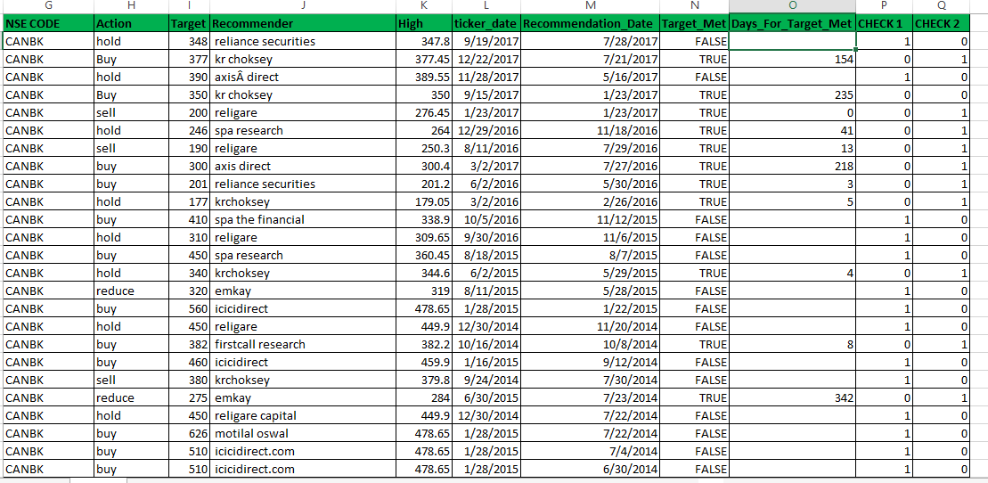
Structured Dataset

Slide 12
Trading Strategy
The goal of most investors generally is to buy low and sell high. This can result in two quite different approaches to equity investing.
Trading involves following the short-term price fluctuations of different stocks closely and then trying to buy low and sell high.
Buy and Hold is an investment strategy for which an investor buys stocks and holds them for a long period regardless of fluctuations in the market.

Slide 13
Market Volatility
Market can be volatile and follow three trends:
Bullish – The NIFTY 50 price trend is moving upward
Bearish - The NIFTY 50 price trend is moving downward
Sluggish – The NIFTY 50 price trend is neither moving upward nor downwards

Slide 14
Recommendations/Actions :
The rating is just an indication as to how bullish the analyst is in regards to the stock's future performance.
The recommendations are as follows:
Buy: The recommender is bullish on the stock. BUY means the stock is suitable for purchase now.
Accumulate means the stock is undervalued but there is time to purchase as the price is unlikely to move up suddenly. If it’s a stock, you really want just take the opportunity. Accumulate is a buy recommendation, but not a strong one
Sell: The recommender is bearish towards the stock. SELL means sell all holdings now
Hold: HOLD means the stock being appropriately priced, so you should neither buy nor sell. Hold the stock and sell it at a profit price (Target price)

Slide 15
Important features
Time period:
Time period is the number of days taken for the stock price to meet the target price.
We can evaluate the time period in a year duration.
Target Price Accuracy:
The recommendation of a stock has a target price. If the stock meets the target price, then the accuracy of the prediction is TRUE. This is based on whether the current stock price reaches or exceeds the target price within the 12-months period. If the target price is not met, the accuracy is FALSE.
Error rate:
Target price forecasts that deviate from the actual stock price is calculated as follows
Error rate = [Recommended Target price – Closest Target price met] / Recommended Target price
Accuracy rate = 1- Error Rate

Slide 16
Why did we not take sell action for our analysis?
There are three actions you can perform when you are investing in shares.
You can buy shares (Buy)
you can keep the shares you own(Hold)
you can sell the shares you own(Sell)
Shares that you do not own, you cannot sell it in a cash market. So the sell advice makes no sense for investors that do not own the share.

Slide 17
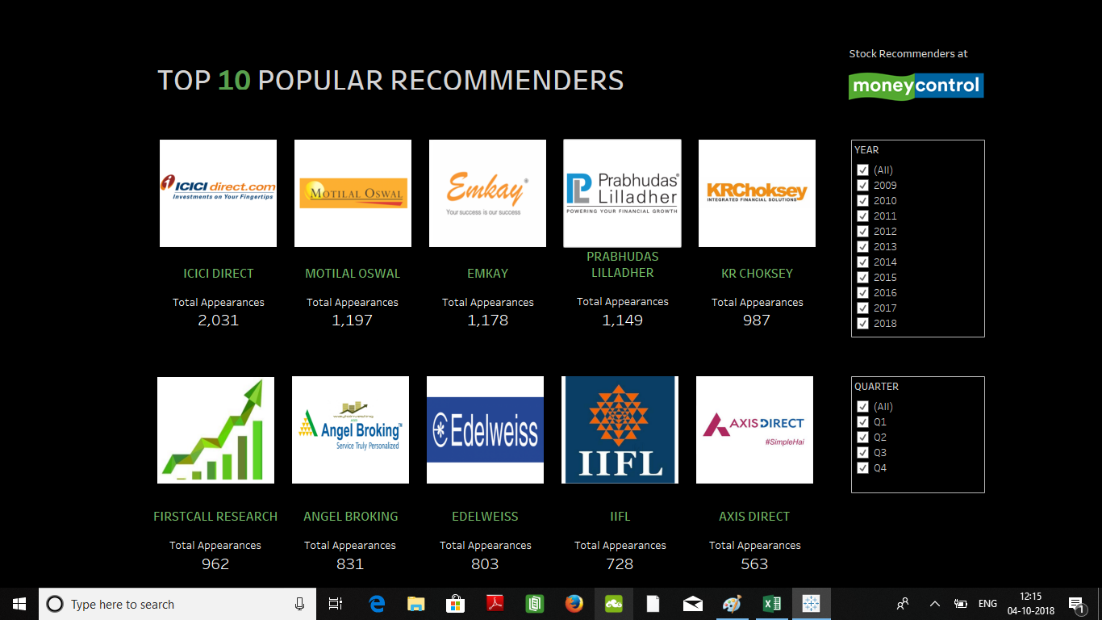

Slide 18
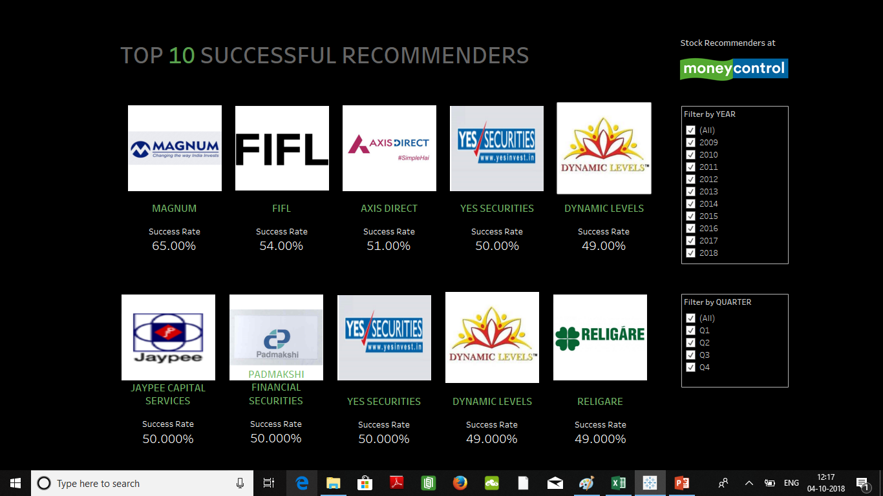

Slide 19
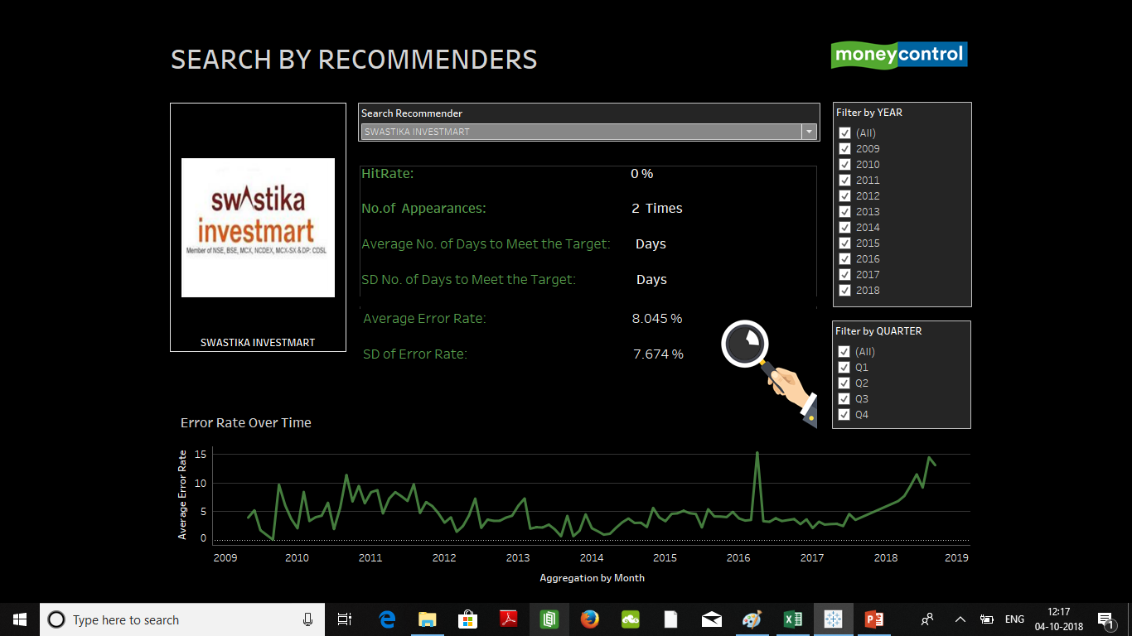

Slide 20
THANK YOU

