Slide 1
E-COMMERCE DATA PIPELINE
By: Prayoga Agusto Haradi

Slide 2

Self-Introduction
Prayoga Agusto
Data Analyst / Data Engineering Enthusiast
Chemical Engineering graduate from University of Indonesia
Professional Experience
Data Management Division Intern at Bank BTN
Notable Projects
E-Commerce Web Scraping
Kafka Streaming Event Processing
Fish Image Classification (CNN)
Certifications
AWS Solutions Architect Associate
Microsoft Certified Power BI Data Analyst Associate

Slide 3
01
PROJECT OVERVIEW

Slide 4
E-commerce Data Pipeline and Analytics Dashboard
Objectives
Analysis Overview
Develop an automated data pipeline for processing e-commerce transaction data
Transform raw data into a structured format suitable for analytics (star schema)
Load processed data into a cloud-based data warehouse
Create insightful visualizations for business intelligence
Sales performance across different product categories
Revenue distribution by order priority
Customer device preferences (web vs. mobile)
Profit trends over time

Slide 5
E-commerce Data Pipeline and Analytics Dashboard (Continued)
Key Results
Analysis Overview
Automated monthly data processing
Enhanced data quality and consistency by data cleaning.
Improved pipeline reliability and scalability
Optimized data warehouse performance by creating a star schema.
Delivered actionable business insights.
Apache Airflow
Python
AWS S3
Docker
AWS Redshift
Amazon QuickSight

Slide 6
02
PROJECT BACKGROUND

Slide 7

Background
E-Commerce platforms often face critical challenges with data silos hindering decision-making and manual reporting causing delays
This project develops an end-to-end data pipeline for a growing e-commerce platform, transforming raw transaction data into actionable insights. By automating data processing and creating an analytics dashboard.
The project will benefit multiple stakeholders, such as: business leaders gain real-time performance data, marketing teams access customer insights, and operations optimize inventory management.

Slide 8
Problem Statement
01
02
03
Data Source
Data Quality
Data Storage
04
05
06
Data Processing
Data Analysis
Reporting
Local CSV files processed monthly
Inconsistent and potentially erroneous data
Lack of scalable storage solution
Manual, time-consuming ETL processes
Lack of a centralized, optimized data warehouse hinders quick insights
Limited ability to generate real-time, actionable insights

Slide 9
Success Metrics
Data Accuracy
Query Performance
Business Impact
Automation
Reducing the percentage of manual ETL Processes.
Increase the percentage of records accurately processed and transformed.
Improve the average response time for standard analytical queries.
Increase the number of data-driven decisions made using insights from the new system.

Slide 10
Data Platforms Used
Apache Airflow orchestrates the extraction of data from monthly updated CSV files.
Processed data is efficiently transferred from S3 to Amazon Redshift.
Amazon QuickSight connects to Redshift to create interactive dashboards and reports.
Data Source and Extraction
Data Loading to Warehouse
Data Analysis and Visualization
Data Transformation and Staging
Data Warehouse Optimization
Python scripts clean and transform the data before storing it in AWS S3.
Redshift organizes data in a star schema for optimized analytics performance.

Slide 11
Data Source
The data source used is a E-Commerce dataset stored in a local computer downloaded from the website Kaggle. It consists of the columns: Order_Date, Time, Aging, Customer_Id, Gender, Device_Type, Customer_Login_type, Product_Category, Product, Sales, Quantity, Discount, Profit, Shipping_Cost, Order_Priority, Payment_method.
Below is a short snippet of the dataset used.

Slide 12
Data Transformation
Convert dates and numeric fields to appropriate data types
Remove null values and duplicates
Calculate profit margin and categorize it
Create dimension tables for customers, products, and dates
Build a fact table for sales with calculated metrics.

Slide 13

Code Snippet

Slide 14
Transformation Tools and Considerations
Python with Pandas Chosen for its powerful data manipulation capabilities and ease of use in ETL processes, offering more flexibility than SQL-based transformations alone.
Apache Airflow Selected for workflow orchestration, offering better scheduling and monitoring compared to cron jobs, with better error handling and dependency management.
AWS S3 Used as a data lake for its scalability and seamless integration with other AWS services. S3 offers virtually unlimited storage and easy integration with Redshift, making it superior to on-premises storage solutions.
Amazon Redshift Preferred for its column-oriented storage and MPP (massively parallel processing) architecture, optimizing analytical query performance.

Slide 15
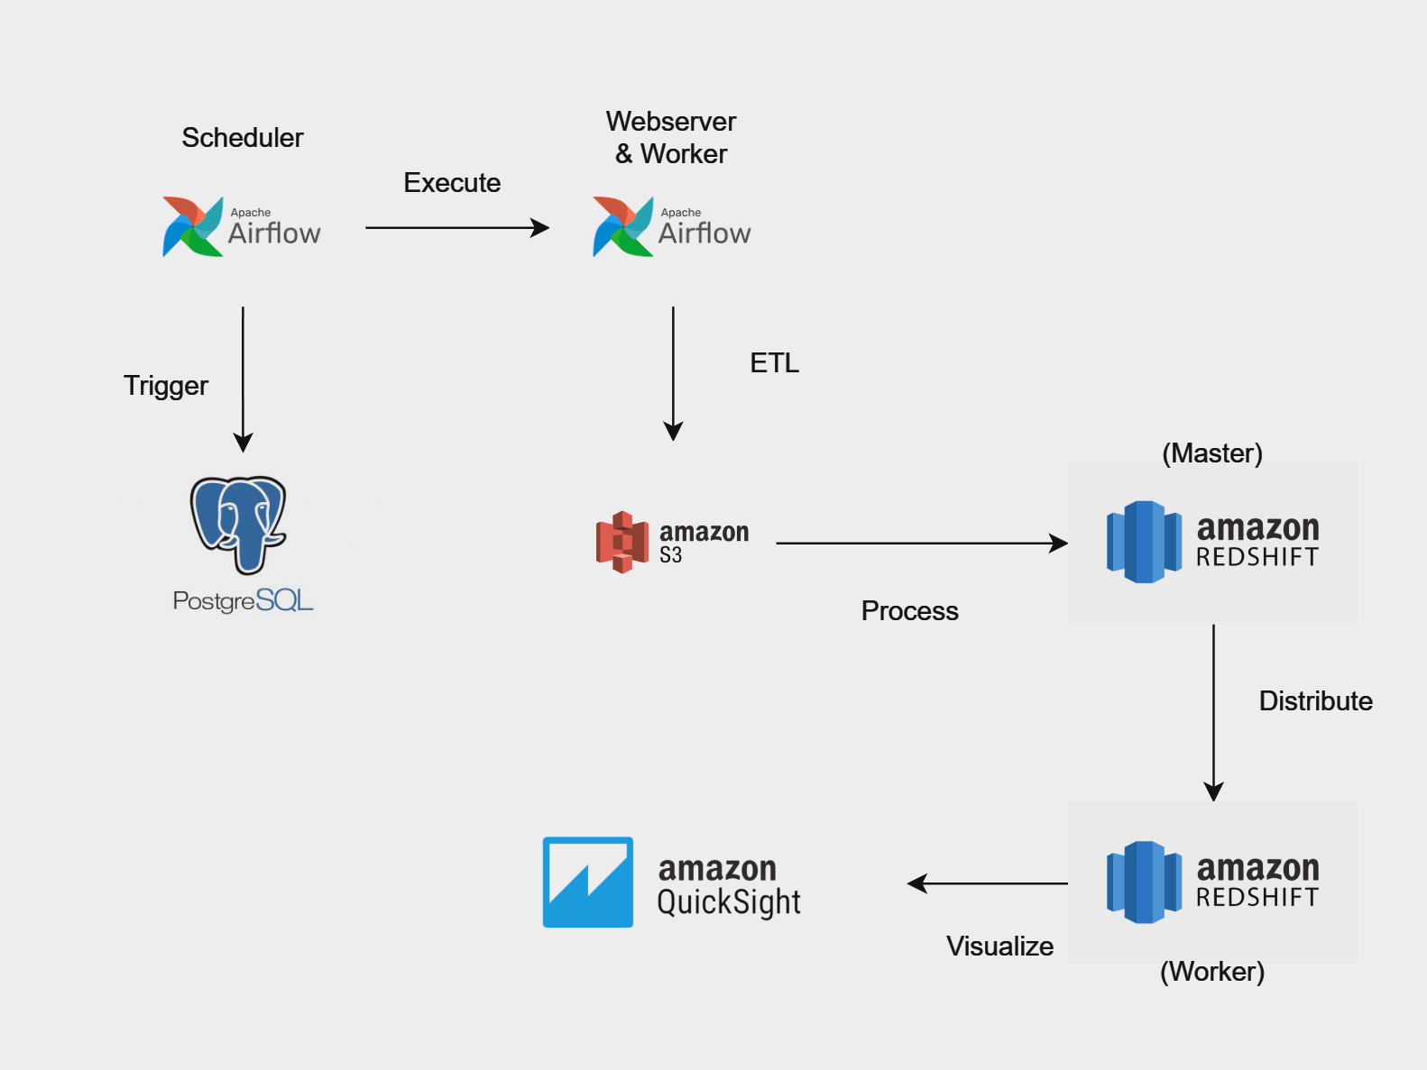
Architecture

Slide 16
Data Modelling
Star Schema Design Optimizes for quick analysis of sales performance across multiple dimensions.
Fact Table: Sales Central table capturing key metrics like revenue, profit, and quantity sold.
Dimension Tables
Customer: Enables customer segmentation and behavior analysis Columns: Gender, Customer_Login_type, customer_key
Product: Facilitates product category performance evaluation Columns: Product_Category, Product, product_key
Date: Allows for time-based trend analysis and seasonality detection Columns: date_key, full_date, year, month, day, weekday
Key Performance Indicators (KPIs)Includes calculated metrics like profit margin and total revenue for easy reporting.

Slide 17
03
Result & Analysis

Slide 18
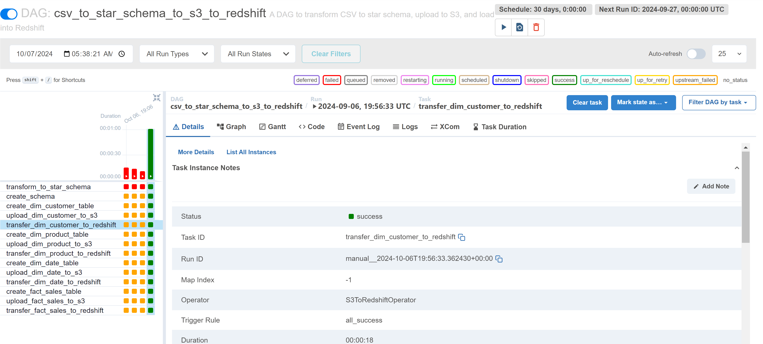
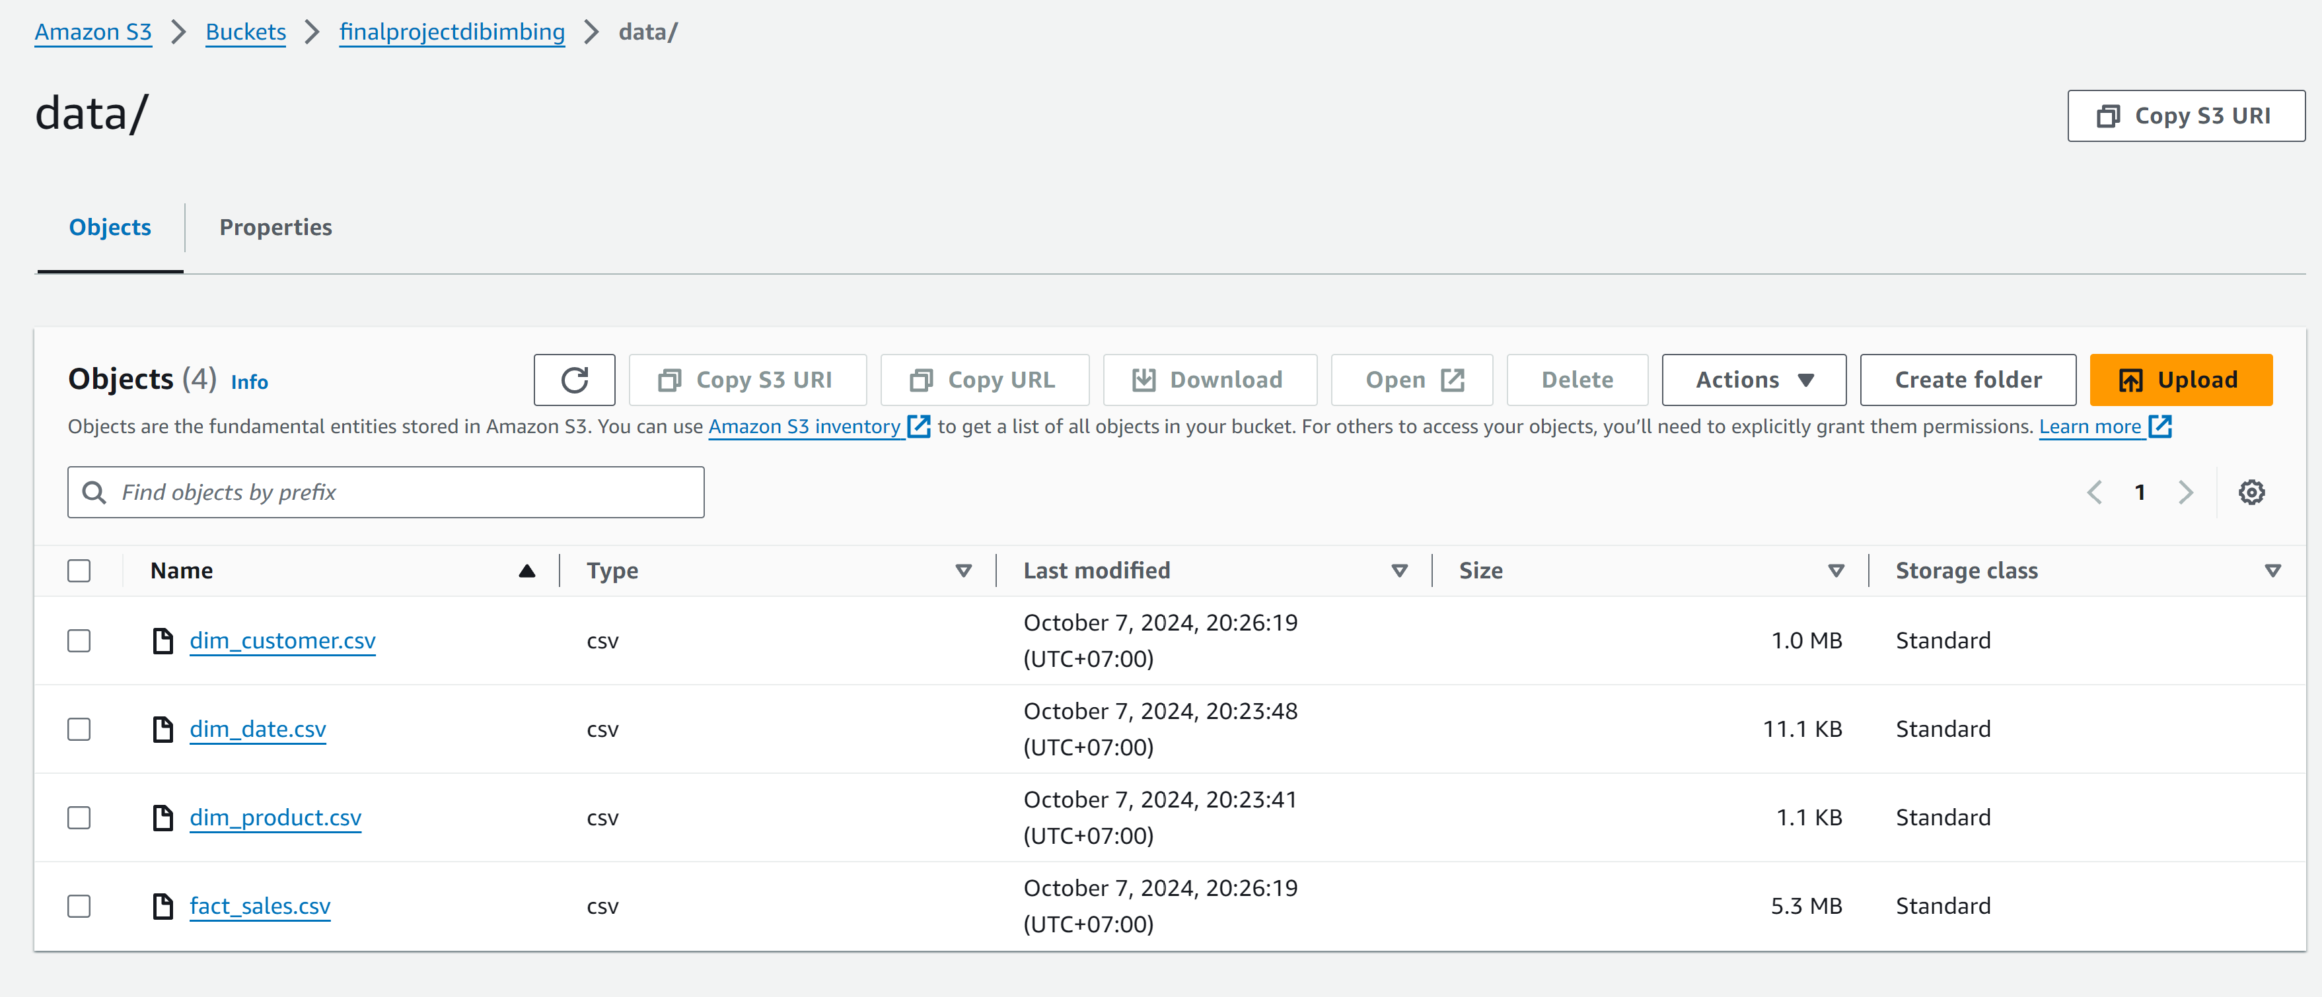
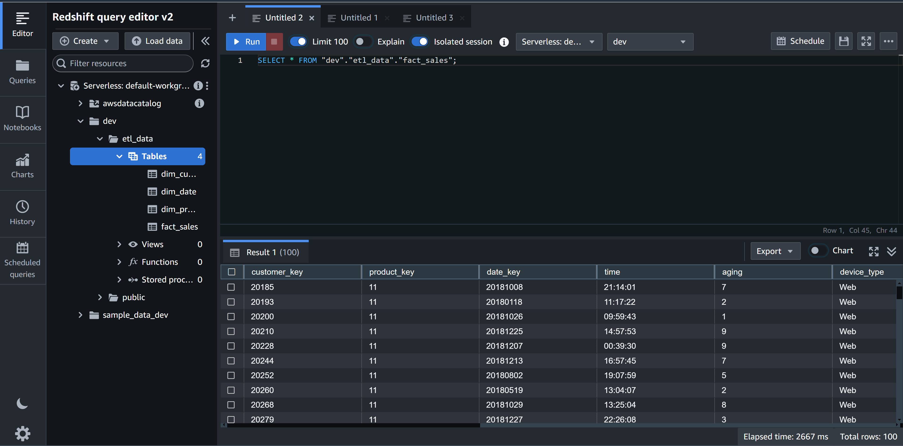
End Result
DAG Running
S3 Bucket
Data loaded into Redshift

Slide 19
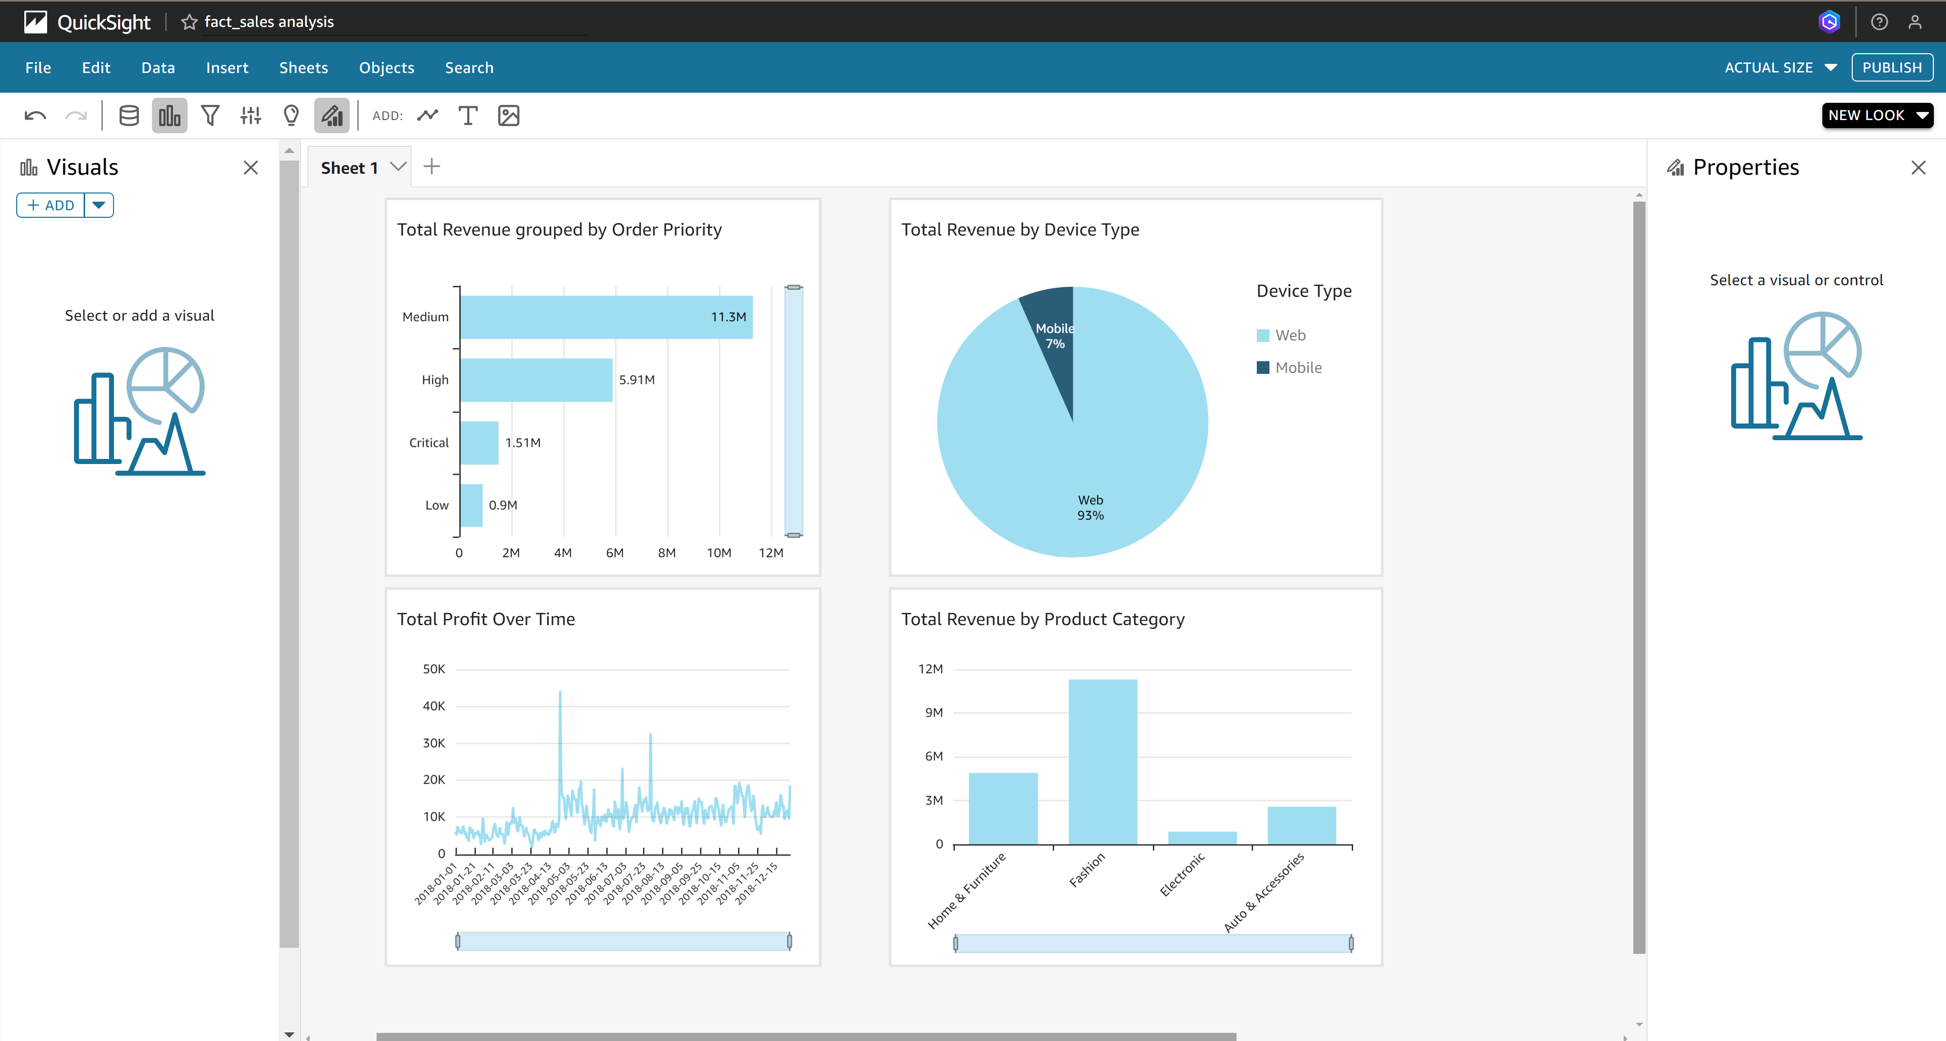
Visualization in Redshift
Medium priority orders generate the highest revenue at 11.3M.
Web orders dominate with 93% of total revenue.
Profit shows fluctuations with occasional high peaks between April-May.
Fashion category leads in revenue generation, followed by Home & Furniture.

Slide 20
04
Conclusion

Slide 21
Conclusion
Successful Implementation Automated ETL pipeline from CSV to Redshift established.
Improved Data Accessibility Star schema design enables efficient querying and analysis.
Business Impact Enhanced ability to derive insights from sales data.
Scalable Solution Platform capable of handling growing data volumes.
Foundation for Advanced Analytics Prepared data structure supports future ML and AI initiatives.

Slide 22
Limitations & Recommendations
Limitations
Recommendations
Potential for high costs with increasing data volumes
Limited to structured CSV data from a single source
Optimize AWS resource usage and explore reserved instances
Integrate additional data types and sources for comprehensive analysis

