Slide 1
CMSC838P, Spring 2005
Design Patterns
Adam Porter
3/1/2005

Slide 2
What is a pattern?
Patterns = problem/solution pairs in context
Patterns facilitate reuse of successful software architectures and design
Not code reuse
  Instead, solution/strategy reuse
  Sometimes, interface reuse

Slide 3
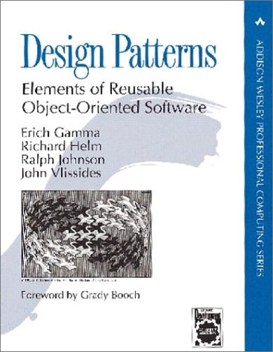
Gang of Four
The book that started it all
Community refers to authors as the “Gang of Four”
Figures and some text in these slides come from book
On reserve in CS library (3rd floor AVW)

Slide 4
Object Modeling Technique (OMT)
Used to describe patterns in GO4 book
Graphical representation of OO relationships
  Class diagrams show the static relationship between classes
  Object diagrams represent the state of a program as series of related objects
  Interaction diagrams illustrate execution of the program as an interaction among related objects

Slide 5
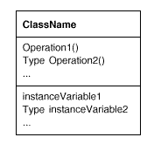
Classes

Slide 6

Object instantiation

Slide 7
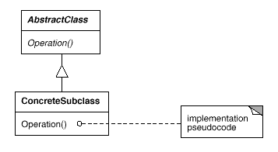
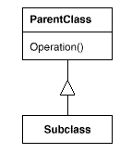
Subclassing and Abstract Classes

Slide 8
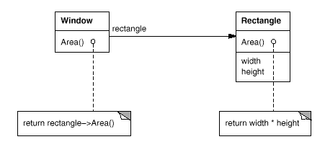
Pseudo-code and Containment

Slide 9
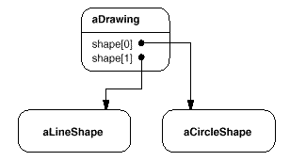
Object diagrams

Slide 10
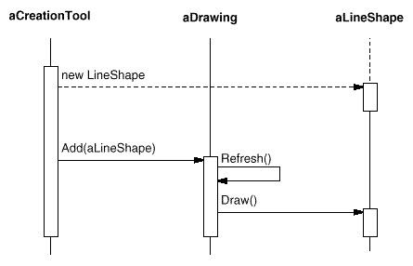
Interaction diagrams
time

Slide 11
Components of a Pattern
Pattern name
  identify this pattern; distinguish from other patterns
  define terminology
Pattern alias – “also known as”
Real-world example
Context
Problem

Slide 12
Components of a Pattern (cont’d)
Solution
  typically natural language notation
Structure
  class (and possibly object) diagram in solution
Interaction diagram (optional)
Consequences
  advantages and disadvantages of pattern
  ways to address residual design decisions

Slide 13
Components of a Pattern (cont’d)
Implementation
  critical portion of plausible code for pattern
Known uses
  often systems that inspired pattern
References - See also
  related patterns that may be applied in similar cases

Slide 14
Design patterns taxonomy
Creational patterns
  concern the process of object creation
Structural patterns
  deal with the composition of classes or objects
Behavioral patterns
  characterize the ways in which classes or objects interact and distribute responsibility.

Slide 15
Creation patterns
Singleton
  Ensure a class only has one instance, and provide a global point of access to it.
Typesafe Enum
  Generalizes Singleton: ensures a class has a fixed number of unique instances.
Abstract Factory
  Provide an interface for creating families of related or dependent objects without specifying their concrete classes.

Slide 16
Structural patterns
Adapter
  Convert the interface of a class into another interface clients expect. Adapter lets classes work together that couldn't otherwise because of incompatible interfaces
Proxy
  Provide a surrogate or placeholder for another object to control access to it
Decorator
  Attach additional responsibilities to an object dynamically

Slide 17
Behavioral patterns
Template
  Define the skeleton of an algorithm in an operation, deferring some steps to subclasses
State
  Allow an object to alter its behavior when its internal state changes. The object will appear to change its class
Observer
  Define a one-to-many dependency between objects so that when one object changes state, all its dependents are notified and updated automatically

Slide 18
Principles Underlying Patterns
Rely on abstract classes to hide differences between subclasses from clients
  object class vs. object type
    class defines how an object is implemented
    type defines an object’s interface (protocol)
Program to an interface, not an implementation

Slide 19
Principles (cont’d)
Black-box vs. white-box reuse
  black-box relies on object references, usually through instance variables
  white-box reuse by inheritance
  black-box reuse preferred for information hiding, run-time flexibility, elimination of implementation dependencies
  disadvantages: Run-time efficiency (high number of instances, and communication by message passing)
Favor composition over class inheritance

Slide 20
Principles (cont’d)
Delegation
  powerful technique when coupled with black-box reuse
  Allow delegation to different instances at run-time, as long as instances respond to similar messages
  disadvantages:
    sometimes code harder to read and understand
    efficiency (because of black-box reuse)

Slide 21
Some Design Patterns

Slide 22
Singleton objects
Some classes have conceptually one instance
  Many printers, but only one print spooler
  One file system
  One window manager
Naïve: create many objects that represent the same conceptual instance
Better: only create one object and reuse it
  Encapsulate the code that manages the reuse

Slide 23
The Singleton solution
Class is responsible for tracking its sole instance
  Make constructor private
  Provide static method/field to allow access to the only instance of the class
Benefit:
  Reuse implies better performance
  Class encapsulates code to ensure reuse of the object; no need to burden client

Slide 24
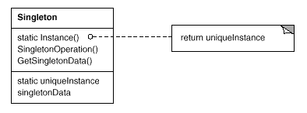
Singleton pattern

Slide 25
Implementing the Singleton method
In Java, just define a final static field
  public class Singleton {
  private Singleton() {…}
  final private static Singleton instance
  = new Singleton();
  public Singleton getInstance() { return instance; }
  }
Java semantics guarantee object is created immediately before first use

Slide 26
Generalizing Singleton: Typesafe Enum
Problem:
  Need a number of unique objects, not just one
  Basically want a C-style enumerated type, but safe
Solution:
  Generalize the Singleton Pattern to keep track of multiple, unique objects (rather than just one)

Slide 27
Typesafe Enum Pattern
Enum
Enum
EnumOp ()
static Enum inst1
static Enum inst2
EnumOp ()
data
Enum
data
EnumOp ()
data
Note: constructor is private

Slide 28
Typesafe Enum: Example
public class Suit {
private final String name;
private Suit(String name) { this.name = name; }
public String toString() { return name; }
public static final Suit CLUBS = new Suit(“clubs”);
public static final Suit DIAMONDS = new Suit(“diamonds”);
public static final Suit HEARTS = new Suit(“hearts”);
public static final Suit SPADES = new Suit(“spades”);
}

Slide 29
Adapter Motivation
Situation:
  You have some code you want to use for a program
  You can’t incorporate the code directly (e.g. you just have the .class file, say as part of a library)
  The code does not have the interface you want
    Different method names
    More or fewer methods than you need
To use this code, you must adapt it to your situation

Slide 30
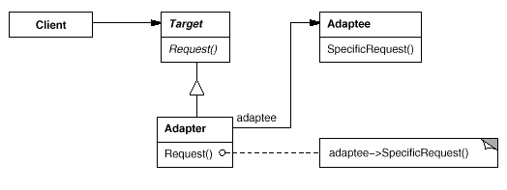
Adapter pattern
Clients needs a target that implements one interface

Slide 31
Proxy Pattern Motivation
Goal:
  Prevent an object from being accessed directly by its clients
Solution:
  Use an additional object, called a proxy
  Clients access to protected object only through proxy
  Proxy keeps track of status and/or location of protected object

Slide 32
Uses of the Proxy Pattern
Virtual proxy: impose a lazy creation semantics, to avoid expensive object creations when strictly unnecessary.
Monitor proxy: impose security constraints on the original object, say by making some public fields inaccessible.
Remote proxy: hide the fact that an object resides on a remote location; e.g. the RemoteLogClient is essentially a remote proxy for a LocalLog.

Slide 33
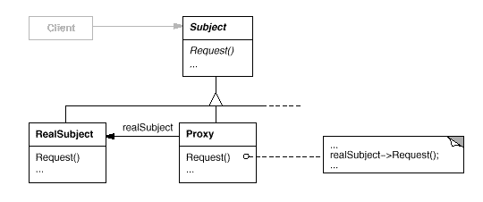
Proxy Pattern Class Diagram

Slide 34
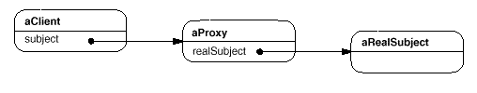
Object Diagram

Slide 35
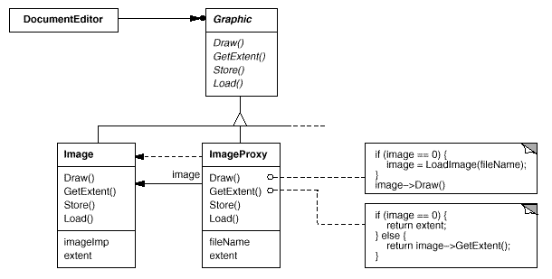
Example Usage Class Diagram

Slide 36
Template Method pattern
Problem
  You’re building a reusable class
  You have a general approach to solving a problem,
  But each subclass will do things differently
Solution
  Invariant parts of an algorithm in parent class
  Encapsulate variant parts in template methods
  Subclasses override template methods
  At runtime template method invokes subclass ops

Slide 37
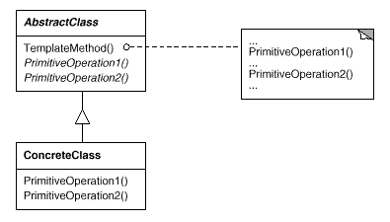
Structure

Slide 38
Example: JUnit
Junit uses template methods pattern
  Junit.framework.TestCase.run() {
  setUp(); runTest(); tearDown()
  }
In class example, subclass (LogRecordTest) overrides runTest() and setUp()

Slide 39
Observer pattern
Problem
  dependent’s state must be consistent with master’s state
Solution structure
  define four kinds of objects:
    abstract subject
      maintain list of dependents; notifies them when master changes
    abstract observer
      define protocol for updating dependents
    concrete subject
      manage data for dependents; notifies them when master changes
    concrete observers
      get new subject state upon receiving update message

Slide 40
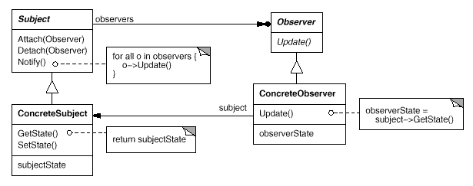
Observer pattern

Slide 41
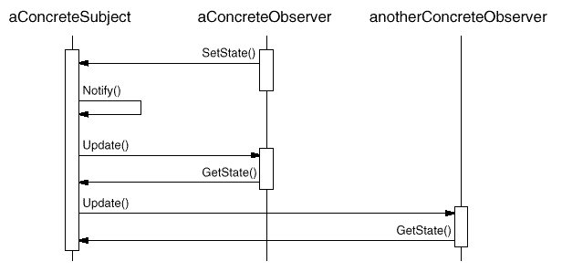
Use of Observer pattern

Slide 42
Observer Pattern (cont’d)
Consequences
  low coupling between subject and observers
    subject unaware of dependents
  support for broadcasting
    dynamic addition and removal of observers
  unexpected updates
    no control by the subject on computations by observers

Slide 43
Observer pattern (cont’d)
Implementation issues
  storing list of observers
    typically in subject
  observing multiple subjects
    typically add parameters to update()
  who triggers update?
    State-setting operations of subject
      Possibly too many updates
    client
      Error-prone if an observer forgets to send notification message

Slide 44
Observer pattern (cont’d)
Implementation issues (cont’d)
  possibility of dangling references when subject is deleted
    easier in garbage-collected languages
    subject notifies observers before dying
  possibility of premature notifications
    typically, method in Subject subclass calls inherited method which does notification
    solve by using Template method pattern
      method in abstract class calls deferred methods, which is defined by concrete subclasses

Slide 45
Observer pattern (cont’d)
Implementation issues (cont’d)
  how much information should subject send with update() messages?
    Push model: Subject sends all information that observers may require
      May couple subject with observers (by forcing a given observer interface)
    Pull model: Subject sends no information
      Can be inefficient
  registering observers for certain events only
    use notion of an aspect in subject
    Observer registers for one or more aspects

Slide 46
Observer pattern (cont’d)
Implementation issues (cont’d)
  complex updates
    use change managers
    change manager keeps track of complex relations among (possibly) many subjects and their observers and encapsulates complex updates to observers

Slide 47
Implementation details
Observing more than one subject.
  It might make sense in some situations for an observer to depend on more than one subject. The subject can simply pass itself as a parameter in the Update operation, thereby letting the observer know which subject to examine.
  Making sure Subject state is self-consistent before notification.

Slide 48
More implementation issues
Implementations of the Observer pattern often have the subject broadcast additional information about the change.
  At one extreme, the subject sends observers detailed information about the change, whether they want it or not. At the other extreme the subject sends nothing but the most minimal notification, and observers ask for details explicitly thereafter
You can extend the subject's registration interface to allow registering observers only for specific events of interest.

Slide 49
Examples
The standard Java and JavaBean event model is an example of an observer pattern

Slide 50
Administrivia
Project2
  Due date changed to Sunday Oct. 13
  You will need to turn in Junit test cases
    More info to follow
  Project1 commentary assignment will be sent out soon
Exam
  Review Oct. 15
    BYOQ – Bring your own questions
  Midterm Oct. 17

Slide 51
State pattern
Suppose an object is always in one of several known states
The state an object is in determines the behavior of several methods
Could use if/case statements in each method
Better solution: state pattern

Slide 52
State pattern
Have a reference to a state object
  Normally, state object doesn’t contain any fields
  Change state: change state object
  Methods delegate to state object

Slide 53
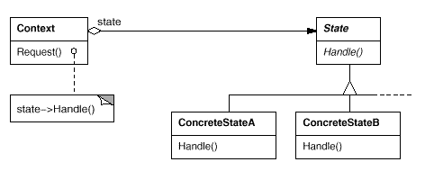
Structure of State pattern

Slide 54
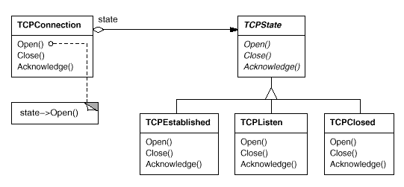
Instance of State Pattern

Slide 55
State pattern notes
Can use singletons for instances of each state class
  State objects don’t encapsulate state, so can be shared
Easy to add new states
  New states can extend other states
    Override only selected functions

Slide 56
Example – Finite State Machine
class FSM {
State state;
public FSM(State s) { state = s; }
public void move(char c) { state = state.move(c); }
public boolean accept() { return state.accept();}
}
public interface State {
State move(char c);
boolean accept();
}

Slide 57
FSM Example – cont.
class State1 implements State {
static State1 instance = new State1();
private State1() {}
public State move (char c) {
switch (c) {
case 'a': return State2.instance;
case 'b': return State1.instance;
default: throw new IllegalArgumentException();
}
}
public boolean accept() {return false;}
}
class State2 implements State {
static State2 instance = new State2();
private State2() {}
public State move (char c) {
switch (c) {
case 'a': return State1.instance;
case 'b': return State1.instance;
default: throw new IllegalArgumentException();
}
}
public boolean accept() {return true;}
}

Slide 58
Decorator Pattern
Motivation
  Want to add responsibilities to individual objects, not to an entire class
  Inheritance requires a compile-time choice
Solution
  Enclose the component in another object that adds the responsibility
    The enclosing object is called a decorator.
  Decorator conforms to the interface of the component it decorates so that its presence is transparent to the component's clients.
  Decorator forwards requests to the component and may perform additional actions before or after forwarding.
  Can nest decorators recursively, allowing unlimited added responsibilities.
  Can add/remove responsibilities dynamically

Slide 59
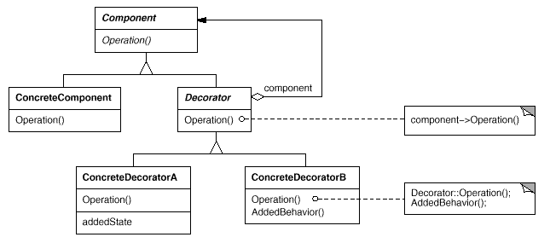
Structure

Slide 60
Example: Java I/O
FileReader frdr = new FileReader(filename);
LineNumberReader lrdr = new LineNumberReader(frdr);
String line;
while ((line = lrdr.readLine()) != null) {
System.out.print(lrdr.getLineNumber() + ":\t" + line);
}

Slide 61
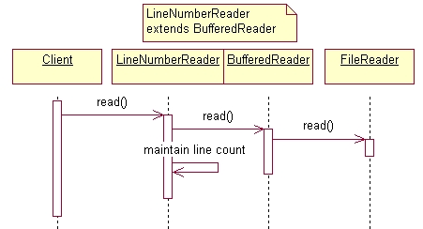
Interaction diagram

Slide 62
Lexi: Simple GUI-Based Editor
Lexi is a WYSIWYG editor
  supports documents with textual and graphical objects
  scroll bars to select portions of the document
  support multiple look-and-feel interfaces
  be easy to port to another platform
Highlights several OO design issues
Case study of design patterns in the design of Lexi

Slide 63
Design Issues
Representation and manipulation of document
Formatting a document
Adding scroll bars and borders to Lexi windows
Support multiple look-and-feel standards
Handle multiple windowing systems
Support user operations
Advanced features
  spell-checking and hyphenation

Slide 64
Structure of a Lexi Document
Goals:
  store text and graphics in document
  generate visual display
  maintain info about location of display elements
Caveats:
  treat different objects uniformly
    e.g., text, pictures, graphics
  treat individual objects and groups of objects uniformly
    e.g., characters and lines of text

Slide 65
Structure of a Lexi Document
Solution:
  define abstract class Glyph for all displayed objects
  glyph responsibilities:
    know how to draw itself
    knows what space it occupies
    knows its children and parent
  use recursive composition for defining and handling complex objects
  define composition of Glyph as instances of Glyph

Slide 66
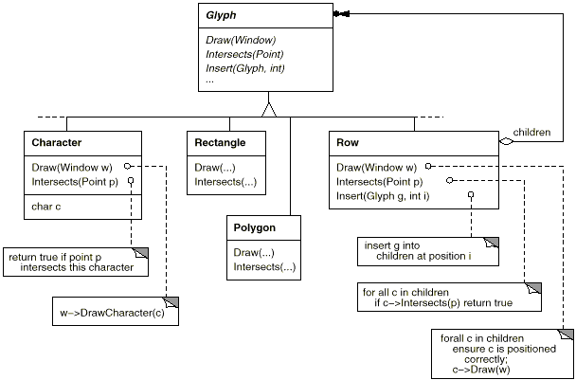
Glyph Class Diagram

Slide 67
The Composite Pattern
Motivation:
  support recursive composition in such a way that a client need not know the difference between a single and a composite object (as with Glyphs)
Applicability:
  when dealing with hierarchically-organized objects (e.g., columns containing rows containing words …)

Slide 68
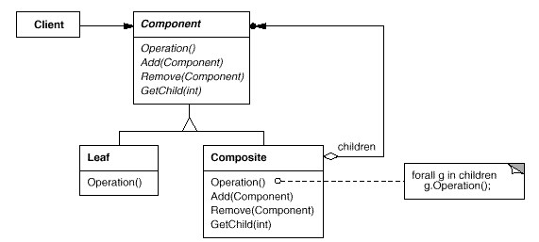
Glyph Class Diagram

Slide 69
Composite Pattern (cont’d)
Consequences:
  class hierarchy has both simple and composite objects
  simplifies clients
  aids extensibility
    clients do not have to be modified
  too general a pattern?
    difficult to to restrict functionality of concrete leaf subclasses

Slide 70
Formatting Lexi Documents
Handle justification, margins, line breaking, etc.
Many good algorithms exist;
  different tradeoffs between quality and speed
  design decision: implement different algorithms, decide at run-time which algorithm to use
Goal: maintain orthogonality between formatting and representation (glyphs)
Solution
  define root class that supports many algorithms
  each algorithm implemented in a subclass

Slide 71
Compositor and Composition
Relevant design decisions:
  compositor: class containing formatting algorithm
  pass objects to be formatted as parameters to compositor methods
  parameters are instances of a Glyph subclass called Composition
  uniform interface between formattable objects and compositor algorithms

Slide 72
Compositor and Composition
Relevant design decisions (cont’d):
  each Composition instance has a reference to a compositor object
  when a composition needs to format itself, it sends a message to its compositor instance

Slide 73
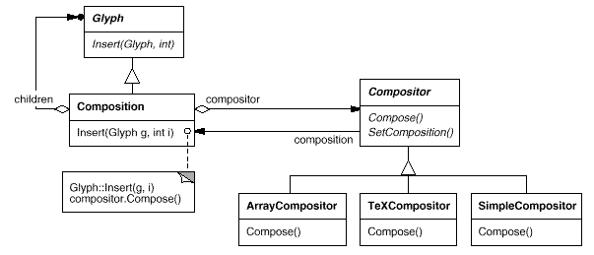
Class Diagram

Slide 74
Strategy Pattern
Name
  Strategy (aka Policy)
Applicability
  many related classes differ only in their behavior
  many different variants of an algorithm
  need to encapsulate algorithmic information

Slide 75
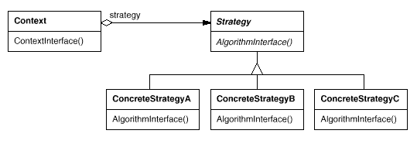
Strategy Pattern: Structure

Slide 76
Strategy Pattern (cont’d)
Consequences
  clear separation of algorithm definition and use
    glyphs and formatting algorithms are independent
    alternative (many subclasses) is unappealing
      proliferation of classes
      algorithms cannot be changed dynamically
  elimination of conditional statements
    as usual with OO programming

Slide 77
Strategy Pattern (cont’d)
Consequences (continued)
  clients must be aware of different strategies
    when initializing objects
  proliferation of instances at run-time
    each glyph has a strategy object with formatting information
    if strategy is stateless, share strategy objects

Slide 78
Adding scroll bars and borders
Where do we define classes for scrollbars and borders?
Define as subclasses of Glyph
  scrollbars and borders are displayable objects
  supports notion of transparent enclosure
    clients don’t need to know whether they are dealing with a component or with an enclosure
Inheritance increases number of classes
  use composition instead (“has a” )

Slide 79
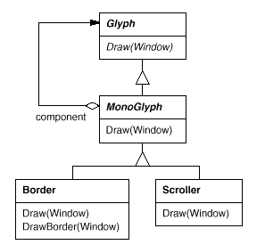
Monoglyph class
void MonoGlyph::Draw (Window* w) {
component->Draw(w);
}
void Border::Draw (Window* w) { MonoGlyph::Draw(w); DrawBorder(w);
}

Slide 80
Decorator Pattern
Name
  Decorator (aka Wrapper)
Applicability
  add responsibilities to objects dynamically and transparently
  handle responsibilities that can be withdrawn at run-time

Slide 81
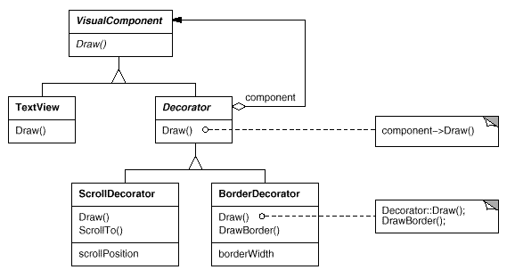
Decorator Pattern: Structure

Slide 82
Decorator Pattern (cont’d)
Advantages
  fewer classes than with static inheritance
  dynamic addition/removal of decorators
  keeps root classes simple
Disadvantages
  proliferation of run-time instances
  abstract Decorator must provide common interface
Tradeoffs:
  useful when components are lightweight
  otherwise use Strategy

Slide 83
Multiple look-and-feel standards
Change Lexi’s look-and-feel at run-time
Obvious solution has clear disadvantages
  use distinct class for each widget and standard
  let clients handle different instances for each standard
Problems:
  proliferation of classes
  can’t change standard at run-time
  code for look-and-feel standard visible to clients
Code example:
      Button* pb = new MotifButton; // bad
      Button* pb = guiFactory->createButton();// better

Slide 84
Multiple look-and-feel standards (cont’d)
Solution:
  define abstract class GUIFactory with creation methods (deferred) for widgets
  concrete subclasses of GUIFactory actually define creation methods for each look-and-feel standard
    MotifFactory, MacFactory, etc.
  must still specialize each widget into subclasses for each look-and-feel standard

Slide 85
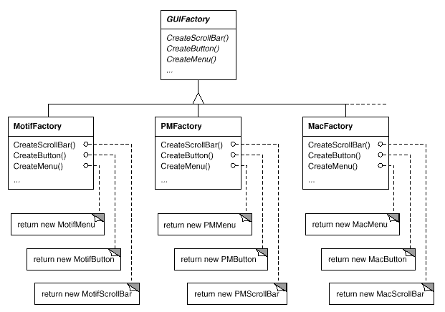
Class diagram for GUIFactory

Slide 86
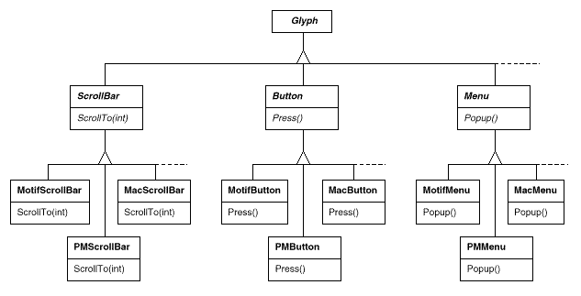
Diagram for product classes

Slide 87
Abstract Factory pattern
Name
  Abstract Factory or Kit
Applicability
  different families of components (products)
  must be used in mutually exclusive and consistent way
  hide existence of multiple families from clients

Slide 88

Structure of Abstract Factory

Slide 89
Abstract Factory (cont’d)
Consequences
  isolate creation and handling of instances from clients
  changing look-and-feel standard at run-time is easy
    reassign a global variable;
    recompute and redisplay the interface
  enforces consistency among products in each family
  adding new family of products is difficult
    have to update all factory classes

Slide 90
Multiple Window Systems
Want portability to different window systems
  similar to multiple look-and-feel problem, but different vendors will build widgets differently
Solution:
  define abstract class Window, with basic window functionality (e.g., draw, iconify, move, resize, etc.)
  define concrete subclasses for specific types of windows (e.g., dialog, application, icon, etc.)
  define WindowImp hierarchy to handle window implementation by a vendor

Slide 91
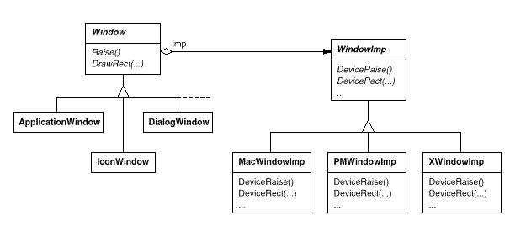
Implementation

Slide 92
Bridge Pattern
Name
  Bridge or Handle or Body
Applicability
  handles abstract concept with different implementations
  implementation may be switched at run-time
  implementation changes should not affect clients
  hide a class’s interface from clients
Structure: use two hierarchies
  logical one for clients,
  physical one for different implementations

Slide 93
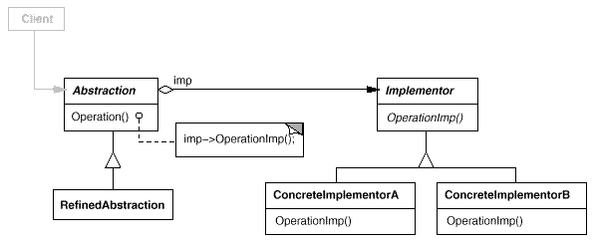
Structure of Bridge Pattern

Slide 94
Bridge Pattern
Consequences:
  decouple interface from impl.and representation
  change implementation at run-time
  improve extensibility
    logical classes and physical classes change independently
    hides implementation details from clients
      sharing implementation objects and associated reference counts

Slide 95
Supporting User Commands
Support execution of Lexi commands
  GUI doesn’t know
    who command is sent to
    command interface
Complications
  different commands have different interfaces
  same command can be invoked in different ways
  Undo and Redo for some, but not all, commands (print)

Slide 96
Supporting User Commands (cont’d)
An improved solution
  create abstract “command” class
    command must have reversible method
  create action-performing glyph subclass
  delegate action to command
Key ideas
  pass an object, not a function
  pass context to the command function
  store command history

Slide 97
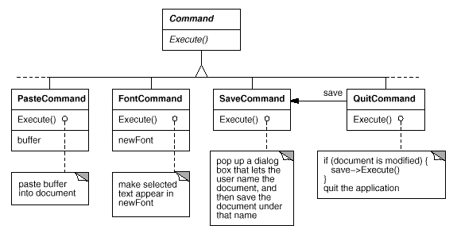
Command Objects

Slide 98
Command Pattern
Name
  Command or Action or Transaction
Applicability
  parameterize objects by actions they perform
  specify, queue, and execute requests at different times
  support undo by storing context information
  support change log for recovery purposes
  support high-level operations
    macros

Slide 99
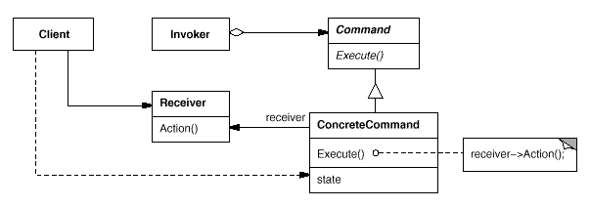
Structure of Command Pattern

Slide 100
Command Pattern
Consequences:
  decouple receiver and executor of requests
    Lexi example: Different icons can be associated with the same command
  commands are first class objects
  easy to support undo and redo
    must add state information to avoid hysteresis
  can create composite commands
    Editor macros
  can extend commands more easily

Slide 101
Command Pattern
Implementation notes
  how much should command do itself?
  support undo and redo functionality
    operations must be reversible
    may need to copy command objects
    don’t record commands that don’t change state
  avoid error accumulation in undo process

Slide 102
Spell-Checking and Hyphenation
Must do texual analysis
  multiple operations and implementations
Must add new functions and operations easily
Must efficiently handle scattered information and varied implementations
  different traversal strategies for stored information
Should separate traversal actions from traversal

Slide 103
Iterator Pattern
Name
  Iterator or Cursor
Applicability
  access aggregate objects without exposing internals
  support multiple traversal strategies
  uniform interface for traversing different objects

Slide 104
Iterator Pattern
Key ideas
  separate aggregate structures from traversal protocols
  support addition of traversal functionality
  small interfaces for aggregate classes,
  multiple simultaneous traversals
Pattern structure
  abstract Iterator class defines traversal protocol
  concrete Iterator subclasses for each aggregate class
  aggregate instance creates instances of Iterator objects
  aggregate instance keeps reference to Iterator object

Slide 105
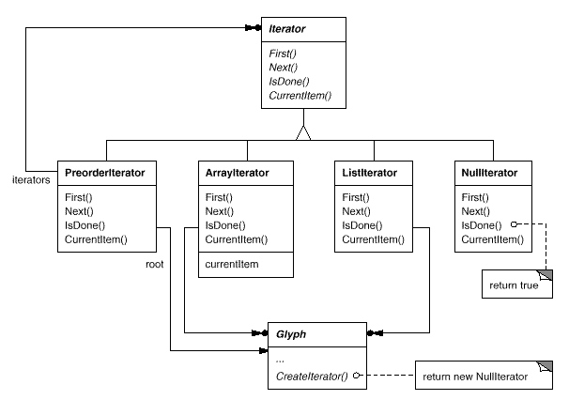
Structure of Iterator Pattern

Slide 106
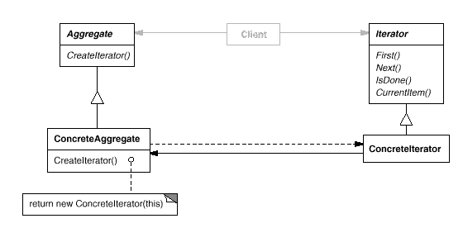
Structure of Iterator Pattern

Slide 107
Iterator Pattern (cont’d)
Consequences
  support different kinds of traversal strategies
    just change Iterator instance
  simplify aggregate’s interface
    no traversal protocols
  supports simultaneous traversals

Slide 108
Iterator Pattern (cont’d)
Implementation issues
Who controls iteration?
  external vs. internal iterators
    external:
      client controls the iteration via “next” operation
      very flexible
      some operations are simplified - logical equality and set operations are difficult otherwise
    internal:
      Iterator applies operations to aggregate elements
      easy to use
      can be difficult to implement in some languages

Slide 109
Iterator Pattern (cont’d)
Who defines the traversal algorithm?
  Iterator itself
    may violate encapsulation
  aggregate
    Iterator keeps only state of iteration
How robust is the Iterator?
  are updates or deletions handled?
  don’t want to copy aggregates
  register Iterators with aggregate and clean-up as needed
  synchronization of multiple Iterators is difficult

Slide 110
Implementation of Operations
Compiler represents prog. as abstract syntax tree
  Different nodes for different components for a language
    Different classes for assignment stmts, vars, expressions.
  Operations on abstract syntax trees
    Type checking, code generation, pretty-printing, etc

Slide 111
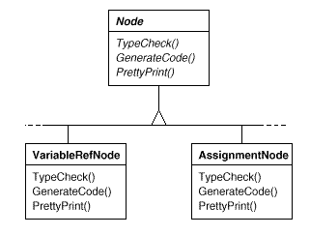
Traditional

Slide 112
Problems
Distributing operations across the node classes leads to a system that's:
  Hard to understand, maintain, and change
Adding a new op will require recompiling all classes
Would be better if each new operation
  Could be added separately, and
  Node classes were independent of op that apply to them

Slide 113
Visitor pattern
Name
  Visitor or double dispatching
Applicability
  related objects must support different operations and actual op depends on both the class and the op type
  distinct and unrelated operations pollute class defs
  object structure rarely changes, but ops changed often

Slide 114
Visitor Pattern (cont’d)
Structure
  define two class hierarchies,
    one for object structure
    one for each operation family (called visitors)
  compiler example:
    Object subclasses VariableRef, AssignmentNode.
    Operation subclasses TypeCheck, GenerateCode, PrettyPrint

Slide 115
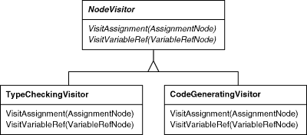
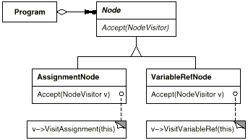
Visitor pattern

Slide 116
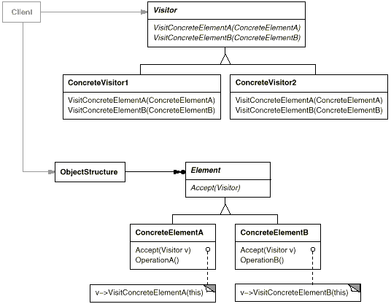
Structure of Visitor Pattern

Slide 117
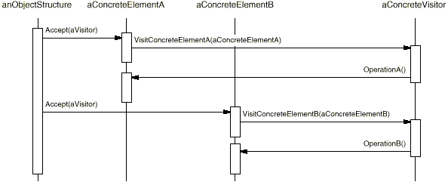
Use of Visitor Pattern

Slide 118
Visitor Pattern (cont’d)
Consequences
  adding new operations is easy
    add new operation subclass with a method for each concrete element class
    easier than modifying every element class
  gathers related operations and separates unrelated ones
  adding new concrete elements is difficult
    must add a new method to each concrete Visitor subclass
  allows visiting across class hierachies
    Iterator needs a common superclass
  can accumulate state rather than pass it a parameters

Slide 119
Visitor Pattern (cont’d)
Implementation issue:
  Who is responsible for traversing object structure?
Plausible answers:
  visitor
    must replicate traversal code in each concrete visitor
  object structure
    define operation that performs traversal while applying visitor object to each component
  Iterator
    Iterator sends message to visitor with current element as arg

Slide 120
Pattern hype
Patterns get a lot of hype and fanatical believers
  We are going to have a design pattern reading group, and this week we are going to discuss the Singleton Pattern!
Patterns are sometimes wrong or inappropriate for a particular language or environment
  Patterns developed for C++ can have very different solutions in Smalltalk or Java

Slide 122
Visitor pattern
A visitor encapsulates the operations to be performed on an entire structure
  E.g., all elements of a parse tree
Allows the operations to be specified separately from the structure
  But doesn’t require putting all of the structure traversal code into each visitor/operation

Slide 123
Double-dispatch
Accept code is always trivial
  Just dynamic dispatch on argument, with runtime type of structure node taking into account in method name
A way of doing double-dispatch
  Dynamic dispatching on the run-time types of two arguments
  Visitor code invoked depends on run-time type of both visitor and node

Slide 124
Using overloading in a visitor
You can name all of the visitXXX(XXX x) methods just visit(XXX x)
  Calls to Visit (AssignmentNode n)
  and Visit(VariableRefNode n) distinguished by compile-time overload resolution

Slide 125
Easy to provide default behavoir
Default
visit(BinaryPlusOperatorNode)
can just forward call to visit(BinaryOperatorNode)
Visitor can just provide implementation of visit(BinaryOperatorNode) if it doesn’t care what type of binary operator node it is at

Slide 126
State in a visitor pattern
A visitor can contain state
  E.g., the results of parsing the program so far
Or use stateless visitors and pass around a separate state object

Slide 127
Traversals
In the standard visitor pattern, the visitor at a node is responsible for visiting the components (i.e., children) of that node
  if that is what is desired
    Visitors can be applied to flat object structures
Several other solutions
  acceptAndTraverse methods
  Visit/process methods
  traversal visitors applying an operational visitor

Slide 128
More on visitor traversals

Slide 129
acceptAndTraverse methods
accept method could be responsible for traversing children
  Assumes all visitors have same traversal pattern
    E.g., visit all nodes in pre-order traversal
  Could provide previsit and postvisit methods to allow for more complicated traversal patterns
    Still visit every node
    Can’t do out of order traversal
    In-order traversal requires inVisit method

Slide 130
Accept and traverse
Class BinaryPlusOperatorNode {
void accept(Visitor v) {
v->visit(this);
lhs->accept(v);
rhs->accept(v);
}
…}

Slide 131
Visitor/process methods
Can have two parallel sets of methods in visitors
  Visit methods
  Process methods
Visit method on a node:
  Calls process method of visitor, passing node as an argument
  Calls accept on all children of the node (passing the visitor as an argument

Slide 132
Preorder visitor
Class PreorderVisitor {
void visit(BinaryPlusOperatorNode n) {
process(n);
n->lhs->accept(this);
n->rhs->accept(this);
}
…}

Slide 133
Visit/process, continued
Can define a PreorderVisitor
  Extend it, and just redefine process method
    Except for the few cases where something other than preorder traversal is required
Can define other traversal visitors as well
  E.g., PostOrderVisitor

Slide 134
Traversal visitors applying an operational visitor
Define a Preorder traversal visitor
  Takes an operational visitor as an argument when created
Perform preorder traversal of structure
  At each node
    Have node accept operational visitor
    Have each child accept traversal visitor

Slide 135
PreorderVisitor with payload
Class PreorderVisitor {
Visitor payload;
void visit(BinaryPlusOperatorNode n) {
payload->visit(n);
n->lhs->accept(this);
n->rhs->accept(this);
}
…}

