Slide 1
Software Design Patterns

Slide 2
Overview
In this section I will be discussing about –
Basics of design patterns
Types
Different design patterns with non-software and software examples
For software example, I have explained each pattern based on a very popular game “Temple Run2”.

Slide 3
Definitions
Christopher Alexander defined a pattern as “a solution to a problem in a context”:
“Each pattern describes a problem which occurs over and over again in our environment and then describes the core of the solution to that problem, in such a way that you can use this solution a million times over, without ever doing it the same way twice.”

Slide 4
Components required for patterns:
Name
Purpose, the problem it solves
Way to accomplish this
Constraints and forces we have to consider in order to accomplish it

Slide 5
Why study design patterns?
Because design patterns-
Help reuse existing high quality solutions to commonly occurring problems
Improve individual and team learning
Shift level of thinking to a high perspective
Illustrate basic object-oriented principles
Improves modifiability and maintainability of the code
Improve team communication n individual learning

Slide 6
Types of patterns:
Creational
Behavioral
Structural

Slide 7
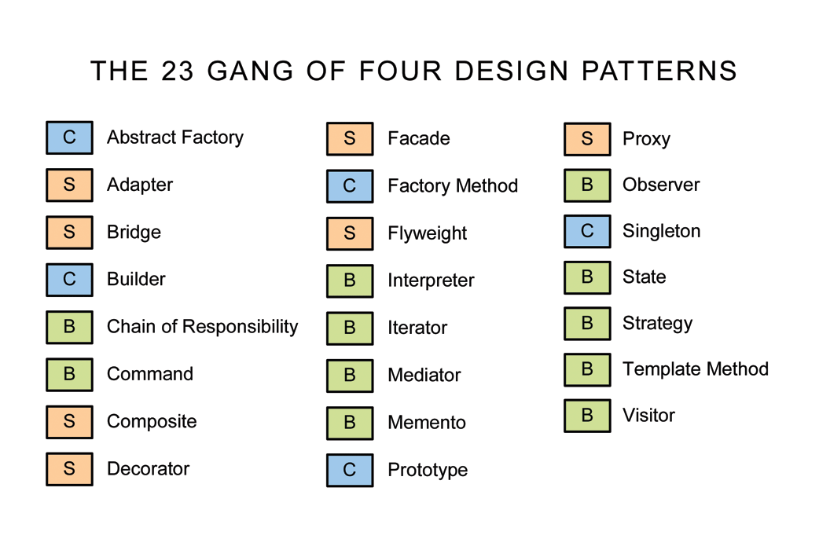
examples: creational(c),behavioral(b) and structural(s) patterns

Slide 8
1) Façade pattern
Provide a unified interface to a set of interfaces in a subsystem.
Defines a higher-level interface that makes the subsystem easier to use.

Slide 9
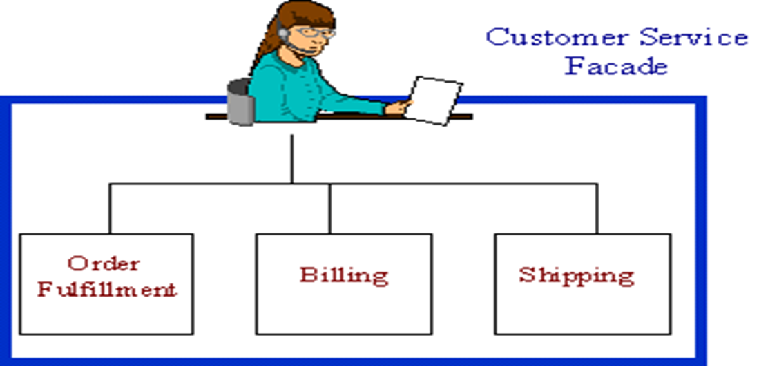
Non-software example for façade
The customer service representative acts as a Facade, providing an interface to the order fulfillment department, the billing department, and the shipping department.
Object Diagram for facade using Phone Order

Slide 10
Software example
In temple run game the “upgrade” option acts as a façade, giving an interface for selecting a player, for abilities and powerups.

Slide 11
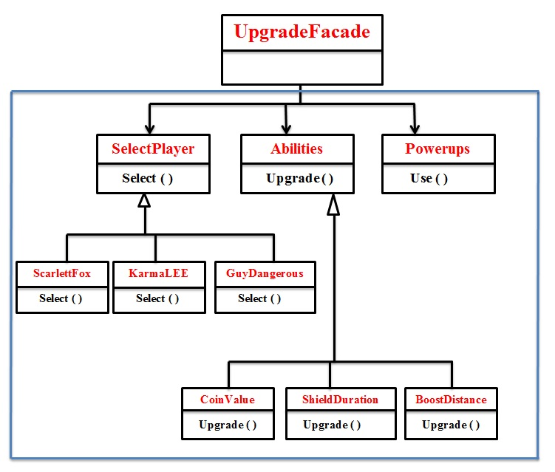
Implementation of facade pattern in Temple Run2

Slide 12
2) Observer pattern
Define a one-to-many dependency between objects where a state change in one object results in all its dependents being notified and updated automatically.
oservers delegate the responsibility for monitoring for an event to a central object(the subject) so that it can notify a varying list of objects that an event has occurred.

Slide 13
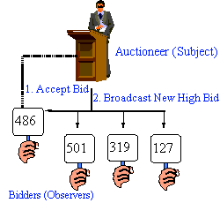
Non-software example
The following figure shows an Auction example of an observer
The auctioneer starts the bidding, and "observes" when a paddle is raised to accept the bid. The acceptance of the bid changes the bid price, which is broadcast to all of the bidders in the form of a new bid.

Slide 14
Software example
In temple run game ,when the player completes certain objective(s) following needs to be updated/notified automatically-
Current list(list of objectives to be achieved)
Complete list(list of objectives completed)
Increase multiplier
Increase score

Slide 15
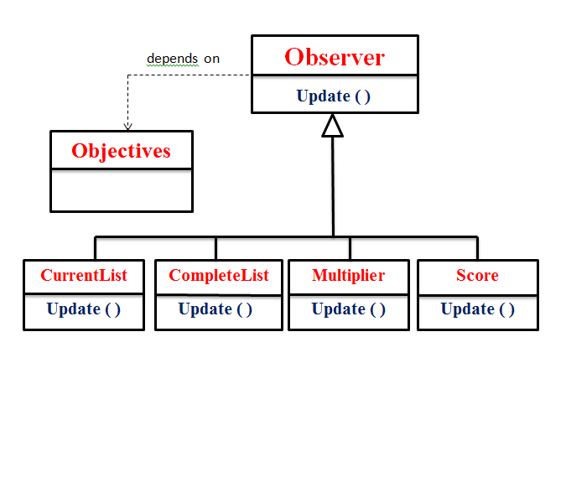
Implementation of observer pattern in Temple Run2

Slide 16
3) Decorator pattern
Attach additional responsibilities to an object dynamically keeping the same interface.
Decorators provide a flexible alternative to subclassing for extending functionality.
The object that we want to use does the basic function.
However, we need to add some additional functionality occurring before or after the object’s base function.
Allows extension of functionalities without resorting subclassing.

Slide 17
Non-software example:
The Decorator attaches additional responsibilities to an object dynamically.
Although paintings can be hung on a wall with or without frames, frames are often added, and it is the frame which is actually hung on the wall.
Prior to hanging, the paintings may be matted and framed, with the painting, matting, and frame forming a single visual component.

Slide 18
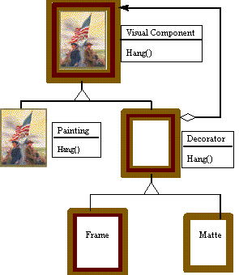
Painting example for decorator pattern

Slide 19
Software example
In temple run game, run is a basic object. The player can simply go on running without taking any powerups(boost, shield,coin magnet).
Additional functionality like Boost(runs faster),shield(protects from fire n other obstacles),coin magnet(attracts the coins automatically while running) will be added if the player takes any of the above mentined powerups which will be appearing on the screen while running.

Slide 20
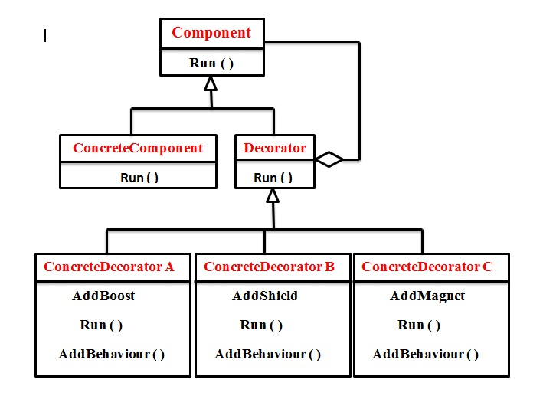
Implementation of decorator pattern in Temple Run2

Slide 21
4) State pattern
Allow an object to alter its behavior when its internal state changes.
The object will appear to change its class.

Slide 22
Non-software example
This pattern can be observed in a vending machine.
Vending machines have states based on the inventory, amount of currency deposited, the ability to make change, the item selected, etc.
When currency is deposited and a selection is made, a vending machine will either deliver a product and no change, deliver a product and change, deliver no product due to insufficient currency on deposit, or deliver no product due to inventory depletion.

Slide 23
Object diagram for state using vending machine

Slide 24
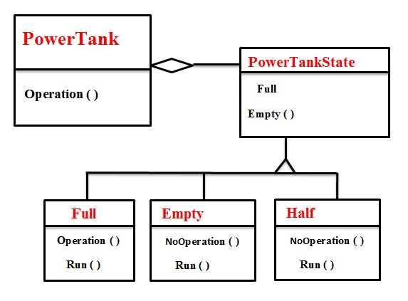
Implementation of state pattern in Temple Run2

Slide 25
5) Strategy pattern
Define a family of algorithms, encapsulate each one, and make them interchangeable.
Strategy lets the algorithm vary independently from clients that use it.
It enables us to use different rules or algorithms depending on the context in which they occur.
Separates the selection of algorithms from the implementation of the algorithm.

Slide 26
Non-software example
Modes of transportation to an airport is an example of a Strategy.
Any of these modes of transportation will get a traveler to the airport, and they can be used interchangeably.
The traveler must chose the Strategy based on tradeoffs between cost, convenience, and time.

Slide 27
Object Diagram for Strategy using Airport Transportation Example

Slide 28
Software example for strategy
In temple run game, when a use double clicks on himself the following changes happen:-
If the power tank is not filled-no changes
If the power tank is filled ,one of the following happens until the tank gets emptied
If Powerup=boost, engages boost instantly
If Powerup=score bonus, then instant 500 point bonus
If Powerup=coin magnet, then engages coin magnet instantly
If Powerup=shield, then engages shield instantly
There are four strategies a user can select for operation to occur when we double click (when the power tank is full).

Slide 29
(cont.)
In the above example we can observe that there is a “change of state” in tank from empty to full and vice versa.
And the player can select any of the “strategies”(boost, coin magnet, shield or score bonus) depending on his need. They all have same interface
(Note: the user needs to select any of the strategies(in powerup menu) before he starts playing so that he can use that just by double clicking when the tank is full.

Slide 30
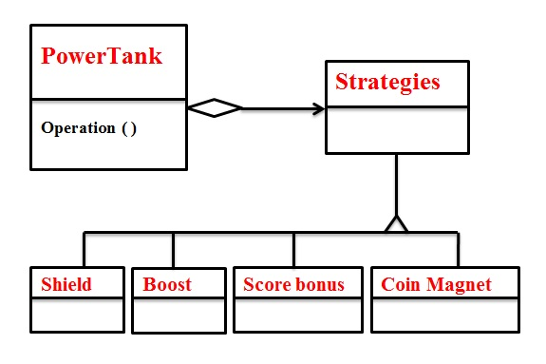
Implementation of strategy pattern in Temple Run2

Slide 31
6) Template method pattern
The Template Method defines a skeleton of an algorithm in an operation, and defers some steps to subclasses.
Template method lets subclasses redefine certain steps of an algorithm without changing the algorithm's structure
Allow definition of subsets that vary while maintaining a consistent basic process
Good platform for code reuse n ensures that the required steps are implemented.

Slide 32
Non-software example
Home builders use the Template Method when developing a new subdivision.
A typical subdivision consists of a limited number of floor plans, with different variations available for each floor plan.
Within a floor plan, the foundation, framing, plumbing, and wiring will be identical for each house.
Variation is introduced in the latter stages of construction to produce a wider variety of models.

Slide 33
Basic floor plan using template method

Slide 34
Software example
In temple run game the basic process is running.
Variations can be introduced when the player takes boost, coin magnet or shield while running which will not affect the basic process i.e running.

Slide 35
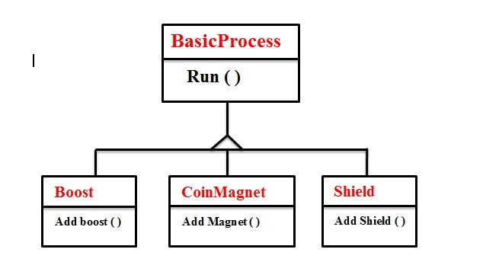
Implementation of template pattern in Temple Run2

Slide 36
7) Iterator pattern
Provide a way to access the elements of an aggregate object sequentially without exposing its underlying representation.
Example:
When the viewer selects the "next" button, the next tuned channel will be displayed.
Consider watching television in a hotel room in a strange city.
When surfing through channels, the channel number is not important, but the programming is. If the programming on one channel is not of interest, the viewer can request the next channel, without knowing its number.

Slide 37
Non-software examples
Object Diagram for Iterator using Channel Selector Example

Slide 38
Software example
In temple run game, the player has to run on the animated path which is designed in such a way that the different animations are repeated by selecting them randomly.
Animation selector selects one of the following in an iterative manner throughout the game.
Normal rock road on mountains
Rope
wooden bridge
broken bridge
Tunnel
water falls
fallen trees and other obstacles

Slide 39
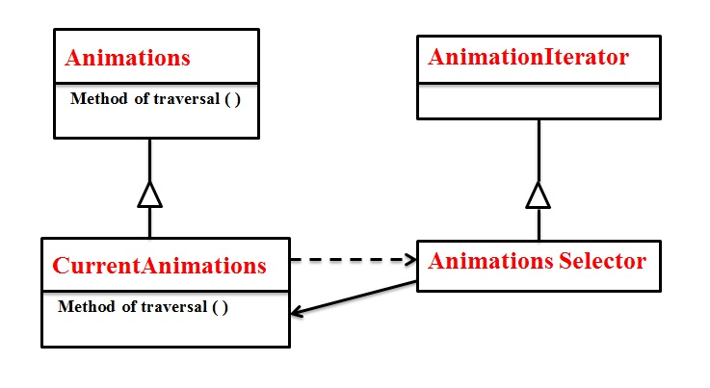
Implementation of Iterator pattern in Temple Run2

Slide 40
8) Bridge pattern
The Bridge pattern decouples an abstraction from its implementation, so that the two can vary independently.
Example: A household switch controlling lights, ceiling fans, etc. is an example of the Bridge.
The purpose of the switch is to turn a device on or off. s
The actual switch can be implemented as a pull chain, a simple two position switch, or a variety of dimmer switches.

Slide 41
Non-software example
Object Diagram for Bridge using Electrical Switch Example

Slide 42
Software example
In temple run game we can have following options under the caption “play”
Swipe
Slide
Tilt
Duck
Double tap
Using bridge pattern we are switching between one of the above operation without even knowing the actual implementation.

Slide 43
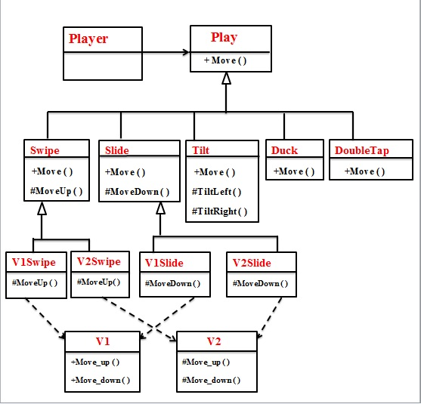
Implementation of bridge pattern in Temple Run2

Slide 44
9) Singleton pattern
Ensure a class has only one instance, and provide a global point of access to it.
Example:
The office of the President of the United States is a Singleton.
The United States Constitution specifies the means by which a president is elected, limits the term of office, and defines the order of succession.
As a result, there can be at most one active president at any given time.
Regardless of the personal identity of the active president, the title, "The President of the United States" is a global point of access that identifies the person in the office.

Slide 45
Non-software example
Object Diagram for Singleton using Presidency Example

Slide 46
Software example
In temple run game, the player can play well and set high score
This high score is a single instance of a class
It is a global point of access that identifies highest scored points.

Slide 47
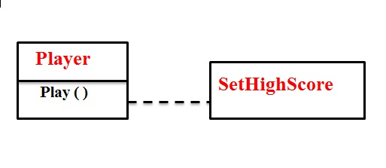
Implementation of singleton pattern in Temple Run2

Slide 48
References
Design Patterns Explained by Alan Shalloway and James R. Trott
Non-Software Examples of Software Design Patterns by Michael Duell

