Slide 1


SMART SHOPPING TROLLEY USING IoT TECHNOLOGY
K.L.N.COLLEGE OF INFORMATION TECHNOLOGY POTTAPALAYAM – 630 612. DEPARTMENT OF COMPUTER SCIENCE AND ENGINEERING
Project members : R.Tyndale Praveen (910716104067)
B.Senthil Kumar (910716104052)
C.Yogesh Kumar (910716104074)
Internal Guide : Mr.R.Arun Kumar (AP/CSE)

Slide 2
Introduction
Shopping in the present day usually involves waiting in line to get your items scanned for checkout.
This can result in a great deal of wasted time for customers. Furthermore, the technology currently used in checkouts barcodes - is from another era, developed in the 1970s.
To overcome these problems and to change and improve the existing system, we have designed “ SMART SHOPPING TROLLEY using IoT technology ”.

Slide 3
Problem statement
The shopping experience in a shopping mall or grocery store is very time
consuming especially when the customer has to wait in a long queue for
billing and payment counters.
Due to having many employees in a particular mall , it affects its overall
revenue growth.
To solve the above problems and to make the shopping experience efficient for the customers.

Slide 4
Proposed system
A smart shopping cart which contains RFID reader , LCD display , DC motors , option buttons , Wi-Fi module , ZigBee transceiver. All the components are connected to the microcontroller .
All the items are given a RFID tag and the cart scans the items and store the data on microcontroller and displays on screen.
The cart can be controlled by using Bluetooth enabled app.
The IoT data is updated in the cloud for stock maintenance using ESP8266 and bill generation using ZigBee.
A stand-alone computer connected with ZigBee transceiver is used to display the IoT data using dashboard.

Slide 5
System Architecture
Option button
Buzzer
RFID reader
Embedded chip
ZigBee
LCD
Wi-Fi Module
Motor Driver
TROLLEY SECTION
Stand-alone System
ZigBee
Dashboard
BILLING SECTION

Slide 6
Project objective
To enable easy purchasing of products using RFID technology.
To continuously upload the data through cloud.
To aware the user about data regarding the product’s name and amount.
To maintain the list of available stocks in the shop in an automated manner.

Slide 7
Overall flow diagram
Customer card
CONTROLLER
No
Wi-Fi
RFID authenticate
Yes
End
Bluetooth enabled trolly allocated
Access databases
Product selection
User check out option
Selected items
Trolly disconnect
Database refresh
User
feedback
Bill generation
Database

Slide 8
Hardware Specifications
Arduino
Wi-Fi Module
Zigbee module
RFID tag and Reader
Buzzer
Option Button
Power Supply

Slide 9


Software Specifications
Arduino IDE
Embedded C
Thingspeak
Android app
Termite 2.6

Slide 10
Arduino IDE
Arduino integrated development environment or we can say it is Arduino software.
It consists of a text editor, where the code is written based on Embedded C language.
A message area is given, which shows message or any error message.
The tool bar contains buttons for common features.
The programs are uploaded to Arduino board by USB connection.
This process is called code-uploading or code-burning.

Slide 11

Embedded C
Embedded C is an extension that provides support for developing efficient programs for embedded devices.
It is not a part of the C language.
It has similar program structure as C language.

Slide 12
IoT dashboard
Thingspeak :-
It is an open source IoT dashboard application.
It is written in ruby and it is cross platform.
It is used to store and retrieve IoT data from MQTT protocol via the local Wi-Fi connection.
It displays the IoT data transferred from the Arduino using Widgets.

Slide 13
Termite 2.6
Termite is an easy-to-use and easy-to-configure RS232 terminal.
It uses an interface similar to that of "messenger" or "chat" programs, with a large window that contains all received data and an edit line for typing in strings to transmit.
The terminal is used to view the output of billing details in a shop.

Slide 14
Serial Bluetooth terminal
'Serial Bluetooth Terminal' is a line-oriented terminal / console app for microcontrollers, arduinos and other devices with a serial / UART interface connected with a bluetooth to serial converter to your android device.
It provides options and buttons for users to control the Bluetooth enabled IoT device.

Slide 15
MODULE-1
Power supply with controller.
RFID reader with tag check.
The main objective of this module is to allocate the trolley for the customer.
POWER SUPPLY
CONTROLLER
RFID READER
RFID TAG

Slide 16
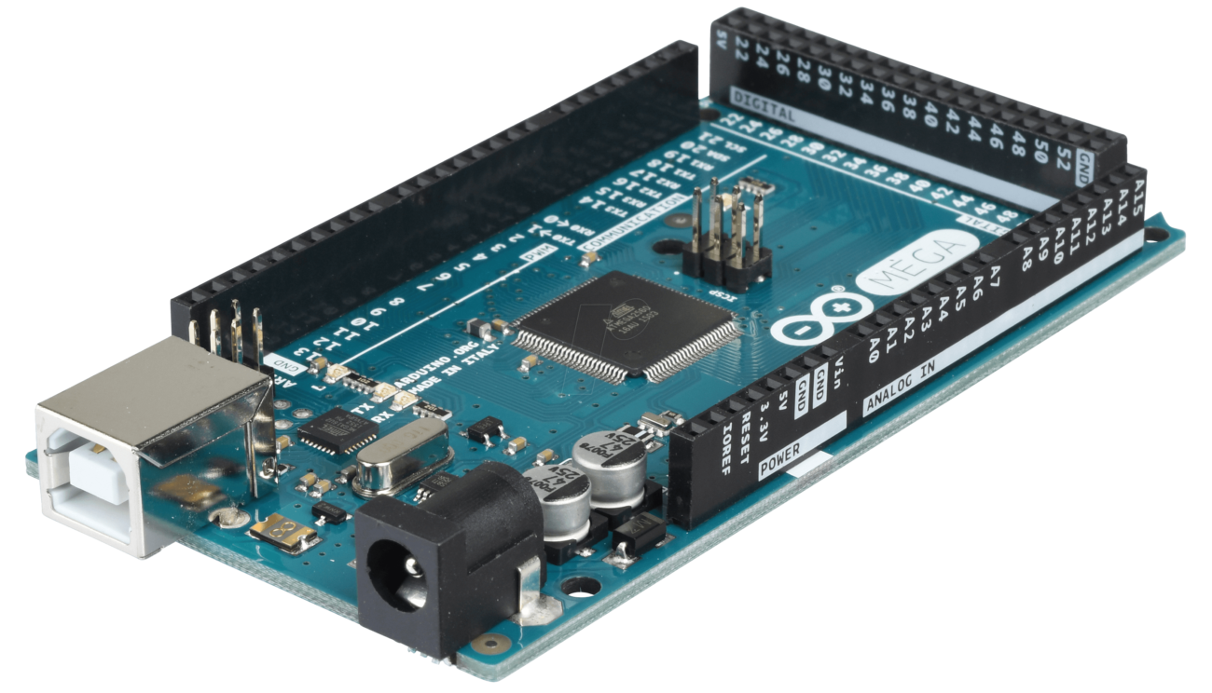
Arduino
Microcontroller board based on the ATmega 2560.
It has an USB connector, reset button and a power jack and supports 7 to 12V power supply.
It has 54 digital pins and 16 analog pin.

Slide 17
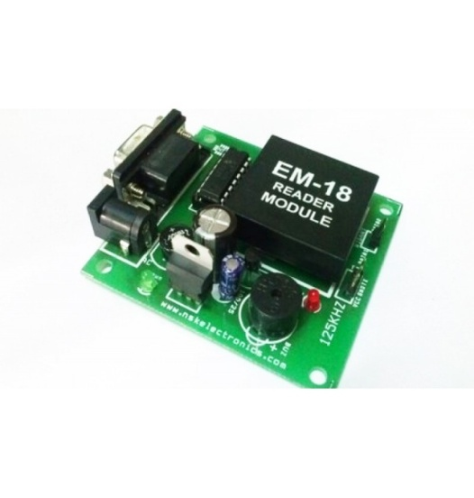
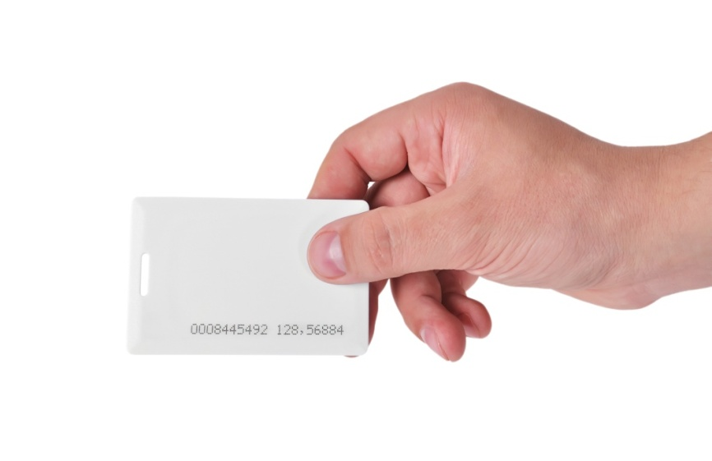
RFID tag and scanner
Radio-Frequency Identification (RFID) is the use of radio waves to read and capture information stored on a tag attached to an object. A tag can be read from up to several feet away and does not need to be within direct line-of-sight of the reader to be tracked.

Slide 18
MODULE-2
RFID reader with controller and input and output check.
The controller with bluetooth rover check.
The RFID tag with the option button checks.
POWER SUPPLY
CONTROLLER
BLUETOOTH MODULE
RFID READER
PUSH BUTTON
RFID TAG

Slide 19
Program to control shopping cart

Slide 20
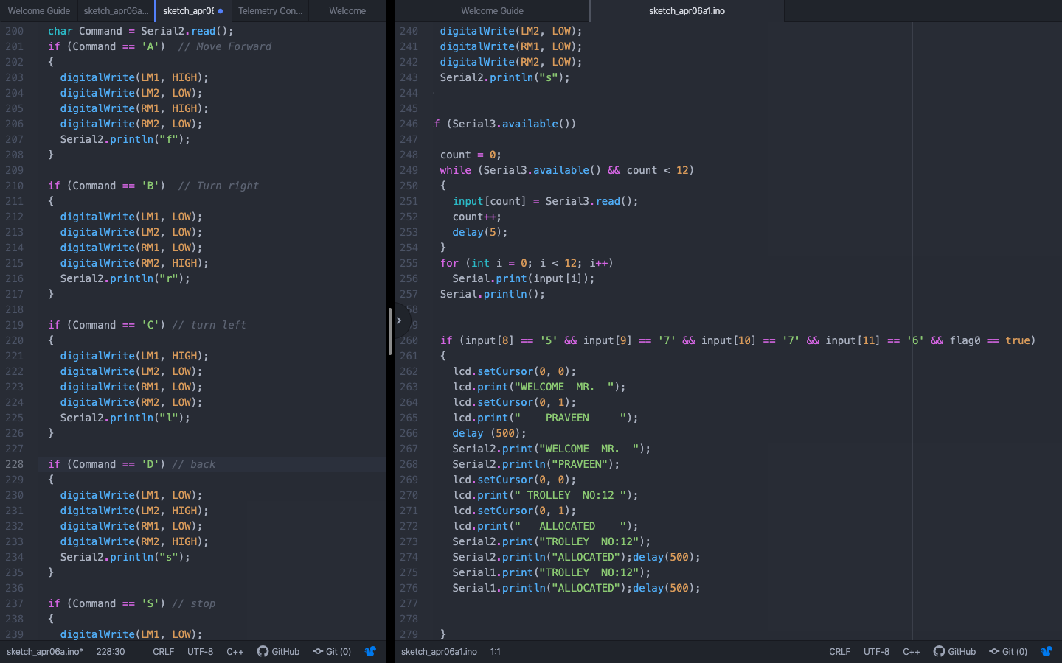

Slide 21
MODULE-3
The conditional statement with the RFID tag check.
The zigbee with the controller check.
POWER SUPPLY
CONTROLLER
BLUETOOTH MODULE
RFID READER
IoT Module
ZIGBEE TRANSCEIVER
RFID TAG
PUSH BUTTON

Slide 22
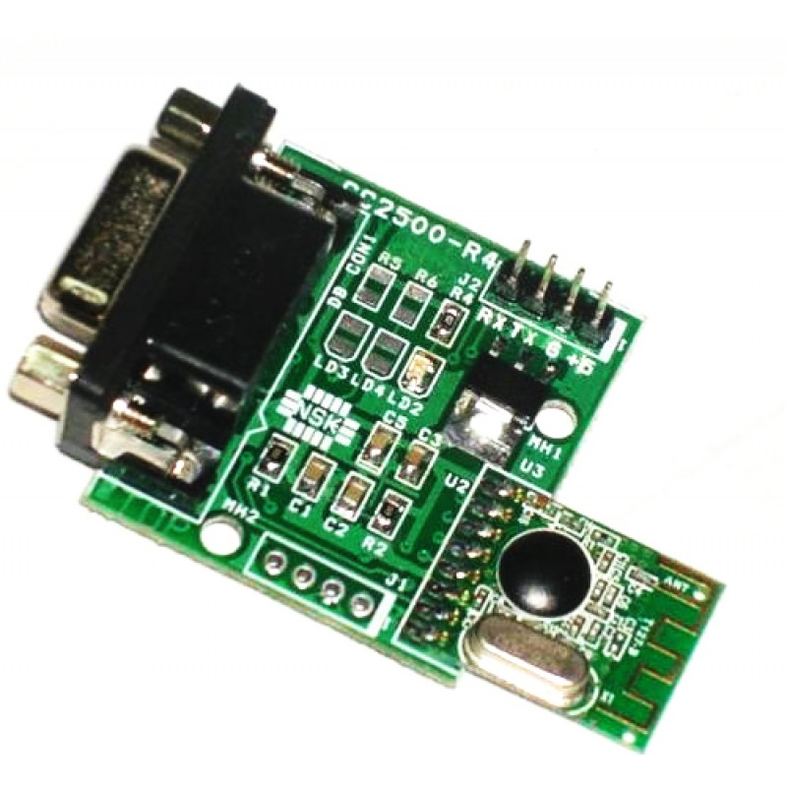
ZigBee
Zigbee communication is specially built for control and sensor networks on IEEE 802.15.4 standard for Wireless Personal Area Networks (WPANs), and it is the product from Zigbee alliance. This communication standard defines physical and Media Access Control (MAC) layers to handle many devices at low-data rates. These Zigbee’s WPANs operate at 868 MHz, 902-928MHz and 2.4 GHz frequencies. The date rate of 250 kbps is best suited for periodic as well as intermediate two way transmission of data between sensors and controllers.

Slide 23
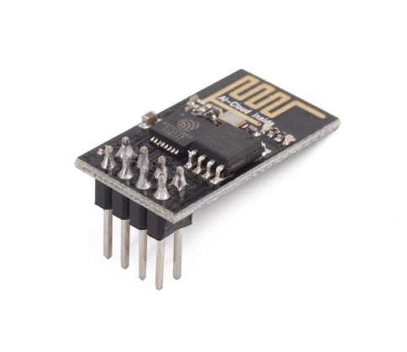
IoT module
ESP8266 is Wi-Fi enabled system on chip (SoC) module
Used for development of IoT (Internet of Things) embedded applications.
To communicate with the ESP8266 module, microcontroller needs to use set of AT commands using UART having specified Baud rate.

Slide 24
Algorithm
Check for the master card and display card information.
Allocate trolley number.
Initiate the Movement of the trolley by Bluetooth texts such as ’A’,’B,’C’,’D’,’S’.
Scan the items that are placed inside the trolley.
Choose the option to select or not select.
If yes, select the product.
If no, repeat the process.
Store the product’s name and price in Arduino.
Send the stored data through cloud every 3 seconds using ESP8266 to IoT dashboard.
Terminate the shopping process by using checkout option.
Transmit the details over receiver ZigBee module.
ID for the purchased items are removed from the database and those items are decremented from the stock.

Slide 25
Screenshots

Slide 26
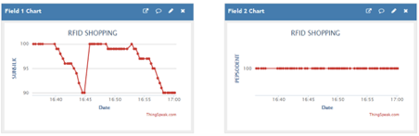
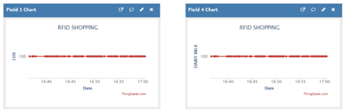
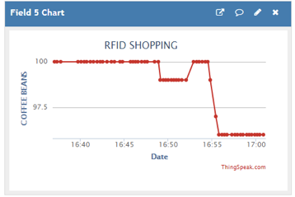
IoT dashboard

Slide 27
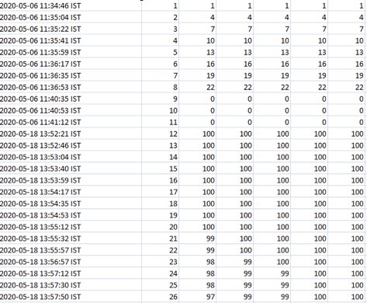
Cloud entries page
CLOUD STOCK UPDATE IN EXCEL FILE

Slide 28
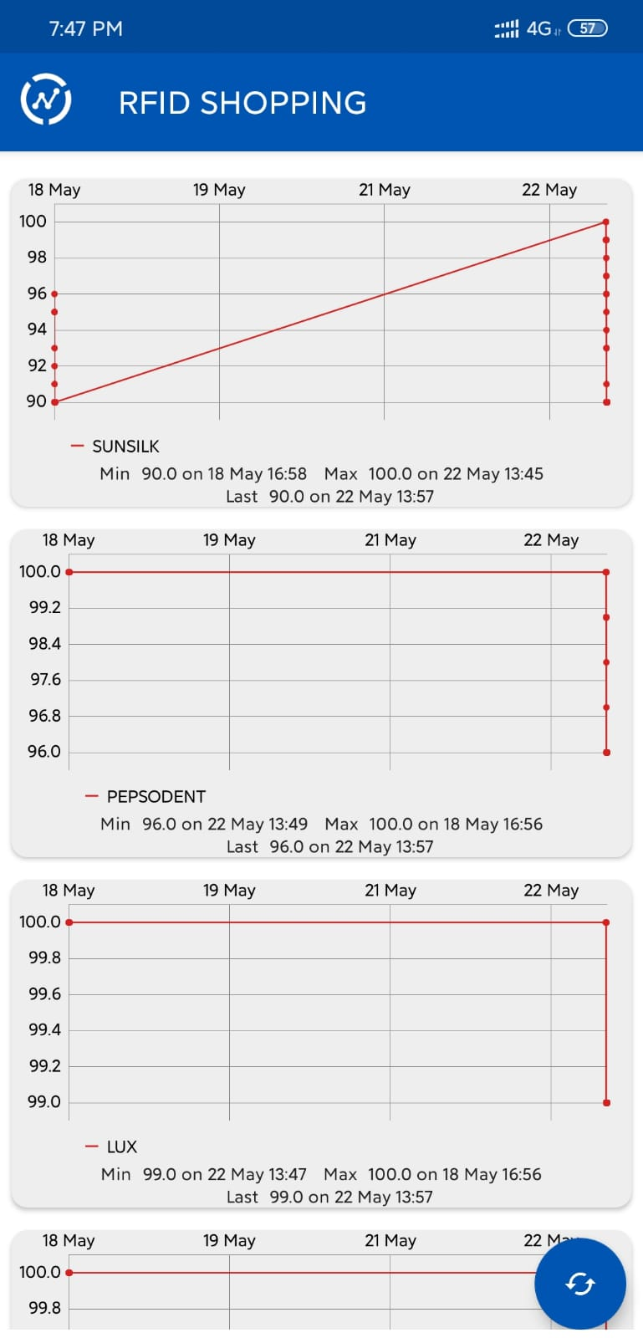
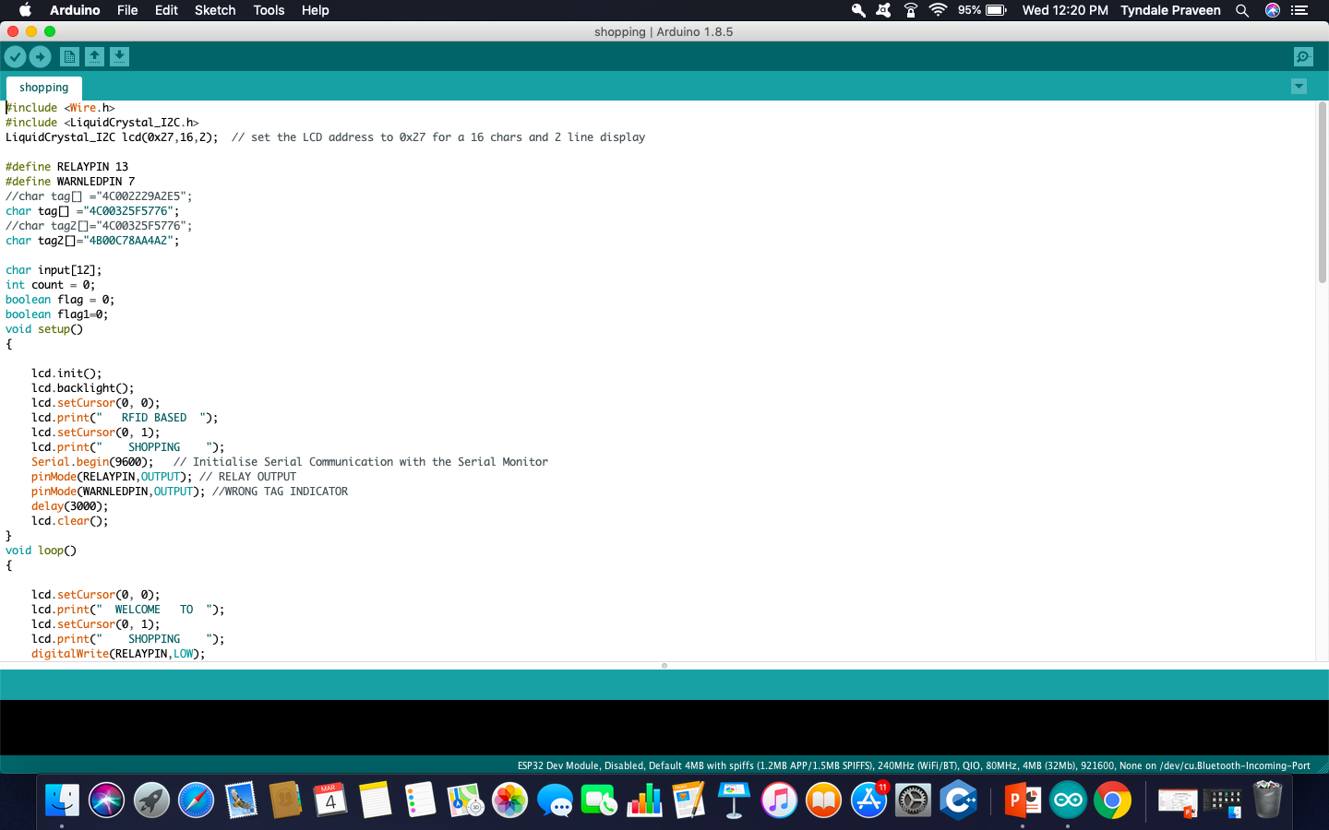
Mobile dashboard and Arduino IDE

Slide 29
Conclusion
IoT based Smart shopping trolley enables an automated central billing system in malls.
By using ZigBee , the product information are directly sent to billing system from the cart.
By using IoT module and Thingspeak the customer information , product information, trolley’s battery percentage can be viewed on the dashboard in the Standalone system . The product stock maintenance is done through cloud.
Customers need not to wait in a long queue in the billing counter. Thus, reducing customer’s time.

Slide 30
References
[1] Athauda, T., Marin, J. C. L., Lee, J., & Karmakar, N.” Robust low-cost
passive UHF RFID based smart shopping trolley ” (2018).
[2] Devipriya, D., Sri, V. S., & Mamatha, I. “Smart Store Assistor for Visually
Impaired ”(2018).
[3] Feng, J., Li, F., Xu, C., & Zhong, R. Y. IEEE Transactions on Systems, Man,
and Cybernetics: Systems, 1–8.” Data-Driven Analysis for RFID-Enabled
Smart Factory: A Case Study ” (2018).
[4] Jardine, N., Gericke, G. A., Kuriakose, R. R., & Vermaak, H. J.” Wireless
Smart Product Tracking using Radio Frequency Identification ” (2019).
[5] Liu, L., Zhou, B., Zou, Z., Yeh, S.-C., & Zheng, L. 2018 (CAMAD).” A
Smart Unstaffed Retail Shop Based on Artificial Intelligence and IoT ”
(2018).

Slide 31
Thank You

