Slide 1


P.E.S COLLEGE OF ENGINEERING, MANDYA (An Autonomous Institution Affiliated to VTU, Belagavi)
Mini-Project Presentation On
“E-Assistant Chatbot”
Presented by
Karthik Bharadwaj V
(4PS20MC017)
Theja G
(4PS20MC054)
Under the Guidance of Dr. M.N. Veena Professor
Department of MCA

Slide 2
Agenda
Introduction
Scope and Objective Of the project
Existing system
Proposed system
Advantages of Proposed system
System architecture diagram
System requirements
System design
System implementation
System testing
Conclusion
Future enhancement
References

Slide 3
Introduction
A chatbot also known as a talk bot, instant messaging bot, chatter bot, interactive agent, or an artificial conversational entity.
Chatbot is a computer program that helps you to communicate via messages.
They are formulated to mimic human behavior.
Virtual assistants are software programs that help you ease your day-to-day tasks and improves user productivity.
The proposed idea is to create a chatbot system using Artificial Intelligence methods that can perform system tasks upon voice commands as well as keyboard.
Most chatbots use natural language processing for interpreting the user input and generating the corresponding response but simple systems uses keywords.

Slide 4
Scope and Objectives of the Project
Scope of the project
E-Assistant chatbot is fully functioning, semi-autonomous system that can assist user service experiences and response time.
Objective of the project
Main objective of E-Assistant chatbot is using semantic data sources available on the web, user generated content and providing knowledge from knowledge databases.
The main purpose of an intelligent virtual assistant is to answer questions that users may have.

Slide 5
Existing System
In the existing System we must enter the search criteria manually and though there are many assistants you cannot modify according to your needs due to present commands given by the developers.
Disadvantages
Time consuming.
Manual process.

Slide 6
Proposed System
The proposed system provides an interface for login using face authentication.
The user can chat as if chatting with a human.
The device accepts voice input processes it to provide desired output to the user.
It became easier to send whatsapp messages, take screenshots, control volume settings, searching on Google without opening the browser, and performing many other daily tasks like playing music, opening your favorite IDE with the help of a single voice command.

Slide 7
Advantages of Proposed System
Chatbot can gather information efficiently and accurately.
Saves time, assigning repeated tasks to virtual voice assistants frees up the human time and resources. They also perform the tasks more efficiently than the humans
Chatbot has 24/7 Availability, this means that chatbot can answer user queries whenever user have queries.
These digital voice-enabled assistants also make the operations hands-free. You don’t need to touch any screen or type in anything.

Slide 8
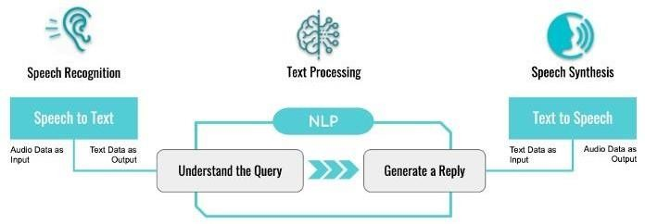
System Architecture diagram of the Proposed System
Figure 1 : System architecture diagram

Slide 9
Hardware Requirements
System Requirements
Processor | Intel core i5 8th Gen
Hard disk | 1 TB
RAM | 8 GB
Table 1: Hardware requirements
Software Requirements
Operating System | Windows 10 pro
IDE | PyCharm 3.2
Editor | Visual studio Code
Programming language | Python
Table 2: Software requirements

Slide 10
System Design
Use case diagram
A use case diagram is a graphical depiction of a user's possible interactions with a system.
The use cases are used during the analysis phase of a project to identify and partition system functionality.
They separate the system into actors and use case. Actors represent roles that are played by user of the system.
Those users can be humans, other computers, pieces of hardware, or even other software systems.

Slide 11
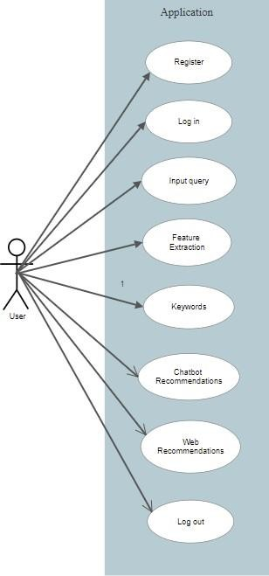
Continues…
Figure 2 : User use case Diagram

Slide 12
Sequence Diagram
A sequence diagram shows object interactions arranged in time sequence.
It depicts the objects involved in the scenario and the sequence of messages exchanged between the objects needed to carry out the functionality of the scenario.
Sequence diagrams are sometimes called event diagrams or event scenarios.
Used primarily to design, document and validate the architecture, interfaces and logic of the system by describing the sequence of actions that need to be performed to complete a task or scenario.

Slide 13
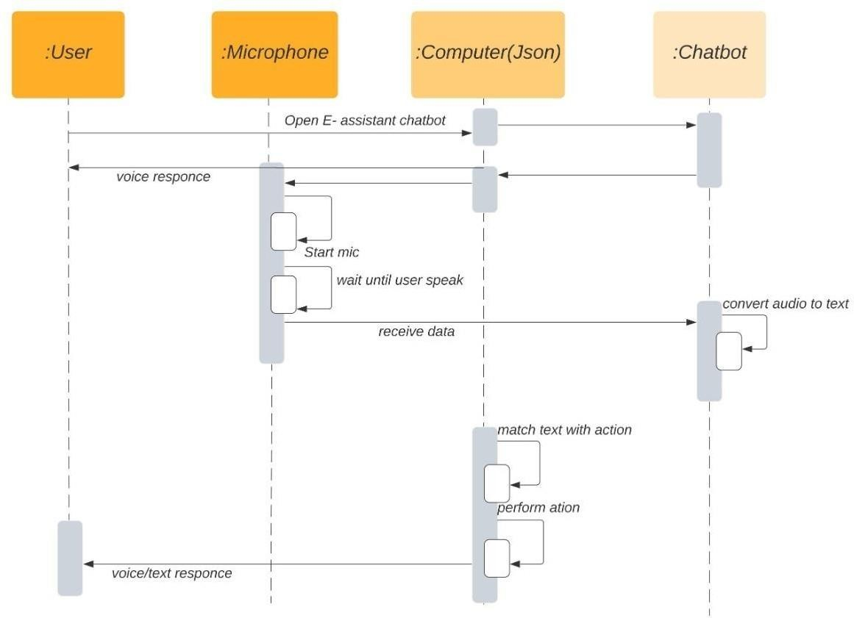
Figure 3 : User sequence diagram
Continues…

Slide 14
Activity Diagram
Activity diagrams are graphical representations of workflows of stepwise activities and actions with support for choice, iteration and concurrency.
It is a simple and intuitive illustration of what happens in a workflow, what activities can be done in parallel, and whether there are alternative paths through the workflow.

Slide 15
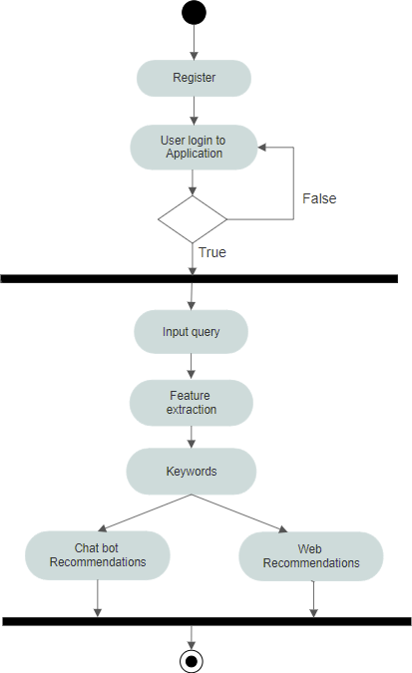
Figure 4 : User Activity Diagram
Continues…

Slide 16
Class Diagram
Class diagrams are the main building block in object-oriented modeling. They are used to show the different objects in a system, their attributes, their operations and the relationships among them.
The standard class diagram is composed of three sections.
Top section : contains the name of the class.
Middle section: contains the attributes of the class.
The bottom section shows the possible operations that are associated with the class.

Slide 17
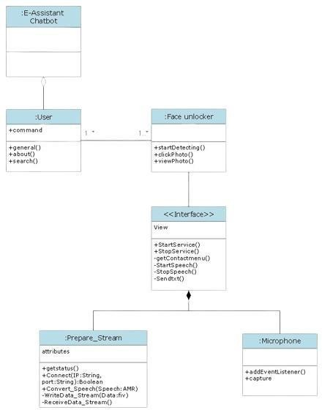
Figure 5 : User Class Diagram
Continues…

Slide 18
System Implementation
The term implementation has different meanings ranging from the conversation of a basic application to a complete replacement of a computer system.
Implementation includes all those activities that take place to convert from old systems to new the new system may be totally new replacing and existing manually or automated system or it may be major modification to an existing system .

Slide 19
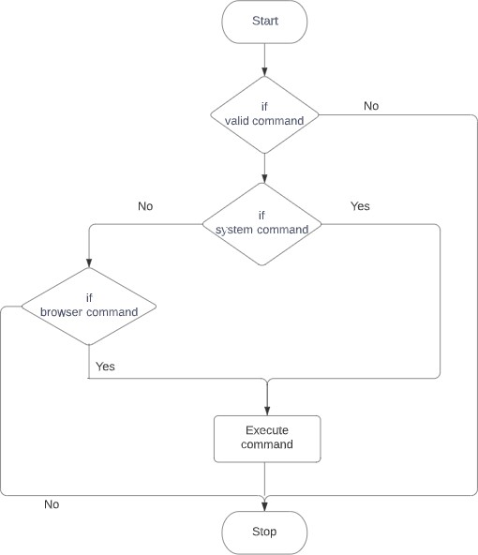
Continues…
Figure 6: Flowchart

Slide 20
System Testing
Unit Testing
Focuses verification on the smallest unit of module
Initially the module interface is tested, then the local data structure and boundary conditions are tested.
Integration Testing
Combined the each module and is tested.
System Testing
Here the entire system is tested
The goal is to see if system meets its requirements

Slide 21
Continues…
Test Case Number | Testing Scenario | Expected result | Result
 | Registration Testing
TC – 01 | Clicking Add face without entering details | Alert "Please fill all the details" | Pass
TC – 02 | Clicking Add face without entering name | Alert " Please fill the details " | Pass
TC – 03 | Clicking Add face without entering gender | Alert " Please fill the details " | Pass
TC – 04 | Clicking Add face without checking I agree to use my face for security | Alert "Check the condition" | Pass
TC – 05 | Clicking Submit without choosing your avatar | Alert "Choose your avatar" | Pass
Table 3: Unit Test cases

Slide 22
Continues…
Test Case Number | Testing Scenario | Expected result | Result
 | Login Testing
TC – 06 | Attempt to login without registered face | Alert "Face not found" | Pass
TC – 07 | Attempt to login without connected to network | Alert "Your system is offline" | Pass
TC – 08 | Attempt to send whatsapp message without entering valid phone number | Alert "Phone number is invalid" | Pass
TC – 09 | Attempt to control volume by using keyboard | Alert "Volume settings changed" | Pass
TC – 10 | Attempt to capture screenshot by using keyboard | Alert "Screenshot taken" | Pass

Slide 23
Continues...
Test Case Number | Testing Scenario | Expected result | Result
TC – 11 | Input query to set timer | Alert "Alarm rings to set time" | Pass
TC – 12 | Clicking clear facial data | Alert "Your face has been cleared" | Pass
TC – 13 | Closing the application using shutdown command | Alert "Shutting down the system" | Pass
Table 4 : Integration Test Cases

Slide 24
Continues...
Test Case Number | Testing Scenario | Expected result | Result
TC-01 | Registered user must only login to the application | System should permit the authorized user to access all the services | Pass
TC-02 | Chatbot response and operations to the user query | System should perform and show operations to the user based on query | Pass
Table 5 : System Test Cases

Slide 25
Conclusion
By reviewing the literature we come to know that this system is giving the accurate result. E-Assistant chatbot can be used to not only to chat and get information but it makes our services faster as a personal assistant.
The proposed system lets the user to login securely using face authentication to access all the services. E-Assistant chatbot is used to instantly take screenshots, control volume levels, adding items to list for reminders, language translations, opening desired applications and much more based on query being asked by the user.

Slide 26
Future Enhancement
The E-Assistant chatbot can accommodate any updates in future as the modular approach used in E-Assistant chatbot makes it more flexible and easier to integrate additional modules and features without disturbing the current system functionaries.
The E-Assistant chatbot will easily able to integrate with devices in future for a connected home using Internet of Things.
Also making chat bots to learn more on its own and develop a new skill in it upon voice command system and computer vision.
Chat bot android app can also be developed for making more chat bot voice terminals.

Slide 27
References
[1] Sharma, Rakesh Kumar, and Manoj Joshi. “An Analytical Study and Review of open Source Chatbot framework, RASA.” International Journal of Engineering Research and, vol.9, no.06 (2020).
[2] Thosani, Parth, et al. “A Self Learning Chat-Bot from User Interactions and Preferences.” 2020 4th International Conference on Intelligent Computing and Control Systems (ICICCS). IEEE, pp. 224-229, 2020.
[3] Carlene Lebeuf, Margaret-Anne Storey, and Alexey Zagalsky, “Software Bots” in IEEE Software, www.computer.org/software.
[4] “How Do Chatbots Work? A Guide to the Chatbot Architecture”, https://www.marutitech.com/chatbotswork-guide-chatbot-architecture/.
[5] Gk, “Soul of the Machine : How chatbots work.”
https://medium.com/@gk_/how-chat-bots-workdfff656a35e2.

Slide 28
THANK YOU

