Slide 1
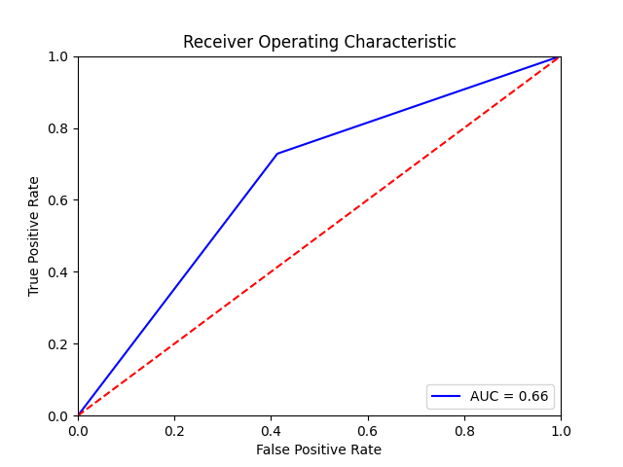
Example prediction made by SUMO-NN
Extract 15mers centered on lysines
NSYAGQLKSARFEEA
>sp|Q9C091|GRB1L_HUMAN GREB1-like protein
MGNSYAGQLKSARFEEALHNSIEASLRCSSVVPRPIFSQLYLDPDQHPFSSADVKPKVED
……
DLKKFKFLKGATLCVICQDRSSLRQTIVRLELEDEWQFRLRDEFQTANSSDDKPLYFLTG
RHV
PFSSADVKPKVEDLD
…..
LKKFKFLKGATLCVI
TANSSDDKPLYFLTG
Positive predictions
TEKLAGVKQEVIKES
QHIEATPKIVHYAIL
SUMO-NN architecture
Embedding
LSTM
Linear
Negative predictions
NSYAGQLKSARFEEA
…..
TANSSDDKPLYFLTG

