Slide 1
Training on Git & GitHub

Slide 2
Agenda
Introduction of git and GitHub
States of git.
Initial git configuration.
Create a git repository.
Add and commit a file.
Branching and merging
Working with repository.
Git command.
Demonstration.

Slide 3
Introduction of git and github
Git is a distributed version-control system for tracking changes in source code during software development. It allow us to:
Revert or whole files project to earlier state.
Compare change over time.
See who modified what?
Control modification by collaborators with permissions of admin/owner.
GitHub is a Repository hosting service for Git. GitHub provides a web based graphical interface that works on top of Git. It provides many features like control collaborator access, create repository, branch, issue and pull request etc.
Link for download Git command line tool : “https://git-scm.com/downloads”.
Link for create login user account on git hub “https://github.com/”.

Slide 4
States of git
Git has three main states that your files can reside in: modified, staged, and committed.
Modified means that you have changed the file but have not committed it.
Staged means that you have marked a modified file in its current version to go into your next commit snapshot.
Committed means that the data is safely stored in your local database

Slide 5
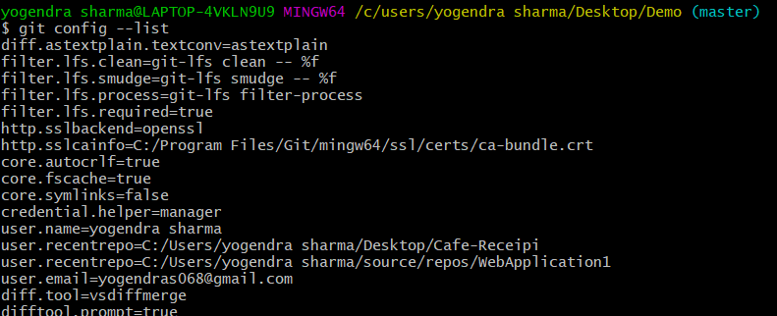
Initial Git Configuration
Set the name and email for Git to use when you commit: –
git config --global user.name "Bugs Bunny"
git config --global user.email bugs@gmail.com
You can call git config --list to verify these are set.

Slide 6
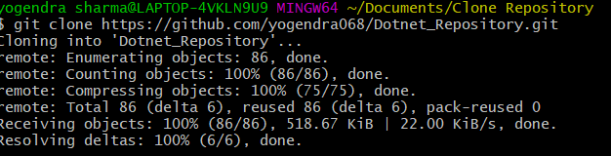
Create a git repository
There is two way to create local repository:
git init: Initialize an existing directory as a Git repository. This will create a git directory in your current working directory.
git clone [url]: Retrieve an entire repository from a hosted location via URL.

Slide 7
Add and commit a file
Before commit any file we need to stage it.
git add .: Mark all files of working directory to staging state. Which are ready to commit in next snapshot.
git add <filename>: Mark specify file name to staging state.
git commit -m “user message with commit”: This command use to commit all file to local git repository.
To undo changes on a file before you have stage it:
git restore filename (discard change to the file).
git checkout <commit Id> (move back and forth of commit)
All these commands are acting on your local version of repository.

Slide 8
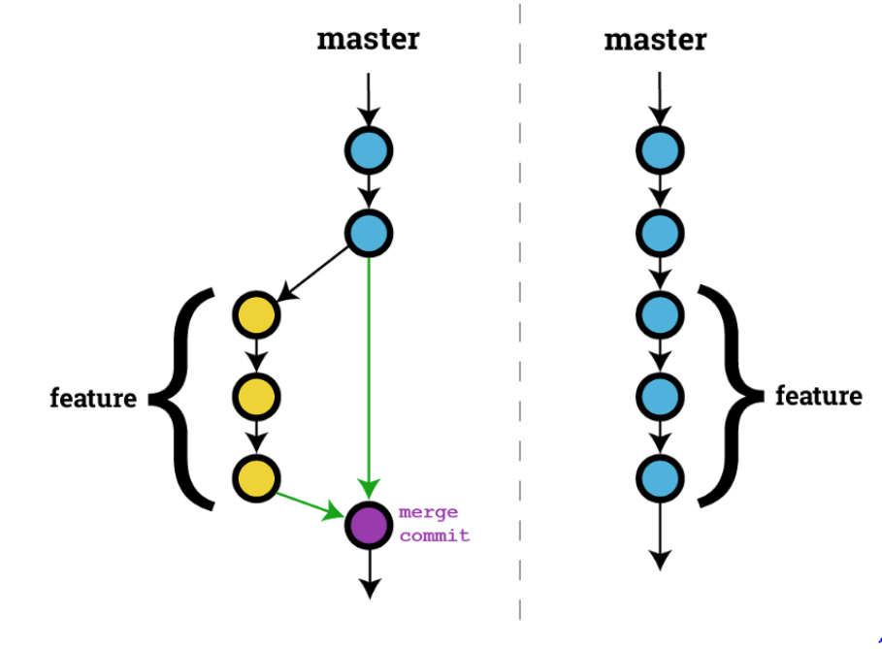
Branching and merging
Git allow us to create/manage number of branch. Git provide default master branch when we create .git repository. To create branch perfrom git branch <branchname>, git checkout <branchname>, To merge perform git checkout master git merge <branchname>.

Slide 9
Git Command.
git status Show modified files in working directory, staged for your next commit.
git reset [file] Unstage a file while retaining the changes in working directory.
git remote add Origin https://github.com/yourusername/your-repo-name.git
git push [alias] [branch] Transmit local branch commits to the remote repository branch.
git pull [alias] [branch] Fatch latest changes from remote branch to the local repository branch.
git diff Diff of what is changed but not staged.
git diff --staged Diff of what is staged but not yet committed.
git log To view all commits to that branch.
git ls-files To list down all file name under our local repository.

Slide 10
Demonstration

