Slide 1

NAGARNETRA
AI-Powered Civic Sanitation Intelligence & Municipal Dispatch Platform
Unified operational workflow connecting WhatsApp citizen intake, Haversine 50m spatial clustering, real-time Leaflet GIS command center, and Gemini 3.6 Flash / Gemma AI intelligence.
51
Active Hotspots
Geospatially clustered dump points mapped across Lucknow
526
Total Reports Logged
Inbound citizen complaints ingested via WhatsApp webhook
57%
AI Match & Merge Rate
Duplicate submissions grouped into unified SWC-XXXX tickets

Slide 2
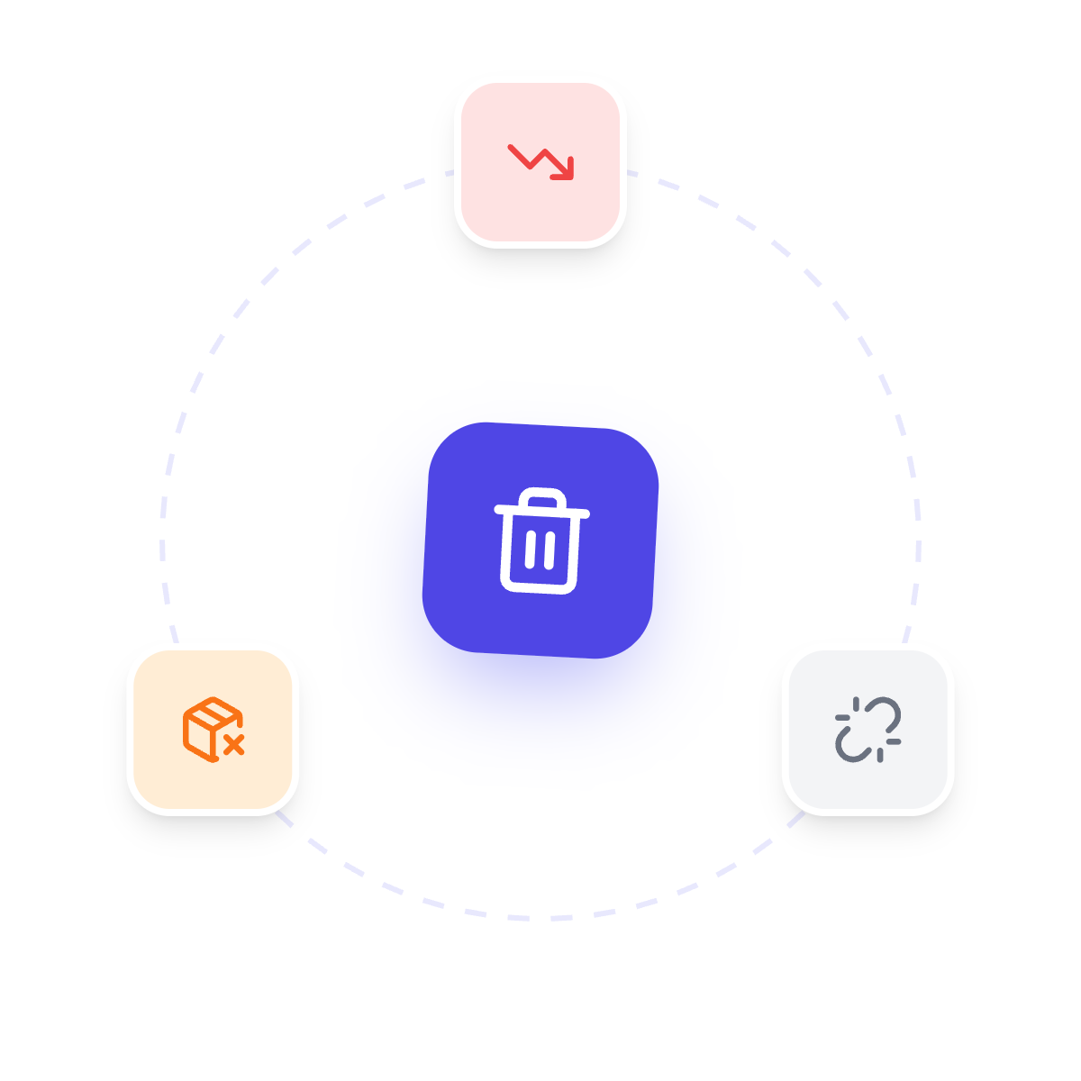
01 / PROBLEM & SOLUTION
Waste Reports Need One Central Operating System
NagarNetra turns fragmented WhatsApp complaints into structured, actionable municipal cleanup workflows.
1. Zero-Friction Intake
Citizens report garbage dump sites instantly via WhatsApp with photo and live GPS location—no new app download required.
2. 50m Haversine Clustering
Intelligent spatial engine groups repeat nearby reports into unified SWC-XXXX tickets with SHA-256 image deduplication.
3. Real-Time Command Dashboard
Municipal supervisors get a live GIS map with H3 hexagon analytics, severity filters, and squad dispatch controls.

Slide 3
02 / TARGET STAKEHOLDERS
Three User Groups Sharing One Real-Time Source of Truth
The platform connects citizens reporting waste, supervisors prioritizing it, and field teams resolving it.
01
Citizens
WhatsApp Interface
Report dump points in < 15 seconds, receive status tracking updates, and provide post-cleanup feedback ratings.
02
Municipal Supervisors
Admin Command Center
Inspect recurring dump sites, track resolution SLAs, view H3 hexagon severity density, and trigger AI analysis.
03
Cleanup Squads
Field Operations
Receive zone-based cleanup tasks, navigate to exact GPS coordinates, and resolve tickets with proof-of-work.

Slide 4
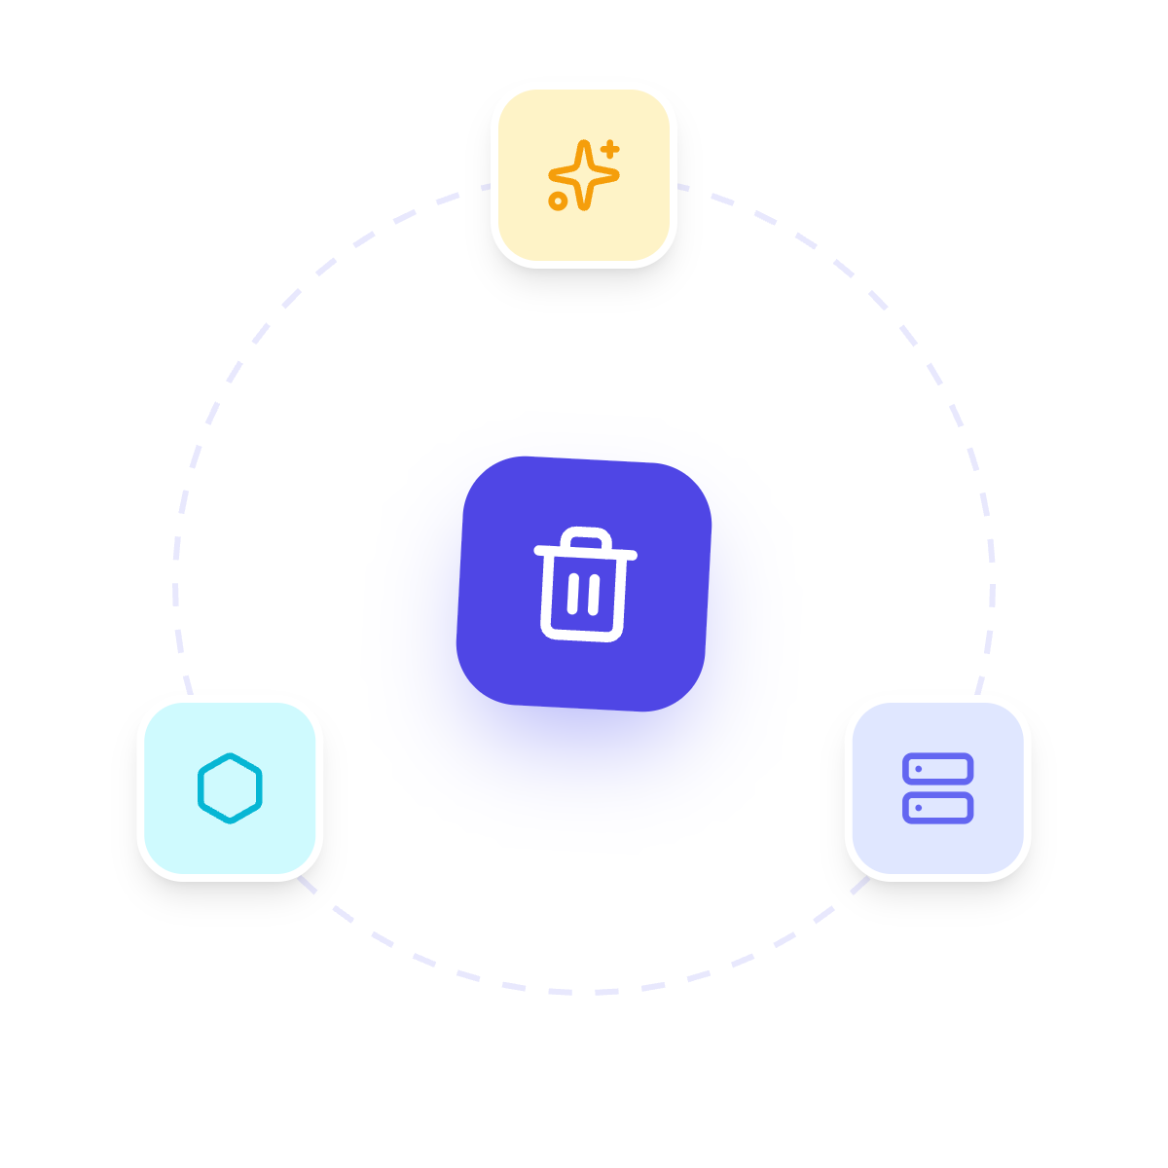
03 / TECH STACK & CLOUD INFRASTRUCTURE
Production Express Server & Gemini AI Engine
Decoupled Node.js architecture deployed on Render with real-time Firebase Firestore database.
Layer | Technology | Role & Description
Frontend Web App | React + Vite, Tailwind, Leaflet, Uber H3 | Interactive GIS map, analytics dashboard, and citizen RAG chat.
Backend Services | Render Express Server, Node.js | Webhook processing, state machine, Haversine clustering, REST APIs.
Database & Auth | Firebase Firestore (Cloud), Admin SDK | Real-time sync, transaction counters, rules-secured data store.
AI & WhatsApp | Gemini 3.6 Flash / Gemma, Twilio Webhook | Automated waste detection, RAG city assistant, multi-lingual WhatsApp.

Slide 5
04 / IMPLEMENTATION & SCALING
Phased Rollout Strategy Across Municipalities
Standardized geospatial zoning allows NagarNetra to expand seamlessly from pilots to city-wide operations.
Phase 1: Intake & Deduplication
WhatsApp webhook, photo/GPS ingestion, SHA-256 hashing, and automated complaint logging.
Phase 2: Spatial Clustering
50m Haversine distance grouping, SWC-XXXX ticket creation, and ward-level boundary mapping.
Phase 3: Render Cloud Migration
Express server deployment on Render, Firebase Admin SDK integration, and startup secret validation.
Phase 4: Multi-City Replication
H3 hexagonal grid zoning, standardized SLA dashboards, and automated citizen survey loops.

