Slide 1
Software as
a Service
Yogendra Bahadur Shrestha
LFA/PHP & JS

Slide 2
What is SaaS ?
“ Software as a Service “
Software licensing and delivery model
Subscription basis
On demand software
Accessed via web-browser
Multi-tenant architecture
Potential to reduce IT support costs - outsourcing
“ Pay by the drink “
Notes:
Application Service Providers

Slide 3
SaaS Variations
Largest market - CRM
Others -
payroll processing
finance and accounting
HRM
ERP
Content Management
Many more

Slide 4
SaaS Sales
In 2010 - $10 billion
In 2011 - $12.2 billion
In 2015 - $21.3 billion
Notes:
up by 20.7 % - projected in 2015

Slide 5
Characteristics
Configuration and Customization
Accelerated Feature Delivery
Open Integration Protocols
Collaborative Functionality
Notes:
1 - Look, feel, pagelayouts, add options and features
2 - hosted centrally, single configuration/faster testing, web analytical tools, agile development methods
3 - offers integration protocols and APIs, based on HTTP, REST, SOAP - MASHUPS
4 - inspired by social media - share informations

Slide 6
Adoption Drivers
Web-based user interface
Standardization of web technologies and frameworks
Increasing internet access
Notes:
1 - the growing use of web-based user interface by applications
2 - web page technologies (HTML, JavaScript, CSS), - web application frameworks like Ruby on Rails or Laravel (PHP)

Slide 7
Adoption Challenges
Data security and issues
Latency
Adaptation to new versions
Vendor going out of business

Slide 8
Freemium & Premium
Use this for free - here you go
Like it ? We also offer this feature? Want to use it?
Well, it will cost you “ $ “ monthly, and added $ for this feature

Slide 9
Emerging Trends
Third Wave Software Adaptation
SaaS Integration Platform (SIP)
Vendors - Zoho, Sutisoft, Microsoft, Oracle
Clients - Yamaha, CEAT, Hyatt, Mahindra Finance, Cipla
Engineering Applications
Healthcare Applications
Notes:
1 - SIPs allow subscribers to access multiple SaaS applications through a common platform
Engineering - startups and reduced initial costs
Health - Affordable Care ACT 2010, - change in payment structure and increased accountability - using SAAS 67%

Slide 10





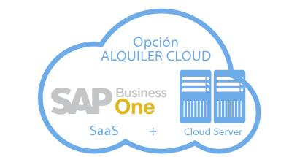
Top Vendors

Slide 11




Open Source SaaS
OpenShift
Hadoop
Riak
Magento
Notes:
OpenShift - PaaS - Platform
Hadoop - Big Data Tool
Riak - Database
Magento - Ecommerce

Slide 12
Video about SaaS

Slide 13
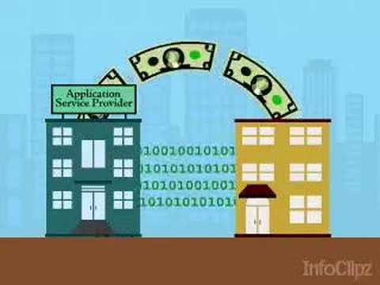

Slide 14
THANK YOU

