Slide 1

Intelligent Database Query Assistant: A
Conversational AI for SQL Queries
Team_No: 13
Sl. No. | Reg. No. | Name of the student
1 | BL.EN.U4CSE22210 | B.V.Dinesh Krishna
2 | BL.EN.U4CSE22246 | P.Yogendrasai
3 | BL.EN.U4CSE22251 | S.Rajeev

Slide 2
Introduction
The Intelligent Database Query Assistant is an innovative conversational AI system designed to bridge the gap between non-technical users and relational databases by enabling natural language interactions. Leveraging advanced technologies like LangChain and OpenAI's language models, the system translates user queries into precise SQL commands, eliminating the need for specialized database knowledge. This solution empowers professionals across industries—such as business analysts, healthcare workers, and government officials—to access critical data effortlessly, enhancing decision-making and operational efficiency.
Traditional database interfaces often pose significant barriers for users unfamiliar with SQL, creating reliance on IT departments and delaying time-sensitive insights. The proposed system addresses these challenges by offering an intuitive, secure, and scalable platform that not only generates accurate SQL queries but also provides results in natural language. With features like real-time feedback, query transparency, and session management, the assistant ensures accessibility while fostering user confidence and learning. This project represents a significant step toward democratizing data access through AI-driven conversational interfaces.

Slide 3
Literature Survey
Sl.No. | AUTHORS | PAPER | INFERENCE
1 | V. Murali, R. J. Sarma, P. A. Sukanya and P. Athri | ChEMBL Bot - A Chat Bot for ChEMBL database | This study presents ChEMBL Bot, a chatbot designed for querying the ChEMBL database using natural language. It explores the integration of NLU (Natural Language Understanding) techniques with structured database querying, highlighting challenges in mapping unstructured inputs to SQL queries. The research emphasizes the importance of domain-specific knowledge for improving chatbot accuracy in database interactions.
2 | T. Simud, S. Ruengittinun, N. Surasvadi, N. Sanglerdsinlapachai and A. Plangprasopchok | A Conversational Agent for Database Query: A Use Case for Thai People Map and Analytics Platform | This paper introduces a conversational agent tailored for querying the Thai People Map and Analytics Platform. The study discusses challenges in handling complex Thai language structures and converting user intent into structured SQL queries. The authors propose a framework for enhancing query generation through entity recognition and intent detection, making database interaction more user-friendly.
3 | S. Hari Krishnan Parthasarathi, L. Zeng and D. Hakkani-Tür | Conversational Text-to-SQL: An Odyssey into State-of-the-Art and Challenges Ahead | This research provides an extensive survey of state-of-the-art Text-to-SQL models, highlighting advancements in deep learning and NLP for automatic SQL generation. The study identifies key challenges such as handling ambiguous queries, multi-turn conversations, and contextual dependencies. The authors propose future directions for improving SQL parsing efficiency and enhancing model interpretability.

Slide 4
Literature Survey
Sl.No. | AUTHORS | PAPER | INFERENCE
4 | R. Alonso, D. Dessí, A. Meloni and D. Reforgiato Recupero | A Novel Knowledge Plug-In for Incorporating Information About Employability From the O*NET Database Into Conversational Agents | The paper introduces a novel knowledge plug-in that integrates employment-related information from the O*NET database into conversational agents. It discusses how knowledge graphs can enhance chatbot-based data retrieval, making queries more context-aware and relevant. The findings suggest that enriching conversational agents with external knowledge significantly improves database query responses.
5 | M. Owda, Z. Bandar and K. Crockett | Conversation-Based Natural Language Interface to Relational Databases | This early work explores the architecture of a conversation-driven natural language interface for relational databases. The authors present a rule-based approach to mapping user inputs to SQL queries, identifying key challenges such as synonym handling, query reformulation, and ambiguity resolution. The study emphasizes the importance of iterative dialogue refinement in improving query accuracy.
6 | Galitsky, B., & Galitsky, B | Developing Conversational Natural Language Interface to a Database | This book chapter discusses linguistic structures and dialogue management in conversational interfaces for databases. The authors highlight pattern-based matching and machine learning techniques to improve SQL query generation. They argue that incorporating contextual learning allows chatbots to understand complex user queries more accurately.

Slide 5
Research Gaps
This project addresses key research gaps identified in existing conversational database interfaces. First, prior systems like ChEMBL Bot [1] and Thai People Map [2] were limited to single-domain queries and struggled with complex multi-table joins, while our solution leverages schema-aware LLMs to handle sophisticated cross-table queries. Second, earlier approaches by Owda et al. [5] and Galitsky [6] lacked query transparency and user feedback mechanisms, which we resolve through explainable AI features that display generated SQL and enable interactive refinement. Additionally, while works like Kumar et al. [11] and Reshmi et al. [12] focused on accuracy, they overlooked enterprise scalability and security - gaps our system closes through LangChain integration and robust error handling for production environments.
The project also advances beyond domain-specific solutions like ChatbotSQL [8] by offering cross-industry applicability, and improves upon static educational tools by incorporating real-time learning through conversational feedback. Unlike ontology-based systems [15] or benchmarks like CoSQL [16], our approach combines the flexibility of OpenAI models with structured database context to balance generalization with precision. Finally, we address deployment challenges noted by Colas et al. [13] through a portable web architecture that maintains performance under concurrent enterprise workloads, filling a critical gap between research prototypes and practical implementation.

Slide 6
Problem Statement
Non-technical users face significant barriers in accessing relational databases due to the complexity of SQL, creating reliance on IT teams and delaying data-driven decisions. Existing natural language interfaces often fail to handle complex queries, lack transparency in query translation, and struggle with scalability and security. This project develops an intelligent conversational AI system using LangChain and OpenAI to enable accurate, user-friendly natural language to SQL conversion while ensuring explainability, security, and enterprise-ready performance for diverse domains.

Slide 7
Methodology
Agile Methodology:
The development followed the Agile software development lifecycle, using iterative sprints and continuous feedback loops. This allowed the team to adapt to evolving user needs, fix issues quickly, and ensure the product remained aligned with its goals.
Followed 4-week sprint cycles
Emphasized incremental development
Regular team stand-ups and reviews
Integrated feedback from test runs and demos into each sprint

Slide 8
Methodology
User Stories:
User stories were designed to represent real-world scenarios that the application should support. These stories helped the team prioritize features and design a system centered around user needs.
As a business analyst, I want to ask questions in English to fetch sales data.
As an HR manager, I want to retrieve employee records using simple queries.
As a healthcare worker, I want to fetch patient reports using natural language.
As a public official, I want to analyze city data without using SQL.

Slide 9
Methodology
System Requirements:
Functional Requirements:
Define what the system should do, covering its features and capabilities.
Accept natural language queries through a web interface
Convert queries to SQL using LangChain + OpenAI
Execute SQL queries and fetch results from MySQL
Display results and optional SQL syntax
Store user query history for reusability
Prompt user for clarification in case of errors

Slide 10
Methodology
System Requirements:
Non-Functional Requirements:
Define how the system should perform.
Usability: Simple and intuitive UI for non-technical users
Performance: Respond within 3 seconds under normal load
Reliability: Stable database connections and robust error handling
Security: Protection against SQL injection
Scalability: Handle multiple concurrent users
Portability: Web-based, platform-independent

Slide 11
Methodology
System Architecture:
The architecture includes four main components integrated into a seamless conversational workflow.
User Input → Natural language query
SQL Chain → Uses LLM and schema to generate SQL
Execution Engine → Runs SQL against MySQL DB
Result Processor → Converts result to natural language
Optional SQL transparency and chat history layers enhance usability.

Slide 12
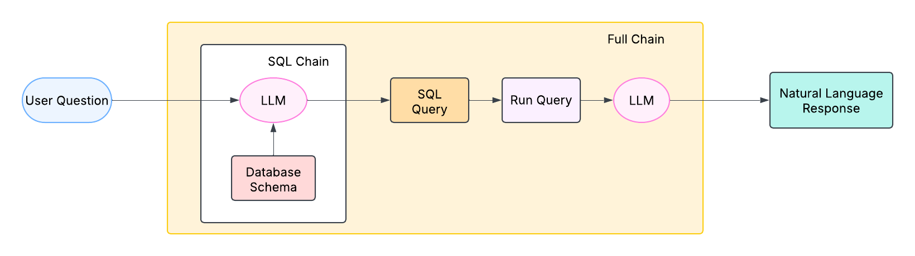
Methodology
System Architecture Diagram:

Slide 13
Methodology
Testing ensured the assistant’s reliability and correctness through systematic validation.
Unit tests for each module (query conversion, execution, formatting)
Manual testing via MySQL Workbench for backend SQL verification
Cross-verification between AI response and actual DB output
Clarification handling tested with ambiguous or incomplete inputs

Slide 14
Results
The system was tested end-to-end through a live web interface with MySQL connectivity and AI integration.
Accurate SQL generation from natural queries
Clear response display and optional query preview
UI supported real-time query validation and feedback
Assistant matched SQL results verified via MySQL Workbench

Slide 15
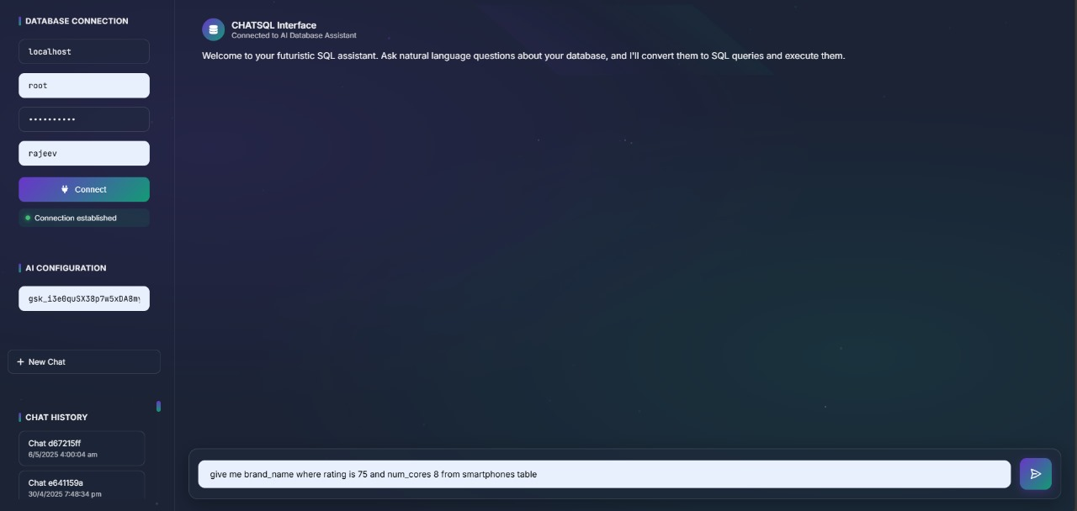
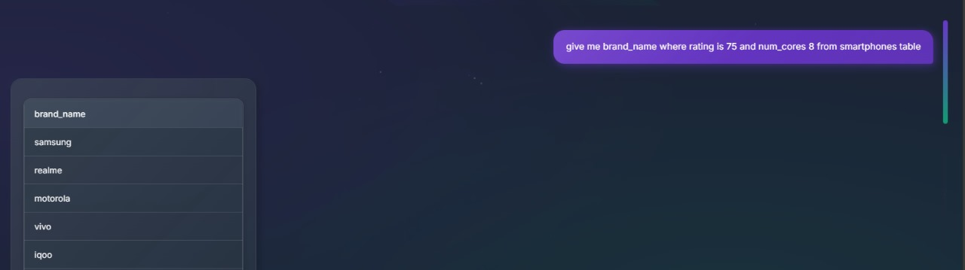
Results
Demo:
Results show matching smartphone brands based on user input.
Main interface for database connection and AI assistant access.
Text input box for entering natural language queries.

Slide 16
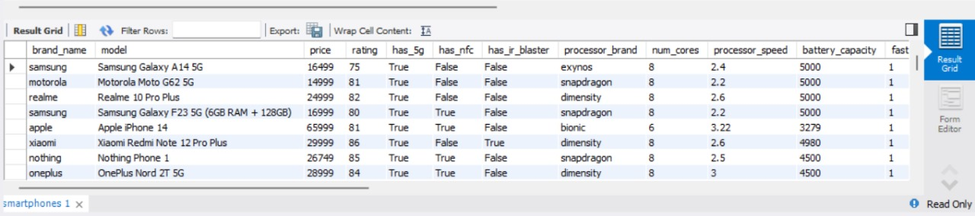
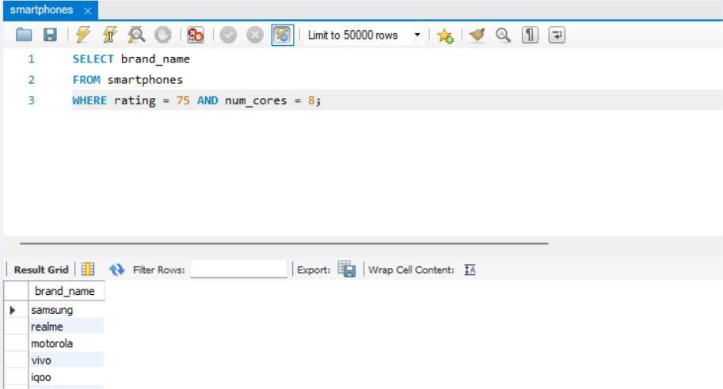
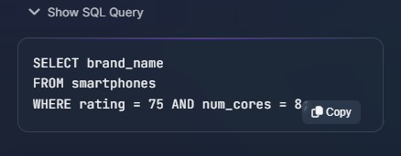
Results
Demo:
SQL query shown for clarity and learning.
Query verification in MySQL Workbench.

Slide 17
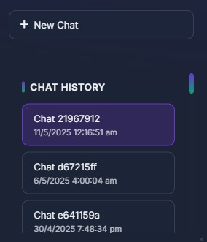
Results
Demo:
Chat history panel for quick access and reuse of past queries.

Slide 18
Results
Sprints:
The development was broken into focused sprints with clear deliverables and sprint reviews.
Sprint 1: Database connection + query interface
Sprint 2: LangChain integration + schema awareness
Sprint 3: Output formatting + error handling
Sprint 4: SQL transparency + testing + final polishing
Each sprint ended with demos, retrospectives, and backlog updates.

Slide 19
Results
Bug Report:
Bug ID | Description | Steps to Reproduce | Expected Behavior | Actual Behavior | Severity
BUG-001 | No error message shown when incorrect DB credentials are entered | 1. Launch the application 2. Enter incorrect database host, username, or password 3. Click on "Connect" | A clear error message should be displayed (e.g., "Incorrect credentials" or "Connection failed") | No feedback or error message is shown; the connection silently fails | High
BUG-002 | Inconsistent loading of chat history | 1. Open the application 2. Submit multiple queries 3. Reopen the session or navigate to chat history 4. Try to view previous chats | All previous chats should load completely and display the full conversation history | Some chats fail to load or display incomplete data; history appears blank or partially loaded | Medium

Slide 20
Results
Definition of Done:
The following criteria were used to validate task completion before release.
[✔] User Frindly UI
[✔] Query accepted and translated correctly
[✔] SQL executed and response displayed
[✔] Option to view SQL query works
[✔] Errors handled with proper user prompts
[✔] Backend validation confirmed result accuracy
[✔] Chat history stored and reusable

Slide 21
Conclusion:
The Intelligent Database Query Assistant successfully enables non-technical users to interact with relational databases through natural language. By combining LangChain, OpenAI models, and SQL execution logic, it offers an intuitive and transparent querying system. The application addresses accessibility, correctness, and usability in real-world data environments.
Future Scope:
Add multi-turn conversation memory for follow-up queries
Support voice-based interaction and speech-to-text
Extend compatibility to PostgreSQL, SQL Server, and NoSQL
Integrate data visualization like charts and graphs
Build role-based access control for enterprise-grade security
Add auto-learning from past queries for personalization

Slide 22
THANK YOU

