Slide 1



PREDICTORS OF ACADEMIC EXCELLENCE
A Statistical Analysis of California Elementary Schools using R & JASP
PRESENTED BY:
Yogen Rathod

Slide 2


Executive Summary & Objectives
Project Objective
To identify the key socioeconomic and institutional drivers of academic performance (API Scores) across 400 California schools.
DATA SET : elemapi2
Primary Tools
R Studio: Advanced modeling, custom ggplot2 visualizations, and automated scripts.
JASP: Rapid hypothesis testing, descriptive profiling, and high-fidelity reporting.
Why not Excel? While Excel is good for data entry, R and JASP provide rigorous statistical testing (p-values, residuals) and handle complex multi-variable modeling more efficiently.

Slide 3
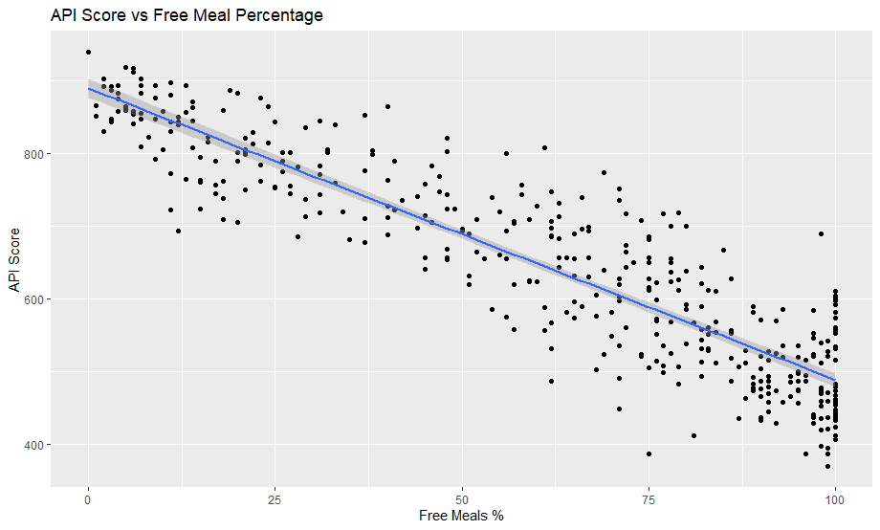
EDA: The Impact of Poverty (R Studio)
03/10
This scatterplot compares Free Meal Percentage (meals) with API Score (api00).
The downward trend shows a strong negative relationship between poverty and academic performance.
Correlation = approximately −0.90, indicating a very strong inverse relationship.
Executive Insight
As poverty levels increase, academic performance declines significantly. This suggests that socioeconomic factors play a major role in the academic achievement gap.

Slide 4

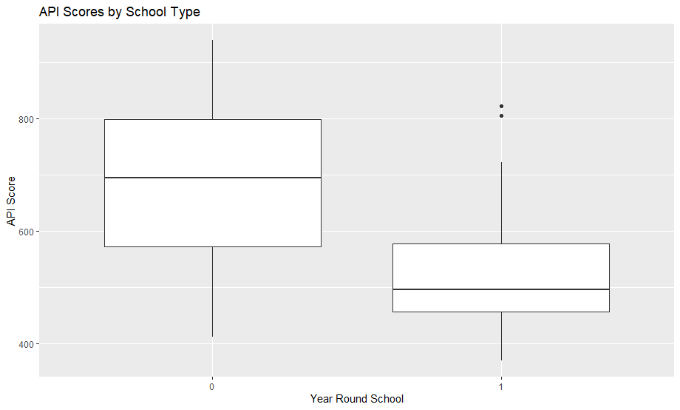
EDA: Performance Across Poverty Categories
04/10
Schools were grouped into three poverty categories using mealcat.
Low-poverty schools (Category 0) show the highest median API scores.
High-poverty schools (Category 2) show the lowest median scores.
The median gap between groups is approximately 300 points.
Executive Insight
Poverty creates clear performance tiers, with students in high-poverty schools consistently scoring lower than those in low-poverty schools.

Slide 5

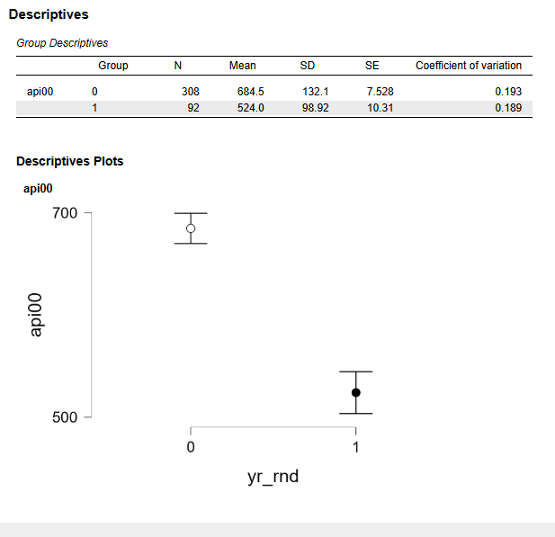
Statistical Testing – T-Test Results
05/10
Research Question: Does school calendar type affect academic performance?
Results:
Traditional Schools: Mean = 684.5
Year-Round Schools: Mean = 524.0
Mean Difference: 160.5 points
p-value < .001
Executive Insight:
Since p < .05, the difference is statistically significant. Traditional schools outperform year-round schools by approximately 160 points, suggesting year-round schools may face greater socioeconomic and resource challenges.

Slide 6
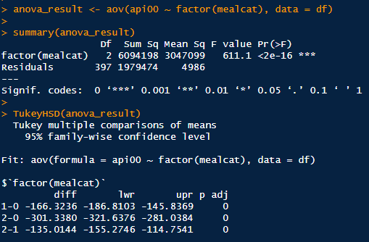
Statistical Testing – ANOVA & Post-Hoc
06/10
The Goal: Prove that poverty levels (mealcat) create distinct "classes" of school performance.
Detailed Interpretation:
The ANOVA: Your F-value is 611.1 with a p-value < 2e-16. This tells the executives that it is virtually impossible that poverty doesn't affect scores.
The Tukey Test: This breaks down the size of the gap.
Category 1 vs 0: A drop of 166 points.
Category 2 vs 0 (High vs Low Poverty): A massive drop of 301 points.
Executive Takeaway: Poverty isn't just a minor hurdle; it represents a 300-point performance deficit that standard teaching alone cannot bridge.

Slide 7
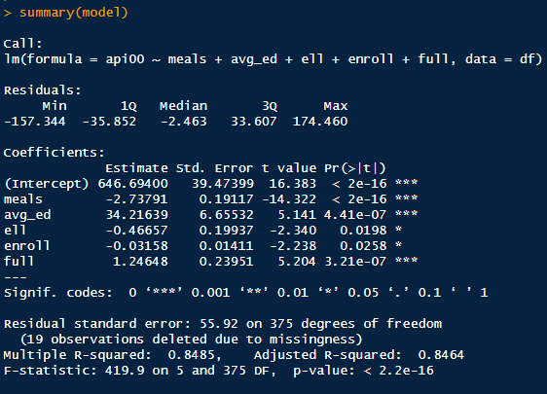
Modeling – Multiple Regression (The Math)
07/10
The Goal: Show how accurately we can predict success using multiple factors simultaneously.
Detailed Interpretation:
The Model Fit: Point to the Multiple R-squared: 0.8485.
Explanation: Tell the audience: "Our model explains 84.8% of the factors that determine a school's API score. This gives us a very reliable roadmap for policy intervention."
Significance: Every variable has *** next to it, meaning every factor we chose (Poverty, Parent Ed, English Learners, Enrollment, and Credentials) is a "statistically significant" predictor

Slide 8
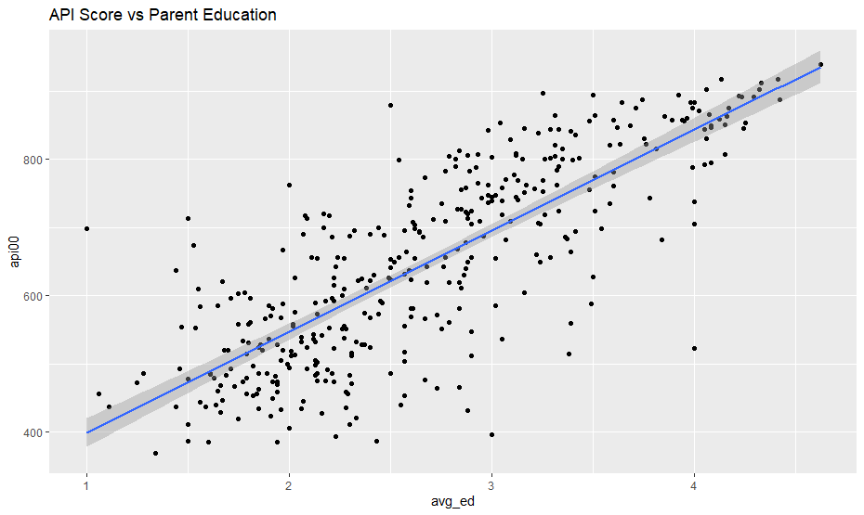
Interpreting the Predictors (Actionable Decisions)
08/10
Detailed Interpretation:
-This scatterplot shows the positive relationship between Parent Education and API Scores.
-The "Levers":
Parent Education (avg_ed): For every 1-unit increase in the education index, API scores rise by 34.2 points.
Teacher Credentials (full): Every 1% increase in fully credentialed teachers adds 1.24 points to the score.
English Learners (ell): Every 1% increase in English learners results in a -0.46 point drop, suggesting a need for more ESL resources.
Executive Takeaway: We cannot easily change a student's poverty level, but we can control teacher credentialing. Investing in teacher certification is a proven, statistically backed way to raise school performance.

Slide 9
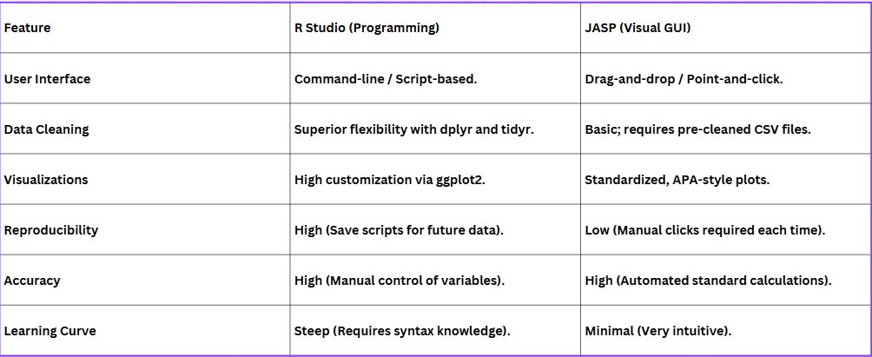
Strategic Tool Comparison: R Studio & JASP
09/10
Objective: Evaluating software efficacy for educational data modeling.

Slide 10
Conclusions & Actionable Insights
10/10
Insights Uncovered: We moved beyond simple averages to prove that 85% of school performance is predictable based on socioeconomic and institutional factors.
Actionable Discovery: While poverty is the strongest negative predictor, Teacher Credentials (full) and Parent Education (avg_ed) provide a statistically significant path to improvement.
Final Recommendations:
1. Increase funding for teacher certification in Category 2 & 3 districts.
2. Develop community programs focused on adult literacy and parent education.
3. Re-evaluate the support structures for Year-Round schools to bridge the 160-point gap.
"Data analytics allows us to move from 'guessing' to 'knowing,' providing a clear roadmap for educational equity in California."

Slide 11
Thank you

