Slide 1
FREQUENCY / PROOFFORGE CYBER
01 / 10
FREQUENCY
VERIFIABLE PROOF-OF-WORK
ENGINEERING DISCOVERY & HIRING
Proof you can inspect. Skills you can trust.
Team HM26-C3B5 · Members: [ YOGESH S ] · Colleges: [ Amrita School Of Computing]
· Members: [AMAL ] · Colleges: [ Jain Deemed to be University ]
· Members: [ NISHKALA G B ] · Colleges: [Amrita School Of Computing]
Selected problem · The proof gap in cybersecurity hiring
TEAM HM26-C3B5 · EVIDENCE BEFORE CLAIMS
FREQUENCY

Slide 2
FREQUENCY / PROOFFORGE CYBER
02 / 10
THE PROOF GAP
Resumes and certificates show claims. They rarely show reproducible work, sound reasoning, or how a candidate explains a finding.
A MYSURU HIRING SCENARIO
A local team screens many applicants. A capable candidate without a familiar credential is easy to miss; an inflated claim is hard to verify.
Candidates lose visibility. Reviewers spend time rechecking. Recruiters lack comparable evidence.
TEAM HM26-C3B5 · EVIDENCE BEFORE CLAIMS
FREQUENCY

Slide 3
FREQUENCY / PROOFFORGE CYBER
03 / 10
WHO IT SERVES
CANDIDATE
REVIEWER
RECRUITER
Demonstrates work through a finding, assessment and technical defense. Needs a clear path and low-bandwidth access.
Checks reproduction evidence, records a decision and scores defense. Human judgment remains authoritative.
Filters evidence-backed profiles and reviews sanitized proof before inviting candidates.
TEAM HM26-C3B5 · EVIDENCE BEFORE CLAIMS
FREQUENCY

Slide 4
FREQUENCY / PROOFFORGE CYBER
04 / 10
FROM WORK TO PROOF
01
Candidate completes a section assessment and submits a structured finding.
02
API scores answers server-side and hashes submitted evidence.
03
Reviewer reproduces, questions and records a decision.
04
Verified records inform capability and proof-confidence signals.
05
Recruiter inspects sanitized proof and can invite the candidate.
PRODUCT CAPTURE NEEDED
No genuine screenshots are checked in. Replace this with a capture of the running product.
TEAM HM26-C3B5 · EVIDENCE BEFORE CLAIMS
FREQUENCY

Slide 5
FREQUENCY / PROOFFORGE CYBER
05 / 10
ARCHITECTURE
React + TypeScript role workspaces → Flask modular API → PostgreSQL
Candidate UI
Reviewer UI
Recruiter UI
Managed browser / network allowlist
Flask modular API
Audit events
Authorized isolated lab
PostgreSQL
Evidence SHA-256
API records audit events and hashes evidence. Candidate lab UI is synthetic; no isolated target is provisioned.
TEAM HM26-C3B5 · EVIDENCE BEFORE CLAIMS
FREQUENCY

Slide 6
FREQUENCY / PROOFFORGE CYBER
06 / 10
CONSTRAINTS & HONEST STATUS
Evidence integrity · SHA-256 hash and duplicate flag in API | PARTIAL
Jurisdiction · No isolated lab provisioned; do not test arbitrary targets | NOT BUILT
Priority · Human reviewer controls verification | HANDLED
Bad input · API validates assessment shape and finding fields | PARTIAL
Offline · Local SQLite fallback; no offline sync guarantee | PARTIAL
TEAM HM26-C3B5 · EVIDENCE BEFORE CLAIMS
FREQUENCY

Slide 7
FREQUENCY / PROOFFORGE CYBER
07 / 10
THE KEY DECISION
CHOSEN
REJECTED
Deterministic server-side scoring + structured evidence + human reviewer authority
LLM as final grader: faster feedback, but less repeatable and harder to defend on adversarial evidence.
TRADE-OFF ACCEPTED
Human review takes longer and creates a reviewer-capacity bottleneck. The MVP favors explainable decisions.
TEAM HM26-C3B5 · EVIDENCE BEFORE CLAIMS
FREQUENCY

Slide 8
FREQUENCY / PROOFFORGE CYBER
08 / 10
WHAT THE CODE PROVES
API flow
Review flow
Discovery boundary
Assessment answer keys stay server-side; each section score is persisted.
Human reviewer decisions, defense responses and rubric values have API persistence.
API sanitizes verified proof. Some candidate and recruiter screens still use synthetic data.
REAL CAPTURE SLOTS
Add 2–3 genuine screenshots: candidate assessment, reviewer decision, recruiter sanitized proof. None are checked in.
TEAM HM26-C3B5 · EVIDENCE BEFORE CLAIMS
FREQUENCY

Slide 9
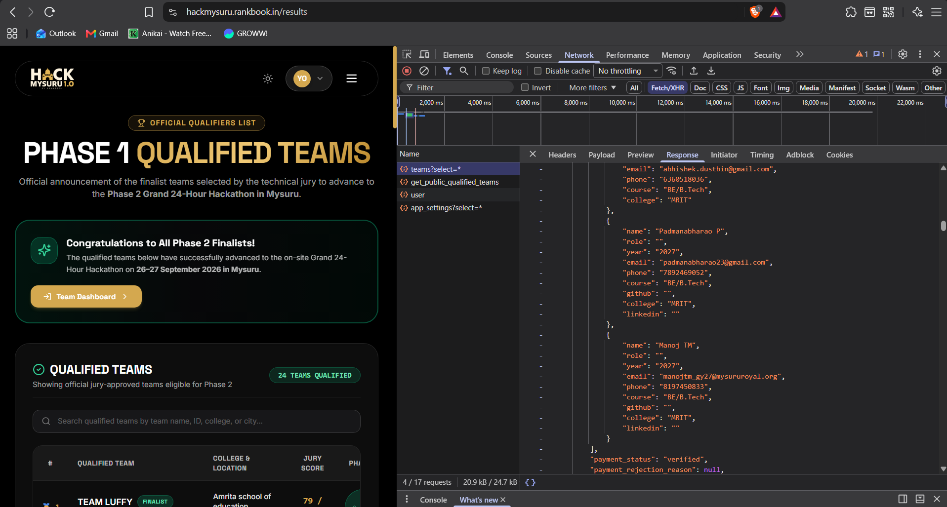

Slide 10
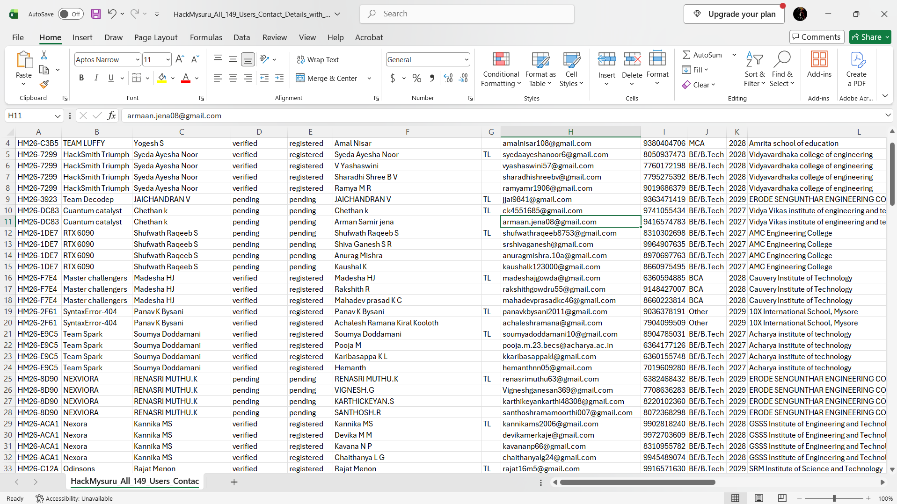

Slide 11
FREQUENCY / PROOFFORGE CYBER
10 / 10
NEXT & DISCLOSURE
1 Connect role pages to authenticated persisted records.
2 Provision isolated, resettable labs with egress denied.
3 Add shared rate limiting, monitoring and peak-load tests.
AI disclosure: Claude/Gemini assisted development; no runtime LLM makes hiring decisions.
LIVE MVP
https://proofforge-cyber.onrender.com
REPOSITORY
github.com/yogesh-37911/HM26-C3B5-Phase2
TEAM HM26-C3B5 · EVIDENCE BEFORE CLAIMS
FREQUENCY

