Slide 1
Polar
Codes
Lab Group: 2
Project Group: 11

Slide 2
Honor Code
We declare that
→ The work that we are presenting is our own work.
→ We have not copied the work (the code, the results, etc.) that someone else has done.
→ Concepts, understanding and insights we will be describing are our own.
→ We make this pledge truthfully. We know that violation of this solemn pledge can carry grave consequences.

Slide 3
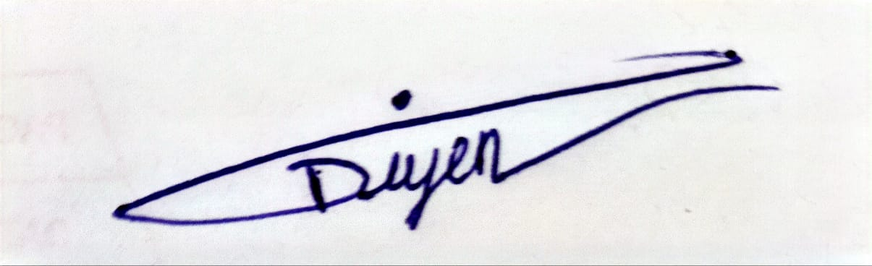
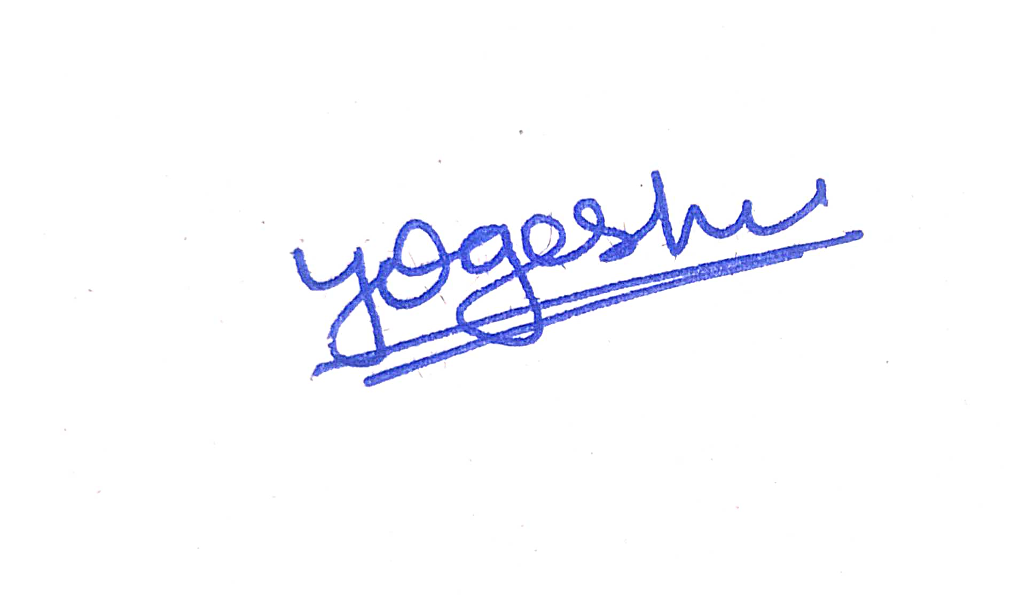

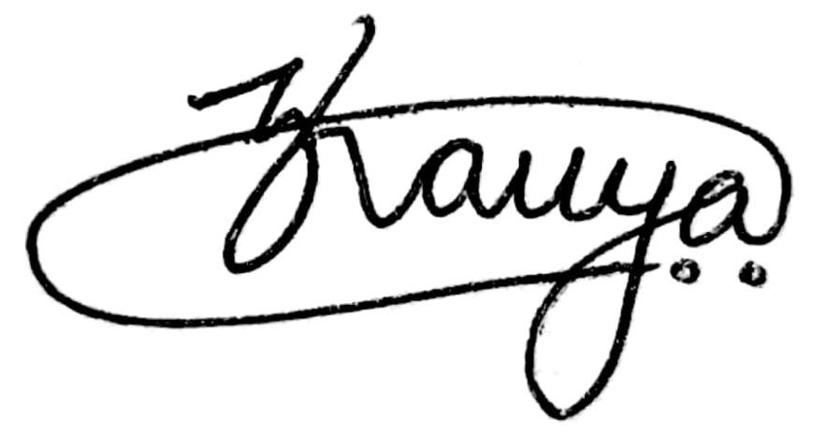
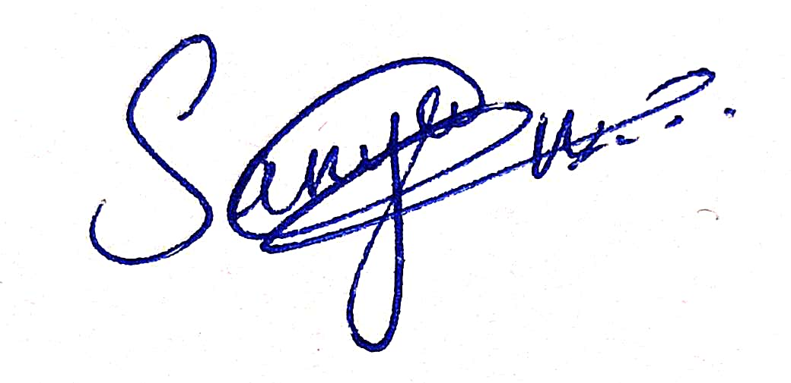
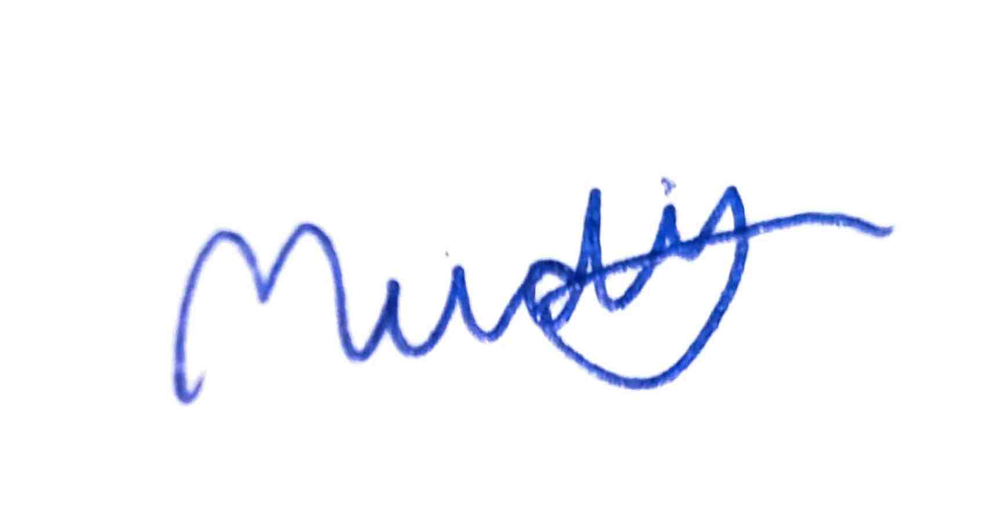
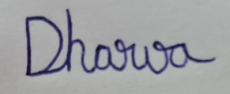
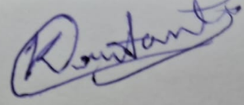
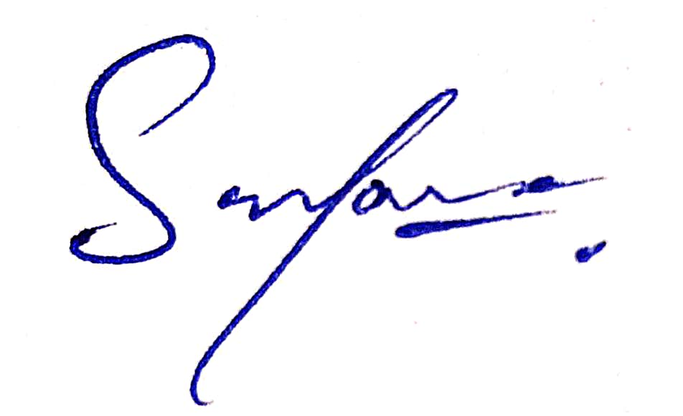
Group Members
202301113 Diyen Pambhar
202301114 Yogesh Bagotia
202301115 Meet Dobariya
202301116 Kavya Chauhan
202301117 Sanya Vaishnavi
202301118 Mudit Rungta
202301119 Dharva Patel
202301120 Krutant Jethva
202301121 Sri Sadana Dharavath

Slide 4
01
Idea of Polar Codes

Slide 5
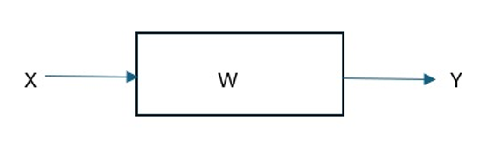
B-DMC Channel
Binary Discrete Memoryless Channel
W:X→Y , where X and Y are Binary inputs
The channel is described by W(y|x), x ∈ X,y ∈Y which gives us the probability of receiving y when x is transmitted.
The capacity of the channel is given by the mutual information I (X;Y), X is uniformly distributed over {0,1}

Slide 6
Among all the channels, there are two types of channels for which it is easy to communicate.
Perfect Channels: Output Y determines value of X
Useless channels: Output Y is independent of the value of X
In real world the channels are neither fully perfect nor completely useless. They are in between.
Arikan’s idea of polarisation helps us to convert these binary input channels into these extreme channels in a way that information is not lost and it is of low complexity.

Slide 7
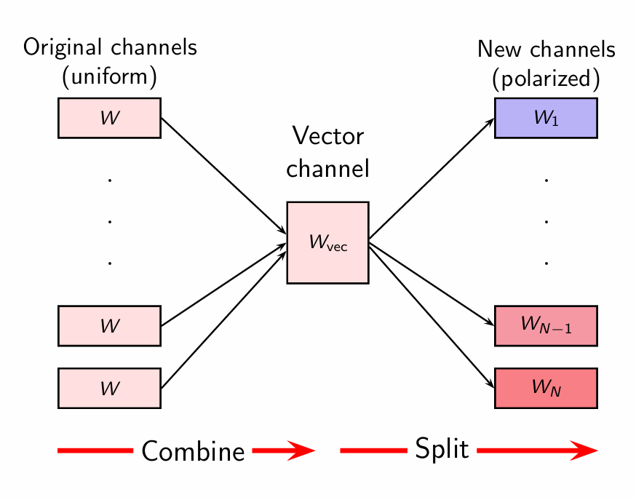

Slide 8
02
Polar Transform

Slide 9
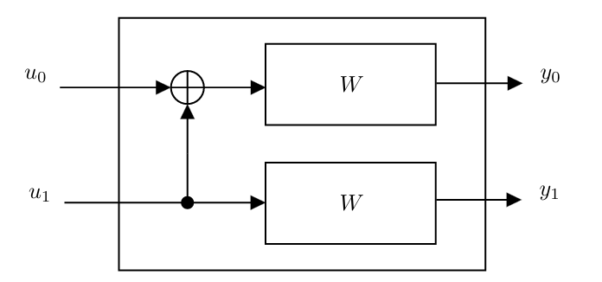
Polar Transform
Here, we take two copies of W:X→Y.
y₀ = u₀ ⊕ u₁
y₁ = u₁
2 I (W) = I (u₀ u₁ ; y₀ y₁)
where y₀ = u₀ ⊕ u₁ and y₁ = u₁
2 I (W) = I (u₀ ; y₀ y₁) + I (u₁ ; y₀ y₁ / u₀)
2 I (W) = I (u₀ ; y₀ y₁) + I (u₁ ; y₀ y₁ u₀)
2 I (W) = I (W−) + I (W+)

Slide 10
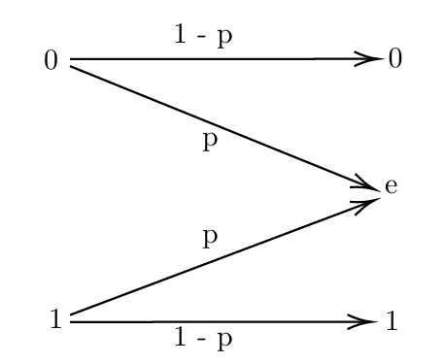

Example of BEC
Let W be BEC(p) i.e.
X ; with probability (1-p)
? ; with probability p
Y =

Slide 11
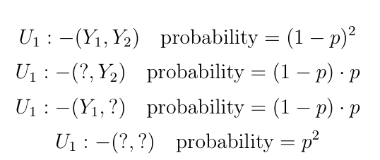
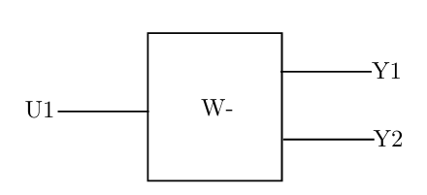
W⁻ Channel
Erasure Probability : p(2-p)

Slide 12
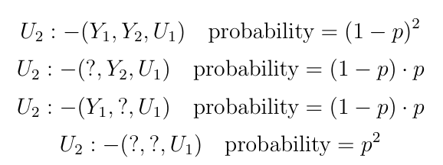
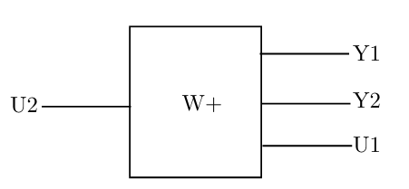
W⁺ Channel
Erasure Probability: p²

Slide 13
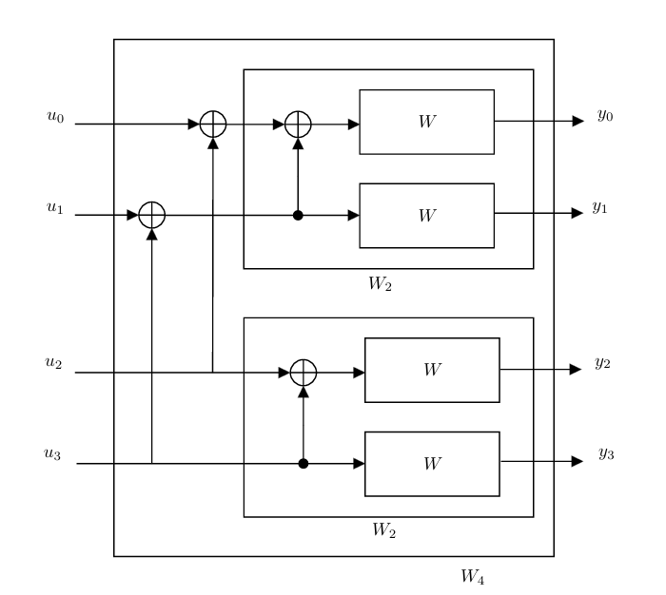

Slide 14
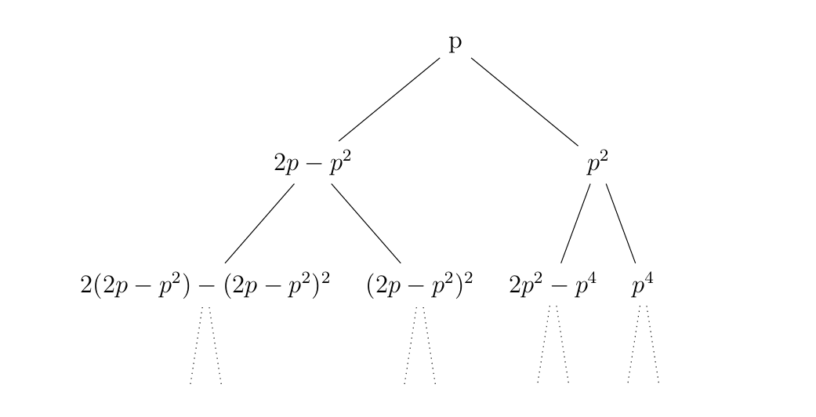
Error Probability Tree
Polar codes follow Mathew’s effect as the good channels get better and bad channels get worse.

Slide 15
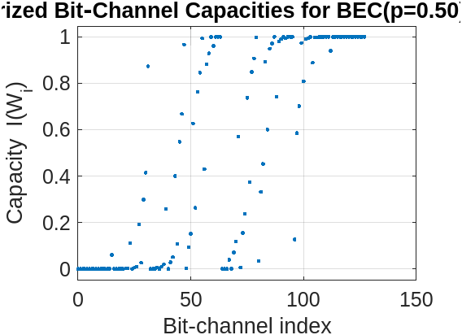
Polarization for BEC (½) , N = 128

Slide 16
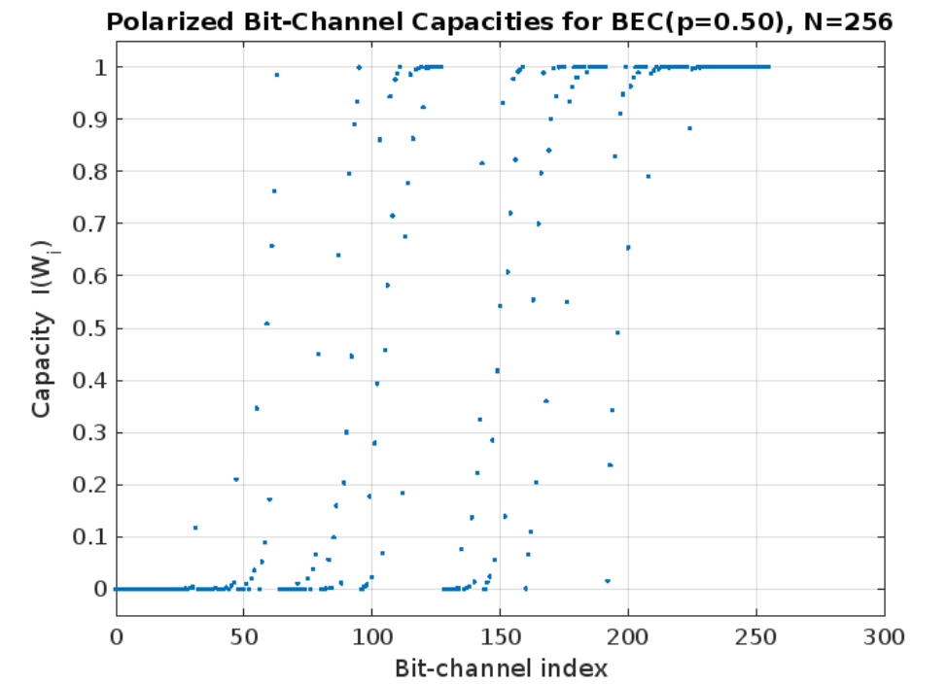

Slide 17
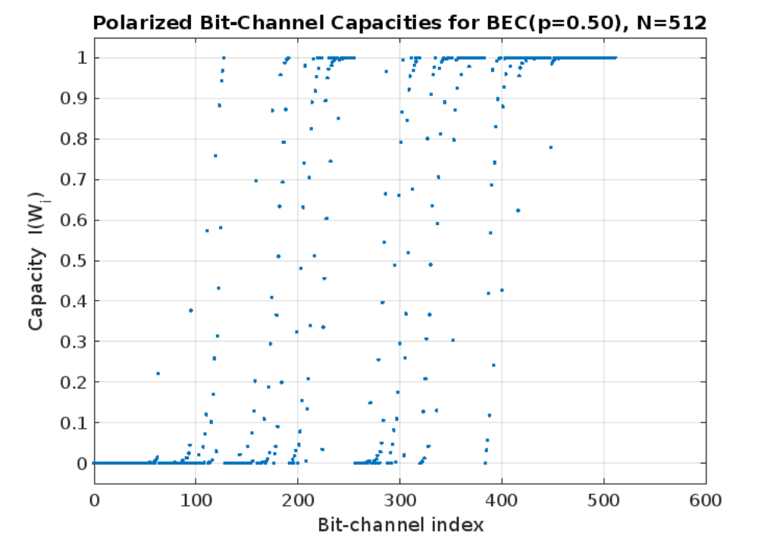

Slide 18
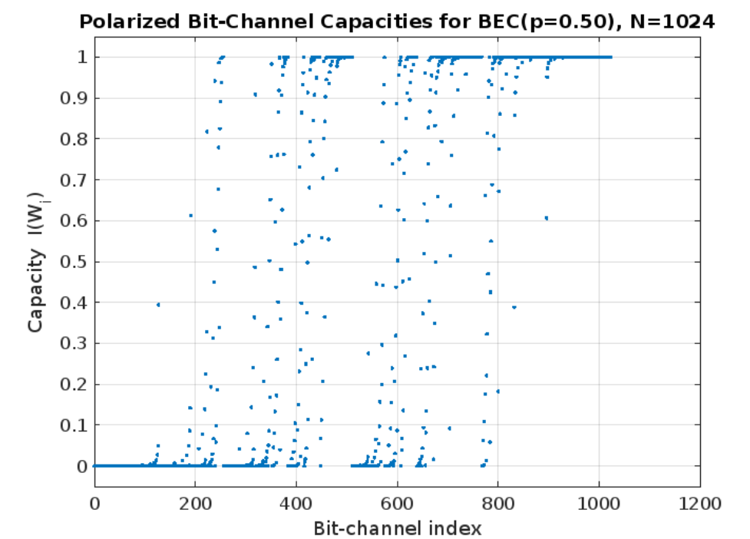

Slide 19
03
Encoding

Slide 20
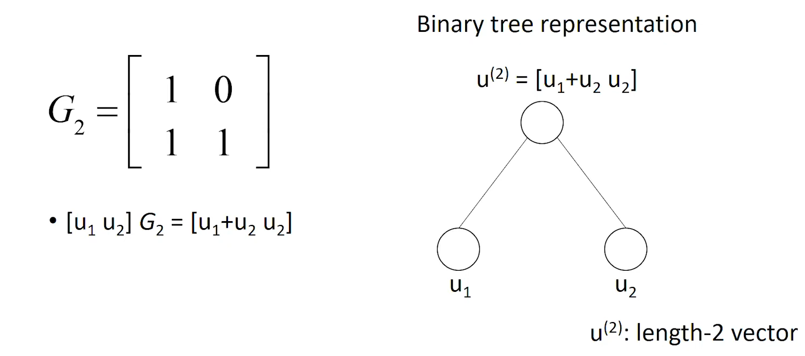
Generator Matrix

Slide 21
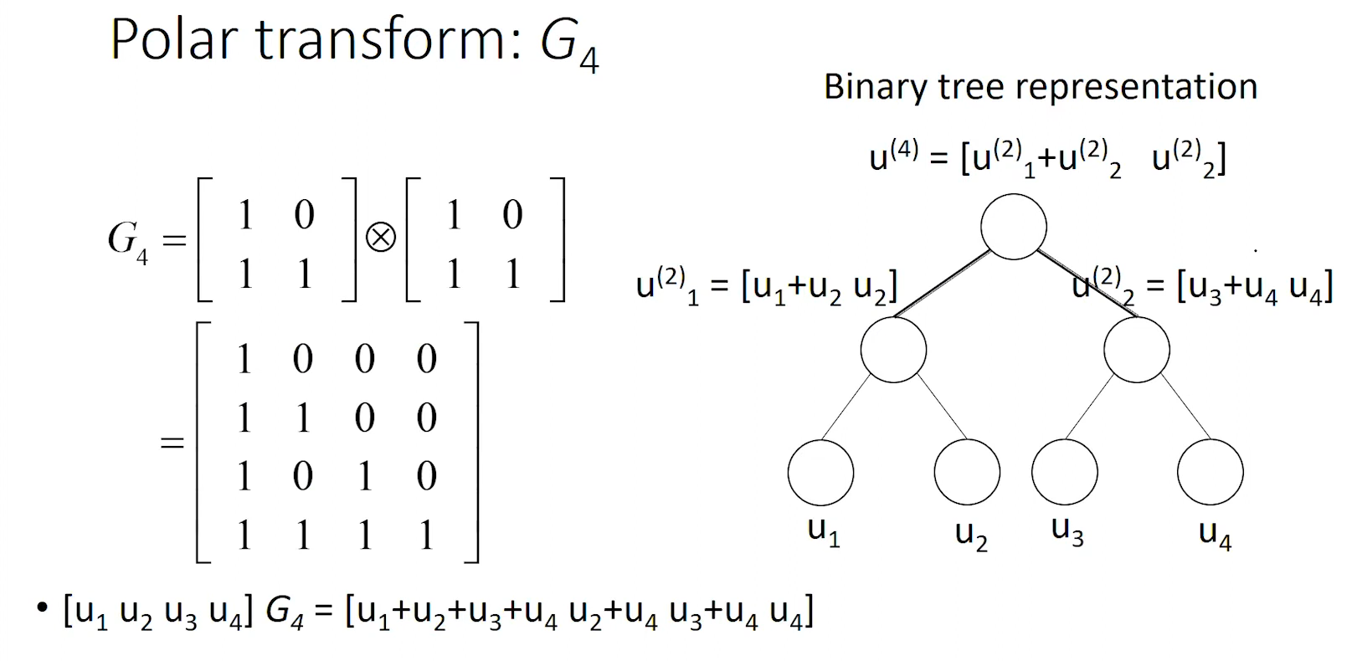

Slide 22
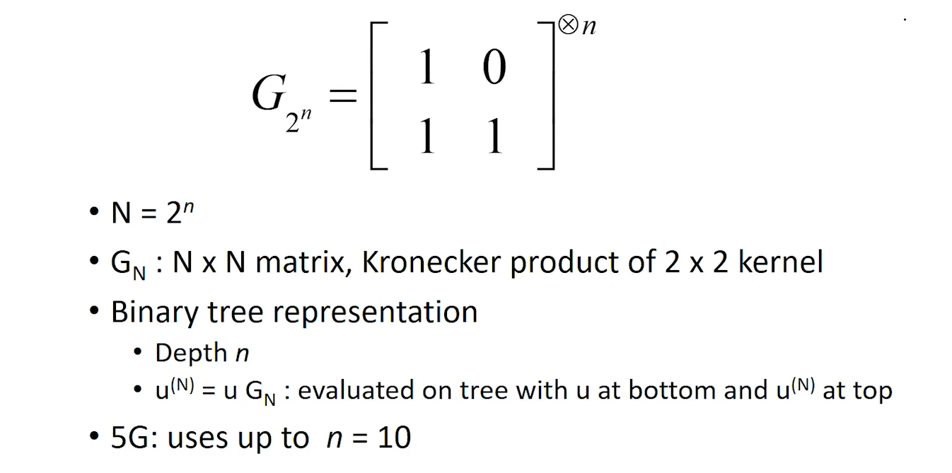
General Form

Slide 23
Reliability Sequence
Given by the 5G standard
From worst to Best
Sequences for N less than 1024 is derived from the sequence of N = 1024
N = 8 : 1 2 3 5 4 6 7 8
N = 16: 1 2 3 5 9 4 6 10 7 11 13 8 12 14 15 16
N = 32: 1 2 3 5 9 17 4 6 10 7 18 11 19 13 21 25 8 12 20 14 15 22 27 26 23 29 16 24 28 30 31 32

Slide 24
Reliability sequence for N = 1024
0 1 2 4 8 16 32 3 5 64 9 6 17 10 18 128 12 33 65 20 256 34 24 36 7 129 66 512 11 40 68 130 19 13 48 14 72 257 21 132 35 258 26 513 80 37 25 22 136 260 264 38 514 96 67 41 144 28 69 42 ... 516 49 74 272 160 520 288 528 192 544 70 44 131 81 50 73 15 320 133 52 23 134 384 76 137 82 56 27 ... 97 39 259 84 138 145 261 29 43 98 515 88 140 30 146 71 262 265 161 576 45 100 640 51 148 46 75 266 273 517 104 162 ... 53 193 152 77 164 768 268 274 518 54 83 57 521 112 135 78 289 194 85 276 522 58 168 139 99 86 60 280 89 290 529 524 ... 196 141 101 147 176 142 530 321 31 200 90 545 292 322 532 263 149 102 105 304 296 163 92 47 267 385 546 324 208 386 150 153 ... 165 106 55 328 536 577 548 113 154 79 269 108 578 224 166 519 552 195 270 641 523 275 580 291 59 169 560 114 277 156 87 197 ... 116 170 61 531 525 642 281 278 526 177 293 388 91 584 769 198 172 120 201 336 62 282 143 103 178 294 93 644 202 592 323 392 ... 297 770 107 180 151 209 284 648 94 204 298 400 608 352 325 533 155 210 305 547 300 109 184 534 537 115 167 225 326 306 772 157 ... 656 329 110 117 212 171 776 330 226 549 538 387 308 216 416 271 279 158 337 550 672 118 332 579 540 389 173 121 553 199 784 179 ... 228 338 312 704 390 174 554 581 393 283 122 448 353 561 203 63 340 394 527 582 556 181 295 285 232 124 205 182 643 562 286 585 ... 299 354 211 401 185 396 344 586 645 593 535 240 206 95 327 564 800 402 356 307 301 417 213 568 832 588 186 646 404 227 896 594 ... 418 302 649 771 360 539 111 331 214 309 188 449 217 408 609 596 551 650 229 159 420 310 541 773 610 657 333 119 600 339 218 368 ... 652 230 391 313 450 542 334 233 555 774 175 123 658 612 341 777 220 314 424 395 673 583 355 287 183 234 125 557 660 616 342 316 ... 241 778 563 345 452 397 403 207 674 558 785 432 357 187 236 664 624 587 780 705 126 242 565 398 346 456 358 405 303 569 244 595 ... 189 566 676 361 706 589 215 786 647 348 419 406 464 680 801 362 590 409 570 788 597 572 219 311 708 598 601 651 421 792 802 611 ... 602 410 231 688 653 248 369 190 364 654 659 335 480 315 221 370 613 422 425 451 614 543 235 412 343 372 775 317 222 426 453 237 ... 559 833 804 712 834 661 808 779 617 604 433 720 816 836 347 897 243 662 454 318 675 618 898 781 376 428 665 736 567 840 625 238 ... 359 457 399 787 591 678 434 677 349 245 458 666 620 363 127 191 782 407 436 626 571 465 681 246 707 350 599 668 790 460 249 682 ... 573 411 803 789 709 365 440 628 689 374 423 466 793 250 371 481 574 413 603 366 468 655 900 805 615 684 710 429 794 252 373 605 ... 848 690 713 632 482 806 427 904 414 223 663 692 835 619 472 455 796 809 714 721 837 716 864 810 606 912 722 696 377 435 817 319 ... 621 812 484 430 838 667 488 239 378 459 622 627 437 380 818 461 496 669 679 724 841 629 351 467 438 737 251 462 442 441 469 247 ... 683 842 738 899 670 783 849 820 728 928 791 367 901 630 685 844 633 711 253 691 824 902 686 740 850 375 444 470 483 415 485 905 ... 795 473 634 744 852 960 865 693 797 906 715 807 474 636 694 254 717 575 913 798 811 379 697 431 607 489 866 723 486 908 718 813 ... 476 856 839 725 698 914 752 868 819 814 439 929 490 623 671 739 916 463 843 381 497 930 821 726 961 872 492 631 729 700 443 741 ... 845 920 382 822 851 730 498 880 742 445 471 635 932 687 903 825 500 846 745 826 732 446 962 936 475 853 867 637 907 487 695 746 ... 828 753 854 857 504 799 255 964 909 719 477 915 638 748 944 869 491 699 754 858 478 968 383 910 815 976 870 917 727 493 873 701 ... 931 756 860 499 731 823 922 874 918 502 933 743 760 881 494 702 921 501 876 847 992 447 733 827 934 882 937 963 747 505 855 924 ... 734 829 965 938 884 506 749 945 966 755 859 940 830 911 871 639 888 479 946 750 969 508 861 757 970 919 875 862 758 948 977 923 ... 972 761 877 952 495 703 935 978 883 762 503 925 878 735 993 885 939 994 980 926 764 941 967 886 831 947 507 889 984 751 942 996 ... 971 890 509 949 973 1000 892 950 863 759 1008 510 979 953 763 974 954 879 981 982 927 995 765 956 887 985 997 986 943 891 998 766 ... 511 988 1001 951 1002 893 975 894 1009 955 1004 1010 957 983 958 987 1012 999 1016 767 989 1003 990 1005 959 1011 1013 895 1006 1014 1017 1018 ... 991 1020 1007 1015 1019 1021 1022 1023

Slide 25
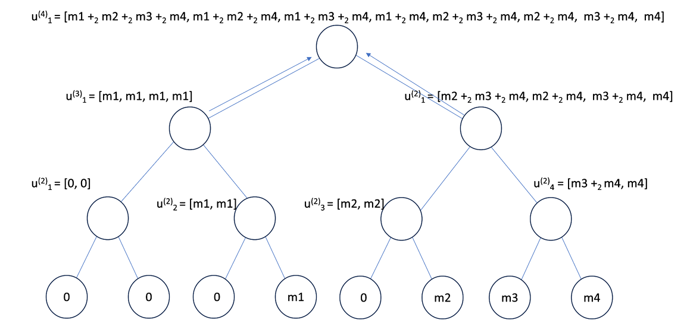

Slide 26
04
Successive Cancellation Decoding

Slide 27
INTUITIVE UNDERSTANDING OF POLAR DECODING
Starts with the received signal, treating it as a set of probabilities or beliefs about each bit that was sent.
Decoding works step-by-step, moving through the encoding structure (polar transform) in reverse, to estimate the original message bits.
The process is efficient, with a computational complexity of about O(n log n), which is quite practical even for long messages.
It uses soft information (like likelihoods or log-likelihood ratios) from the channel as input.
The final output is a set of hard decisions—that is, fixed bit values (like 0 or 1) based on the best estimates.

Slide 28
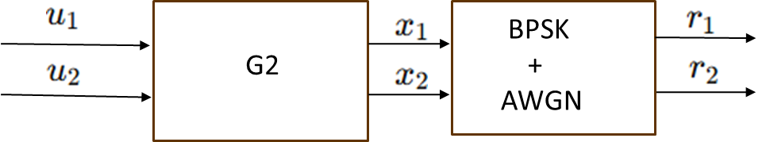
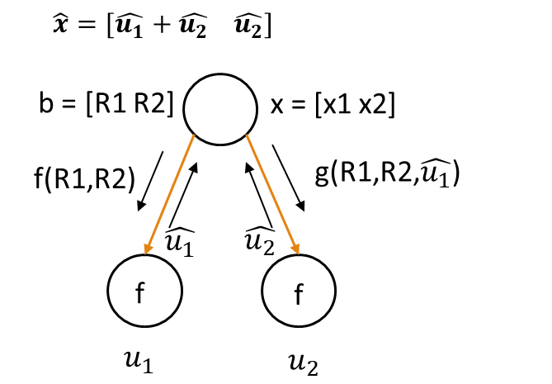


Successive Cancellation Decoding for N=2
We compute the LLR for û₁ using the min-sum function:
L(u1​) = f(r1​,r2​) = sgn(r1) ⋅ sgn(r2) ⋅ min( |r1| , |r2| )
0 if L(u1) ≥ 0
=
1 if L(u1) < 0
After decoding ,
L(u2)=g(r1,r2, ) = r2+(1-2 )r1

Slide 29
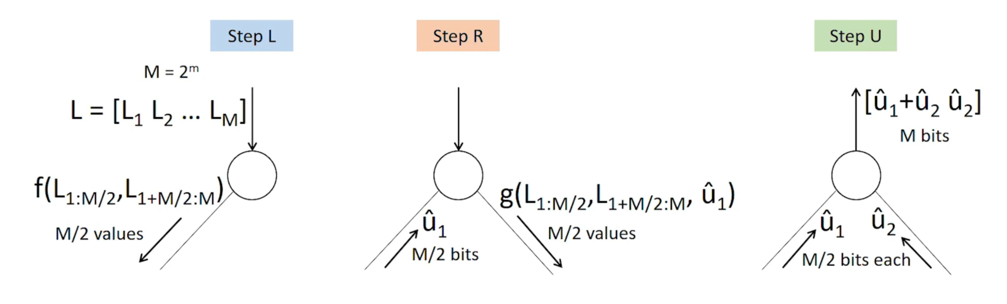
STEPS OF SC DECODING

Slide 30



r = [ r1 r2 r3 r4 r5 r6 r7 r8 ]
l1 l2 l3 l4
L=[f(r1,r5) f(r2,r6) f(r3,r7) f(r4,r8)]
ll1 ll2
LL1 LL2
[ f(l1,l3) f(l2,l4) ]
[g(l1,l3,v1] g[(l2,l4,v2)]
f(ll1,ll2)
g[ ll1,ll2, ]
f(LL1,LL2)
f
f
f
m1
f
m2
m3
m4
u1 u2 u3 u4 u5 u6 u7 u8

Slide 31
Successive Cancellation List Decoding
05

Slide 32
Overview of SCL
SCL decoding extends SC decoding by making multiple decisions for each bit, rather than a single one, and maintaining a list of candidate codewords.
For each possible decision, a penalty (Decision Metric) is assigned. If the decision aligns with the belief (received signal), the penalty is zero; if it doesn't, the penalty is ∣L∣.
The Path Metric is the cumulative sum of the Decision Metrics for a given path, reflecting the likelihood of the decoded sequence.
Even for frozen bits, a penalty is applied if the decision goes against the belief.
SCL decoding keeps a fixed list size M. If the list exceeds M paths, only the M paths with the lowest Path Metric are retained.
The process can be viewed as running M decoders simultaneously, each maintaining different decoding paths, and selecting the best ones based on the lowest Path Metric.
The time complexity of SCL decoding is M×Nlog⁡N , where N is the length of the codeword.

Slide 33
Decision Diagram
0
0
1
Pruned
0
0
0
Pruned
PM+0
1
1
PM
0
0
Pruned
0
PM+|L|
1
0
1
0
Pruned
1
u1(Frozen)
u2(Info)
u4(Info)
1
u3(Frozen)

Slide 34
Improvement to SCL Decoding with CRC
Cyclic Redundancy Check (CRC) is essentially a set of parity check bits added to the transmitted data.
Upon receiving the data, the receiver performs polynomial division using a predefined generator polynomial. If the remainder of the division is zero, it indicates that no errors are detected. If the remainder is non-zero, errors are present in the data.
CRC provides an extra layer of error detection, enhancing the reliability of the communication system.
The addition of CRC helps identify error patterns that may be beyond the correction capability of the SCL decoder. In situations where SCL may fail to correct errors, CRC can highlight the presence of such uncorrectable errors.

Slide 35
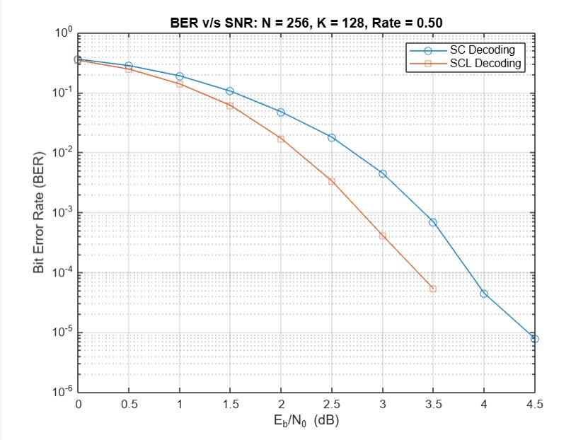
BER Performance of Polar Code: SC vs SCL Decoding

Slide 36
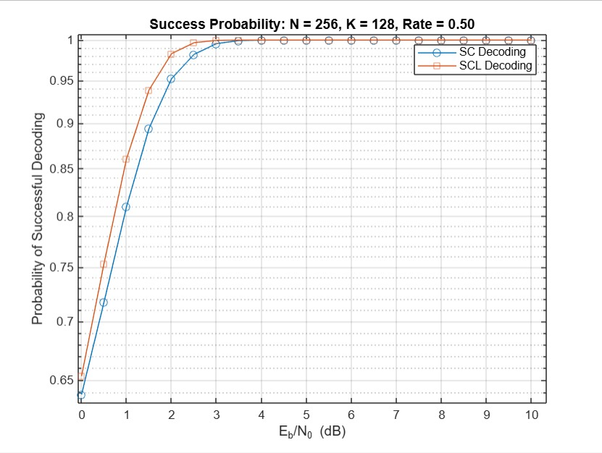
Decoding Success Rate of Polar Code: SC vs SCL

Slide 37
Convergence to Shannon Capacity
06

Slide 38
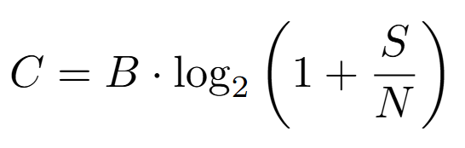
How Polar Codes Achieve Shannon Capacity
Polar codes efficiently achieve the Shannon capacity using a recursive structure and Successive Cancellation decoding, with complexity around O(N log N). As N grows, error probability approaches zero, ensuring reliable transmission below the channel capacity. Shannon’s Noisy Channel Theorem that if Information rate R > C then reliable transmission becomes impossible
Shannon’s Capacity Formula (for AWGN channel):
C = channel capacity (bits/sec)
B = bandwidth (Hz)
S/N​ = signal-to-noise ratio (SNR)
Notes:
Polar codes provide an explicit and efficient method to achieve the Shannon capacity, meaning they are not just a theoretical construct but a practical coding scheme with a defined structure.. Their encoding uses a recursive structure based on a Kronecker product of a simple matrix, and their decoding—using Successive Cancellation (SC)—has relatively low complexity, approximately O(NlogN), where N is the block length. Most importantly, as the block length N→∞, the probability of error under SC decoding tends toward zero, meaning polar codes can transmit information reliably at any rate less than the channel capacity. This makes them both theoretically optimal and practically implementable.
The Shannon capacity (or Shannon limit) refers to the maximum rate at which information can be transmitted over a communication channel with arbitrarily low error, given the presence of noise.

Slide 39
Channel Polarisation
Channel polarization is the core idea behind polar codes.
It transforms N=2^n identical channels into subchannels WN(i)​, where:
Some become highly reliable (good),
Others become completely noisy (bad).
ensures the reliability of each subchannel:
Z(W)≈0: Good channel (low error)
Z(W)≈1: Bad channel (high error)
After polarization, we:
Select good subchannels with low Z(W) to carry information bits.
Freeze the rest (set to known values like 0) to aid decoding.
This ensures that information is sent only through reliable paths, leading to low error probability and capacity-achieving performance.

Slide 40
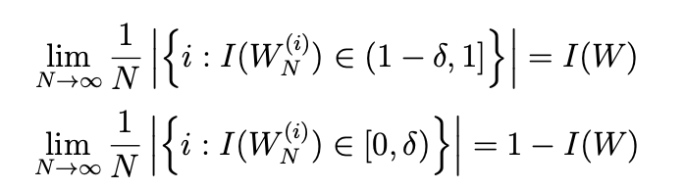
Channel Polarisation
This says that as N→∞, the fraction of channels with mutual information near 1 approaches the capacity C, and the rest approach 0 - this is channel polarization.
A fraction I(W) of the synthetic channels become almost perfect (capacity ≈ 1)
The rest become completely noisy (capacity ≈ 0)
Thus, we can transmit data over the good channels and freeze the bad ones.

Slide 41
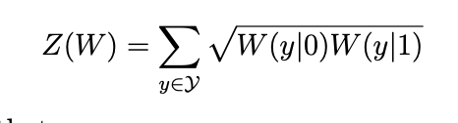

Bhattacharyya Parameter Z(W)
The reliability of each bit-channel W (i) N is measured by its Bhattacharyya parameter
This is used to find usable channels after polarization
Z(W) ≈ 0 → Reliable channel
Z(W) ≈1 → Noisy channel
The total error probability under SC decoding also tends to zero.

Slide 42
How Polar Codes Achieve Shannon Capacity
Asymptotic behavior | As block length N→∞, the fraction of good (reliable) channels approaches the Shannon capacity C.
Rate convergence, Polarization | We choose to send info bits only through these good channels, hence achieving rate R→C, and we freeze the bits in the noisy channels
Error probability | For each info bit, the error probability vanishes as block length increases.
Formal Result | Arıkan proved: Polar codes achieve the symmetric capacity of B-DMCs under SC decoding with vanishing block error probability

Slide 43
Practical Uses of Polar Codes
1. 5G Mobile Networks (3GPP Standard)
Used in control channels (DCI/UCI) of 5G NR.
Efficient for short block lengths and low-latency decoding.
2. Error Correction in Data Storage
While not as common as LDPC in storage systems, polar codes are being considered for:
Optical storage
Scenarios requiring strong error correction with low decoding complexity
3. Ultra-Reliable Low-Latency Communications (URLLC)
Applied in autonomous vehicles, factory automation, and remote healthcare.
Ensures fast and error-free data transmission.

Slide 44
Theoretical and Research Applications
1. First Capacity-Achieving Code with Low Complexity
Arikan’s polar codes are the first explicit code construction proven to achieve the Shannon capacity for symmetric binary-input memoryless channels with O(Nlog⁡N) complexity.
2. Foundational for Code Design
Inspired further work in coding theory:
List decoding for polar codes
CRC-aided polar codes (used in 5G)
Hybrid schemes combining polar and other codes
3. Quantum Polar Codes
Extensions of polar coding principles into quantum error correction and quantum communication channels.

Slide 45
THANK YOU

