Slide 1
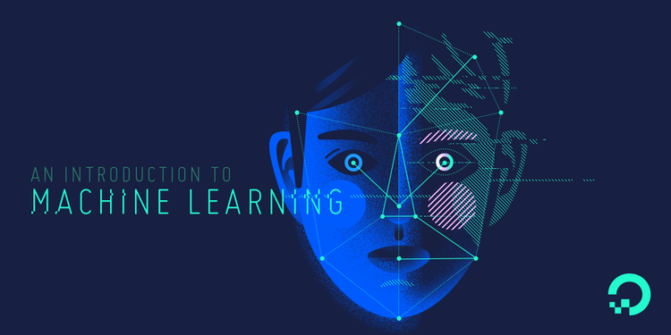
Authors:
Yogesh Sidhwani
Prashant Tiwari
Priyanka Verma

Slide 2
Contents
Our Understanding Of machine Learning.
Workflow of ML.
Examples.
Ipl Data Analysis and Codebase.
Models.

Slide 3
What is machine Learning?
Machine learning teaches computers to do what comes naturally to humans: learn from experience. Machine learning algorithms use computational methods to “learn” information directly from data without relying on a predetermined equation as a model.
The algorithms adaptively improve their performance as the number of samples available for learning increases.
Important breakthroughs led to the emergence of Machine Learning– credited to Arthur Samuel in 1959 – that rather than “teaching computers everything they need to know about the world and how to carry out tasks, it might be possible to teach them to learn for themselves”. - Forbes

Slide 4
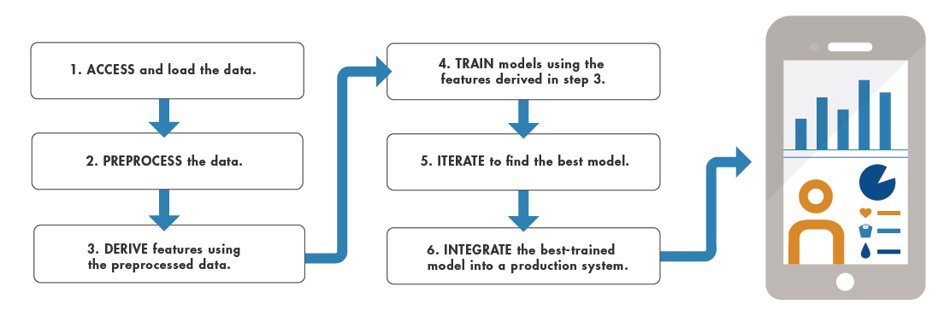
Machine Learning Workflow

Slide 5
Examples of Machine Learning in Real world
Voice Recognition Systems in SIRI and CORTANA.
Fastest Route suggestion by GOOGLE MAPS.
Predictive Text and Suggestive search by GOOGLE.
NETFLIX’S Movie/TV Series Recommendation Algorithm.
Related list of music tracks(based on likes) by SPOTIFY.
Recommended Products by AMAZON and similar e-commerce.

Slide 6
Business Case -IPL MODEL (Software and DATA)
Programming Language – Python 3.6
Libraries/Plugins – Pandas, NumPy, Matplotlib, Scikit.
Software/Tools – Jupyter Notebook.
Data – Matches.csv(records/observations of all the matches played in all the IPL seasons).
Deliveries.csv(ball by ball data of all the matches played in all the IPL seasons).
Pre-Processing Techniques: Label Encoder and One Hot Encoding.
Algorithms: Logistic Regression, KNeighborsClassifier, DecisionTreeClassifier, RandomForestClassifier,
GradientBoostingClassifier.
Target/predict – Winner.

