Slide 1
Opening a new Hospital in Delhi, India
IBM Applied Data Science Capstone
By: Yogesh Singhal
April 2020

Slide 2
AGENDA
Introduction: Business Problem
Data Description
Methodology
Analysis
Results
Discussion and Conclusion

Slide 3
INTRODUCTION
Business Problem
The objective of this project is to take part of this remodelling process therefore, the proposal to make a new hospital having 500 beds. For this, the need is to analyse and select the best location in Delhi to open a new hospital. Using Data Science methodology and machine learning techniques as clustering, regression etc., this project aims to answer the business problem: In Delhi, India if government wants to open a hospital, where would the data science team will recommend building it?
Target Audience of the Project
This hospital will help to overcome the shortage of beds per 1000 population. Currently, the total number of hospital beds in the national capital increased from 48,096 in 2014-15 to 57,194 in the last fiscal, according to Delhi's Economic Survey report. This translated in a jump in beds per 1000 population from 2.68 to 2.99 in the corresponding periods. Delhi government need to further improve his number and provide the best health practices to its people and decline the death rate due to poor health care facilities in the country.

Slide 4
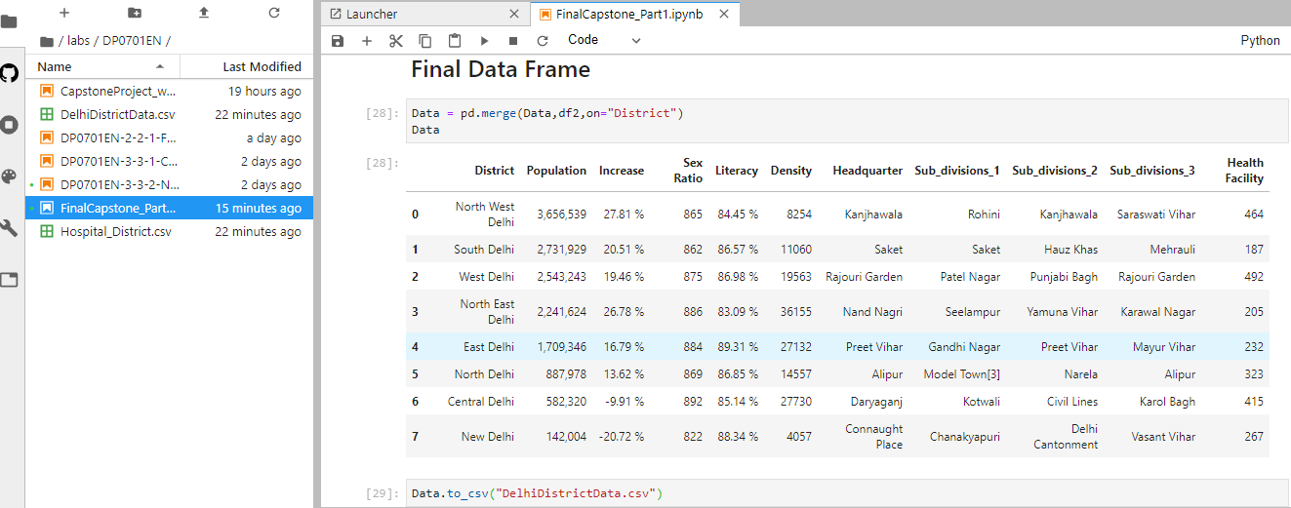
DATA DESCRIPTION
Data is prepared using:
Data Extraction
Web Scraping from various sources.
Data Downloading from government website.
Data Preparation
Data Cleaning
Data merging
Data Definition

Slide 5
The final Data frame contains 11 columns:
District: Delhi is divided into various districts; this column
represents the districts in Delhi.
Population: Each district populations is represented in this column.
Increase: Increase in population since last decade.
Sex Ration: Female, Male ratio is represented in this column.
Literacy: represents literacy rate in the respective districts.
Density: People density in respective districts.
Headquarter: Headquarter of the respective districts lies in these areas.
Subdivision: Divisions under each district.
Health Facility: Number of hospitals under each district.

Slide 6
METHODOLOGY
In this project we will direct our efforts on detecting areas of Delhi that have low hospital density, particularly those with low number of government hospitals. We will limit our analysis to area ~2km around city centre.
In first step we have collected the required district wise.
Second step in our analysis will be calculation and exploration of 'hospital density' across different areas of Delhi.
In third and final step we will focus on most promising areas and within those create clusters of locations that meet some basic requirements established in discussion with stakeholders: we will be using k-means clustering of those locations to identify general zones / neighbourhoods / addresses which should be a starting point for final 'street level' exploration and search for optimal venue location by stakeholders.

Slide 7
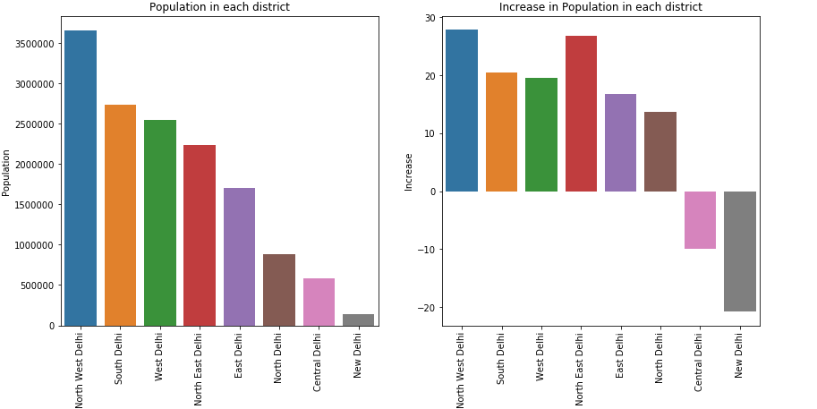
ANALYSIS
1. Data Visualization
1. The Maximum population is of "North-west Delhi" having Headquarters at "Kanjhawala"
2. During the years, The population has grown much in the same "North west delhi" while in some places like "Central Delhi" and "North Delhi", it has reduced.

Slide 8
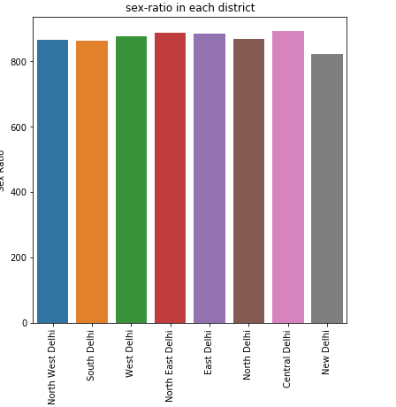
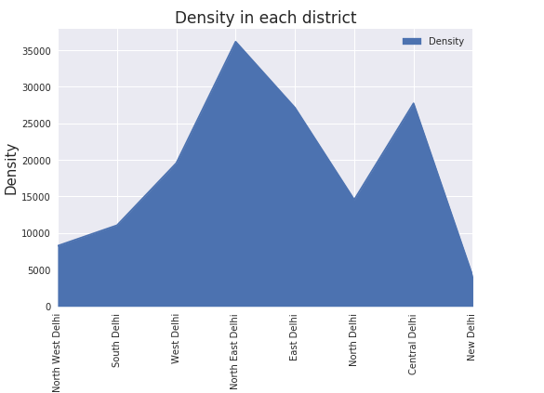
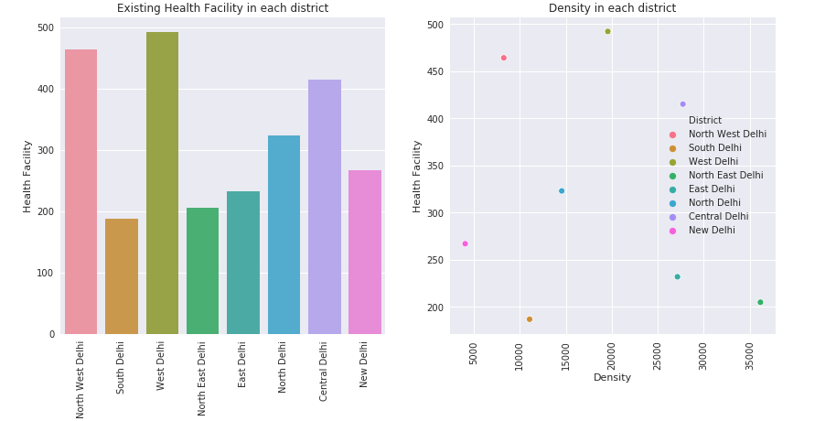
1. The sex-ratio is almost equal in all districts and doesnot matters much.
2. While the density (total number of people per land area) of "North East Delhi" having Headquarter:"Nand Nagri" is the highest.
1. Number of hospitals in South Delhi,North East Delhi,ast Delhi are very less.
2. As we can see in density and health facility chart that all the points are not lying on a single increasing order line according to density this shows some districts have less number of health facility as the population is.

Slide 9
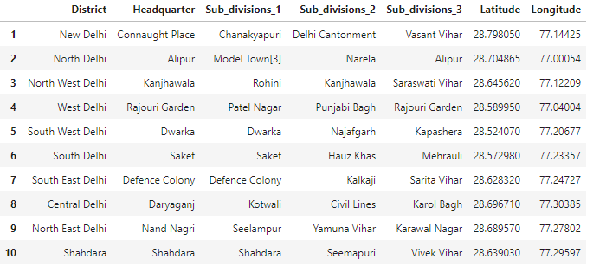
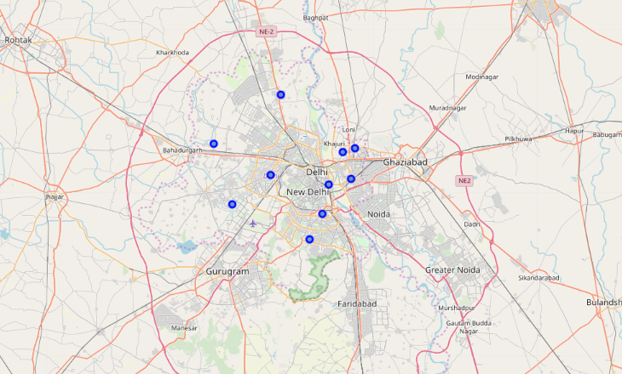
2. Getting Latitudes and Longitudes
In obtaining the location data of the Headquarters of the Districts, the Geocoder package is used with the arcgis_geocoder to obtain the latitude and longitude of the needed locations.
3. Map Visualization
Using the geopy library, the latitude and longitude values of Delhi is obtained. The geographical coordinate of Delhi are 28.6517178, 77.2219388.

Slide 10
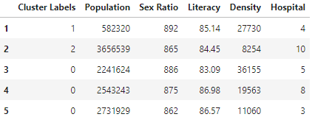
4. Clustering
The venues will be clustered based on the processed data obtained above.
In clustering the data points will maximum inter distance and minimum intra distance is will be clustered in a single cluster.
Now, how to decide how many cluster we should choose:
Optimal Number of Clusters for K-means
To get the optimal number of clusters to be used for the K-mean, there are a number ways possible for the evaluation. Therefore, in this task, the following are used:
Elbow (Criterion) Method
Silhouette Coefficient

Slide 11
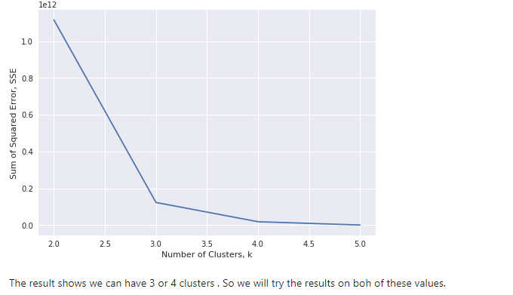

Elbow Method
The approach for this is to run the k-means clustering for a range of value k and for each value of k, the Sum of the Squared Errors (SSE) is calculated., calculate sum of squared errors (SSE). When this is done, a plot of k and the corresponding SSEs are then made. At the elbow (just like arm), that is where the optimal value of k is. And that will be the number of clusters to be used. The whole idea is to have minimum SSE.
2. Silhouette Coefficient
To find the optimal value of the number of clusters, k, the number of clusters is iterated corresponding Silhouette Coefficients calculated for each of the k-values used. The highest Silhouette Coefficient gives the best match to its own cluster.

Slide 12
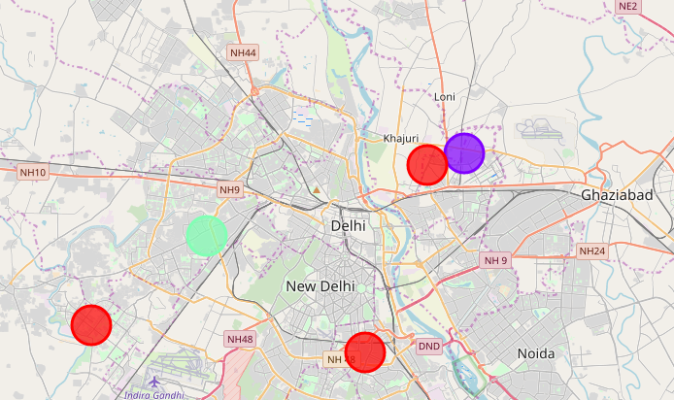
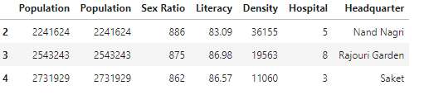


Visualizing the resulting clusters
Cluster 1
Cluster 2
Cluster 3

Slide 13
RESULT
The following are the highlights obtained from above 3 clusters and the data analysis:
It is surprising to know that despite being the most populated area of Delhi, we are have only 10 hospitals in Kanjhawala.
whereas daryaganj has 4 hospitals for 0.5 million people.
Although the clusters have variation, but as compared to population each district is short of hospitals.
The number of number of hospitals is less in cluster 1 as compared to the population they are catering to.

Slide 14
Discussion and Conclusion
Although if we see from population density point of view each area requires more number of hospitals to provide health care facilities to more number of people.
But, to be specific it will be beneficial to open a hospital in at Saket South Delhi and Nand Nagri, North East Delhi as this will cater to more population and the provide more health care facilities as there are more people in these areas and less facilities. We were not able to find any venues nearby Kanjhawala , the reason is that Khanjawala is a village and has very less amenities within 1kms.
Some drawback of these analyses is that clustering is done on only the most common venues which are obtained using four square location. Also, we have taken into consideration one city under each district . Also the result can vary if we use other clustering techniques like DBSCAN.
In conclusion, this project would have had better results if there were more data in terms of basic facilities like water etc. within the area, price of the land, traffic access and allowance of more venues exploration with the Foursquare (limited venues for free calls). Also, getting the speciality of hospital within the clusters would have helped in providing more insight into the best location.

Slide 15
THANK YOU

