Slide 1
Haystack
Private Electrum sync
A light wallet's real addresses, hidden among decoys, and the hiding measured by attacking it.
Padding 10: one real address (solid) in every ten sent
Built for BOSS Battle · Cypherpunk track
github.com/yogesh0509/Haystack
Notes:
Haystack is about one specific leak: what a light Bitcoin wallet tells the server it syncs with. It hides the wallet's real addresses among decoy addresses, so the server can't tell which ones are the wallet's. The second half of the project is just as important: an attacker, written in the same repository, that plays the server and measures how well the hiding works. The grid on the right is the idea in one picture: at padding 10, one address in every ten sent is real.

Slide 2
One sync hands over the whole wallet
Receive addresses 0–49
then change 0–49
Light wallet
stock bdk_wallet scan
Electrum server
logs every query
one connection, one burst
Each square is one address the server was asked about, in arrival order. All 100 belong to one wallet, and the order labels which ones hold change.
Source: a stock bdk_wallet full scan, logged by the repo's honeypot server (docs/00-problem.md §4).
Notes:
A light wallet doesn't know which of its addresses have been used, so on every sync it asks the server about all of them, including the unused ones it will hand out next. Electrum servers receive a scripthash, a SHA-256 of the address's script, but that hash is public and unkeyed, so it identifies the address as well as the address itself does. The repo's honeypot, a fake server that logs every query, received all 100 of a stock bdk_wallet scan's scripthashes together, on one connection. The first 50 were receive addresses and the last 50 change addresses, so even the change is labelled by order. The operator ends up with the wallet's full address set, balance, history, change, and the addresses it will be paid at next.

Slide 3
Today's fixes leave a gap
NO PRIVACY
HAYSTACK'S TARGET
EXPERTS ONLY
Ask a public Electrum server
Privacy without a node
Run your own node
Cheap and easy. The server learns every address.
Privacy from the Electrum servers wallets already use.
Private, but needs a machine, hundreds of GB and uptime.
Partial fixes
Tor
Hides your IP address, not which addresses you ask about.
Bloom filters (BIP37)
Bitcoin's first try. Wallets under about 20 addresses leak almost all of them.
Compact block filters
Far more private, but heavy on mobile bandwidth and slow.
Notes:
Today the private option is running your own node, which needs a machine, hundreds of gigabytes and constant uptime, so almost no mobile user does it, while asking a public Electrum server gives no privacy at all. Tor hides your IP address, but the server still receives the complete labelled set of addresses. Bloom filters, BIP37, were Bitcoin's first attempt to hide the address list; Gervais and colleagues showed in 2014 that a wallet with fewer than about 20 addresses reveals almost all of them, and that a restart makes it worse. Compact block filters, BIP157 and 158, are the honest protocol-level answer, but the bandwidth is punishing on mobile, sync is slow, and the server still learns which blocks you fetched. Haystack targets the space between the two ends, privacy from the Electrum servers wallets already use (docs/00-problem.md, section 7; docs/05-prior-art.md).

Slide 4
Haystack in four ideas
external 0–80: 9
internal 0–51: 9
bits
same shape, no owner
0
3.32
Padding
Decoy
Ledger
Score
Each real address is sent with padding − 1 decoys. The user sets it on a dial.
An address of the same type that nobody owns, from a keyed hash.
Freezes each address's decoy count. Decoys are never withdrawn.
The repo's attacker guesses which are real. The result, in bits.
Notes:
Haystack sends each real address among decoys to an unmodified Electrum server, keeps only the real answers, and measures the hiding with its own attacker; four ideas carry it. Padding is the dial: at padding 10, each real address goes out with 9 decoys. A decoy is a made-up address of the same script type as the real one, built from a keyed hash of the wallet's public keys, so nobody holds a key for it. The ledger records, per keychain and index range, how many decoys each address was given the first time it was queried; the example shown is the real ledger the demo wrote, 9 decoys for external 0 to 80 and internal 0 to 51. The score is what the repo's attacker achieves when it tries to pick the real addresses out, reported in bits; the next slides explain each one.

Slide 5
Privacy is measured in bits
1
The attacker picks as many addresses as the wallet really has.
2
Precision is the share of its picks that are real.
3
Score = −log₂(precision), capped at random guessing.
Haystack at padding 10: about 2.6–2.7
structural attacker, mean of 13 test wallets
bits
0
1
2
3
Plain Electrum: 0.00
every pick right: −log₂(1) = 0
Ceiling at padding 10: 3.32
10% right, as random: −log₂(0.1) = 3.32
A second score covers only addresses with coin history, so unused addresses can't hide exposed funds.
Notes:
The score answers one question: if the attacker names as many addresses as the wallet really has, how many of its picks are right? Plain Electrum sends only real addresses, so every pick is right, precision is 100 percent, and minus log base 2 of 1 is 0 bits. At padding 10, a random pick of 100 addresses out of 1,000 is right 10 percent of the time, and minus log base 2 of 0.1 is 3.32 bits, the most that setting can give. Against the strongest attacker in the repo, which learns from 12 other wallets' syncs, Haystack scores about 2.6 to 2.7 bits averaged over 13 test wallets (README, 'What is finished'). A second number, the same precision among addresses with coin history only, is always printed beside it, because the many unused addresses could otherwise hide exposed funds (docs/03-metric.md).

Slide 6
Redrawn decoys are undone in three syncs
A 100-address wallet sends 900 decoys per sync. Each cell is the attacker's score after that sync, in bits.
sync 1
sync 2
sync 3
sync 4
sync 5
sync 6
Fresh
redrawn every sync
3.32
0.12
0.00
0.00
0.00
0.00
Rotated
redrawn every 3 syncs
3.32
3.32
3.32
0.08
0.08
0.08
Fixed
the same every sync
3.32
3.32
3.32
3.32
3.32
3.32
Haystack
Real addresses appear in every sync and a redrawn decoy rarely does twice, so comparing syncs leaves only the wallet.
Output of python3 -m attack strategies (docs/00-problem.md §6), checked by tests/test_regression.py.
Notes:
This is the most important result in the repo, and it rules out the obvious design. If decoys are redrawn every sync, the server can intersect what two or three syncs asked for: the real addresses are in all of them, a fresh decoy almost never is. After sync 2 only 9 decoys survive next to the 100 real addresses, which is 0.12 bits; after sync 3 none do. Rotating decoys every three syncs only delays the same collapse to the first sync of the second epoch. Keeping the same decoys forever leaves nothing to remove, which is the rule Haystack follows; the table is the real output of python3 -m attack strategies.

Slide 7
Same decoys every sync, never withdrawn
Public keys
the wallet's account xpubs
Decoy key
tagged SHA-256 of the xpubs
HMAC-SHA256(key,
keychain ‖ index ‖ j)
Decoy j
same script type as the real one
address 0
address 1
address 2
new address
Sync 1
Sync 2
Sync 3, after a payment
9 new decoys, in the same sync
Each block is one address and its decoys, drawn sorted; on the wire they are shuffled.
The ledger saves each count before anything is sent, so a crash or a reinstall sends the same set again.
Notes:
Decoy j for a position is an HMAC-SHA256 of the keychain, the index and j, under a key that is a tagged SHA-256 of the wallet's account xpubs, its extended public keys. Because the key comes from the wallet's own public keys, every device and every reinstall derives exactly the same decoys without being told anything. So syncs 1 and 2 send byte-identical sets, and the intersection attack finds nothing to remove. When a payment moves the wallet's last used address forward, the new position arrives with its own 9 new decoys in the same sync; an address first sent alone would stand out in the difference between two syncs. The ledger records each count before the decoys go out, so a crash between the two can't hand a position a different set next time.

Slide 8
Privacy costs bandwidth, not correctness
KiB per steady-state sync, paid regtest wallet
8.4×
the bytes of a plain sync (253.42 ÷ 30.14 KiB)
11.9 MiB a day
48 automatic syncs at the default 30-minute average
✓
Same balance, transactions, coins and chain tip as plain bdk_electrum, through a reorganisation and a double-spend (cargo test -p haystack-regtest).
Notes:
The price of padding is bandwidth. On the paid regtest wallet's second sync, with its cache warm, a plain sync moved 30.14 KiB and padding 10 moved 253.42 KiB: 253.42 divided by 30.14 is 8.4 times (docs/07-walkthrough.md, case 10). Automatic syncs run on a random timer averaging 30 minutes, which is 24 times 60 divided by 30, or 48 syncs a day; 48 times 253.5 KiB is about 11.9 MiB a day (docs/02-design.md, 'Sync scheduling'). What padding never costs is correctness: the regtest tests run Haystack and plain bdk_electrum against a real electrs and require identical balances, transactions, unspent coins, used indices and chain tip, through a one-block reorganisation and a double-spent payment.

Slide 9
Four Rust crates and a Python attacker
On the device (trusted)
Measurement, run locally
demo/
the wallet page: dial, balance, score
session log in, score out
attack/ (Python)
A1 compares syncs, A2 learns shape; prints bits
bdk_wallet (upstream)
descriptors, keychains, stored transactions
regtest/
local chain, correctness tests, training sessions
haystack-electrum/ the padded sync client
Electrum server
across the network, unmodified
client.rs
planner.rs
decoy.rs
chain.rs
ledger.rs
cache_file.rs
capture/ scripts/
stock-wallet baseline, honeypot server
session.rs
schedule.rs
key.rs
Notes:
The repo is a Cargo workspace of four crates plus a Python package. haystack-electrum is the product: the padded client, with one file per job, from the planner that decides which positions to query to the ledger, the saved cache, the session log and the sync timer. demo is a web wallet built from bdk_wallet's own Electrum example with only the five allowed changes; after every sync it runs the attacker on the session log and shows the score. attack is the Python attacker: A1 compares syncs, A2 is a classifier trained on other wallets' sessions, which regtest generates on a local Bitcoin chain alongside the correctness tests. capture and scripts record what an unmodified wallet sends and include the honeypot server, the baseline every score is calibrated against.

Slide 10
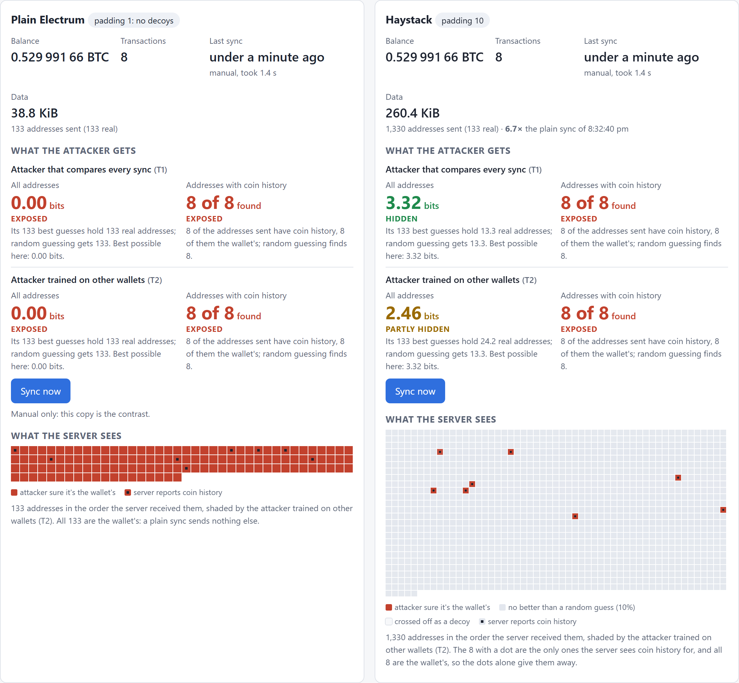
The demo: plain and Haystack side by side
1
Same balance, same 8 transactions
Padding changes what the server sees, not what the wallet shows.
2
0.00 bits against 3.32 and 2.46
Plain is fully exposed. Haystack is hidden from the comparing attacker and partly hidden from the trained one.
3
8 of 8 funded addresses found
This restored wallet's addresses with coin history stay exposed: the main known limit.
Real capture: one sync per copy, regtest chain (worthless coins).
Notes:
This is the demo wallet's Lab tab, captured for this deck after one sync of each copy on a local regtest chain. Both copies show the same balance and the same 8 transactions, which is the correctness claim made visible. Plain Electrum sent 133 addresses and both attackers read 0.00 bits; Haystack sent 1,330 and read 3.32 bits from the attacker that compares syncs and 2.46 from the attacker trained on other wallets. The data line reads 6.7 times the plain sync because this is a first sync; the 8.4 times on the bandwidth slide is the steady-state second sync with a warm cache. Both copies also find 8 of 8 addresses with coin history: made-up decoys never have history, so a restored wallet's funded addresses stand out, which is the next slide.

Slide 11
What Haystack does not hide yet
!
A restored wallet's funds
!
An address paid while watched
Made-up decoys never have history, so any address with history must be real.
It goes from no history to some, and nobody pays a decoy.
!
Attacks nobody has built
!
Obfuscation, not cryptography
On-chain linking and sync timing aren't scored, so the score covers only the attacks in the repo.
The bound is measured, not proven. Private information retrieval would prove it, at a cost no Electrum server supports today.
Notes:
These limits are stated in the README and measured where possible, not discovered later. A restored wallet's funded addresses stay exposed: decoys taken from the chain would fix that against the structural attacker, but Haystack finds them by asking the same server, which could name every one from its own log, so an independent lookup server is the planned fix. A payment to a watched address exposes it with certainty, because an address that goes from no history to some must be real. On-chain clustering and timing attacks aren't built, and every score holds only against the attacks in the repo. Finally, this is obfuscation: the privacy is an empirical score, not a cryptographic guarantee.

Slide 12
Try it yourself
Five minutes, no build: Python standard library only
# Why redrawn decoys fail, by the project's own attacker
python3 -m attack strategies
# Six real padded syncs, scored by the same attacker
python3 -m attack score --session tests/fixtures/haystack-session.jsonl \
--honeypot tests/fixtures/haystack-honeypot-log.json --tier T1
The demo wallet on any system, with Docker
git clone https://github.com/yogesh0509/Haystack.git
cd Haystack
docker build -t haystack .
docker run -it --rm -p 127.0.0.1:7878:7878 -v haystack-out:/haystack/out haystack
Notes:
Two ways in. The first needs only Python's standard library and a clone: the strategies table from earlier, and the six padded syncs committed as fixtures, which read 3.32 bits each. The second runs the whole demo in Docker on Linux, macOS or Windows: it starts a private regtest chain, gives the wallet a history, and serves the page at 127.0.0.1 port 7878 once the log says it is ready. The README notes the build took five and a half minutes on an 8-core machine, and it downloads bitcoind and electrs checked against pinned hashes. A native build with cargo is described in the README, and docs/07-walkthrough.md runs every case with its expected output.

Slide 13
Haystack
Private Electrum sync
github.com/yogesh0509/Haystack
Start with docs/00-problem.md and docs/07-walkthrough.md: every number has a command that reproduces it.
Next on the roadmap: an independent lookup server for chain decoys, and attacks on on-chain links and sync timing.
GPL-3.0
Padding 10: one real address (solid) in every ten sent
Notes:
Everything shown today is in the repository, and each number has the command that reproduces it, starting from docs/00-problem.md and docs/07-walkthrough.md. The roadmap's next items are an independent lookup server so chain decoys can't be named from the sync server's log, and the attacks that aren't built yet: on-chain clustering and sync timing. The code is GPL-3.0. Thank you.

