Slide 1

TJS ENGINEERING COLLEGE
(Approved by AICTE&Affiliated to Anna University Chennai & Accredited by NAAC) An ISO 9001 : 2015 Certified Institution
DEPARTMENT OF COMPUTER SCIENCE AND ENGINEERING
Project name : Smart Water Management.
Phase-4 .
Team name : Proj_112821_team_3.
Team members :
Sathish Kumar.S(112821104063).
Sai Kumar.S(112821104056).
Venkatesh.M(112821104072).
Yogesh.S(112821104076).
Srikanth.K(112821104068).

Slide 2
ABSTRACT:
The established method of testing water quality is to gather samples of water manually and send to the lab to test and analyze. This method is time consuming, wastage of man power, and not economical. The water quality measuring system that we have implemented checks the quality of water in real time through various sensors (one for each parameter: pH, conductivity, temperature, turbidity, oxidation_reduction_potential) to measure the quality of water. As a variation in the value of this parameter points towards the presence of pollutants. This system can keep a strict check on the pollution of the water resources and be able to provide an environment for safe drinking water. Thus the quality of the water is measured using the sensors and the corresponding action will be taken to resolve the problem. Here in addition to this we can also use level detection sensors like ultrasonic sensors to detect the level of the water incase of fresh water resources. Thus management of water is performed.

Slide 3
OBJECTIVE:
We have to measure the values of temperature, pH values, conductivity, oxidation reduction potential, turbidity. People face many health-related issues because of using contaminated water. An efficient water quality monitoring system using IBM Watson is potential constraint for determining quality of water .
So to analyze the condition of the water resources like quality and the level, we can use the IOT based sensor devices, which collects all the data necessary to analyze the condition of the water resources.
We all know that, the condition of good drinking water should satisfy certain requirements like it should have correct ph level, it should be turbidity free, should have compact temperature.

Slide 4
LITERATURE SURVEY:
EXISTING PROBLEM:
The existing Water Quality monitoring system employ human towards sampling the water Quality, Testing and perform the analysis. Currently some amount of technological innovation has been applied in water quality monitoring by using robotic fish, Digital camera and laser beam. Also research been done by employing wireless sensor also in water quality monitoring.
There is no automation to find out the condition of the water quickly. Everything relies on the manual work of collecting the data to find out the condition of the water which consumes much time and hence finally the correcting actions also get delayed.

Slide 5
PROPOSED SOLUTION:
The challenge with the existing system is that there is no fully automated water Quality monitoring system using IBM Watson employing Sensors. Also system possess no intelligence as such which allows for analyzing the data for prediction. These systems so developed communicate within a small geographical area.
In this proposes system, IOT technology is used which is using the necessary sensors to collect the required data from the water resources. Hence the automation is invoked instead of the manual power.
Hence quick actions will be taken to mitigate the condition of the water incase of any problem with the condition of the water.

Slide 6
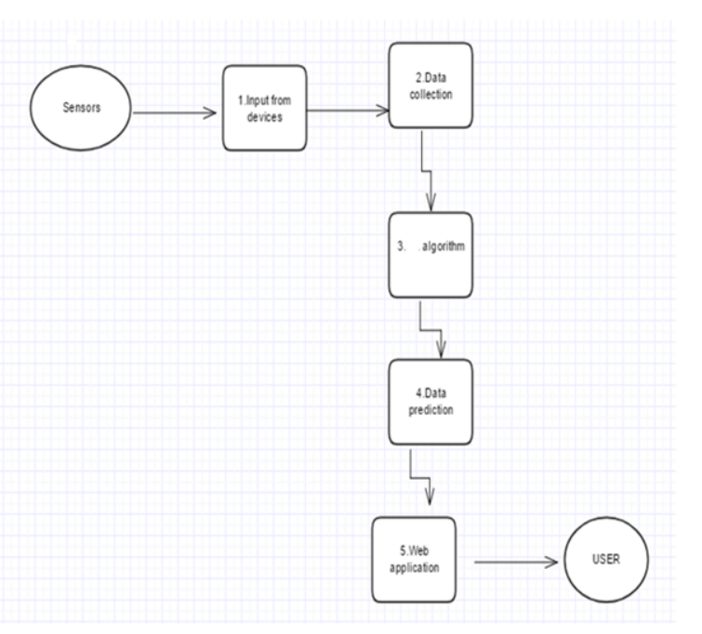
BLOCK DIAGRAM:

Slide 7
SOFTWARE REQUIRED:
Python
IOT Cloud Platform
IBM Cloud
Node- RED
IBM IOT Platform

Slide 8
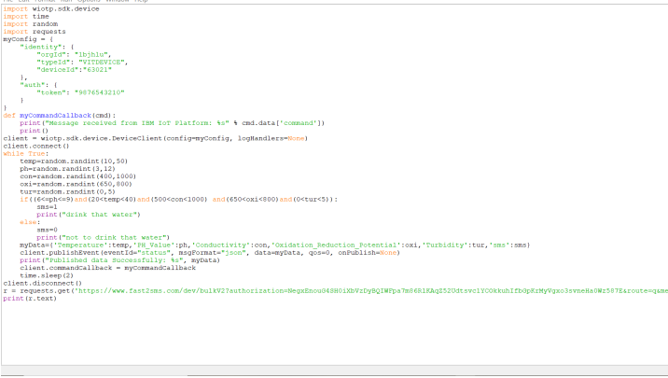
CODE:

Slide 9
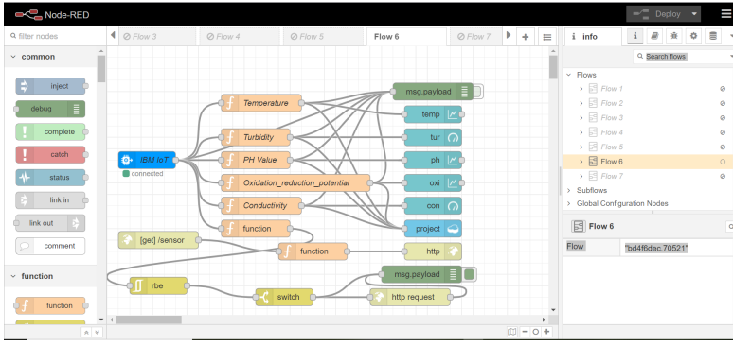
NODE-RED SCHEMATC VIEW

Slide 10
CONCLUSION:
The low cost, efficient, real-time water quality monitoring system using IBM Watson has been implemented and tested. Through this system, the officials can keep track of the levels of pollution occurring in the water bodies and send immediate warnings to the public. This can help in preventing diseases caused due to polluted water and presence of metals.
The real time system which performs the monitoring of the water resources is established using the IOT sensors and the IBM cloud platform.

Slide 11
THANK YOU

