Slide 1


Laptop Price Prediction
This project aims to develop machine learning models to accurately predict laptop prices based on various features and specifications.

Slide 2

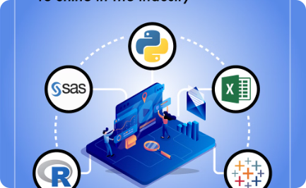

Project Overview and Scope
Overview
Scope
Collaboration
This project aims to develop a machine learning model for predicting laptop prices based on various features such as processor, RAM, storage, and more. The model will be trained using Linear Regression and Random Forest algorithms.
The project scope includes data collection, exploratory data analysis, feature engineering, model training, evaluation, and deployment. The goal is to provide a reliable and accurate price prediction tool for customers and businesses.
The project will involve a cross-functional team of data scientists, machine learning engineers, and business analysts to ensure the model aligns with the business requirements and delivers maximum impact.

Slide 3
Business Problem and Objective
Laptop Price Prediction
Objective
The business problem is to help consumers find the best laptop at the most suitable price point based on their specific needs and budget.
The objective is to develop accurate machine learning models that can predict laptop prices based on features such as processor, RAM, storage, and other technical specifications.

Slide 4



Technical Stack and Approach
Languages
Algorithms
Tools
Python is the primary language used for this project, with a focus on libraries like NumPy, Pandas, and Scikit-learn.
Two machine learning models will be developed: Linear Regression and Random Forest Regression.
Jupyter Notebook and relevant data analysis/visualization libraries will be used for exploratory data analysis and model building.

Slide 5

Data Collection and Understanding
Data Sources
Data Cleaning and Preprocessing
Feature Engineering
The laptop price data was collected from various online marketplaces and retailer websites, providing a comprehensive dataset covering a wide range of laptop models and specifications.
Key features such as processor speed, RAM, storage capacity, and display size were extracted from the data and transformed into a format suitable for machine learning models.
The raw data was thoroughly cleaned, with missing values imputed and outliers removed to ensure the integrity and reliability of the dataset.

Slide 6
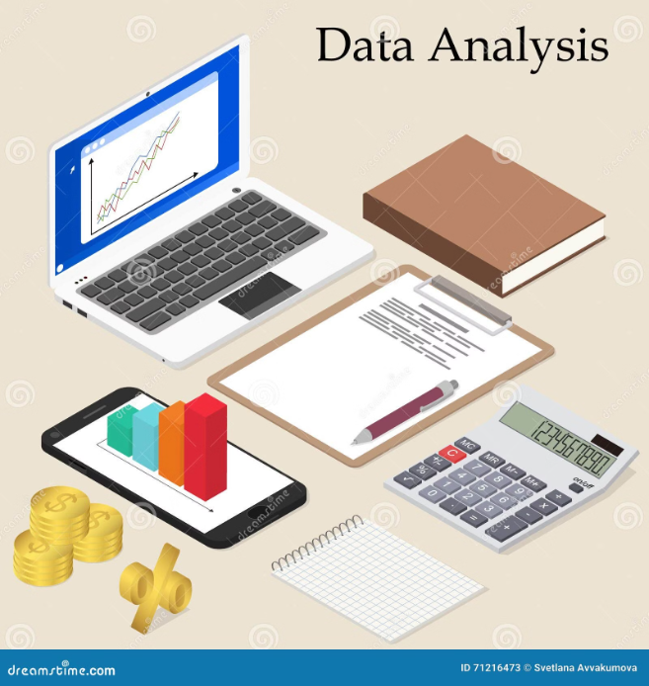
Exploratory Data Analysis
Conducted a thorough exploratory data analysis to understand the dataset and identify key trends and relationships.
Analyzed the distribution of the target variable (laptop prices) and identified the factors with the strongest correlation to price.
Explored the relationships between different features, such as screen size, processor speed, and memory capacity, to uncover insights that will inform the model development process.

Slide 7




Model Development (Linear Regression and Random Forest)
Linear Regression
Trained a linear regression model on the laptop price data, evaluating its performance using R-squared, RMSE, and other key metrics.
Feature Engineering
Engineered new features like price-to-performance ratio and weighted processor speed to improve model accuracy.
Random Forest
Implemented a Random Forest model, leveraging its ability to capture non-linear relationships and handle complex feature interactions.
Hyperparameter Tuning
Carefully tuned hyperparameters like the number of trees and max depth to optimize the performance of the Random Forest model.

Slide 8
Conclusion and Next Steps
Key Insights
Next Steps
The analysis revealed that factors like processor speed, RAM, and storage capacity are the most influential in determining laptop prices. The models also highlighted the importance of brand recognition and display quality.
Going forward, we plan to expand the dataset to include more recent models and incorporate additional features such as battery life and warranty information. This will help refine the predictive capabilities of the models.

Slide 9

Questions If any ??
We have covered a lot of ground in our presentation on the Laptop Price Prediction project. At this point, we welcome any questions you may have about the technical approach, data analysis, model development, or potential next steps. Please feel free to ask, and we will do our best to provide clear and informative responses.

Slide 10

Thank you
Thank you for your attention and for joining us today. We appreciate your interest in our Laptop Price Prediction project and hope the presentation was informative and insightful.

