Slide 1



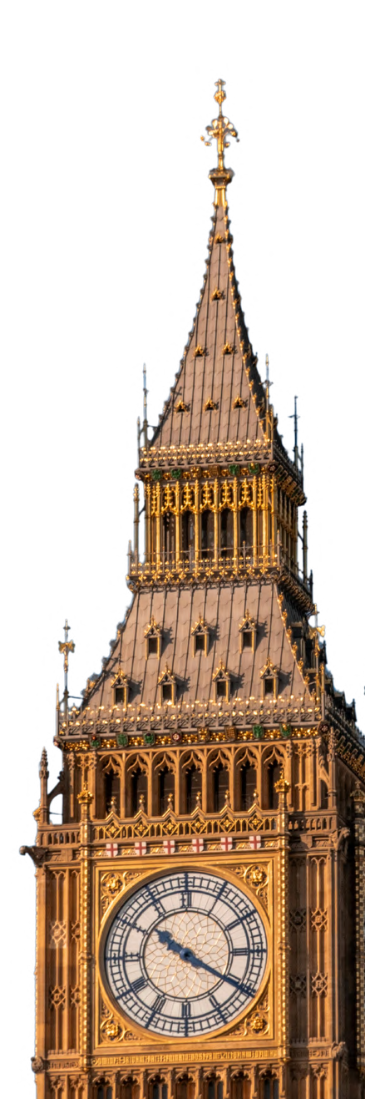
ALEROPATH CONNECT
The Community Engine
Presented by
Team members

Slide 2




The Problem

Slide 3


Our Vision

Slide 4



The Solution
A Unified Digital Community Ecosystem

Slide 5


How It Works

Slide 6


The Core Features

Slide 7


Technical Architecture
System Design Overview

Slide 8


What Makes It Different

Slide 9


Impact

Slide 10


Product Roadmap

Slide 11
Product / Demo
Key Screens & User Flows
OPTIONAL
IF YOU DONT REQUIRED PLEAS REMOVE THIS SLIDE

Slide 12
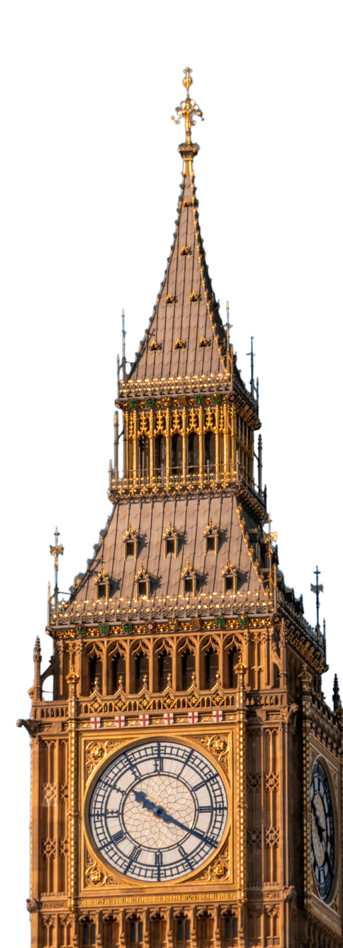







THANK YOU

