Slide 1

Presented by
Neeharika Buddha
Graduate student, University of Kansas
October 22, 2009
EECS710

Slide 2
Contents
Introduction
Classical DoS attacks
Flooding attacks
Distributed Denial-of-Service (DDoS)
How DDoS attacks are waged?
Reflector and amplifier attacks
Other DoS attacks
Detecting DoS attacks
Approaches to defense against DoS
Responding to a DoS attack
Conclusion

Slide 3
Contents
Introduction
Classical DoS attacks
Flooding attacks
Distributed Denial-of-Service (DDoS)
How DDoS attacks are waged?
Reflector and amplifier attacks
Other DoS attacks
Detecting DoS attacks
Approaches to defense against DoS
Responding to a DoS attack
Conclusion

Slide 4
Definition
Denial-of-service (DoS) attack aims at disrupting the authorized use of networks, systems, or applications
  by sending messages which exhaust service provider’s resources ( network bandwidth, system resources, application resources)
Distributed denial-of-service (DDoS) attacks employ multiple (dozens to millions) compromised computers to perform a coordinated and widely distributed DoS attack
Victims of (D)DoS attacks
  service-providers (in terms of time, money, resources, good will)
  legitimate service-seekers (deprived of availability of service itself)
  Zombie systems(Penultimate and previous layers of compromised systems in DDoS)

Slide 5
Analyzing the goal of DoS attacks
A (D)DoS attack is different in goal : iWar, in short
  Just deny availability
  Can work on any port left open
  No intention for stealing/theft of information
    Although, in the process of denying service to/from victim, Zombie systems may be hijacked

Slide 6
Who? What for?
The ulterior motive
  Earlier attacks were proofs of concepts or simple pranks
  Pseudo-supremacy feeling (of defaulters) upon denying services in large scale to normal people
    DoS attacks on Internet chat channel moderators
  Eye-for-eye attitude
  Political disagreements
  Competitive edge
  Hired
Major lack of data on perpetrators and motives
Levels of attackers
  Highly proficient attackers who are rarely identified or caught
  Script-kiddies
Source: Mirkovic, J., Dietrich, S., Dittrich, D., & Reiher, P. (2005)

Slide 7
Why should we care?
As per 2006 CSI/FBI Computer Crime and Security Survey
  25% of respondents faced some form of DoS attacks in previous 12 months. This value varied from 25% to 40% over the course of time
  DoS attacks are the 5th most costly form of attacks
A DoS attack is not just missing out on the latest sports scores or Tweets or weather reports
Internet is now a critical resource whose disruption has financial implications, or even dire consequences on human safety
  Cybercrime and cyberwarfare might use of DoS or DDoS as a potential weapon to disrupt or degrade critical infrastructure
  DDoS attacks are a major threat to the stability of the Internet
Source: Mirkovic, J., Dietrich, S., Dittrich, D., & Reiher, P. (2005)

Slide 8
Fast facts
In Feb 2000, series of massive DoS attacks incapacitated several high-visibility Internet e-commerce sites, including Yahoo, Ebay and E*trade
In Jan 2001, Microsoft’s name sever infrastructure was disabled
  98% legitimate users could not get to any Microsoft’s servers
In Sept 2001, an attack by a UK-based teenager on the port of Houston’s Web server, made weather and scheduling information unavailable
  No ships could dock at the world’s 8th busiest maritime facility due to lack of weather and scheduling information
  Entire network performance was affected
In Oct 2002, all Domain Name System servers were attacked
  Attack lasted only an hour
  9 of the 13 servers were seriously affected
In Aug 2009, the attack on Twitter and Facebook

Slide 9
Approaches to DoS attacks
Internet designed for minimal-processing and best-effort forwarding any packet
  Make shrewd use of flaws in the Internet design and systems
  Unregulated forwarding of Internet packets : Vulnerability ,Flooding
Vulnerability attack
  Vulnerability : a bug in implementation or a bug in a default configuration of a service
  Malicious messages (exploits) : unexpected input that utilize the vulnerability are sent
  Consequences :
    The system slows down or crashes or freezes or reboots
    Target application goes into infinite loop
    Consumes a vast amount of memory
  Ex : Ping of death, teardrop attacks, etc.
Source: Mirkovic, J., Dietrich, S., Dittrich, D., & Reiher, P. (2005)

Slide 10
Approaches to DoS attacks cont’d ….
Flooding attack
  Work by sending a vast number of messages whose processing consumes some key resource at the target
  The strength lies in the volume, rather than the content
  Implications :
    Make the traffic look legitimate
    Flow of traffic is large enough to consume victim’s resources
    Send with high packet rate
    These attacks are more commonly DDoS
  Ex : SYN spoofing attack, Source address spoofing, cyberslam, etc.
Source: Mirkovic, J., Dietrich, S., Dittrich, D., & Reiher, P. (2005)

Slide 11
Contents
Introduction
Classical DoS attacks
Flooding attacks
Distributed Denial-of-Service (DDoS)
How DDoS attacks are waged?
Reflector and amplifier attacks
Other DoS attacks
Detecting DoS attacks
Approaches to defense against DoS
Responding to a DoS attack
Conclusion

Slide 12
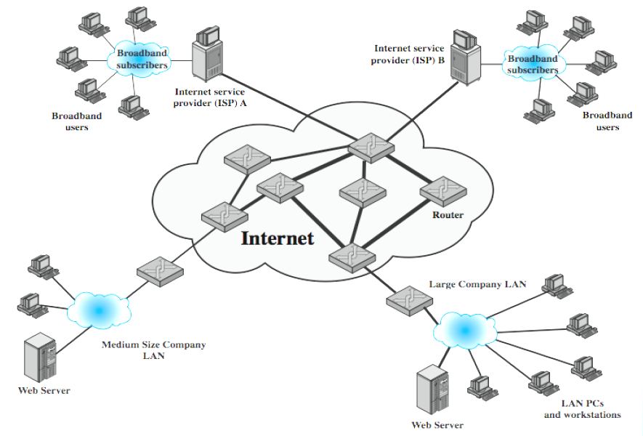
Classical DoS attacks
Simplest classical DoS attack: Flooding attack on an organization
  Ping flood attack
Service denied to legitimate users

Slide 13
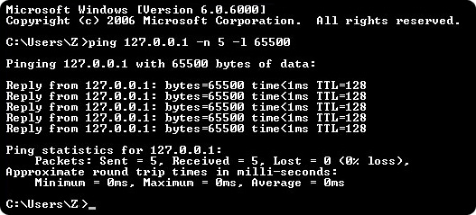
Ping flood attack
Ping of Death
Use of ping command options -n –l
Source: learn-networking.com

Slide 14
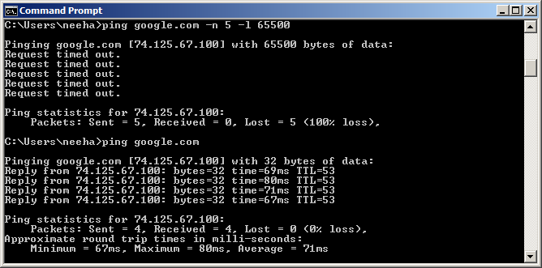
Ping flood attack cont’d ….
Generally useless on larger networks or websites

Slide 15
Disadvantage to attacker
Attacker’s source is easily identified
Chances of attack flow being reflected back to attacker

Slide 16
Source address spoofing
Falsification : Use of forged source IP address
Privileged access to network handling code via raw socket interface
  Allows direct sending and receiving of information by applications
  Not needed for normal network operation
In absence of privilege, install a custom device driver on the source system
  Error prone
  Dependent on operating system version

Slide 17
Spoofing via raw socket interface
Difficult to identify source

Slide 18
Spoofing via raw socket interface cont’d….
Unfortunately removal of raw sockets API is not an apt solution to prevent DoS attacks
  Microsoft’s removal of raw sockets API in the release of Windows XP Service Pack 2 in August 2004 was expected to break applications like the public domain nmap port scanner
  In just a few days, a workaround was produced restoring the ability of nmap to craft custom packets
    http://seclists.org/nmap-hackers/2004/0008.html
Source: Mirkovic, J., Dietrich, S., Dittrich, D., & Reiher, P. (2005)

Slide 19
SYN spoofing
Takes advantage of the three-way handshake that occurs any time two systems across the network initiate a TCP connection request
Unlike usual brute-force attack, not done by exhausting network resources but done by overflowing the system resources (tables used to manage TCP connections)
Require fewer packets to deplete
Consequence: Failure of future connection requests ,thereby denying access to the server for legitimate users
Example: land.c sends TCP SYN packet using target’s address as source as well as destination

Slide 20
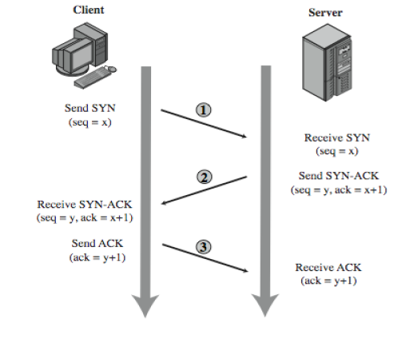
TCP 3-way connection handshake
Address,
Port number,
Seq x
Recorded in a table of known TCP connections
Server in LISTEN State
Vulnerability: Unbounded ness of LISTEN state

Slide 21
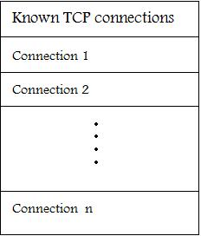
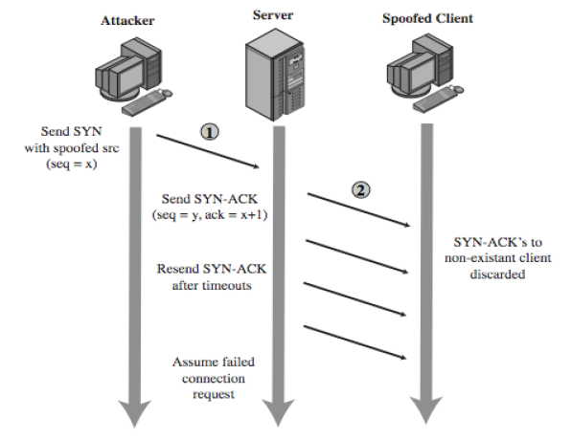
SYN spoofing cont’d ….

Slide 22
Factors considered by attacker for SYN spoofing
The number of sent forged packets are just large enough to exhaust the table but small as compared to a typical flooding attack
Keep sufficient volume of forged requests flowing
  Keep the table constantly full with no timed-out requests
Make sure to use addresses that will not respond to the SYN-ACK with a RST
  Overloading the spoofed client
  Using a wide range of random addresses
  A collection of compromised hosts under the attacker's control (i.e., a "botnet") could be used

Slide 23
Detecting SYN spoof attack
After the target system has tried to send a SYN/ACK packet to the client and while it is waiting to receive an ACK packet, the existing connection is said to be half open or host in SYN_RECEIVED state
If your system is in this state, it may be experiencing SYN-spoof attack
To determine whether connections on your system are half open, type netstat –a command
This command gives a set of active connections .Check for those in the state SYN_RECEIVED which is an indication of the threat of SYN spoof attack
Source: Fadia (2007)

Slide 24
Analysing traffic
Spoofing makes it difficult to trace back to attackers
Analysing flow of traffic required but not easy!
  Requires cooperation of the network engineers managing routers
  Query flow information: a manual process
How about filtering at source itself ?
Backscatter traffic : used to infer type and scale of DoS attacks
  Utilise ICMP echo response packets generated in response to a spoofed ping flood

Slide 25
Contents
Introduction
Classical DoS attacks
Flooding attacks
Distributed Denial-of-Service (DDoS)
How DDoS attacks are waged?
Reflector and amplifier attacks
Other DoS attacks
Detecting DoS attacks
Approaches to defense against DoS
Responding to a DoS attack
Conclusion

Slide 26
Flooding attacks
Goal : Bombarding large number of malicious packets at the victim, such that processing of these packets consumes resources
Any type of network packet can be used
  Attack traffic made similar to legitimate traffic
Valid traffic has a low probability of surviving the discard caused by flood and hence accessing the server
Some ways of flooding :
  To overload network capacity on some link to a server
  To overload server’s ability to handle and respond to this traffic
The larger the packet, the more effective the attack

Slide 27
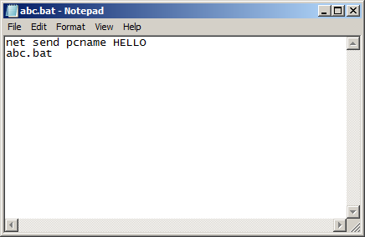
Flooding attack within local network
Simply sending infinite messages from one computer to another on the local network , thereby wasting the resources of the recipient computer to receive and tackle the messages
The following code (abc.bat) sends infinite messages to victim

Slide 28
Types of flooding attacks
Classified based on type of network protocol used to attack
ICMP flood
  Uses ICMP packets , ex: ping flood using echo request
  Typically allowed through, some required
UDP flood
  Exploits the target system’s diagnostic echo services to create an infinite loop between two or more UDP services
TCP SYN flood
  Use TCP SYN (connection request packets)
  But for volume packet

Slide 29
Indirect attacks
Single-sourced attacker would be traced
Scaling would be difficult
Instead use multiple and distributed sources
  None of them generates traffic to bring down its own local network
  The Internet delivers all attack traffic to the victim
Thus, victims service is denied while the attackers are still fully operational
Indirect attack types
  Distributed DoS
  Reflected and amplifier attacks

Slide 30
Contents
Introduction
Classical DoS attacks
Flooding attacks
Distributed Denial-of-Service (DDoS)
How DDoS attacks are waged?
Reflector and amplifier attacks
Other DoS attacks
Detecting DoS attacks
Approaches to defense against DoS
Responding to a DoS attack
Conclusion

Slide 31
Distributed Denial-of-service
Attacker uses multiple compromised user work stations/PCs for DoS by:
  Utilising vulnerabilities to gain access to these systems
  Installing malicious backdoor programs , thereby making zombies
  Creating botnets: large collection of zombies under the control of attacker
Generally, a control hierarchy is used to create botnets
  Handlers: The initial layer of zombies that are directly controlled by the attacker
  Agent systems: Subordinate zombies that are controlled by handlers
  Attacker sends a single command to handler, which then automatically forwards it to all agents under its control
Example: Tribe Flood Network (TFN), TFN2K

Slide 32
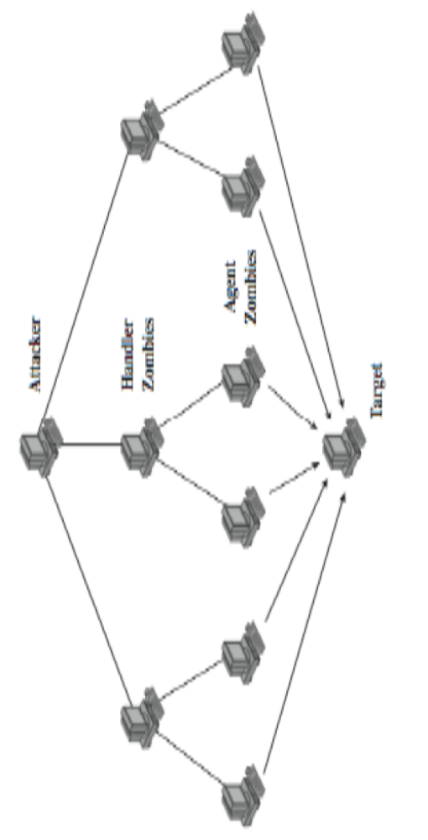
DDoS control hierarchy
Example: Tribe Flood Network (TFN)
  Relied on large number of compromised systems and layered command structure
Command-line program
Trojan Program

Slide 33
Contents
Introduction
Classical DoS attacks
Flooding attacks
Distributed Denial-of-Service (DDoS)
How DDoS attacks are waged?
Reflector and amplifier attacks
Other DoS attacks
(D)DoS attack trends
Detecting DoS attacks
Approaches to defense against DoS
Responding to a DoS attack
Conclusion

Slide 34
How DDoS attacks are waged ?
Recruitment of the agent network
Controlling the DDoS agent network
Use of appropriate toolkits
Use of IP Spoofing
Mirkovic, J., Dietrich, S., Dittrich, D., & Reiher, P. (2005)

Slide 35
Recruitment of the agent network
Scanning
Breaking into vulnerable machines
  Malware propagation
Source: Mirkovic, J., Dietrich, S., Dittrich, D., & Reiher, P. (2005)

Slide 36
Scanning
Find sufficiently large number of vulnerable machines
  Manual or semi-automatic or completely automatic process
  Trinoo: discovery and compromise is manual but only installation is automated
    http://staff.washington.edu/dittrich/misc/trinoo.analysis.txt
  Slammer-,MyDoom- : automated process
Recruit machines that have sufficiently good connectivity
Netblock scans are initiated sometimes
  Based on random or explicit rationale
Examples of scanning tools : IRC bot , worms
Source: Mirkovic, J., Dietrich, S., Dittrich, D., & Reiher, P. (2005)

Slide 37
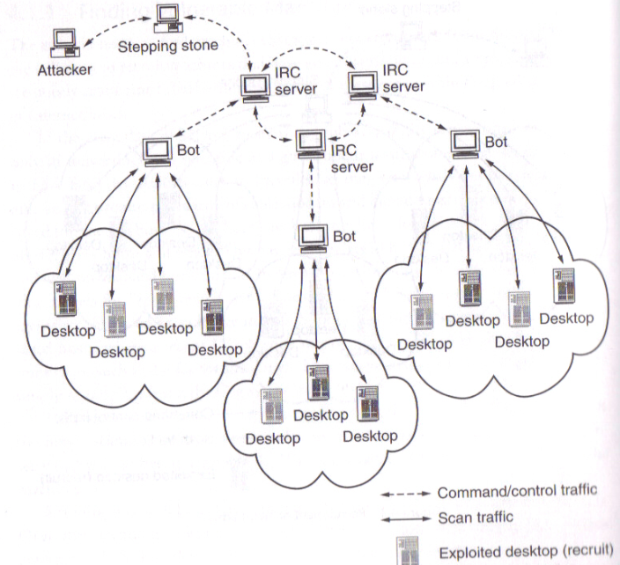
Scanning using IRC bot
Mirkovic, J., Dietrich, S., Dittrich, D., & Reiher, P. (2005)

Slide 38
Scanning using worms
Popular method of recruiting DDoS agents
Scan/infect cycle repeats on both the infected and infecting machines
Worms spread extremely fast because of their parallel propagation pattern
Worms choice of address for scanning
  Random
  Random within a specific range of addresses
  Using hitlist
  Using information found on infected machines
Worms are often not completely cleaned up
  Some infected machines might continue serving as DDoS agents indefinitely!
  Code Red – infected hosts still exist in the Internet
Source: Mirkovic, J., Dietrich, S., Dittrich, D., & Reiher, P. (2005)

Slide 39
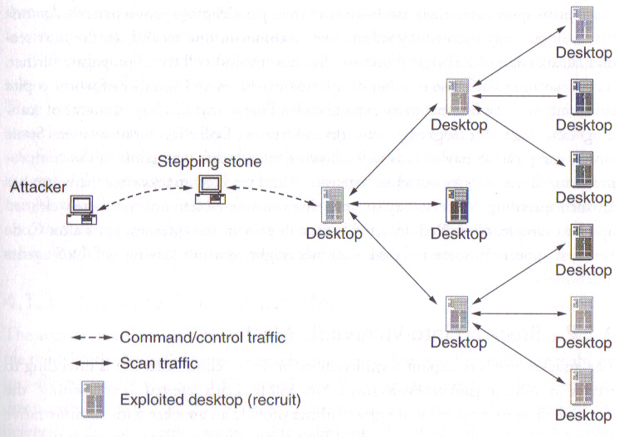
Scanning using worms cont’d ….
Source: Mirkovic, J., Dietrich, S., Dittrich, D., & Reiher, P. (2005)

Slide 40

Breaking into vulnerable machines
Most vulnerabilities provide an attacker with administrative access to system
Attacker updates his DDoS toolkit with new exploits
  Propagation Vectors
Vulnerability Exploitation cycle
New vuln. discovered
Exploited at larger scale
Automated tools appear
Patches for vuln. appear
Exploits for a vuln. decline
Source: Mirkovic, J., Dietrich, S., Dittrich, D., & Reiher, P. (2005)

Slide 41
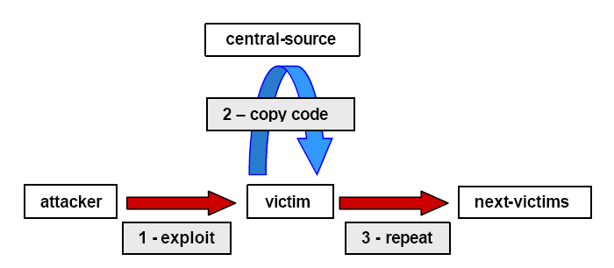
Malware propagation
Propagation with central repository or cache approach
  Advantage for defender: central repositories can be easily identified and removed
  Ex: trinoo , Shaft etc
Source: www.cert.org/archive/pdf/DoS_trends.pdf

Slide 42
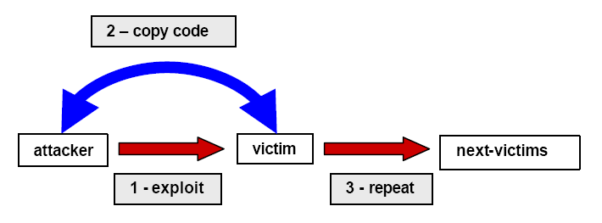
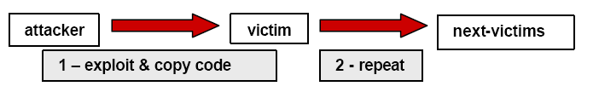
Malware propagation methods cont’d….
Back chaining/pull approach
Autonomous/push approach
TFTP
Source: www.cert.org/archive/pdf/DoS_trends.pdf

Slide 43
Controlling DDoS agent network
Attacker communicates with agents using “many-to-many” communication tools
Twofold-purpose for attacker
  To command the beginning/ending and specifics of attack
  To gather statistics on agent behaviour
Strategies for establishing control
  Direct command control
  Indirect command control
Source: Mirkovic, J., Dietrich, S., Dittrich, D., & Reiher, P. (2005)

Slide 44
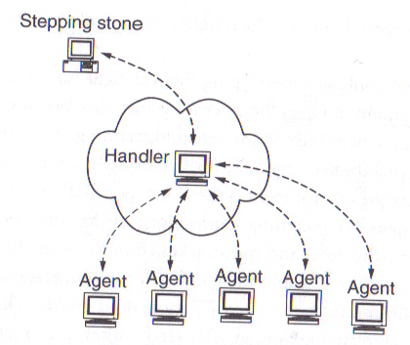
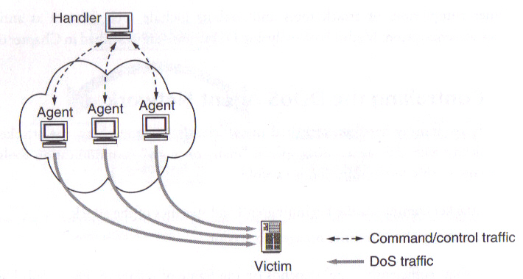
Direct commands control
Source: Mirkovic, J., Dietrich, S., Dittrich, D., & Reiher, P. (2005)

Slide 45
Drawbacks of direct command control
If one machine is captured, the whole DDoS network could be identified
Any anomalous event on network monitor could be easily spotted
Both handlers and agents need to be ready always to receive messages
  Opening ports and listening to them
  Easily caught
Source: Mirkovic, J., Dietrich, S., Dittrich, D., & Reiher, P. (2005)

Slide 46
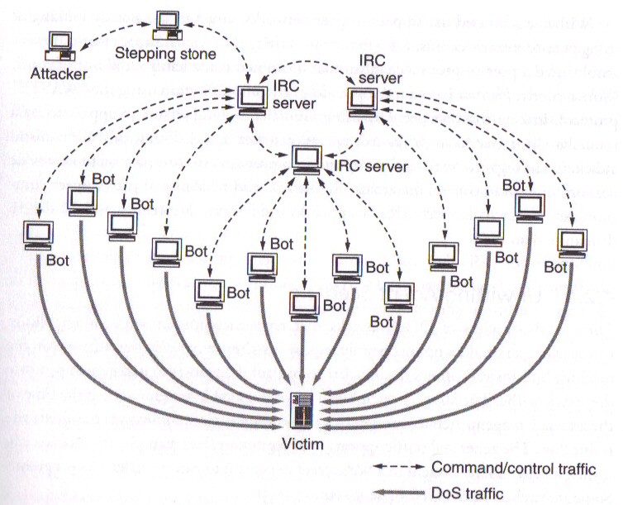
Indirect command control
Where is the handler ?
Source: Mirkovic, J., Dietrich, S., Dittrich, D., & Reiher, P. (2005)

Slide 47
Advantages of IRC to attacker
Server is maintained by others
The channel(handler) not easily recognisable amidst thousands of other channnels
Even though channel is discovered, it can be removed only through cooperation of the server’s administrators
By turning compromised hosts to rogue IRC servers, attackers are a step ahead in concealing their identity
Source: Mirkovic, J., Dietrich, S., Dittrich, D., & Reiher, P. (2005)

Slide 48
DDoS attack toolkits
Some popular DDoS programs
  Trinoo,TFN,Stacheldraht,Shaft,TFN2K,Mstream,Trinity,Phatbot
Blended threat toolkits: Include some (all) of the following components
  Windows network service program
  Scanners
  Single-threaded DoS programs
  An FTP server
  An IRC file service
  An IRC DDoS Bot
  Local exploit programs
  Remote exploit programs
  System log cleaners
Source: Mirkovic, J., Dietrich, S., Dittrich, D., & Reiher, P. (2005)

Slide 49
DDoS attack toolkits cont’d ….
  Trojan Horse Operating systems program replacements
  Sniffers
Phatbot implements a large percentage of these functions in a single program
Source: Mirkovic, J., Dietrich, S., Dittrich, D., & Reiher, P. (2005)

Slide 50
Contents
Introduction
Classical DoS attacks
Flooding attacks
Distributed Denial-of-Service (DDoS)
How DDoS attacks are waged?
Reflector and amplifier attacks
Other DoS attacks
Detecting DoS attacks
Approaches to defense against DoS
Responding to a DoS attack
Conclusion

Slide 51
Reflector and amplifier attacks
Unlike DDoS attacks, the intermediaries are not compromised
R & A attacks use network systems functioning normally
Generic process:
  A network packet with a spoofed source address is sent to a service running on some network server
  A response to this packet is sent to the spoofed address(victim) by server
  A number of such requests spoofed with same address are sent to various servers
  A large flood of responses overwhelm the target’s network link
Spoofing utilised for reflecting traffic
These attacks are easier to deploy and harder to trace back

Slide 52
Reflection attacks
Direct implementation of the generic process explained before
  Reflector : Intermediary where the attack is reflected
  Make sure the packet flow is similar to legitimate flow
Attacker’s preference: response packet size > original request size
Various protocols satisfying this condition are preferred
  UDP, chargen, DNS, etc
Intermediary systems are often high-capacity network servers/routers
Lack of backscatter traffic
  No visible side-effect
  Hard to quantify

Slide 53
Reflection attack using TCP/SYN
Exploits three-way handshake used to establish TCP connection
  A number of SYN packets spoofed with target’s address are sent to the intermediary
Flooding attack but different from SYN spoofing attack
Continued correct functioning is essential
Many possible intermediaries can be used
  Even if some intermediaries sense and block the attack, many other won’t

Slide 54
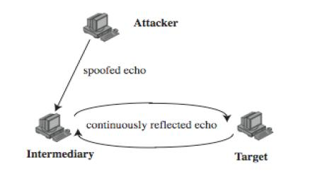
Further variation
Establish self-contained loop(s) between the intermediary and the target system using diagnostic network services (echo,chargen )
Fairly easy to filter and block
Large UDP Packet+
spoofed source

Slide 55
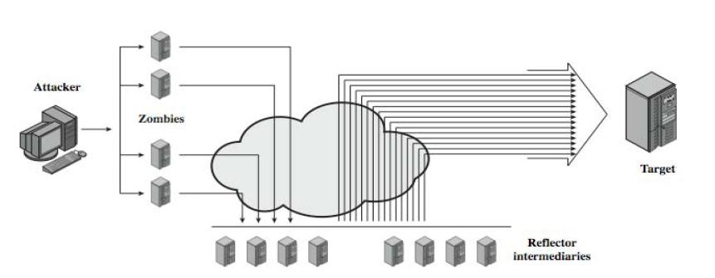
Amplification attacks
Differ in intermediaries generate multiple response packets for each original packet sent

Slide 56
Amplification attacks possibilities
Utilize service handled by large number of hosts on intermediate network
A ping flood using ICMP echo request packets
  Ex: smurf DoS program
Using suitable UDP service
  Ex: fraggle program
TCP service cannot be used

Slide 57
Defense from amplification attack
Not to allow directed broadcasts to be routed into a network from outside

Slide 58
Smurf DoS program
Two main components
  Send source-forged ICMP echo packet requests from remote locations
  Packets directed to IP broadcast addresses
If the intermediary does not filter this broadcast traffic, many of the machines on the network would receive and respond to these spoofed packets
  When entire network responds, successful smurf DoS has been performed on the target network
Besides victim network, intermediary network might also suffer
  Smurf DoS attack with single/multiple intermediary(s)
  Analyze network routers that do not filter broadcast traffic
  Look for networks where multiple hosts respond
Source: http://www.cert.org/advisories/CA-1998-01.html

Slide 59
DNS amplification attacks
DNS servers is the intermediary system
Exploit DNS behavior to convert a small request to a much larger response
  60 byte request to 512 – 4000 byte response
Sending DNS requests with spoofed source address being the target to the chosen servers
Attacker sends requests to multiple well connected servers, which flood target
  Moderate flow of packets from attacker is sufficient
  Target overwhelmed with amplified responses from server

Slide 60
Contents
Introduction
Classical DoS attacks
Flooding attacks
Distributed Denial-of-Service (DDoS)
How DDoS attacks are waged?
Reflector and amplifier attacks
Other DoS attacks
Detecting DoS attacks
Approaches to defense against DoS
Responding to a DoS attack
Conclusion

Slide 61
Teardrop
This DoS attack affects Windows 3.1, 95 and NT machines and Linux versions previous to 2.0.32 and 2.1.63
Teardrop is a program that sends IP fragments to a machine connected to the Internet or a network
Teardrop exploits an overlapping IP fragment bug
  The bug causes the TCP/IP fragmentation re-assembly code to improperly handle overlapping IP fragments
  A 4000 bytes of data is sent as
    Legitimately (Bytes 1-1500) (Bytes 1501 – 3000) (Bytes 3001-4500)
    Overlapping (Bytes 1-1500) (Bytes 1501 – 3000) (Bytes 1001-3600)
This attack has not been shown to cause any significant damage to systems
The primary problem with this is loss of data
Source: Fadia (2007)

Slide 62
Cyberslam
DDoS attack in a different style
Zombies DO NOT launch a SYN Flood or issue dummy packets that will congest the Web server’s access link
Zombies fetch files or query search engine databases at the Web server
From the web server’s perspective, these zombie requests look exactly like legitimate requests
so the server ends up spending lot of its time serving zombies,causing DoS to legitimate users
Source: Kandula (2005)

Slide 63
Techniques to counter cyberslam
Password authentication
  Cumbersome to manage for a site like Google
  Attacker might simply DDoS the password checking mechanism
Computational puzzles
  Computation burden quite heavy compared to service provided
Graphical puzzles
Kill-bots suggested in [Kandula 2005]
Source: Kandula (2005)

Slide 64
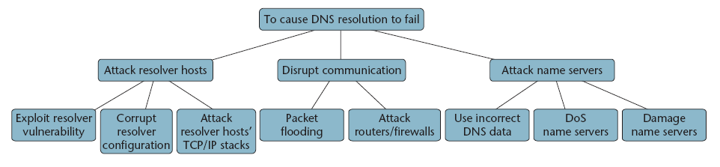
Attack tree: DoS against DNS
Source: Cheung (2006)

Slide 65
How to protect DNS from (D)DoS ?
Multiple scattered name servers
Anycast routing
  Mulitple name servers sharing common IP address
Over-provisioning of host resources and network capacity
Diversity
  DNS software implementation, OS, hardware platforms
TSIG : The transaction signature
Use of dedicated machines
Source: Cheung (2006)

Slide 66
Contents
Introduction
Classical DoS attacks
Flooding attacks
Distributed Denial-of-Service (DDoS)
How DDoS attacks are waged?
Reflector and amplifier attacks
Other DoS attacks
Detecting DoS attacks
Approaches to defense against DoS
Responding to a DoS attack
Conclusion

Slide 67
DoS detection techniques
Detector’s goal: To detect and distinguish malicious packet traffic from legitimate packet traffic
Flash crowds: High traffic volumes may also be accidental and legitimate
  Highly publicised websites: (unpredictable) Slashdot news aggregation site
  Much-awaited events: (Predictable) Olympics, Soccer etc.
There is no innate Internet mechanism for performing malicious traffic discrimination
Once detected, vulnerability attacks are easy to be addressed
If vulnerability attacks volume is so high that it manifests as flooding attack, very difficult to handle
Source: Carl (2006)

Slide 68
Vulnerability attack detection techniques
Detection techniques can be installed locally or remotely
  Locally : detectors placed at potential victim resource or at a router or firewall within the victim’s subnetwork
  Remotely: To detect propagating attacks
Attack defined by detection methods: an abnormal and noticeable deviation of some statistic of the monitored network traffic workload
  Proper choice of statistic is crutial
Source: Cheung (2006)

Slide 69
Statistical detection methods
Activity profiling: Monitoring network packet’s header information
  Backscatter analysis
Sequential change-point detection
  Chi-Square/Entropy Detector
Wavelet Analysis
  Cusum and wavelet approaches
Source: Cheung (2006)

Slide 70

Backscatter
http://www.caida.org/data/passive/network_telescope.xml

Slide 71
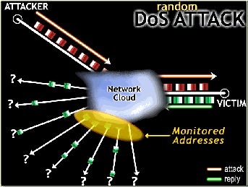
Backscatter cont’d ….
Generally, source addresses chosen at random for spoofing based flooding attacks
Unsolicited Victim’s responses are equi-probably distributed (Backscattered) across the entire Internet address space
  Received backscatter evidence of presence of attacker
Source: Moor (2006)

Slide 72
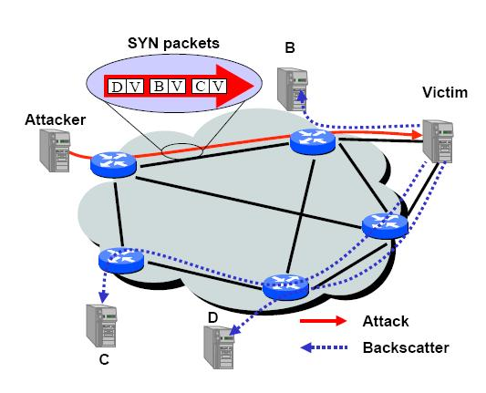
Backscatter analysis
Backscatter analysis used to quantify the prevalence of DoS attacks and identify the type of attack
Assumptions :
  Address uniformity
  Reliable delivery
  One response generated for every packet in an attack
Backscatter hypothesis
  Unsolicited packets observed by the monitor represent backscatter
Source: Moor (2006)

Slide 73




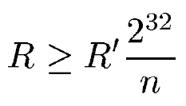
Quantification using backscatter
Network Telescope : Monitoring block of n IP addresses
Probability of a given host receiving at least one unsolicited response from victim during an attack of m packets
Probability of n hosts receiving at least one unsolicited response from victim during an attack of m packets
Expected # of backscatter packets given an attack of m packets at a single host
Expected # of backscatter packets given an attack of m packets at n hosts
Average arrival rate of unsolicited responses (R’ is the measured avg. inter-arrival backscatter rate R is the extrapolated attack rate in pps)
Moor (2006)

Slide 74
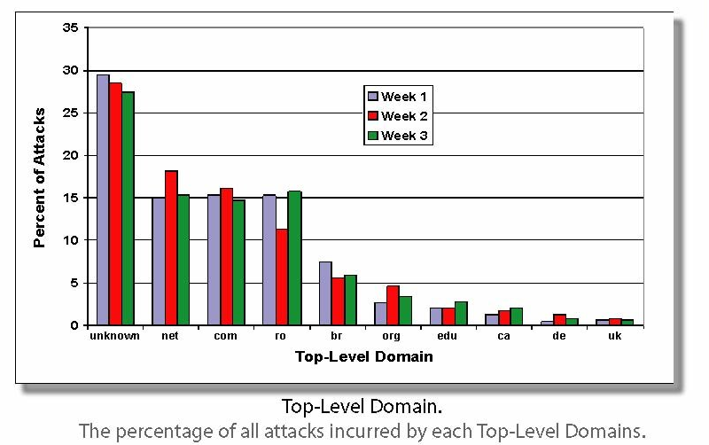
What types of machines are attacked?
Moor (2006)

Slide 75
Contents
Introduction
Classical DoS attacks
Flooding attacks
Distributed Denial-of-Service (DDoS)
How DDoS attacks are waged?
Reflector and amplifier attacks
Other DoS attacks
Detecting DoS attacks
Approaches to defense against DoS
Responding to a DoS attack
Conclusion

Slide 76
Defenses against DoS attacks
DoS attacks cannot be prevented entirely
Impractical to prevent the flash crowds without compromising network performance
Three lines of defense against (D)DoS attacks
  Attack prevention and preemption
  Attack detection and filtering
  Attack source traceback and identification

Slide 77
Attack prevention
Limit ability of systems to send spoofed packets
  Filtering done as close to source as possible by routers/gateways
  Reverse-path filtering ensure that the path back to claimed source is same as the current packet’s path
    Ex: On Cisco router “ip verify unicast reverse-path” command
Rate controls in upstream distribution nets
  On specific packet types
  Ex: Some ICMP, some UDP, TCP/SYN
Use modified TCP connection handling
  Use SYN-ACK cookies when table full
  Or selective or random drop when table full

Slide 78
Attack prevention cont’d ….
Block IP broadcasts
Block suspicious services & combinations
Manage application attacks with “puzzles” to distinguish legitimate human requests
Good general system security practices
Use mirrored and replicated servers when high performance and reliability required

Slide 79

October 2009
6th Annual National Cybersecurity Awareness Month
One of the themes: shared responsibility

Slide 80
Contents
Introduction
Classical DoS attacks
Flooding attacks
Distributed Denial-of-Service (DDoS)
How DDoS attacks are waged?
Reflector and amplifier attacks
Other DoS attacks
Detecting DoS attacks
Approaches to defense against DoS
Responding to a DoS attack
Conclusion

Slide 81
Responding to attacks
Need good incident response plan
  With contacts for ISP
  Needed to impose traffic filtering upstream
  Details of response process
Have standard antispoofing, rate limiting, directed broadcast limiting filters
Ideally have network monitors and IDS
  To detect and notify abnormal traffic patterns

Slide 82
Responding to attacks cont’d ….
Identify the type of attack
  Capture and analyze packets
  Design filters to block attack traffic upstream
  Identify and correct system application bugs
Have ISP trace packet flow back to source
  May be difficult and time consuming
  Necessary if legal action desired
Implement contingency plan
Update incident response plan

Slide 83
Contents
Introduction
Classical DoS attacks
Flooding attacks
Distributed Denial-of-Service (DDoS)
How DDoS attacks are waged?
Reflector and amplifier attacks
Other DoS attacks
Detecting DoS attacks
Approaches to defense against DoS
Responding to a DoS attack
Conclusion

Slide 84
Conclusion
(D)DoS attacks are genuine threats to many Internet users
Annoying < l < Debilitating ; l = losses
Level of loss is related to motivation as well shielding attempts from the defender
  Attackers taking advantage of ignorance of the victims w.r.t. (D)DoS attacks
Defensive measures might not always work
  Neither threat nor defensive methods are static
Prognosis for DDoS
  Increase in size
  Increase in sophistication
  Increase in semantic DDoS attacks
  Infrastructure attacks
DDoS are significant threats to the future growth and stability of Internet

Slide 85
Thank you!
Questions ?

