Slide 1
Arab Academy for Banking &Financial Sciences
Faculty of Information Systems & Technology - Department of CIS
Information System Security
Ph.D
Denial of Service Attack (DoS)
Prepared To: Dr. lo’ai tawalbeh
Prepared by : mohammad nassar

Slide 2
Learning Objectives
TYPES OF ATTACKS.
Definitions of DoS and DDoS attacks .
Costs of DoS attacks for victim organizations.
Classification of DoS attacks.
Strategic Firewall Placement.
Default Deny.
Detecting DDoS Attacks by Monitoring the Source IP addresses.
Example.
Conclusion.

Slide 3
TYPES OF ATTACKS
Nontechnical attack
Technical attack
Denial-of-service
attack
Malicious code
Sniffing
Spoofing
Virus
Worm
Trojan horse

Slide 4
Definitions of DoS and DDoS attacks
• A DoS (Denial of Service) attack aims at preventing, for
legitimate users, authorized access to a system resource . The attacker uses specialized software to send a flood of data packets to the target computer with the aim of overloading its resources
• DDoS ( distributed Denial of Service attacks)
  A denial-of-service attack in which the attacker gains illegal administrative access to as many computers on the Internet as possible and uses the multiple computers to send a flood of data packets to the target computer

Slide 5
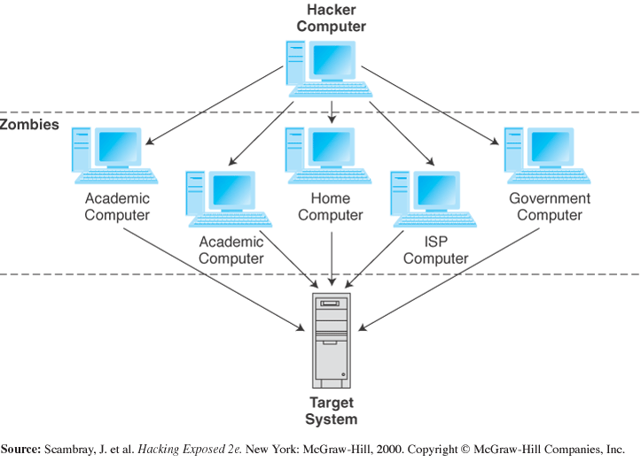
Distributed Denial-of-service (DDoS) attack

Slide 6
INTERNET INSECURITY
􀂾 Morris worm of 1987
􀂾 Password sniffing attacks in 1994
􀂾 IP spoofing attacks in 1995
􀂾 Denial of service attacks in 1996
􀂾 Email borne viruses 1999
􀂾 Distributed denial of service attacks 2000
􀂾 Fast spreading worms and viruses 2003
􀂾 Spam 2004
􀂾 … no end in sight
􀂙 Internet insecurity grows at super-Internet speed
􀂾 security incidents are growing faster than the Internet (which has
roughly doubled every year since 1988)

Slide 7
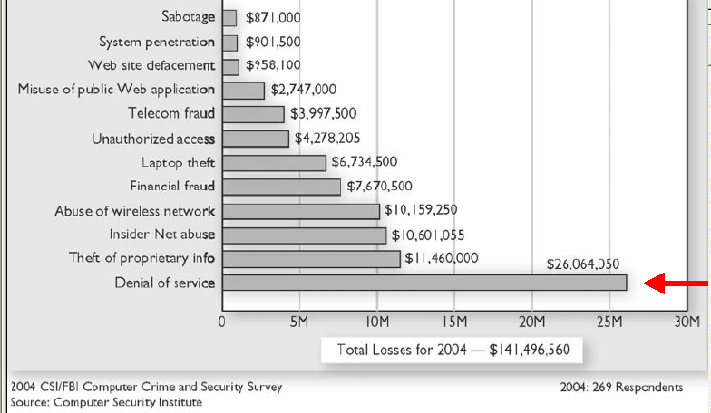
Costs of DoS attacks for victim organizations
• Denial of Service is currently the most expensive computer crime for victim organizations:

Slide 8
Classification of DoS attacks
1. Bandwidth consumption:
Attacks will consume all available network bandwidth
2. Resource starvation:
Attacks will consume system resources (mainly CPU, memory, storage space)
3. Programming flaws:
Failures of applications or OS components to handle exceptional conditions (i.e. unexpected data is sent to a vulnerable component). 4. Routing and DNS attacks:
  manipulate routing tables.
  changing routing tables to route to attacker’s net or black hole.
  attack to DNS servers, again route to attackers or black hole.

Slide 9
examples
Smurf
  1. Attacker sends sustained ICMP (availability of host) Echo packets (ping) to broadcast address of the amplifying network, with source address is forged.
  2. Since traffic was sent to broadcast address all hosts in the amplifying LAN will answer to the victim’s IP address.
Ping of death???

Slide 10
Ping (win XP)
C:\>ping 64.233.183.103 with 32 bytes of data (yahoo)
Reply from 64.233.183.103: bytes=32 time=25ms TTL=245
Reply from 64.233.183.103: bytes=32 time=22ms TTL=245
Reply from 64.233.183.103: bytes=32 time=25ms TTL=246
Reply from 64.233.183.103: bytes=32 time=22ms TTL=246
Ping statistics for 64.233.183.103: Packets: Sent = 4, Received = 4, Lost = 0 (0% loss),

Slide 11
examples
Syn flood
  TCP three-way handshake:
    The client requests a connection by sending a SYN (synchronize) message to the server.
    The server acknowledges this request by sending SYN-ACK back to the client, which,
    Responds with an ACK, and the connection is established.
How it work………???
  1. attacker sends SYN packet to victim forging non-existent IP address
  2. victim replies with Syn/Ack but neither receives Ack nor RST from non-existent IP address
  3. victim keeps potential connection in a queue in Syn_Recv state, but the queue is small and takes some time to timeout and flush the queue, e.g 75 seconds
  4. If a few SYN packets are sent by the attacker every 10 seconds, the victim will never clear the queue and stops to respond.

Slide 12
examples
LAND:
The attack involves sending a spoofed TCP SYN packet (connection initiation) with the target host's IP address as both source and destination.
It uses ports (echo and chargen ports).

Slide 13
Bottleneck
To shut down the company’s connection, a hacker only has to overload this relatively slow part of the line.
To stop DDoS attacks, illegitimate traffic must never be allowed to reach the bottleneck.

Slide 14
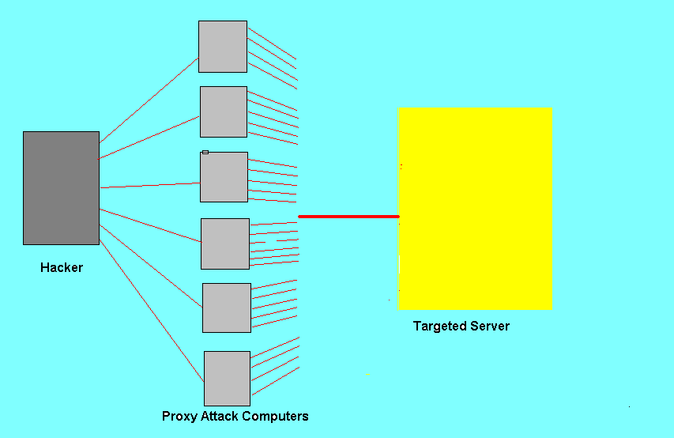
Normal connection
Cable connection
(Bottleneck)
Firewall
(Bad traffic
stopped
here)
ISP

Slide 15
Strategic Firewall Placement
In the strategic firewall placement method, the company’s firewall is placed on the ISP’s premises.
This means that the line connecting the ISP router to the firewall is very short, and a much higher bandwidth line (ex. Ethernet) can be used for this connection at very little extra cost.

Slide 16
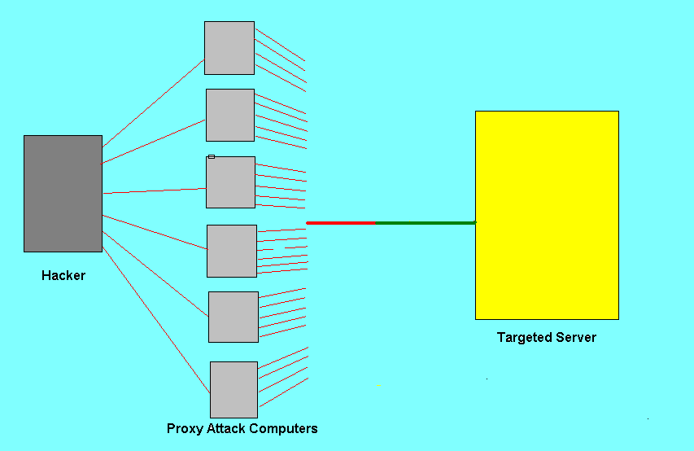
Strategic Firewall Placement
ISP
ISP
Ethernet
connection
Ethernet
connection
Bottleneck
Firewall
Firewall
(Bad traffic
stopped here)
Bottleneck

Slide 17
Strategic Firewall Placement
Firewall remains under the control of the company.
Now the company is able to control exactly which traffic is allowed into the bottleneck part of the connection.

Slide 18
Strategic Firewall Placement
In the old setup, to thwart a DDoS attack, the company had to call the ISP and tell them which kinds of packets to filter.
The company’s internet connection remained inoperative until the ISP was able to complete the company’s request.
When the company controls the firewall, as in strategic firewall placement, they can instead filter unwanted packets almost immediately.

Slide 19
Additional Requirements
Moving the firewall is helpful, but, to completely protect against DDoS attacks, the company also has to change the way its firewall handles inbound connection requests.

Slide 20
Default Deny
Again !!!!!!TCP three-way handshake ……

Slide 21

Default Deny
Spoofed TCP/SYN
Firewall
If every TCP/SYN packet is allowed to reach the company server, hackers can flood the company’s server with these packets, and overload the connection.
Instead, the firewall sends back a SYN/ACK packet to the source IP.
Once the firewall sends out the SYN/ACK packet, it only allows a connection from the IP address that sent the original TCP/SYN packet.
A hacker has to have control of that IP address to be able to connect to the company.
SYN/ACK
1
Blocked Connection
Real TCP/SYN
2
SYN/ACK
Connection Allowed
Server

Slide 22
Default Deny
Default Deny helps prevent a technique known as “spoofing” IP addresses.

Slide 23
Firewall Capabilities
Maintaining these policies could require a lot of computational power from the firewall.
Firewall may not be able to handle the entire job itself.
The processing work of the firewall can be spread among multiple computers if necessary, and those computers would feed directly into the firewall.

Slide 24
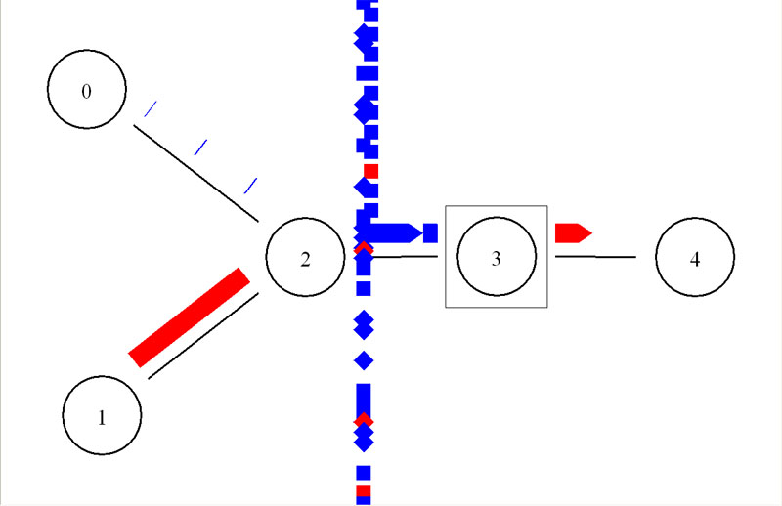
Simulation of Strategic Firewall Placement (NS-2 to simulate DDoS traffic.)
DDoS attack
Buildup of packets in
queue on high-speed
link
Router
1.5 mbps
Target
Legitimate
traffic
Firewall

Slide 25
Simulation of Strategic Firewall Placement
When the link leading up to the firewall is too slow, a DDoS attack basically shuts down the system.
When the link leading up to the firewall is fast enough, the system continues running through a DDoS attack, even after the attack is increased in intensity from 50 to 100 mbps.

Slide 26
How to know if an attack is happening?
Not all disruptions to service are the result of a DOS. There may be technical problems with a particular network. However, the following symptoms could indicate a DoS or DDoS attack:
Unusually slow network performance
Unavailability of a particular web site
Inability to access any web site or any resources
Dramatic increase in the amount of spam received in the account.

Slide 27
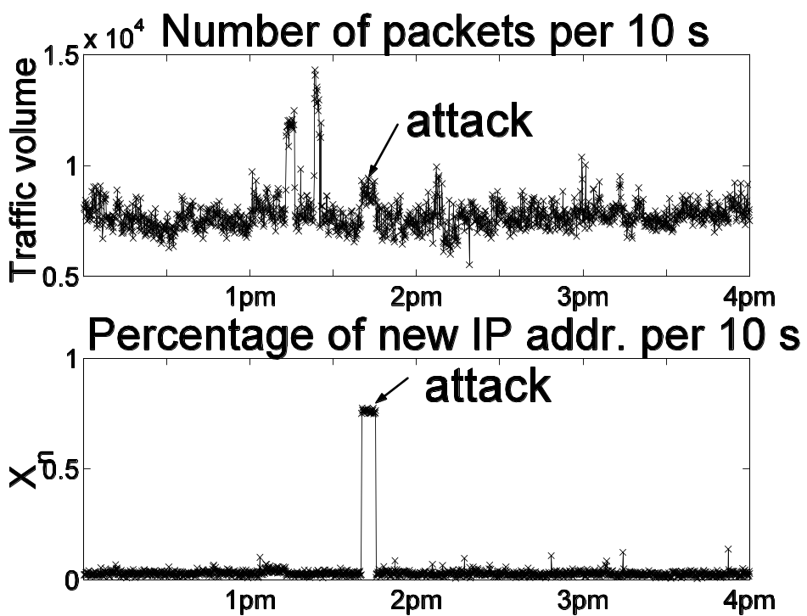
Detecting Distributed Denial of Service Attacks by Monitoring the Source IP addresses
IP addresses in DDoS
attack traffic did not
appear before. [Peng et al. 2003]
Monitoring the traffic volume is likely to create high false
positive
Monitoring the percentage of new IP addresses is very effective in detecting
the attacks

Slide 28
How to avoid being part of the problem?
there are no effective ways to prevent being the victim of a DoS or DDoS attack, but these ways can help:
Install anti-virus software
Install a firewall,
Applying email filters may help manage unwanted traffic

Slide 29
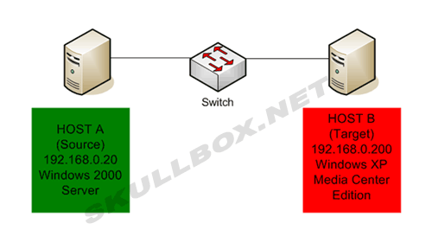
Example (spoofed DoS attack )
A spoofed DoS attack is a process in which one host (usually a server or router) sends a flood of network traffic to another host .

Slide 30
A&B
B: target machine (Athlon 64 3400+ with 1 GB of RAM).
A: The source machine is a Pentium( 3) 700 with 512 MB of RAM.

Slide 31
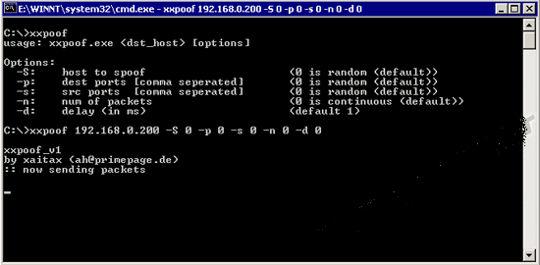
Using xxpoof … Why?

Slide 32
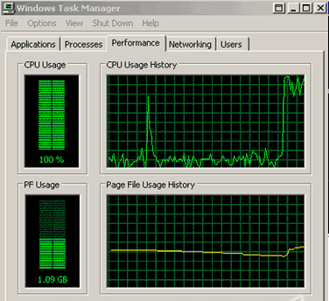
Target Machine Health

Slide 33
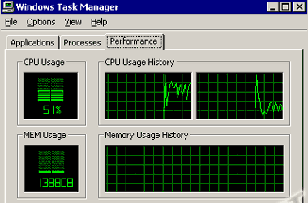
Source Machine Health

Slide 34
Conclusion
Denial of Service is currently the most expensive computer crime for victim organizations.
Strategic firewall placement allows companies to use the Internet during a DDoS attack, and it allows them to continue receiving the packets they want.
Distributed Denial of Service Attacks could be Detected by Monitoring the Source IP.
It is easy to generate a successful DDoS attack that bypasses these defenses.

Slide 35
References:
Turban, Efraim; King,davaid;lee Jae;viehland ,Dannis, (2006),electronic Commerce A Managerial Perspective .International Edition ,Prentice Hall
Chatam, W. Rice, J. and Hamilton, J.A. Jr., "Using Simulation to Analyze Denial of Service Attacks" 2004
Advanced Simulation Technology Conference, April 18 - 24, Arlington, VA,2004
Distributed and Cooperating Firewalls in a Secure Data Network,” IEEE Transactions on Knowledge and Data Engineering, IEEE Educational Activities Department, vol 40, no 5, (September): pp 1307 – 1315, 2003.
S. Gibson, “Distributed Reflection Denial of Service. Description and analysis of a potent, increasingly prevalent, and worrisome Internet attack,” February 22, 2002, available at http://grc.com/dos/drdos.htm
Smith, R.; Chen, Y; and Bhattacharya, S., “Cascade of Huegen C.A. , “The latest in Denial of Service attacks: smurfing description and information to minimize effects”, Feb 2000, available at http://www.pentics.net/denial-of-service/white-apers/smurf.cgi
United State Computer Emergency Readiness Team (2004) “Understanding Denial-of-Service Attacks” http://www.us-cert.gov/cas/tips/ST04-015.html
Williams, Charles (Dr.), (2001)“Who Goes There? Authentication in the On-Line World”, <http://www.bizforum.org/whitepapers/cylink002.htm

