Slide 1

Global Academy of Technology Department of Computer Science and Engineering
Technical Seminar (15CSS86)
DEEP-SEE FACE: A Mobile Face Recognition
System Dedicated to Visually Impaired People
Name: Sathya Narayana R
USN: 1GA15CS134
Guide: Krishna Prasad R
Assistant Professor
Dept. of CSE, GAT

Slide 2
Index
Objective
Abstract
Introduction
Technologies Used
Implementation/Issues/Applications
Comparison Results
Conclusion & Future Scope
Bibliography / References

Slide 3
Objectives
Neural network - deep convolutional neural networks in order to detect, track, and recognize, in real-time, various persons existent in the video streams.
Weight adoption scheme - weight adaptation scheme is able to determine the relevance assigned to each face instance, depending on the frame degree of motion/camera blur, scale variation, and compression artifacts.
Negative mining - negative mining stage that helps us differentiating between known and unknown face identities.
Alerts - the semantic information about the presence of a familiar is delivered with the help of acoustic warning messages, transmitted through bone conduction headphones.

Slide 4
Abstract
In recent years, several frameworks based on mobile platforms and dedicated to healthcare services have emerged. Nowadays, more than 285 million people worldwide suffer from visual impairment.
The visually impaired people adapt to normal life by using traditional assistive aids, such as white canes or walking dogs.
The white cane is widely accepted by the blind community. However, such an assistive element shows quickly its limitations when confronted with the high diversity of situations

Slide 5

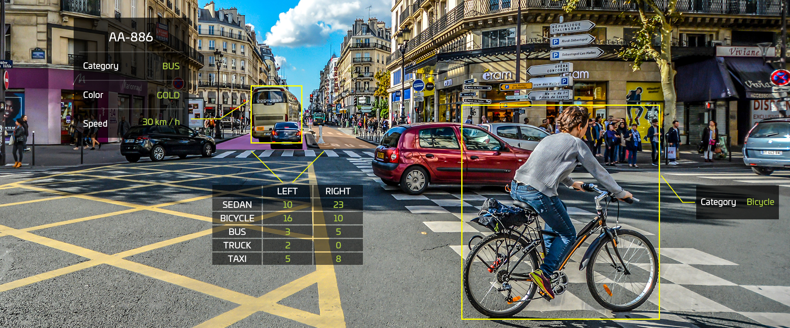
Introduction
DEEP-SEE FACE, a assistive device based on computer vision algorithms and offline-trained deep convolutional neural network that extends the face recognition module.
DEEP-SEE FACE is able to identify in real-time, from video streams, a set of characters, which can be pre-defined by the user and which may correspond to either familiar people.

Slide 6
Technologies Used
CNN
Let us denote by F D fx1; x2; : : : ; xLg a face tracked in a video sequence of length L frames, where xk ; k D 1; : : : ; L is a face instance in the kth frame of the considered video.
global face representation,defined as:
r(F) = Σ _{k} w_{k} . f_{k}
where {w_{k}}^{L}_{k=1} is a set of weights, with w_{k} the coefcient associated to the feature of the kth frame.

Slide 7
Implementation
Face detection
Face tracking
Face recognition
Weight adoption module
Hard negative mining
Acoustic feedback

Slide 8
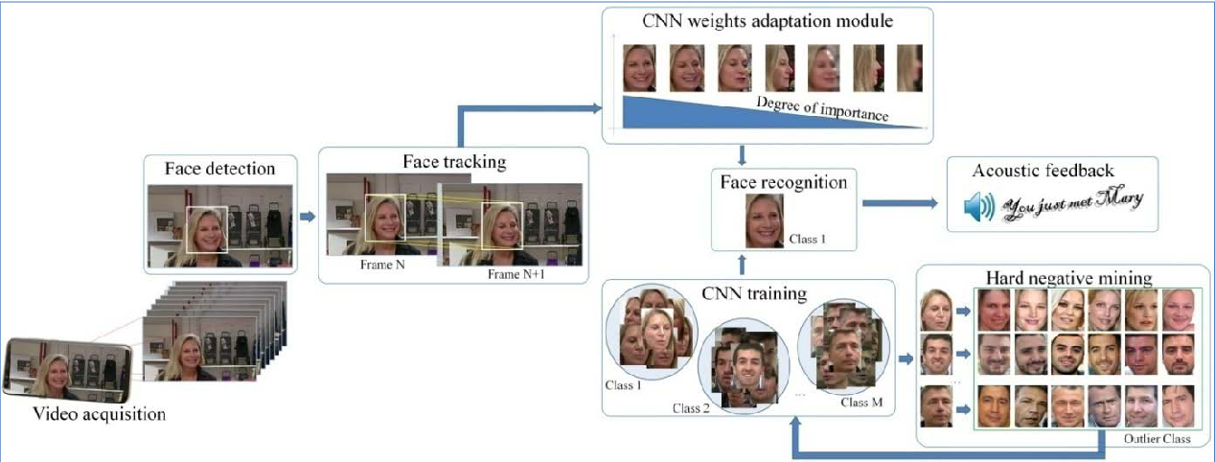
Implementation

Slide 9
Issues
The key challenge in video face recognition is to develop a fixed-size feature representation of the face, constructed at the video level, and independent of the length of the video stream.
So, two challenges are addressed:
1 detect and recognize familiar people when navigating in indoor or outdoor environment
2 acquire additional information about the identity of various people/celebrities appearing on the media broadcasted at TV or over internet.

Slide 10
Application
The state-of-the-art approaches dedicated to the VI assistive devices based on computer vision/machine learning methods.
It is possible to obtain high recognition rates on mobile wearable devices.
This system does not require any dedicated hardware architecture and can be accessible to any VI user at low cost.

Slide 11
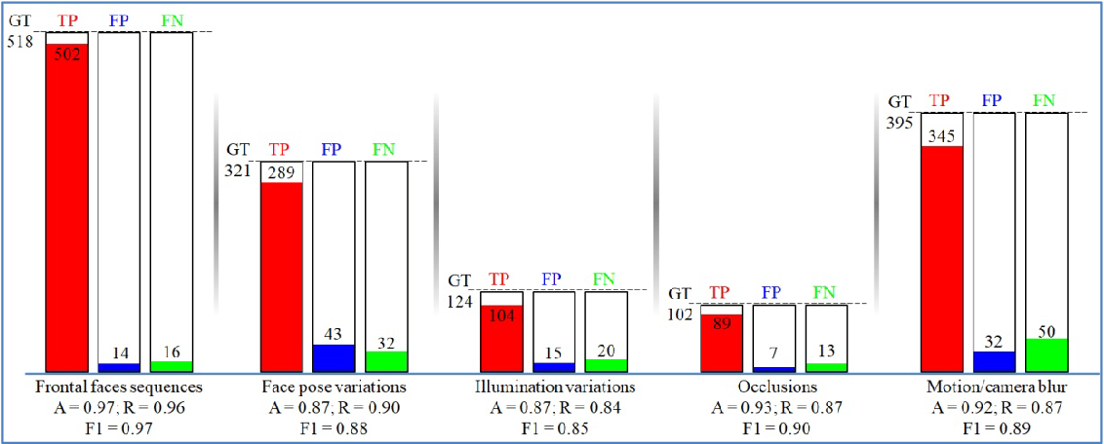
Comparison Results
DEEP-SEE FACE performance evaluation with various indoor/outdoor conditions.

Slide 12
Conclusion & Future Scope
The proposed approach does not require any a priori knowledge about the position of various people existent in the scene and jointly exploits computer vision algorithms and deep convolutional neural networks (CNNs) in order to improve cognition of VI users.
For further work and developments, we envisage to further extend the DEEP-SEE assistive device with additional functionalities that involves: inform the user when a recognized person exists the users field-of-view, navigation guidance, crossing detection or shopping assistance within large super markets.
we can observe that various constructors begin to propose hardware prototypes dedicated to CNN applications.

Slide 13
Bibliography
[1] D. Scherr, R. Zweiker, A. Kollmann, P. Kastner, G. Schreier, and F. M. Fruhwald, "Mobile phone-based surveillance of cardiac patients at home,'' J. Telemedicine Telecare, vol. 12, no. 5, pp. 255261, 2006.
[2] M. Jones, J. Morris, and F. Deruyter, ''Mobile healthcare and people with disabilities: Current state and future needs,'' Int. J. Environ. Res. Public Health, vol. 15, no. 3, p. 515, 2018.
[3] A World Health Organization (WHO)Visual Impairment and Blind-ness. Accessed: Jul. 5, 2018.Available:http://www.who.int/mediacentre/factsheets
[4] A. Rodríguez, J. J. Yebes, P. F. Alcantarilla, L. M. Bergasa, J. Almazán, and A. Cela, ''Assisting the visually impaired: Obstacle detection and warning system by acoustic feedback,'' Sensors, vol. 12.
[5] R. Tapu, B. Mocanu, and T. Zaharia, DEEP-SEE: ''Joint object detection, tracking and recognition with application to visually impaired navigational assistance,'' Sensor, vol. 17.

Slide 14
Thank You

