Slide 1


|| Jai Sri Gurudev ||
Sri Adichunchanagiri Shikshana Trust ®
SJB INSTITUTE OF TECHNOLOGY
Department of Information Science and Engineering
Technical Seminar
Presentation-1
on
“A Computational Model for Improving the Accuracy of Multi-criteria Recommender Systems”
Under the guidance of
Under the guidance of
Mr. Manu M N
Assistant professor
Dept of ISE, SJBIT
PRESENTED BY:
Rahul B.S(1JB15IS083)

Slide 2
ABSTRACT
Artiﬁcial neural networks are complex biologically inspired algorithms made up of adaptive and self-organizing structures that make them suitable for optimization problems, similar to the great networks of neurons in the human brain. So far, artiﬁcial neural networks have not been applied to user modeling in multi-criteria recommender systems.
Now the neural networks-based user modeling technique will exploit some of the characteristics of biological neurons for improving the accuracy of multi-criteria recommendations.
The proposed technique was evaluated using The two similarity-based techniques which are: the worst-case and the average similarity techniques and the results of the comparative analysis have shown that the proposed technique is more efﬁcient than techniques used individually.

Slide 3
INTRODUCTION
In recent years, there has been an increasing interest in recommender systems’ (RSs) research within the ﬁelds of computational and intelligent systems.
Currently, RSs are one of the most widely used groups of intelligent decision support systems and have been extensively used to help internet users to manage the problems of information overload by giving personalized on-line recommendations of items and services.
Some of the areas of applications of RSs include on-line shopping sites such as Amazon, video rental service providers like Netﬂix, e-learning for learning object recommendation, e-tourism, and so on.
Traditionally, RSs are known based on collaborative ﬁltering technique that uses two entities: Users and Items to predict a single rating on a speciﬁc item by a particular user.

Slide 4
However, as several attributes of the items need to be put together to determine users’ preferences on items, one single rating might not be sufﬁcient to represent the likeness of a user on an item. Therefore, it is important to incorporate multiple ratings, covering various attributes of items to make more accurate recommendations
Recent studies within the past recent years involving multi-criteria RSs that have reported the effectiveness of extending the traditional RSs to cover some of the basic attributes of items for improving the recommendation accuracy.
However, this model proposed a neural network-based model that followed an aggregation function approach to integrate the criteria ratings for improving the accuracy of the systems.
The evaluation results of the proposed model have been compared with two heuristic based approaches and also with a single rating collaborative ﬁltering.

Slide 5
Overview of Collaborative Filtering and Multicriteria RSs
RSs use information ﬁltering and data mining techniques to predict a rating r between every user-item pair. Their utility functions are of the form f : user×item → r, where r measures the level of likeness of the item by the user.
RSs techniques are divided into: collaborative ﬁltering, content-based and hybrid techniques.
Collaborative ﬁltering (CF) is a recommendation technique for evaluating the usefulness of items to users based on the opinions of other people called neighbors.
CF techniques are classiﬁed as :
‘memory−based’- which computes the similarities between user to predict unknown rating.
‘model−based’ -that models users and items using machine learning and data mining techniques to ﬁnd unknown ratings.

Slide 6
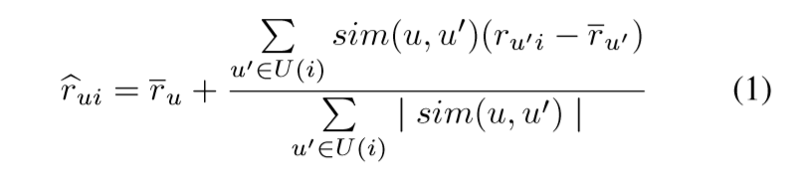
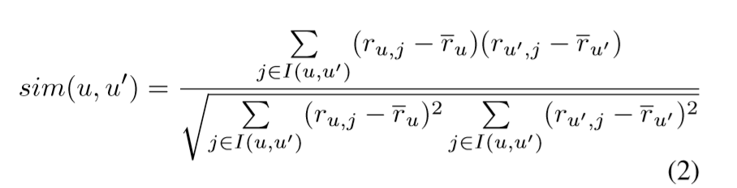
Memory-based CF computes similarities between users or items and uses it to predict unknown rating rui for a user u on an item i .
Eq. (1), where U(i) is the set of users who co-rated i with u, ru is the average rating of u, and sim(u,u’) is the similarity between u and u’ which can be computed using Eq. (2) with I(u,u’) as the set of items rated by u and u’ or using any suitable similarity metric.

Slide 7
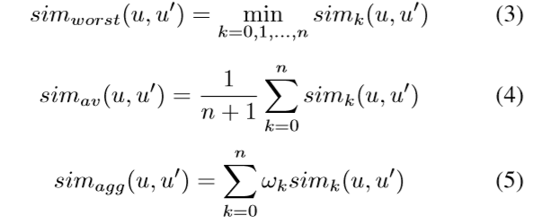
On the other hand, multi-criteria RSs or just MCRSs is the extension of single rating techniques, that account for multiple ratings assigned to various attributes of the items.
Subsequently, the utility of MCRSs are deﬁned as: f : user × item → ro,r1,r2,...,rn, where ro is the overall rating analogous to r in the utility function of the traditional CF, and rk for k =1 ,2,...,n is the criterion rating.
Modeling the similarities to obtain the global similarity could be done in several ways:
the worst case similarity-
the average similarity-
the aggregate similarity-
where ωk is the weights of the similarity for rk.

Slide 8
Related work
A number of researches have been carried out in MCRSs. This section presents a literature review by examining some of the recent relevant studies that applied different approaches and techniques to model the criteria ratings for improving the accuracy of the systems.
The review was conducted based on the two modeling approaches:
Heuristic-based Approach:
This approach adopts a fuzzy linguistic method to represent the preferences of users in the rating matrix and uses fuzzy-based multi-criteria decision-making technique was proposed in ,where accuracy have been tested and analyzed.
Similarly, proposed a fuzzy linguistic approach to represent the multi-criteria ratings and also uses fuzzy-based methods to measure the similarities and computes the overall ratings.

Slide 9
Recently, suggested a technique that combines Adaptive Neuro-Fuzzy Inference Systems (ANFIS) and self-organizing map for improving the accuracy of MCRSs.
2. Model-based Approach:
The model-based has a high advantage than the heuristic-based approach. This is because of its ability to work with both memory- and model-based traditional CF techniques.
This approach focused on some studies that followed model-based approaches to model the systems using statistical and machine learning algorithms integrated with any of the traditional CF technique.

Slide 10
Experiment and Findings
To analyze the predictions of the proposed artiﬁcial neural networks (ANNs)-based approach, a multi-criteria data set was extracted from a Yahoo! Movie website, where users gave ratings to movies based on four attributes (criteria):
the action,
the story,
the direction,
and the visual effect of the movies.
In addition to ratings on these criteria, the data set also contains an overall rating ro, which represents the ﬁnal decisions of the users. Both ro and rk’s were measured in a scale of 13 points from A+ to F, representing the highest and the lowest preferences respectively.

Slide 11
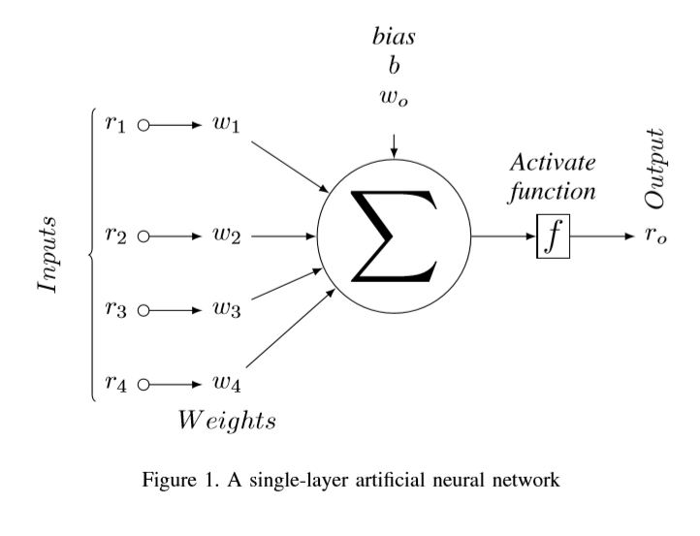
However, in order to work with the numerical ratings, the data set was converted to numerical ratings from 13 to 1 to take the place of the previous A+ to F respectively.

Slide 12
Furthermore, the ANNs used for the study was a single layer network trained with a delta rule algorithm .The inputs to the network are the criteria ratings rk for k =1 ,2,3,4, and a bias b =1. The output of the network is the overall rating ro. The values of ro were computed using an activation function f, which adds a non linearity to the network as neurons’ behaviors are nonlinear.
Furthermore, the study used item-based collaborative ﬁltering techniques in building the three MCRSs. Two heuristic based RSs were implemented based on worst-case and average similarities respectively in addition to the ANNs based MCRSs. Therefore, the experiment was based on the following four RSs:
1) The single rating collaborative ﬁltering (CF).
2) The ANNs-based MCRSs.
3) The average similarity (SIMav) MCRSs.
4) The worst-case similarity (SIMworst) MCRSs.
The four RSs were designed and implemented using object oriented techniques in Java.

Slide 13
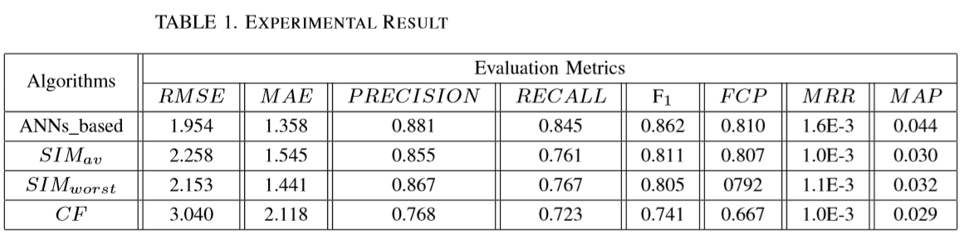
Their prediction results were analyzed in order to provide an exciting opportunity to advance our knowledge of the better technique between different modeling techniques and show the anticipated accuracy improvement of the proposed ANNs-based MCRSs.
The evaluation metrics used are summarized as follows:
Mean absolute error (MAE), which measures the average of positive deviations between predicted ratings and the actual ratings.
Root mean square error (RMSE), which is similar to MAE but it puts more emphasis on large deviations.
PRECISION: It was used to measure the ratio of relevant recommendation to the total items selected.

Slide 14
RECALL: As a metric for measuring the ratio of relevant items recommended to the total relevant items available.
F1: This combines the PRECISION and RECALL to measure the recommendation accuracy.
Fraction of concordant pairs (FCP): Measures the fraction of all correct ordered pairs in the prediction list compared with the actual ratings .
Mean reciprocal rank (MRR): It calculates the average of the reciprocal of the recommendation list.
Mean average precision (MAP): Is the average of the average precision of each user at position n for n =1 ,2,...,N in top-N recommendation.
Each column of the table presents the performance of the four techniques on a particular metric, and one row shows the performance of individual technique on all the metrics.

Slide 15
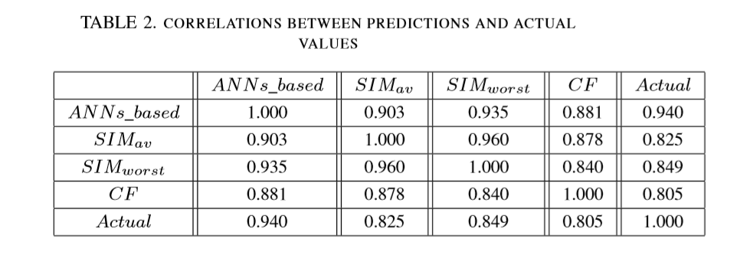
Turning to the correlations between the predicted values and their corresponding actual ratings, Table 2 provides the results of inter-correlations between the four techniques as well as their correlations with the actual ratings.
The ﬁndings observed in this table mirror those of the previous table that has shown the signiﬁcant increase in accuracy of ANNs based techniques over other techniques of the RSs.
The most surprising aspect of the data is the correlation between the actual rating and the ANNs based technique, which was measured to be approximately 94% (perfect correlation).

Slide 16
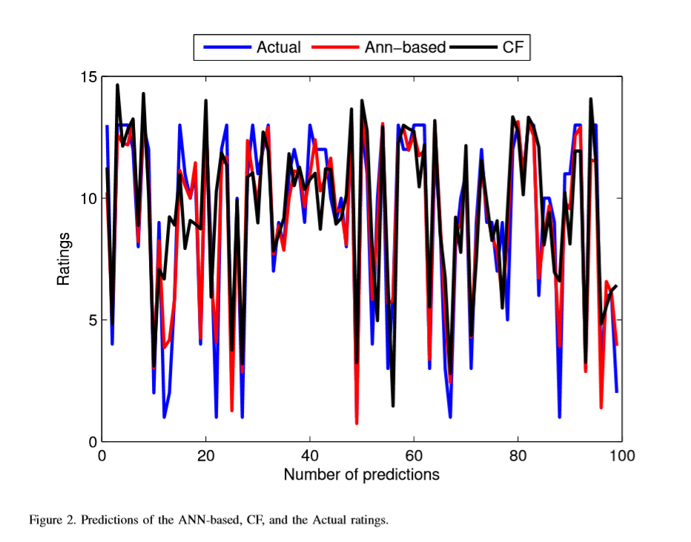
Furthermore, to provide a strong evidence of the accuracy predictions of ANNs-based technique, Figure 2 shows some of the main characteristics of the predictions of the CF and ANNs-based techniques.
The ﬁgure contains graphs of some number of predictions of the two techniques and the corresponding actual ratings. From the ﬁgure, it can be seen that by far the curve of ANNs-based and that of the actual ratings show more linear relationship than with CF.

Slide 17
CONCLUSION
Accuracy improvement is one of the fundamental issues within the area of intelligent decision support systems. RSs are intelligent online tools that help users to discover items that might satisfy their requirements.
Three multi-criteria RSs have been implemented together with a traditional neighborhood-based collaborative ﬁltering RSs. The three multi-criteria RSs integrate the neighborhood-based for computing unknown ratings to the criteria.
The research contributes additional evidence that suggests using ANNs as an aggregation function to model the criteria ratings.
The result of this research supports the sophisticated machine learning algorithms other than the simple techniques should be explored into modeling the criteria ratings in multi-criteria RSs.
However, one limitation of this study is that the ANNs used in this study does not contain any hidden layer.

Slide 18
REFERENCES
[1] N. Manouselis and C. Costopoulou, “Experimental analysis of design choices in multiattribute utility collaborative ﬁltering,” International Journal of Pattern Recognition and Artiﬁcial Intelligence, vol. 21, no. 02, pp. 311–331, 2007.
[2] M. Hassan and M. Hamada, “Performance comparison of featured neural network trained with backpropagation and deltarule techniques for movie rating prediction in multi-criteria recommender systems,” Informatica, vol. 40, no. 4, p. 409, 2016.
[3] M. Hasan and M. Hamada, “A framework for recommending learning peers to support collaborative learning on social network,” International Journal of Simulation–Systems, Science & Technology, vol. 17, no. 35, 2016.
[4] M. Hamada and M. Hassan, “Recommending learning peers for collaborative learning through social network sites,” in 7th International Conference on Intelligent Systems, Modelling and Simulation (ISMS). IEEE, 2016, pp. 60–63.
[5] G. Adomavicius, N. Manouselis, and Y. Kwon, “Multi-criteria recommender systems,” in Recommender systems handbook. Springer, 2015, pp. 854–887.

Slide 19
[6] P. Samatthiyadikun, A. Takasu, and S. Maneeroj, “Bayesian model for a multicriteria recommender system with support vector regression,” in Information Reuse and Integration (IRI), 2013 IEEE 14th International Conference on. IEEE, 2013, pp. 38–45.
[7] N. Sahoo, R. Krishnan, G. Duncan, and J. Callan, “Research notethe halo effect in multicomponent ratings and its implications for recommender systems: The case of yahoo! movies,” Information Systems Research, vol. 23, no. 1, pp. 231–246, 2012.
[8] Y. Zhang, Y. Zhuang, J. Wu, and L. Zhang, “Applying probabilistic latent semantic analysis to multi-criteria recommender system,” Ai Communications, vol. 22, no. 2, pp. 97–107, 2009.
[9] D. Jannach, F. Gedikli, Z. Karakaya, and O. Juwig, “Recommending hotels based on multi-dimensional customer ratings,” in Information and communication technologies in tourism 2012. Springer, 2012, pp. 320–331.
[10] J. Fan and L. Xu, “A robust multi-criteria recommendation approach with preference-based similarity and support vector machine,” in International Symposium on Neural Networks. Springer, 2013, pp. 385–394.

Slide 20
THANK YOU

