Slide 1








MUSIC INDUSTRY
DATA ANALYSIS
USING SQL
Data-Driven Insights & Growth Analysis
Presented by YOGESH ADHANA

Slide 2


Objective of
MUSIC DATA ANALYSIS
To analyze music store sales data using SQL in order to identify revenue drivers, customer behavior, and genre trends, and translate data findings into actionable business insights.

Slide 3


SCHEMA
MUSIC INDUSTRY DATA
Table Used
Records
  Customer – customer details and demographics
  Invoice – purchase transactions and billing information
  InvoiceLine – individual items within each invoice
  Track – song-level details
  Album – album information
  Artist – artist details
  Genre – music categories
  Employee – store employee data
  Customers distributed across multiple countries and cities
  Purchase data covering hundreds of invoices and transactions
  Thousands of music tracks spanning multiple genres
  Wide range of artists and albums represented
  Detailed track-level sales records enabling granular analysis
  Genre, artist, and customer data connected through a relational schema

Slide 4
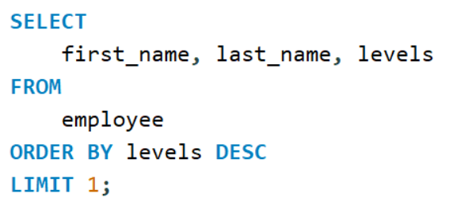

Advanced SQL Analysis
Who is the senior most employee based on job title?
Query
Result

Slide 5
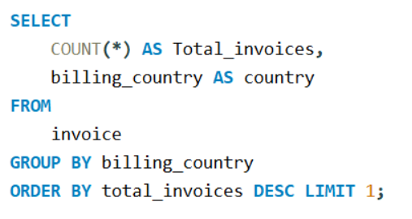
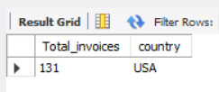
Advanced SQL Analysis
Which countries have the most Invoices?
Query
Result

Slide 6
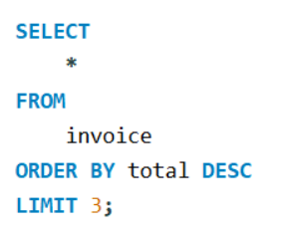
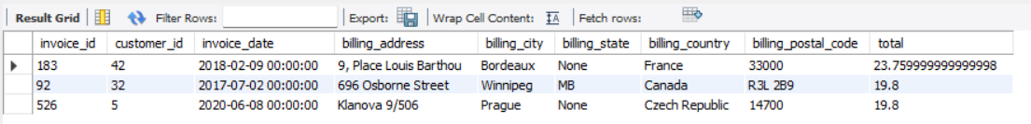
Advanced SQL Analysis
What are top 3 values of total invoice?
Query
Result

Slide 7
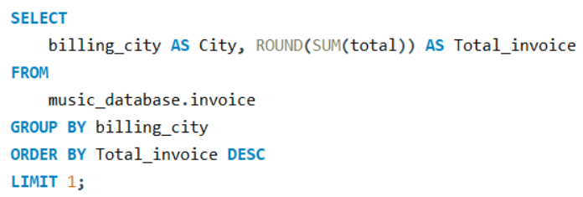

Advanced SQL Analysis
Which city has the best customers? We would like to throw a promotional Music Festival in the city we made the most money. Write a query that returns one city that has the highest sum of invoice totals. Return both the city name & sum of all invoice totals.
Query
Result

Slide 8
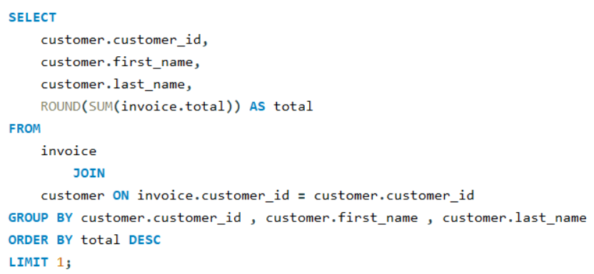

Advanced SQL Analysis
Who is the best customer? The customer who has spent the most money will be declared the best customer. Write a query that returns the person who has spent the most money.
Query
Result

Slide 9
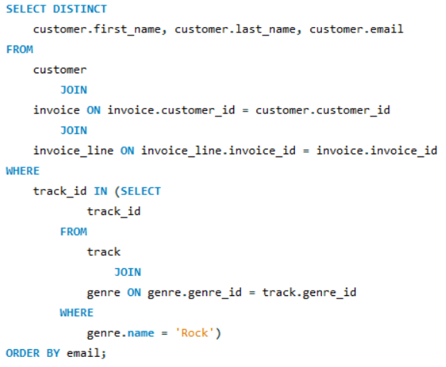
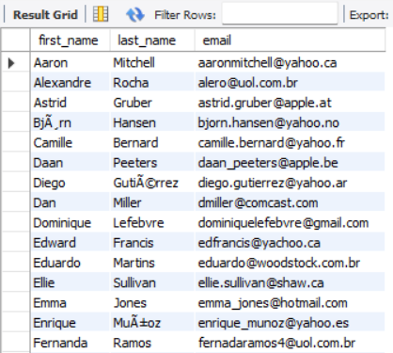
Advanced SQL Analysis
Write query to return the email, first name, last name, & Genre of all Rock Music listeners.
Return your list ordered alphabetically by email starting with A
Query
Result

Slide 10
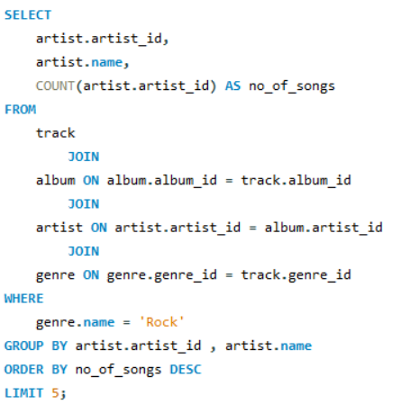
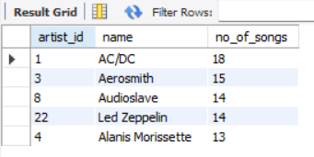
Advanced SQL Analysis
Let's invite the artists who have written the most rock music in our dataset. Write a query that returns the Artist name and total track count of the top 5 rock bands.
Query
Result

Slide 11
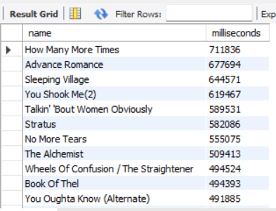
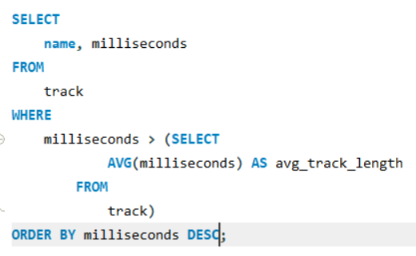
Advanced SQL Analysis
Return all the track names that have a song length longer than the average song length. Return the Name and Milliseconds for each track. Order by the song length with the longest songs listed first.
Query
Result

Slide 12
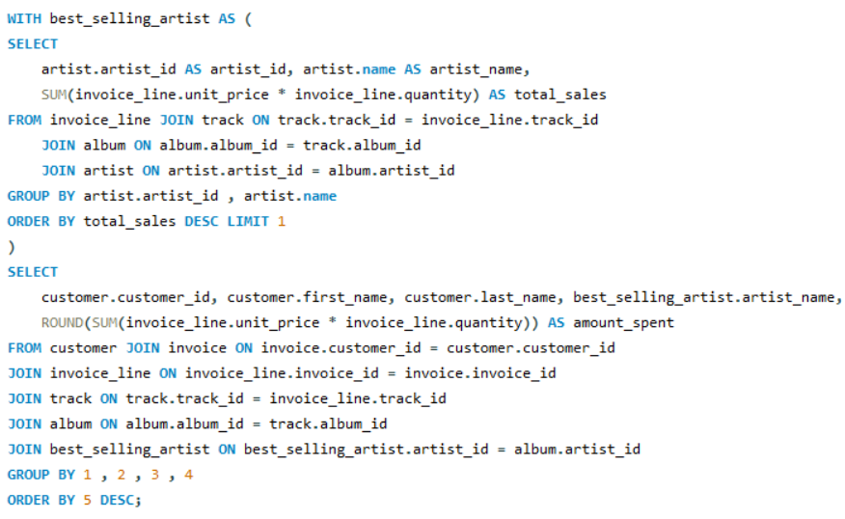
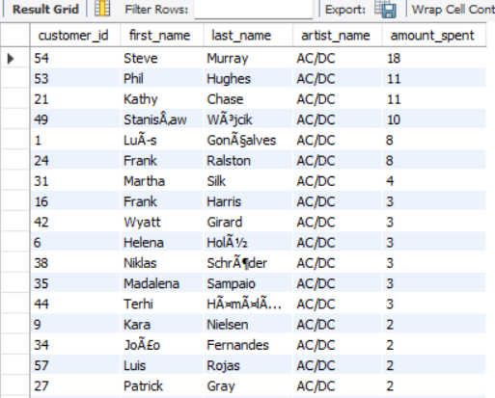
Advanced SQL Analysis
Find how much amount spent by each customer on artists? Write a query to return customer name, artist name and total spent.
Query
Result

Slide 13
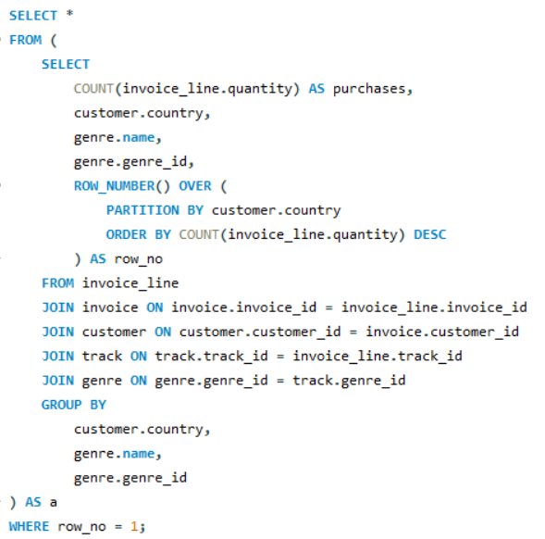
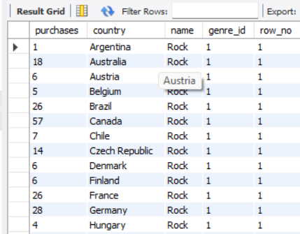
Advanced SQL Analysis
We want to find out the most popular music Genre for each country. We determine the most popular genre as the genre with the highest amount of purchases. Write a query that returns each country along with the top Genre. For countries where the maximum number of purchases is shared return all Genres.
Query
Result

Slide 14
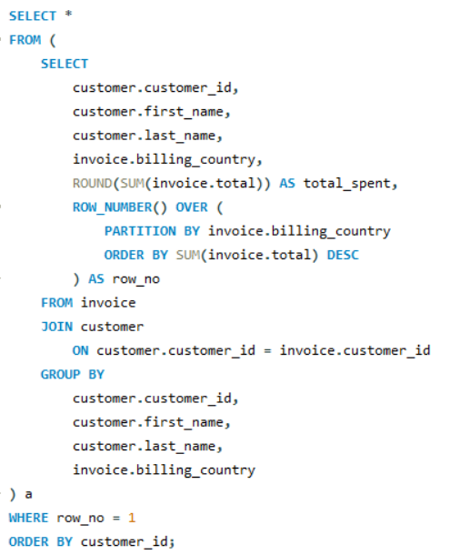
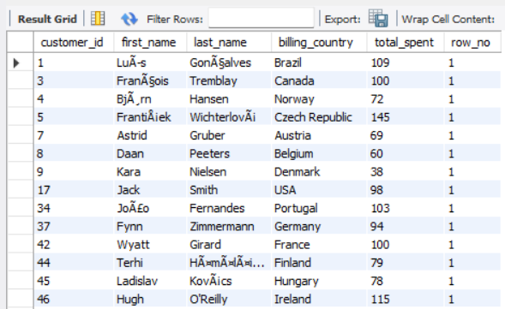
Advanced SQL Analysis
Write a query that determines the customer that has spent the most on music for each country. Write a query that returns the country along with the top customer and how much they spent. For countries where the top amount spent is shared, provide all customers who spent this amount.
Result
Query

Slide 15
Opportunities for
STRATEGIC INSIGHTS
Revenue Optimization
Customer Segmentation
Data-Driven Decisions
  By analyzing Invoice + InvoiceLine + Customer, you can see which cities and customers generate the most revenue.
  Insight: Management can target high-value customers or regions with promotions.
  By linking Customer → Invoice → Track → Genre, you identify which customers prefer which genres.
  Insight: Personalized campaigns increase engagement and retention.
  Combining geographic, customer, and genre insights allows business leaders to make decisions backed by data.
  Example: Decide which city should host a promotional music festival based on highest total invoice revenue.

Slide 16


Conclusion
CONCLUSION
  Applied SQL to analyze a music store database and extract actionable insights.
  Identified top customers, high-revenue cities, popular genres, and top-performing artists.
  Converted raw transactional data into business insights for marketing and growth strategies.
  Demonstrated strong data wrangling, aggregation, and analytical problem-solving skills.

Slide 17

THANKS
A LOT!
for your attention

