Slide 1
AngularJS
AngularJS
Yogesh Dakre
November 2013

Slide 2
Agenda
Introduction to AngularJS
Designing web application using AngularJS
  Form Validation
Testing (To Do)
Best Practices
Migrating existing Application
Demo
References
Q/A
Notes:
http://stephanebegaudeau.tumblr.com/post/48776908163/everything-you-need-to-understand-to-start-with
http://www.thinkster.io/pick/51d287681e4b9c9098000013/a-better-way-to-learn-angularjs
http://docs.angularjs.org/api/
AngularJS is very good to build single page web applications. For those who are not familiar with this concept, it consists on a web application where you only have one “real" HTML page whose content can be changed in Javascript without having to download a new page. The new content is created programmatically in Javascript of with the use of templates. Those applications have advantages like performances (since you are not downloading a new HTML page each time you are navigating to a new page) and drawbacks like history management (what happens if your users click on the button back of their browser?).
With AngularJS, you see that you are using a framework created by people who know what they are doing, as a result most of the problems of regular single page web applications are handled by AngularJS itself.
In order to build your application, You define a main page (index.html) which acts as a container for your web application. In this page, you can bind part of your application to a specific AngularJS module with the directive "ngApp”. You can bind the whole page to a single AngularJS module if you want. After that, you can use the directive "ngView" in order to use partial views.
Your module will tell AngularJS which view should be display in the “ngView" element. This directive also let you separate the content of your application in dedicated files.
Since the beginning of this article, we have been using a dedicated view to display users information.

Slide 3
Introduction
What is AngularJS ?
  MVC javascript framework developed and maintained by Google. It is complete solution for rapid front-end development.
Why AngularJS ?
  Building loosely coupled properly structured, performance driven and maintainable web application using dependency injection.
  AngularJS can do all of the heavy lifting on the client, while providing a rich, fast experience for the end user.
How?
Rest support MVVM Data Binding and DI | Extends HTML Makes HTML your Template Enterprise level testing
Notes:
REST Easy. RESTful actions are quickly becoming the standard for communicating from the server to the client. In one line of JavaScript, you can quickly talk to the server and get the data you need to interact with your web pages. AngularJS turns this into a simple JavaScript object, as Models, following the MVVM (Model View View-Model) pattern.
MVVM to the Rescue! Models talk to ViewModel objects (through something called the $scope object), which listen for changes to the Models. These can then be delivered and rendered by the Views, which is the HTML that expresses your code. Views can be routed using the $routeProvider object, so you can deep-link and organize your Views and Controllers, turning them into navigable URLs. AngularJS also provides stateless controllers, which initialize and control the $scopeobject.
MVVM facilitates a clear separation of the development of the graphical user interface (either as markup language or GUI code) from the development of the business logic or back end logic known as the model (also known as the data model to distinguish it from the view model). The view model of MVVM is a value converter^{[4]} meaning that the view model is responsible for exposing the data objects from the model in such a way that those objects are easily managed and consumed. In this respect, the view model is more model than view, and handles most if not all of the view’s display logic (though the demarcation between what functions are handled by which layer is a subject of ongoing discussion^{[5]} and exploration). The view model may also implement a mediator pattern organising access to the backend logic around the set of use cases supported by the view
Data Binding and Dependency Injection. Everything in the MVVM pattern is communicated automatically across the UI whenever anything changes. This eliminates the need for wrappers, getters/setters or class declarations. AngularJS handles all of this, so you can express your data as simply as with JavaScript primitives, like arrays, or as complex as you wish, through custom types. Since everything happens automatically, you can ask for your dependencies as parameters in AngularJS service functions, rather than one giant main() call to execute your code.
Extends HTML. Most websites built today are a giant series of <div> tags with little semantic clarity. You need to create extensive and exhaustive CSS classes to express the intention of each object in the DOM. With Angular, you can operate your HTML like XML, giving you endless possibilities for tags and attributes. Angular accomplishes this, via its HTML compiler and the use of directives to trigger behaviors based on the newly-created syntax you write.
Makes HTML your Template. If you’re used to Mustache or Hogan.js, then you can quckly grasp the bracket syntax of Angular’s templating engine, because it’s just HTML. Angular traverses the DOM for these templates, which house the directives mentioned above. The templates are then passed to the AngularJS compiler as DOM elements, which can be extended, executed or reused. This is key, because, now, you have raw DOM components, rather than strings, allowing for direct manipulation and extension of the DOM tree.
Enterprise-level Testing. As stated above, AngularJS requires no additional frameworks or plugins, including testing. If you’re familiar with projects, like QUnit, Mocha or Jasmine, then you’ll have no trouble learning Angular’s unit-testing API and Scenario Runner, which guides you through executing your tests in as close to the actual state of your production application as possible.
The Zen of Angular
Angular is built around the belief that declarative code is better than imperative when it comes to building UIs and wiring software components together, while imperative code is excellent for expressing business logic.
It is a very good idea to decouple DOM manipulation from app logic. This dramatically improves the testability of the code.
It is a really, really good idea to regard app testing as equal in importance to app writing. Testing difficulty is dramatically affected by the way the code is structured.
It is an excellent idea to decouple the client side of an app from the server side. This allows development work to progress in parallel, and allows for reuse of both sides.
It is very helpful indeed if the framework guides developers through the entire journey of building an app: from designing the UI, through writing the business logic, to testing.
It is always good to make common tasks trivial and difficult tasks possible.
Angular frees you from the following pains:
Registering callbacks: Registering callbacks clutters your code, making it hard to see the forest for the trees. Removing common boilerplate code such as callbacks is a good thing. It vastly reduces the amount of JavaScript coding you have to do, and it makes it easier to see what your application does.
Manipulating HTML DOM programmatically: Manipulating HTML DOM is a cornerstone of AJAX applications, but it's cumbersome and error-prone. By declaratively describing how the UI should change as your application state changes, you are freed from low-level DOM manipulation tasks. Most applications written with Angular never have to programmatically manipulate the DOM, although you can if you want to.
Marshaling data to and from the UI: CRUD operations make up the majority of AJAX applications' tasks. The flow of marshaling data from the server to an internal object to an HTML form, allowing users to modify the form, validating the form, displaying validation errors, returning to an internal model, and then back to the server, creates a lot of boilerplate code. Angular eliminates almost all of this boilerplate, leaving code that describes the overall flow of the application rather than all of the implementation details.
Writing tons of initialization code just to get started: Typically you need to write a lot of plumbing just to get a basic "Hello World" AJAX app working. With Angular you can bootstrap your app easily using services, which are auto-injected into your application in a Guice-like dependency-injection style. This allows you to get started developing features quickly. As a bonus, you get full control over the initialization process in automated tests.
Difference between
a library - a collection of functions which are useful when writing web apps. Your code is in charge and it calls into the library when it sees fit. E.g., jQuery.
frameworks - a particular implementation of a web application, where your code fills in the details. The framework is in charge and it calls into your code when it needs something app specific. E.g., knockout, ember, etc.

Slide 4
Designing web application using AngularJS
Bare Minimum things
Loading script
  <script
  src="https://ajax.googleapis.com/ajax/libs/angularjs/1.0.4/angular.min.js">
  </script>
Declaring Angular Boundaries
  <html ng-app>
  …
  </html>
And MVC DI jumps in
  • A model containing data that represents the current state of your application.
  • Views that display this data.
  • Controllers that manage the relationship between your model and your views.

Slide 5
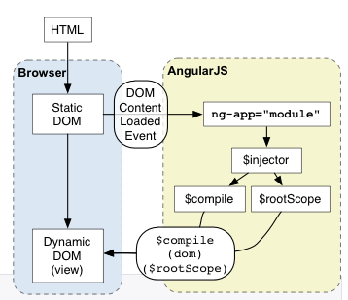
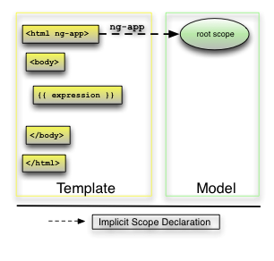
Designing web application using AngularJS
Understanding the how the angular application bootstrap
The injector that will be used for dependency injection is created.
The injector will then create the root scope that will become the context for the model of our application.
Angular will then "compile" the DOM starting at the ngApp root element, processing any directives and bindings found along the way.
Notes:
Angular initializes automatically upon DOMContentLoaded event or when the angular.js script is evaluated if at that time document.readyState is set to 'complete'.
At this point Angular looks for the ng-app directive which designates your application root. If the ng-app directive is found then Angular will:
load the module associated with the directive.
create the application injector
compile the DOM treating the ng-app directive as the root of the compilation.
This allows you to tell it to treat only a portion of the DOM as an Angular application
Every application has a single root scope. All other scopes are descendant scopes of the root scope. Scopes provide separation between the model and the view, via a mechanism for watching the model for changes. They also provide an event emission/broadcast and subscription facility.
$injector is used to retrieve object instances as defined by provider, instantiate types, invoke methods, and load modules.
The $provide service has a number of methods for registering components with the $injector. Many of these functions are also exposed on angular.Module.
http://amitgharat.wordpress.com/2013/06/08/the-hitchhikers-guide-to-the-directive/
http://webelement.newpope.org/#/8

Slide 6
Designing web application using AngularJS
HTML compilation happens in three phases:
1. $compile traverses the DOM and matches directives.
If the compiler finds that an element matches a directive, then the directive is added to the list of directives that match the DOM element. A single element may match multiple directives.
2. Once all directives matching a DOM element have been identified, the compiler sorts the directives by their priority. Each directive's compile functions are executed. Each compile function has a chance to modify the DOM. Each compile function returns a link function. These functions are composed into a "combined" link function, which invokes each directive's returned link function.
3. $compile links the template with the scope by calling the combined linking function from the previous step. This in turn will call the linking function of the individual directives, registering listeners on the elements and setting up $watchs with the scope as each directive is configured to do.
Notes:
Compiler
Compiler is an Angular service which traverses the DOM looking for attributes. The compilation process happens in two phases.
Compile: traverse the DOM and collect all of the directives. The result is a linking function.
Link: combine the directives with a scope and produce a live view. Any changes in the scope model are reflected in the view, and any user interactions with the view are reflected in the scope model. This makes the scope model the single source of truth.
Some directives such as ng-repeat clone DOM elements once for each item in a collection. Having a compile and link phase improves performance since the cloned template only needs to be compiled once, and then linked once for each clone instance.
Directive
A directive is a behavior which should be triggered when specific HTML constructs are encountered during the compilation process. The directives can be placed in element names, attributes, class names, as well as comments.

Slide 7
Designing web application using AngularJS
Below is the corresponding code using the $compile service. This should help give you an idea of what Angular does internally.
    var $compile = ...; // injected into your code
    var scope = ...;
    var html = '<div ng-bind="exp"></div>';
    // Step 1: parse HTML into DOM element
    var template = angular.element(html);
    // Step 2: compile the template
    var linkFn = $compile(template);
    // Step 3: link the compiled template with the scope.
    linkFn(scope);
Notes:
Every application has a single root scope. All other scopes are descendant scopes of the root scope. Scopes provide separation between the model and the view, via a mechanism for watching the model for changes. They also provide an event emission/broadcast and subscription facility.
$injector is used to retrieve object instances as defined by provider, instantiate types, invoke methods, and load modules.
The $provide service has a number of methods for registering components with the $injector. Many of these functions are also exposed on angular.Module.

Slide 8
Designing web application using AngularJS
Concept | Description
Template | HTML with additional markup
Directives | extend HTML with custom attributes and elements
Model | the data that is shown to the user and with which the user interacts
Scope | context where the model is stored so that directives and expressions can access it
Expressions | access variables and functions from the scope
Compiler | parses the template and instantiates directives and expressions
Filter | formats the value of an expression for display to the user
View | what the user sees (the DOM)
Data Binding | sync data between the model and the view
Controller | the business logic behind views
Dependency Injection | Creates and wires objects / functions
Injector | dependency injection container
Module | configures the Injector
Service | reusable business logic independent of views
Notes:
Expression
Directives
Data binding
Filters
Partial Views
Modules
Routes
Controller
Scope

Slide 9
Designing web application using AngularJS - Expression
An "expression" in a template is a JavaScript-like code snippet that allows to read and write variables.
<html ng-app='myApp'>
<body ng-controller='TextController'>
<p>{{someText.message}}</p>
<p>{{12+12}}</p>
<p>{{12|Currency}}</p>
<script
src="https://ajax.googleapis.com/ajax/libs/angularjs/1.0.1/angular.min.js">
</script>
<script>
var myAppModule = angular.module('myApp', []);
myAppModule.controller('TextController',
function($scope) {
var someText = {};
someText.message = 'You have started your journey.';
$scope.someText = someText;
});
</script>
</body>
</html>
Notes:
The goal behind the expressions that you use in templates is to let you be as clever as
you need to be to create hooks between your template, your application logic, and your
data, but at the same time prevent application logic from sneaking into the template.
You can do simple math (+, -, /, *, %), make comparisons (==, !=, >, <, >=, ⇐), perform boolean
logic (&&, ||, !) and bitwise operations (\^, &, |). You can call functions you expose on
$scope in your controller and you can reference arrays and object notation ([ ], { }, .).

Slide 10
Designing web application using AngularJS - Filters
  A filter formats the value of an expression for display to the user.
  {{ expression | filter }}
  {{ 12 | currency }}
  Filters can be applied to the result of another filter. This is called "chaining" and uses the following syntax:
  {{ expression | filter1 | filter2 | ... }}
  Filters may have arguments. The syntax for this is
  {{ expression | filter:argument1:argument2:... }}
  {{ 1234 | number:2 }}
Notes:
A filter formats the value of an expression for display to the user. In the example above, the filter currency formats a number into an output that looks like money.

Slide 11
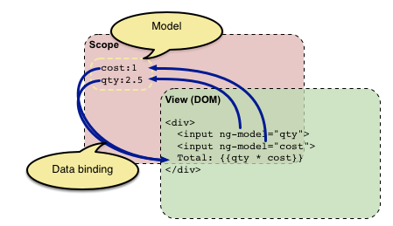
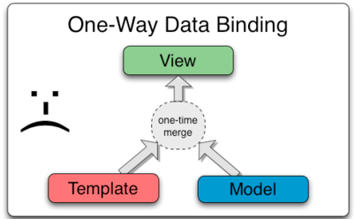
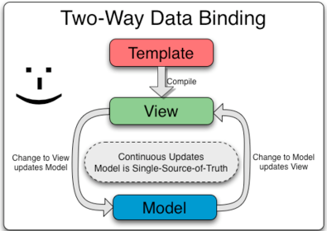
Designing web application using AngularJS - Data binding
http://localhost:8080/angularpoc/demo/1databinding.html
Notes:
HTML compilation happens in three phases:
1. $compile traverses the DOM and matches directives.
If the compiler finds that an element matches a directive, then the directive is added to the list of directives that match the DOM element. A single element may match multiple directives.
Once all directives matching a DOM element have been identified, the compiler sorts the directives by their priority.
2. Each directive's compile functions are executed. Each compile function has a chance to modify the DOM. Each compile function returns a link function. These functions are composed into a "combined" link function, which invokes each directive's returned link function.
3. $compile links the template with the scope by calling the combined linking function from the previous step. This in turn will call the linking function of the individual directives, registering listeners on the elements and setting up $watchs with the scope as each directive is configured to do.

Slide 12

Designing web application using AngularJS - Directives
<html ng-app='myApp'>
<body ng-controller='TextController'>
<p>{{someText.message}}</p>
<script
src="https://ajax.googleapis.com/ajax/libs/angularjs/1.0.1/angular.min.js">
</script>
<script>
var myAppModule = angular.module('myApp', []);
myAppModule.controller('TextController',
function($scope) {
var someText = {};
someText.message = 'You have started your journey.';
$scope.someText = someText;
});
</script>
</body>
</html>
Notes:
What are Directives?
At a high level, directives are markers on a DOM element (such as an attribute, element name, or CSS class) that tell AngularJS's HTML compiler ($compile) to attach a specified behavior to that DOM element or even transform the DOM element and its children.
For AngularJS, "compilation" means attaching event listeners to the HTML to make it interactive. The reason we use the term "compile" is that the recursive process of attaching directives mirrors the process of compiling source code in compiled programming languages.
var myModule = angular.module(...);
myModule.directive('directiveName', function (injectables) {
return {
restrict: 'A',
template: '<div></div>',
templateUrl: 'directive.html',
replace: false,
priority: 0,
transclude: false,
scope: false,
terminal: false,
require: false,
controller: function($scope, $element, $attrs, $transclude, otherInjectables) { ... },
compile: function compile(tElement, tAttrs, transclude) {
return {
pre: function preLink(scope, iElement, iAttrs, controller) { ... },
post: function postLink(scope, iElement, iAttrs, controller) { ... }
}
},
link: function postLink(scope, iElement, iAttrs) { ... }
};
});

Slide 13

Designing web application using AngularJS - Directives
Creating your own directive
  As element <my-dir></my-dir>
  As attribute <span my-dir="exp"></span>
  As class name <span class="my-dir: exp;"></span>
  As comment <!-- directive: my-dir exp -->
Creating directive consuming model data
Creating directive manipulating DOM
Creating a Directive that Wraps Other Elements
Notes:
What are Directives?
At a high level, directives are markers on a DOM element (such as an attribute, element name, or CSS class) that tell AngularJS's HTML compiler ($compile) to attach a specified behavior to that DOM element or even transform the DOM element and its children.
For AngularJS, "compilation" means attaching event listeners to the HTML to make it interactive. The reason we use the term "compile" is that the recursive process of attaching directives mirrors the process of compiling source code in compiled programming languages.
http://docs.angularjs.org/guide/directive

Slide 14
Designing web application using AngularJS - Partial Views
  Partial Views

Slide 15
Designing web application using AngularJS - Modules
  Modules
// Create a new module
var myModule = angular.module('myModule', []);
// register a new service
myModule.value('appName', 'MyCoolApp');
// configure existing services inside initialization blocks.
myModule.config(function($locationProvider) {
// Configure existing providers
$locationProvider.hashPrefix('!');
});
Notes:
http://docs.angularjs.org/api/angular.module
The angular.module is a global place for creating, registering and retrieving Angular modules.
A module is a collection of services, directives, filters, and configuration information.
angular.module is used to configure the $injector.
angular.module(name[, requires], configFn);

Slide 16
Designing web application using AngularJS - Routes
  Routes

Slide 17
Designing web application using AngularJS - Controller
  Controller
  http://localhost:8080/angularpoc/demo/2controller.html
Notes:
http://docs.angularjs.org/guide/controller
In Angular, a Controller is a JavaScript constructor function that is used to augment the Angular Scope.
When a Controller is attached to the DOM via the ng-controller directive, Angular will instantiate a new Controller object, using the specified Controller's constructor function. A new child scope will be available as an injectable parameter to the Controller's constructor function as $scope.
Use Controllers to:
Set up the initial state of the $scope object.
Add behavior to the $scope object.

Slide 18
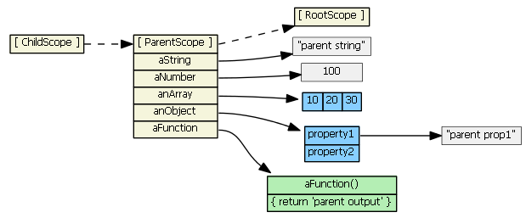
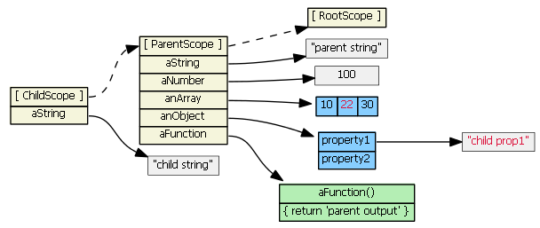
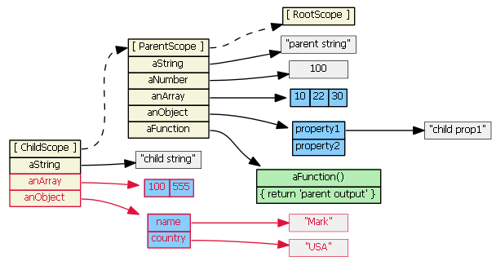
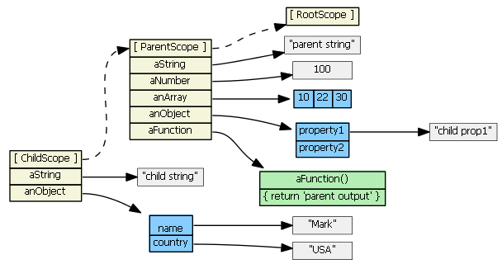
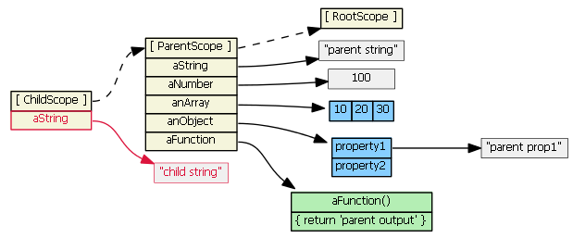
Designing web application using AngularJS - Scope
Notes:
https://github.com/angular/angular.js/wiki/Understanding-Scopes

Slide 19
Designing web application using AngularJS – Form Validation
a. give a “name” to your form e.g. <form name=”loginForm”>
b. mark all required input boxes as required e.g. <input type=’email’ required />
c. to turn on say email validation, you need to set type=’email’
d. check if the form is validating or not by checking loginForm.$invalid. To check this inside your controller, do $scope.loginForm.$invalid

Slide 20

Migrating existing Application – Birds Eye View
C
L
I
E
N
T
Presentation Layer ←→Model
Angular Controller ←→ Services|Factory
Rest Layer (Rest Resources)
S
E
R
V
E
R
EJB + Hibernate

Slide 21
Migrating existing Application
C
L
I
E
N
T
Presentation Layer ←→Routes ←→Model
Angular Controller ←→ Services|Factory
(There are two approaches to achieve 1. Keeping struts framework in place. 2. ripping down everything to build pure AngularJs application.)
Changes in the
Struts navigation will go away
Struts forms will go away
Client Validation changes
Will act as a single page application
Entire presentation layer need to refactored in this scenario

Slide 22
Migrating existing Application
Providing the model access for the Angular Services|Controller we need to create the rest layer which will access the EJB + Hibernate.
Rest Layer should be responsible for handling the interaction with the EJB, do business data validation and Exception handling
getpaid-web Resource Layer
S
E
R
V
E
R
EJB + Hibernate
getpaid-ejb

Slide 23
Best Practices
Create project based on the standard seed project from
https://github.com/angular/angular-seed
Do not use Controllers for:
Any kind of DOM manipulation — Controllers should contain only business logic. If you have to perform your own manual DOM manipulation, encapsulate the presentation logic in directives.
Input formatting — Use angular form controls instead.
Output filtering — Use angular filters instead.
Sharing stateless or stateful code across Controllers — Use angular services instead.
Managing the life-cycle of other components (for example, to create service instances).
Notes:
Do not use Controllers for:
Any kind of DOM manipulation — Controllers should contain only business logic. DOM manipulation (the presentation logic of an application) is well known for being hard to test. Putting any presentation logic into Controllers significantly affects testability of the business logic. Angular offers databinding for automatic DOM manipulation. If you have to perform your own manual DOM manipulation, encapsulate the presentation logic in directives.
Input formatting — Use angular form controls instead.
Output filtering — Use angular filters instead.
Sharing stateless or stateful code across Controllers — Use angular services instead.
Managing the life-cycle of other components (for example, to create service instances).

Slide 24
Demo

Slide 25
References
http://docs.angularjs.org/guide
http://angularfire.com/documentation.html
SunGard HTML5 related references
https://www.csa.sungard.com/wiki/display/html/Framework+UI+Widgets
https://www.csa.sungard.com/wiki/x/v8QzAw
https://www.csa.sungard.com/wiki/display/html/Getting+Started+with+the+HTML5+Framework#GettingStartedwiththeHTML5Framework-(5)WhatshouldIdotolearntheframeworkifI'mjuststartingout

Slide 26
Question/Answers
? Questions are guaranteed where as answers are not ☺

