Slide 1







5th International Conference on Data Analytics & Management
(ICDAM-2024)
14th & 15th June 2024
A Comprehensive Study for Enhancing MNIST
Handwritten Digit Recognition using Convolutional
Neural Networks
Paper ID -177
Authors
YOGESH DEVTULLA(Student)
RISHIKA RAJ(Student)

Slide 2
1. INDEX:
S.No. | Topic | Page No
1 | ABSTRACT | 3
2 | INTRODUCTION | 4
3 | LITERATURE REVIEW | 5
4 | RESEARCH GAP | 6
5 | PROPOSED METHODOLOGY | 7-8
6 | RESULT AND DISCUSSION | 9
7 | COMPARATIVE ANALYSIS | 10
8 | CONCLUSION AND FURTHER WORK | 11
9 | REFERENCES | 12

Slide 3
2. ABSTRACT:
Abstract—In the realms of artificial intelligence and machine learning, handwritten digit identification is essential, particularly in countries with huge and diverse populations. The variety of unique handwriting styles that are common in these areas makes the task very difficult. Modern systems are being developed to recognize handwritten numerals effectively to address this issue. These systems use complex artificial and machine learning techniques, as well as large databases such as MNIST (Modified National Institute of Standard Technology).
The key objective of handwritten digit recognition is to determine the handwritten numbers that come from a wide
range of sources such as pictures, documents, touchscreens, and more. Following that, these numbers are divided into ten pre-established groups, which normally vary between 0 to 9. at this paper, we look at how well Convolutional Neural Networks (CNNs) do at precisely reading handwritten numerals. This is especially useful in situations when the input data looks like scanned photographs, such as in doughnut-shaped software applications.
Keywords— Convolution neural networks (CNNs), deep learning, handwritten digit recognition, machine learning, the MNIST dataset, digits recognition.

Slide 4
3. INTRODUCTION:
• Handwritten digits recognition recognise digits written by hands.
• It uses Artificial & Machine learning Algorithm and database likes
MNIST (modified national institute of standard and technology).
• The Main Aim of “Handwritten digits recognition” is to recognise
the human handwritten digits from different sources like Image,
Paper, Touchscreen and such like, and classify them into 10
predefined class (0-9)

Slide 5
4. LITERATURE REVIEW :
Handwritten Digit Recognition Challenges: Pashine, Dixit, and Kushwaha (2021) emphasize the challenges in handwritten digit recognition due to varying training image sizes and handwritten styles, suggesting that this should be a main goal of OCR research .
Image Pre-processing Importance: Chakraborty, Jahanapi, and Choudhury (2021) highlight the difficulties in recognizing handwritten digits due to diverse shapes and styles, proposing image pre-processing as a crucial step for improving the accuracy of deep learning models .
CNN for Digit Recognition: Padmashali and Kumari (2021) aim to develop a model using convolutional neural networks (CNN) to accurately recognize handwritten digits, testing various classifiers on comparable data to determine effectiveness .
Hybrid Model Approach: Yoon, Singh, Nayyar, Choudhary, and Ahlawat (2021) discuss the integration of CNN and SVM in a hybrid model, where CNN is used for feature extraction and SVM for classification, to enhance the performance of handwriting digit recognition systems .
High Accuracy with CNN and RNN: Rajendran and Kulkarni (2021) compare different neural networks for character recognition, concluding that CNN provides higher accuracy and faster training times for digit recognition compared to MLP and RNN .
Advanced ML Techniques: Alqahtani, Madheswari, Mubarakali, and Parthasarathy (2021) explore advanced machine learning models like LeNet-5, AlexNet, and MiniVGGNet for handwritten digit recognition, focusing on their application using the MNIST dataset .

Slide 6
5. RESEARCH GAPS :
Variability in Handwritten Numbers: Handwritten digit recognition faces challenges due to natural variations in size, width, orientation, and margin alignment of handwritten numbers, necessitating robust recognition models to account for diverse writing styles.
Complex Components and Visual Similarities: Handwritten patterns have complex components that can cause misunderstandings, with certain numbers (e.g., 1 vs. 7, 5 vs. 6) having visual similarities that complicate classification, requiring algorithms to detect minute details.
Unique Handwriting Styles: The uniqueness of each individual's handwriting adds another layer of complexity, as recognition systems must be flexible enough to handle various personal styles and flares in the formation of numbers.
Need for Advanced Algorithms: To address these challenges and achieve accurate digit recognition, there is a need for sophisticated algorithms and models capable of effectively navigating the intricacies of handwritten digit recognition.

Slide 7
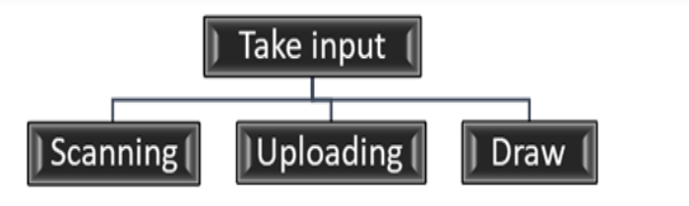
6. PROPOSED METHODOLOGY :
Three different input modes are provided by the proposed system, which has a user interface that is simple to use. Users can choose from three different ways to submit input, including uploading, scanning, and drawing to be processed.
This adaptable feature improves accessibility and meets the needs and preferences of many users.

Slide 8
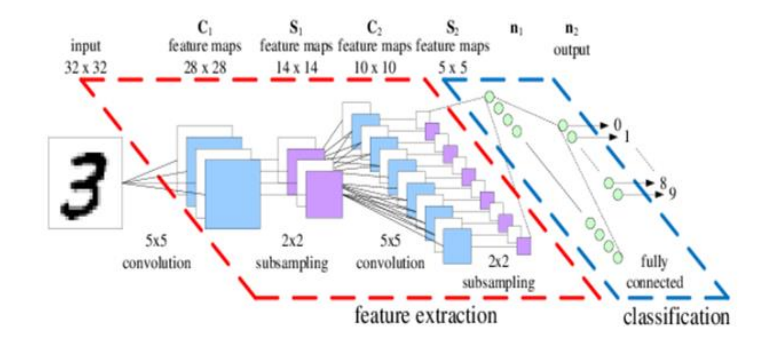
6. PROPOSED METHODOLOGY :

Slide 9
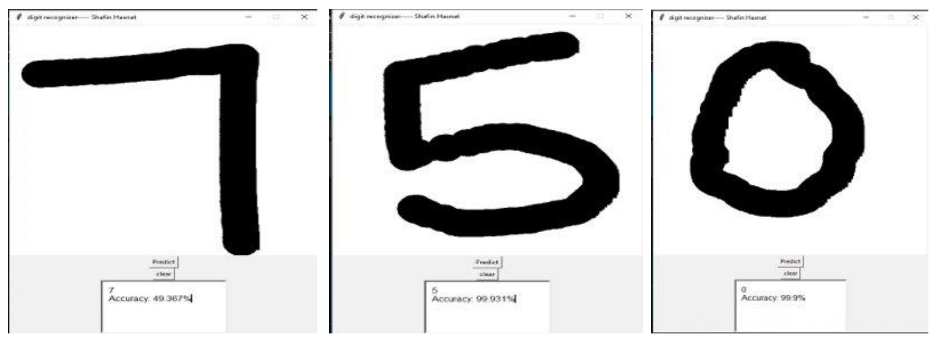
7. RESULTS & DISCUSSION:

Slide 10
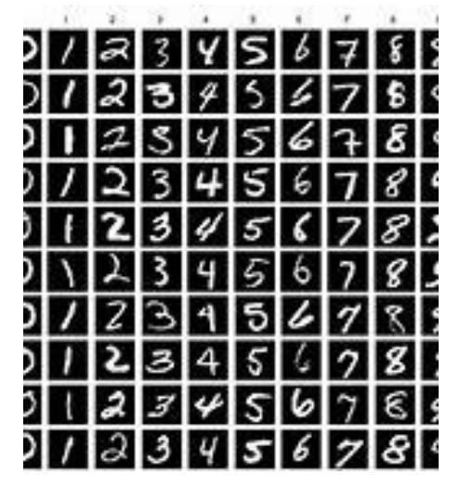
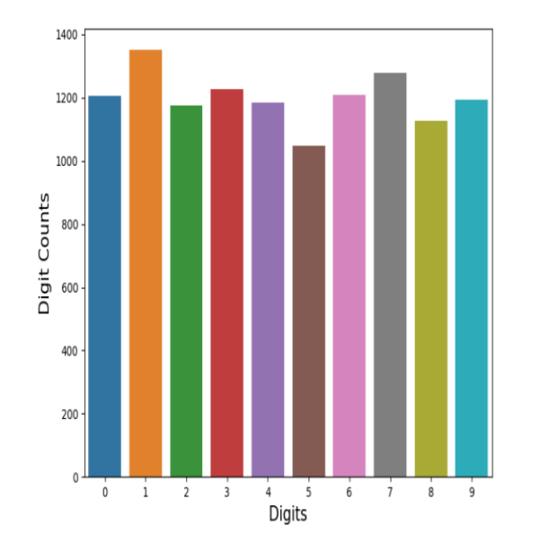
8. COMPARATIVE ANALYSIS:

Slide 11
9. CONCLUSION & FUTURE WORK :
The project successfully created an advanced algorithm using AI and machine learning, achieving a 95.23% average accuracy.
Utilized computer vision techniques from the OpenCV package to manage the inherent variability in handwritten digit size, width, orientation, and margin alignment, enhancing system resilience and adaptability.
Significant progress in distinguishing visually similar numbers (e.g., 1 and 7, 5 and 6, 3 and 8), ensuring more accurate and dependable digit recognition across different handwriting styles.
Implemented techniques like Gaussian blur to overcome challenges from poor lighting and pixelated images, bolstering the model's robustness for practical applications.
The project lays a strong foundation for future developments, with potential expansions to include more features and applications in document processing and automated data entry.
Demonstrates the integration of cutting-edge AI methods with practical computer vision applications, marking substantial progress in the field and establishing a basis for continued innovation.

Slide 12
10. REFERENCES :
[1]Chakraborty, P., Jahanapi, S.S. and Choudhury, T. (2021a) ‘Bangla handwritten digit recognition’, Cyber Intelligence and Information Retrieval, pp. 149–159. doi:10.1007/978-981-16-4284-5_14.
[2] Chakraborty, P., Jahanapi, S.S. and Choudhury, T. (2021a) ‘Bangla handwritten digit recognition’, Cyber Intelligence and Information Retrieval, pp. 149–159. doi:10.1007/978-981-16-4284-5_14.
[3] Padmashali, G.J.S. and Kumari, D. (October 2023).Handwritten digit recognition using deep learning, International Journal of Research in Engineering, Science and Management. Available at:https://journal.ijresm.com/index.php/ijresm/article/view/1026
[4] Ahlawat, S. et al. (2020) ‘Improved handwritten digit recognitionusing convolutional neural networks (CNN)’, Sensors, 20(12), p.3344.doi:10.3390/s20123344.
[5] Ahlawat, S. et al. (2020a) Better handwritten digit recognition using convolutional neural networks (CNN):, Sensors, 20(12), p. 3344.doi:10.3390/s20123344.
[6] Jana, R., Bhattacharyya, S. and Das, S. (2019) ‘Epileptic seizureprediction from EEG signals using DenseNet’, 2019 IEEE Symposium Series on Computational Intelligence (SSCI).doi:10.1109/ssci44817.2019.9003059.
[7] Alqahtani, A.S. et al. (2022) Secure communication and implementation of handwritten digit recognition using deep neural network - optical and Quan
[8] Mezghani, Anis et al(1 Jan. 2023). ‘Recent Advances of ML and DL Approaches for Arabic Handwriting Recognition: 61 – 78 doi:10.1007/s11082-077-04290-7 .
Sarker, Shishir et al. (2019) ‘A Lenet-5 Based Bangla Handwritten Digit Recognition Framework’, HBRP Publication, 2(3), pp. 1–7 doi:10.1109.44817.2019.9003059

