Slide 1


K.RAMAKRISHNAN COLLEGE OF TECHNOLOGY (AUTONOMOUS), TRICHY
SMART BOOK RECOMMENDATION SYSTEM USING MACHINE LEARNING
 | PRESENTED BY, Faisal Ahamad M (Reg.No : 811721243016) Mohammed Faizal T (Reg.No : 811721243033) Mohammed Imran M (Reg.No : 811721243034) Yogesh D (Reg.No : 811721243305)
GUIDED BY,
Mr. R Roshan Joshua M.E,
ASSISTANT PROFESSOR / AI
1

Slide 2
ABSTRACT
In today's digital era, the vast availability of books makes it challenging for readers to discover relevant content that matches their interests. The Smart Ml-Based Book Recommendation System addresses this challenge by leveraging artificial intelligence techniques to provide personalized book suggestions based on user preferences, reading history, and behavior. This system integrates machine learning and deep learning algorithms to analyze user interactions, book metadata, and reviews, ensuring accurate and relevant recommendations.

Slide 3
OBJECTIVE
The objective of this project is to develop an AI-powered book recommendation system that provides personalized suggestions based on user preferences and historical data.

Slide 4
INTRODUCTION
The Smart Book Recommendation System Using machine learning is designed to help users discover books based on their reading preferences, history, and interests.
the system provides personalized book recommendations to enhance the user’s reading experience.
The vast collection of books available today makes it challenging for readers to find books that match their interests. Data such as demographics, job roles, tenure, and satisfaction levels are used for analysis.
The outcome provide Traditional book recommendation methods, such as bestseller lists and user reviews, are often generalized and may not cater to individual preferences.es predictive insights for improving employee retention.
An Smart Book Recommendation System Using Machine helps address this issue by providing personalized book suggestions based on user behavior, reading history, and preferences. Predictive modeling helps identify high-risk employees, enabling targeted retention strategies.

Slide 5
EXISTING SYSTEM
Peer Recommendation: Books are being recommended by peers and friends
Word of mouth: Book recommendations are based on their popularity and rating of the books are spread through the word of mouth.
Editorial or Expert Recommendations: Books are suggested by critics, librarians, publishers, or literary experts.
Manual User Reviews and Ratings: Books are recommended based on average ratings and reviews from other readers.
Bookstore and Library Staff Picks: Recommendations are provided by bookstore employees or librarians based on their expertise.

Slide 6
PROPOSED SYSTEM
Machine Learning Integration: Leverages machine learning algorithms to recommend the suitable books.
Personalized Recommendations with AI & Machine Learning: AI-driven systems analyze user behavior, reading history, and preferences to recommend books tailored to individual tastes.
Chatbots & Virtual Assistants for Book Discovery: AI-powered chatbots interact with users to recommend books based on their mood, interests, or previous reads.
Real-Time Summarization: A Book can be summarized quickly by the user for easier understanding and Time saving
Sentiment Analysis on Reviews for Better Book Matching: AI scans user reviews to determine the sentiment (positive, neutral, or negative) and suggests books accordingly.
Content-Based Filtering : AI analyzes book metadata (title, author, genre, description, keywords) and compares it to books a user has liked.

Slide 7
LITERATURE SURVEY
S.NO | TITLE | YEAR OF PUBLICATION | AUTHORS | ALGORITHMS | MERITS | DEMERITS
1 | Book Recommending Using Text Categorization with Extracted Information | 2022 | Raymond J Mooney, Paul N. Bennett, Loriene Roy. | Naïve Bayers Roccohio Algorithm Decision tree and learning rule Collaborative Filtering | Integration of Information Extraction Effective Use of Machine Learning Algorithms Scalability & Practicality Quantitative Evaluation | Lack of User Interaction & Dynamic Adaptation Absence of Hybrid Approach No Real-World Deployment or User Study Limited Feature Extraction and Preprocessing
2 | Book Recommendation System Using Collaborative-Filtering System | 2022 | C.Arthur CAugustian, Gloriya mathew | Item-Based Collaborative Filtering Pearson Correlation Coefficient Linear Support Vector Machines | Efficient Use of Collaborative Filtering Scalability and Performance Well-Defined Methodology | Data Sparsity Issue High Computational Cost No Use of Deep Learning or Advanced Machine Learning Cold Start Problem

Slide 8

LITERATURE SURVEY
S.NO | TITLE | YEAR OF PUBLICATION | AUTHORS | ALGORITHMS | MERITS | DEMERITS
3 | Book Recommendation System Using Collaborative-Filtering System | 2021 | S. R. Hiray, Atish Bhosale, Komal Patil, Amruta Gaikwad, Riddhesh Deshmukh | Support Vector Machine (SVM) Collaborative Filtering Naïve Bayes User Correlation Factor | Use of SVM for Efficient Recommendations Automated Book Selection Process for Libraries Combination of Collaborative Filtering and Machine Learning Flexible and Scalable System | Limited Content-Based Filtering Lack of Real-World Deployment Computational Cost of SVM
4 | Machine learning-based book recommender system | 2020 | khalid Anwar, Jamshed Siddiqui, Shabab Saquib Sohail. | k-Nearest Neighbors (KNN) Artificial Neural Network (NN) Association Rule Mining (ARM) K-Means Clustering | Comprehensive Survey of ML Techniques Covers Various Application Areas Comparison of Evaluation Metrics Addresses Major Challenges in Recommender Systems | Lack of Experimental Implementation High Computational Cost for Some Approaches No User Study or Real-World Validation No Use Of Recurrent Neural Networks (RNNs)

Slide 9

LITERATURE SURVEY
S.NO | TITLE | YEAR OF PUBLICATION | AUTHORS | ALGORITHMS | MERITS | DEMERITS
5 | Enhancing Personalized Book Recommender System | 2020 | Abdulgafar usman, Abubakar roko, Aminu B. Abba Almu | Euclidean Distance Similarity Function Weighted Average Rating Prediction User-Based Collaborative Filtering | Improved Accuracy with Hybrid Filtering Approach Use of Large-Scale Dataset for Evaluation Reduction of Over-Specialization Potential for Further Improvement | Limited Feature Extraction from Book Content High Computational Cost for Large Datasets Lack of Contextual Awareness

Slide 10
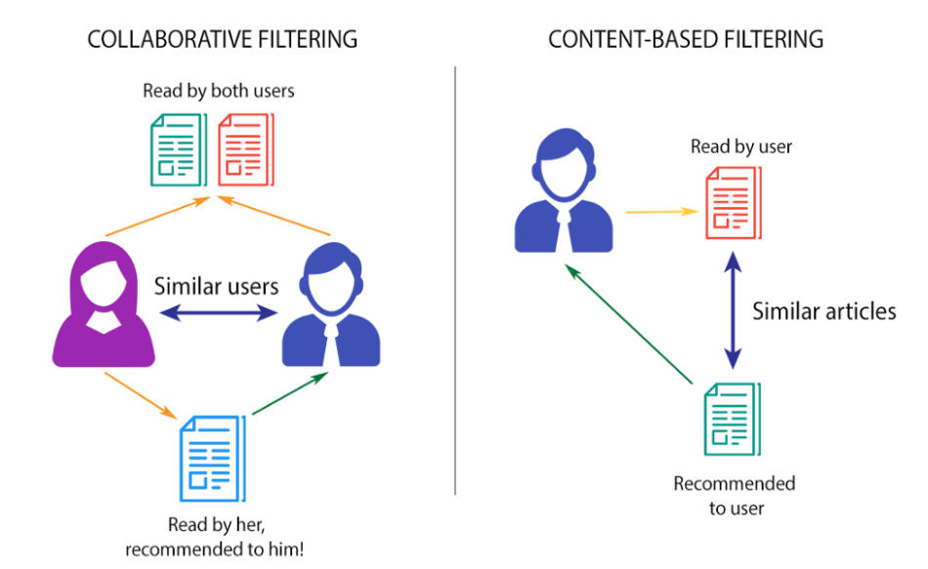
SYSTEM ARCHITECTURE

Slide 11
HARDWARE SPECIFICATION
Processor: Intel Core i5 (8th Gen or higher) / AMD Ryzen 5 or equivalent
RAM: Minimum 8 GB (16 GB recommended for smoother performance)
Storage: Minimum 20 GB of free space for dataset storage, libraries, and project files - GPU (Optional but beneficial): NVIDIA GTX 1650 or higher for faster data processing and model training
Operating System: Windows 10/11, Ubuntu 20.04+, or macOS Monterey or later
SOFTWARE SPECIFICATION
Python: Version 3.9 or higher
Jupyter Notebook: For data analysis, visualization, and model development - pandas: For efficient data manipulation (pip install pandas)
OpenAI API: For the customized ChatBot (pip install openAI)
matplotlib / seaborn: For visualization and exploratory data analysis (pip install matplotlib seaborn)

Slide 12

Installation and Setup:
Key Steps in the Process:
installing essential libraries such as pandas, numpy, scikit-learn, nltk, flask, and joblib.
importing required modules like TfidfVectorizer, cosine_similarity, and CountVectorizer
Install Streamlit.
Used for building the web-based user interface.
Enables real-time user interaction with the recommendation engine.
Environment Setup.
Python 3.x environment created using venv
All dependencies installed via pip
Project organized with separate files.
App.py for Streamlit backend
.pkl files for pre-trained models.
CSV files for datasets

Slide 13
Data Collection and Pre-processing Module
Data collection and pre-processing module involves Gathering raw data from various sources for analysis.
Sources of Data:
Data resources collected from the various publishers.
Datasets used : Books.csv, Ratings.csv, Users.csv
Collected information contains book titles, authors, genres, ISBNs, user ratings
Challenges:
Data Inconsistency
Missing or Incomplete Data
Privacy and Security Concerns
Pre-Processing:
Remove duplicates, Missing Values, Irrelevant entries

Slide 14
Recommendation Logic & Model Implementation
Purpose: To generate highly personalized book suggestions using a hybrid of Content-Based and Collaborative Filtering.
Recommendation Logic :
Content-Based Filtering
Recommends books similar in content (title, genre, author, description) to the user’s selected book using TF-IDF and cosine similarity
Collaborative Filtering
Suggests books based on preferences and behavior of users with similar interests (user-item interactions, rating patterns).
Model Implementation:
TF-IDF Vectorizer used for vectorizing text data
Cosine Similarity calculates content similarity between books
User-book rating matrix used for collaborative learning
Suggests books based on preferences and behavior of users with similar interests (user-item interactions, rating patterns).

Slide 15
EVALUATION MODULE
Purpose: To assess the performance and effectiveness of both content-based and collaborative filtering models in delivering relevant book recommendations.
Evaluation for Content-Based Filtering :
Manual validation of recommendations based on relevance and similarity to input books.
User feedback considered to measure the usefulness and accuracy of suggestions
cosine similarity scores
Evaluation for Collaborative Filtering:
TF-IDF Vectorizer used for vectorizing text data
Checked how well the system predicts unseen books using user rating patterns
User-book rating matrix used for collaborative learning
Purpose: Ensures that recommendations are not only accurate but also relevant, diverse, and personalized to user preferences.

Slide 16

Personalized ChatBot Module
Purpose: To provide users with an intelligent, conversational assistant for book-related queries and recommendations.
Functionalities:
Engages users in natural language conversations.
Delivers personalized recommendations and summaries
Answers book-related questions like
Suggest a mystery book.
Books similar to Atomic Habits?
Enhances user experience with real-time assistance.
Makes the system more interactive and user-friendly.
Helps users who prefer conversational search over typing book names.
Technologies Used:
Chatbase / OpenAI API (GPT-3.5).
Trained or connected with book dataset for relevant responses.

Slide 17
Streamlit Web Application Module
Purpose: To provide a simple, interactive, and user-friendly interface for users to get real-time book recommendations.
What is Streamlit?:
An open-source Python framework used for creating web apps for machine learning and data science projects.
Allows quick UI development without needing HTML/CSS/JavaScript
Key Features:
Accepts user input (book name) through text boxes.
Displays recommended books instantly based on the ML model.
Integrates seamlessly with the backend recommendation logic.
Auto-refreshes with every input change for live interaction.
Cloud Deployment – Can be hosted on platforms like Streamlit Cloud, AWS, or Heroku.

Slide 18
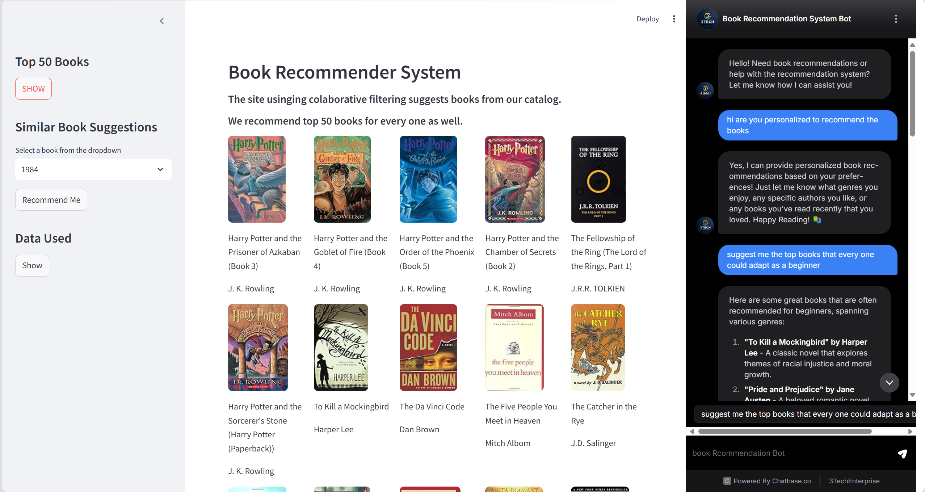
SCREENSHOTS

Slide 19

ADVANTAGES
Personalized Recommendations
Adaptive Learning & Dynamic Updates
Enhanced User Experience
Higher Engagement & Reader Retention
Automated Categorization & Book Tagging
Cross-Selling & Business Growth

Slide 20

APPLICATIONS
Online Bookstores.
Library Management Systems.
E-Learning Platforms.
Book Review & Recommendation Websites
Publishing & Marketing
Personalized Book Clubs & Reading Communities

Slide 21
CONCLUSION
The Smart Book Recommender System is a groundbreaking fusion of machine learning, data science, and AI-driven interactivity, designed to redefine the way readers discover books. By leveraging historical book data from Kaggle, powerful data analysis with pandas, and the precision of cosine similarity, our system crafts highly accurate and personalized recommendations tailored to each user’s unique literary preferences.
With the pickle library, we ensure model persistence, enabling seamless and efficient future use. The Streamlit-powered interactive web application provides an intuitive and engaging user experience, making book discovery both effortless and enjoyable. Further enhancing the system’s capabilities is a customized ChatBot powered by the OpenAI API, offering insightful book-related discussions and recommendations, making the platform more dynamic and user-centric.

Slide 22
REFERENCES
Book Recommendation System Using Collaborative-Filtering System -Mubarak Almutairim, Faizan Younas & Published in IEEE AUG 2020.
Enhancing Personalized Book Recommender System-khalid Anwar, Jamshed Siddiqui, Shabab Saquib Sohail & Published In IEEE DEC 2020.
Book Recommendation System Using Machine Learning- S. R. Hiray, Atish Bhosale, Komal Patil, Amruta Gaikwad, Riddhesh Deshmukh & Published in IEEE June- 2022.
Book Recommending Using Text Categorization with Extracted Information- Raymond J Mooney, Paul N. Bennett, Loriene Roy & IEEE JUL-2022.
5. Enhancing Personalized Book Recommender System-Abdulgafar usman, Abubakar roko,
Aminu B. Abba Almu & Published in IEEE OCT 2022.

Slide 23
THANK YOU

