Slide 1
MQ-2 Gas Sensor: Principles, Applications, and Limitations
AIR QUALITY INSIGHTS THEME

Slide 2
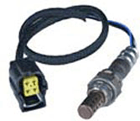
Unveiling the MQ-2 Gas Sensor
A comprehensive exploration of the MQ-2 gas sensor technology, covering its operational principles, diverse applications, key limitations, and vital considerations for effective implementation.

Slide 3
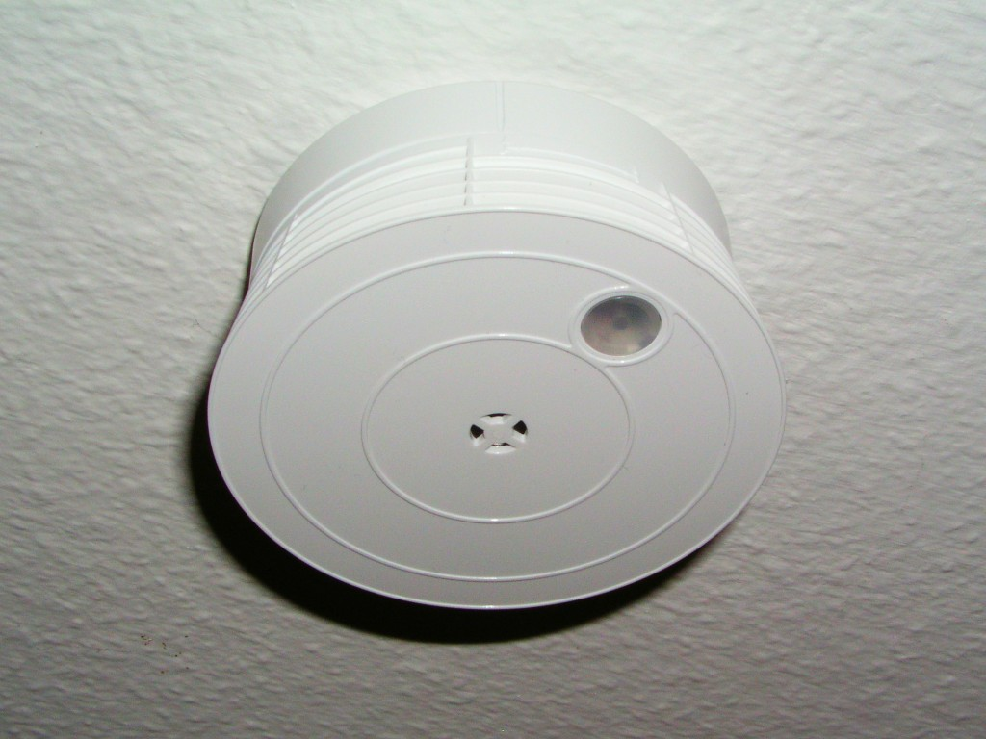
Key Characteristics of MQ-2 Sensors
MQ-2 sensors offer effective detection of smoke and various combustible gases like methane, butane, LPG, and hydrogen, crucial for safety applications.
These sensors are known for their rapid response time, typically within seconds, enabling quick reaction to gas leaks or hazardous environments.
Simple to use, MQ-2 sensors integrate seamlessly with microcontrollers and alarm systems due to their analog output proportional to gas concentration.
MQ-2 sensors have an adjustable sensitivity via a potentiometer, enabling customization to specific detection thresholds based on environmental conditions.
The sensor's compact physical size and low power consumption make it suitable for integration into portable and battery-powered devices for increased mobility and ease of use.
2

Slide 4
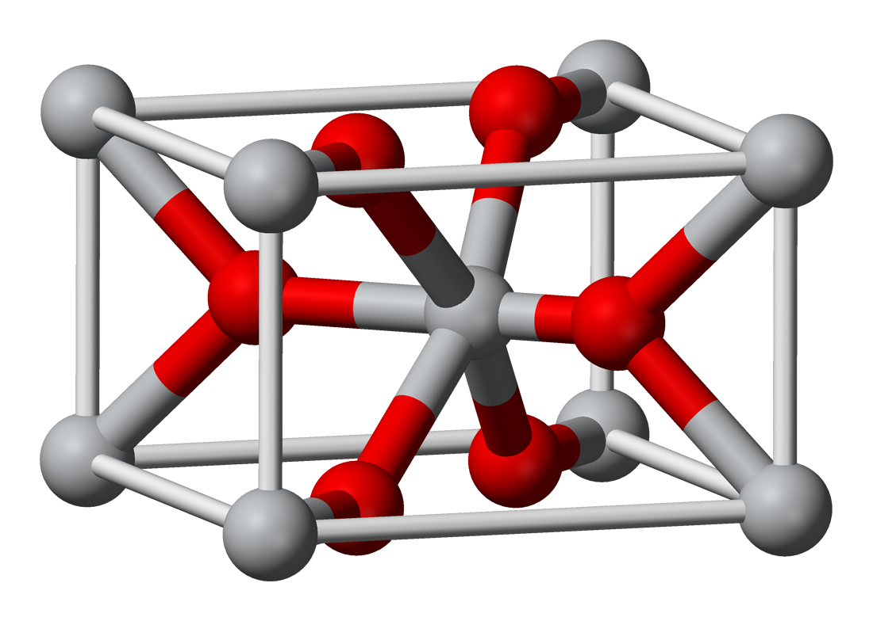
MQ-2 Sensor: Working Principle
Adsorption
Measurement
Gas molecules adsorb onto the SnO2 surface, influencing its resistance and creating a measurable change.
The sensor measures the change in electrical resistance, providing an output signal corresponding to the gas concentration.
The adsorbed gas reacts with the SnO2, altering the concentration of oxygen ions and thereby changing the material's conductivity.
Reaction
3

Slide 5
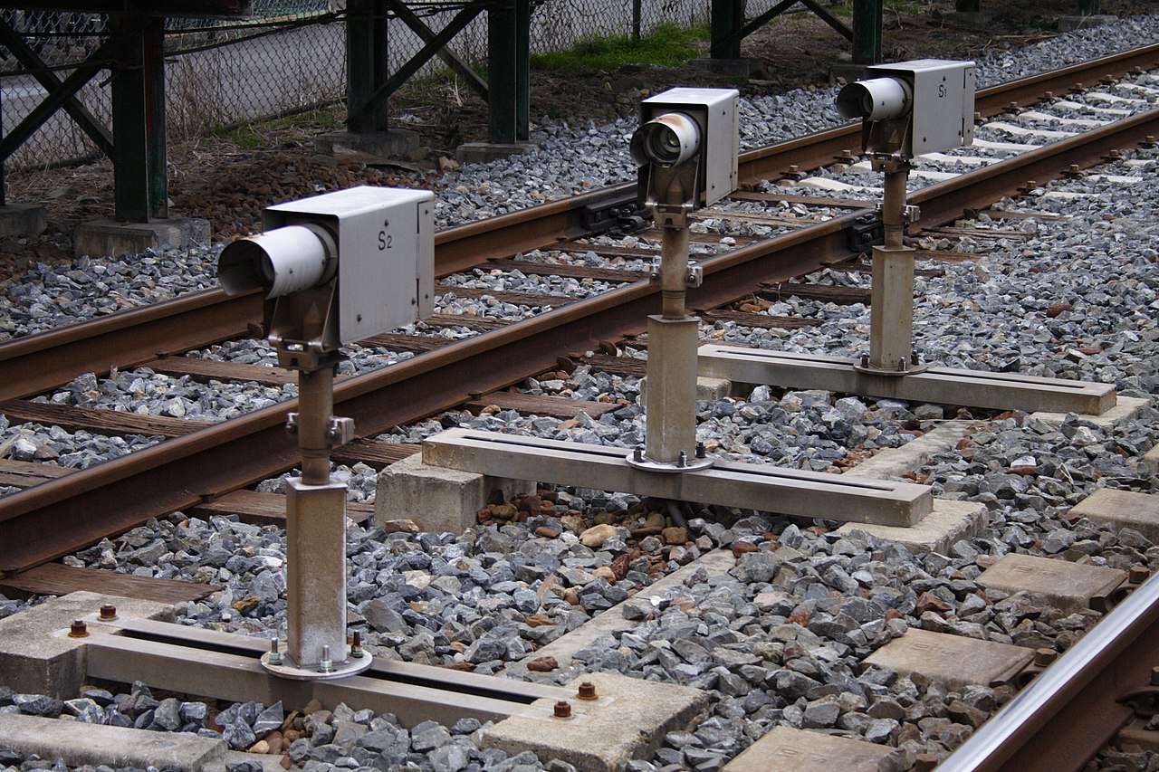
Real-World Applications of MQ-2 Sensors
Exploring diverse uses of MQ-2 sensors in residential, industrial, and automotive environments for safety and environmental monitoring, supported by concrete examples.

Slide 6
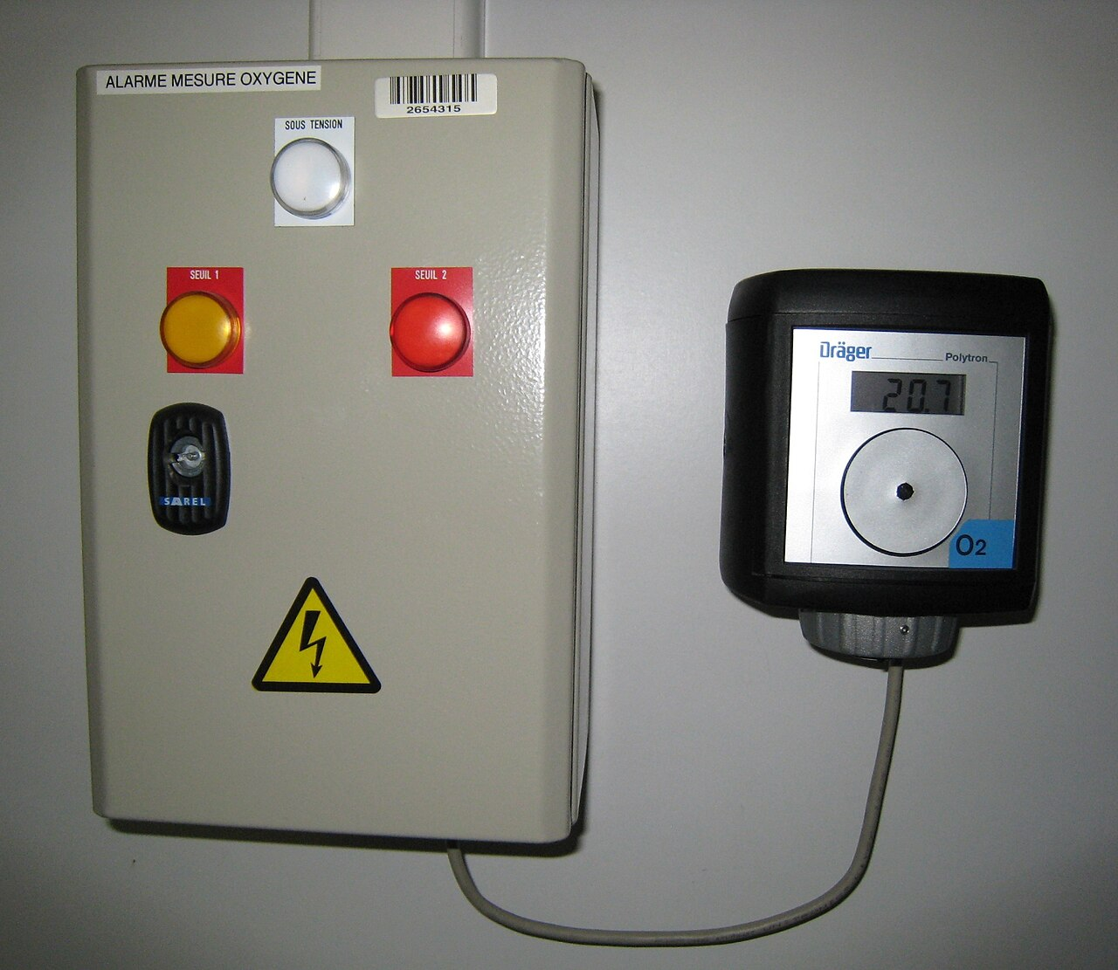
Diverse Applications of MQ-2 Gas Sensors
MQ-2 gas sensors are widely used in residential settings to detect gas leaks and smoke, improving overall safety and potentially preventing accidents.
In industrial environments, these sensors are critical for monitoring flammable gases and ensuring worker safety near welding equipment and gas pipelines.
Automotive applications include integration of MQ-2 sensors in vehicle exhaust monitoring systems to detect leaks or high emissions of combustible gases.
Portable gas detectors utilize the MQ-2 sensor for on-site safety inspections and environmental monitoring in confined spaces or hazardous locations.
MQ-2 sensors can be part of HVAC systems to monitor air quality and detect potentially dangerous gas build-ups, ensuring efficient ventilation control and safety.
5

Slide 7

Navigating MQ-2 Sensor Limitations
A critical review of MQ-2 sensor limitations, cross-sensitivities, environmental factors, and potential inaccuracies to guide proper usage and interpretation of data.

Slide 8

Challenges and Considerations for MQ-2 Sensors
Cross-sensitivity to multiple gasses can make it difficult to accurately identify specific gases, often requiring supplementary sensors or calibration techniques.
Environmental factors such as temperature and humidity significantly affect sensor performance, necessitating compensation circuits for accurate readings.
The MQ-2 sensor's long term drift in sensitivity requires periodical recalibration to maintain accuracy and reliability in extended deployments.
The sensor's sensitivity can degrade when exposed to high concentrations of certain gases over prolonged periods, potentially shortening its lifespan.
MQ-2 sensors are not suitable for detecting all toxic gases, which limits their applicability in settings requiring accurate quantification of specific hazardous substances.
7

Slide 9
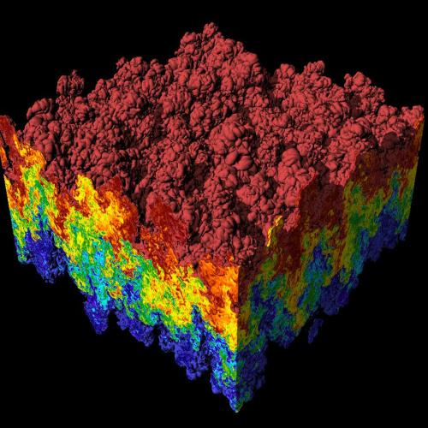
Key Performance Indicators of MQ-2 Sensors
95%
5 sec
Detection Accuracy (Methane)
Typical Response Time
−10°C to 50°C
5+
Operating Temperature Range
Years Expected Lifespan
8

Slide 10

“
“While MQ-2 sensors offer a cost-effective solution for detecting various combustible gases, it's crucial to acknowledge their limitations and calibrate with precision.”
-- Dr. Emily Carter, Sensor Technology Expert
9

Slide 11

Best Practices for Successful MQ-2 Sensor Deployment
Utilizing proper calibration techniques is crucial for establishing a reliable baseline and ensuring accurate readings across different gas compositions.
Implementing temperature and humidity compensation circuitry improves sensor accuracy by mitigating environmental influences on sensor sensitivity.
Regularly monitoring and replacing sensors based on their expected lifespan helps prevent degradation of performance and maintains system reliability.
Employing sensor fusion techniques, such as combining data from multiple sensors, enhances detection by minimizing false alarms and improving accuracy.
Selecting appropriate sensor placement locations is essential for ensuring that the sensor effectively samples the environment where gas leaks are most likely to occur.
10

