Slide 1
Smart Irrigation Revolution: ESP32 & LoRa Powered Agriculture
AQUATECH INNOVATION THEME

Slide 2
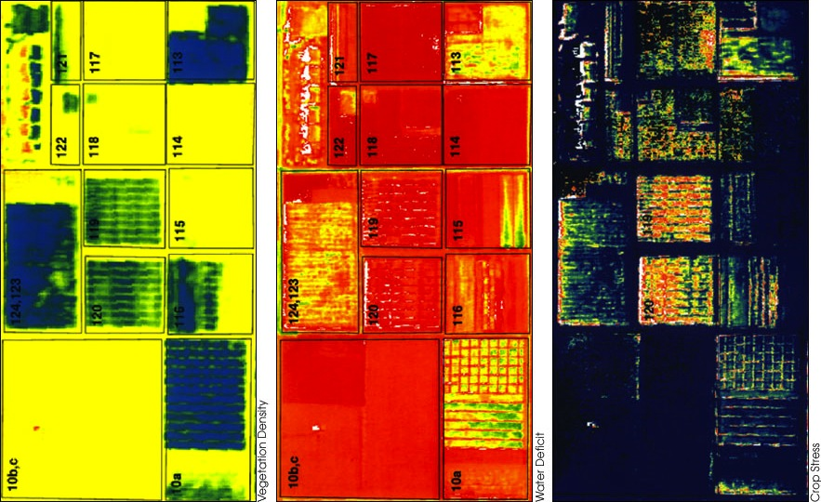
Smart Irrigation: A New Dawn for Agriculture
Harnessing ESP32 and LoRa to transform traditional irrigation into a data-driven, globally accessible, and efficient system.

Slide 3
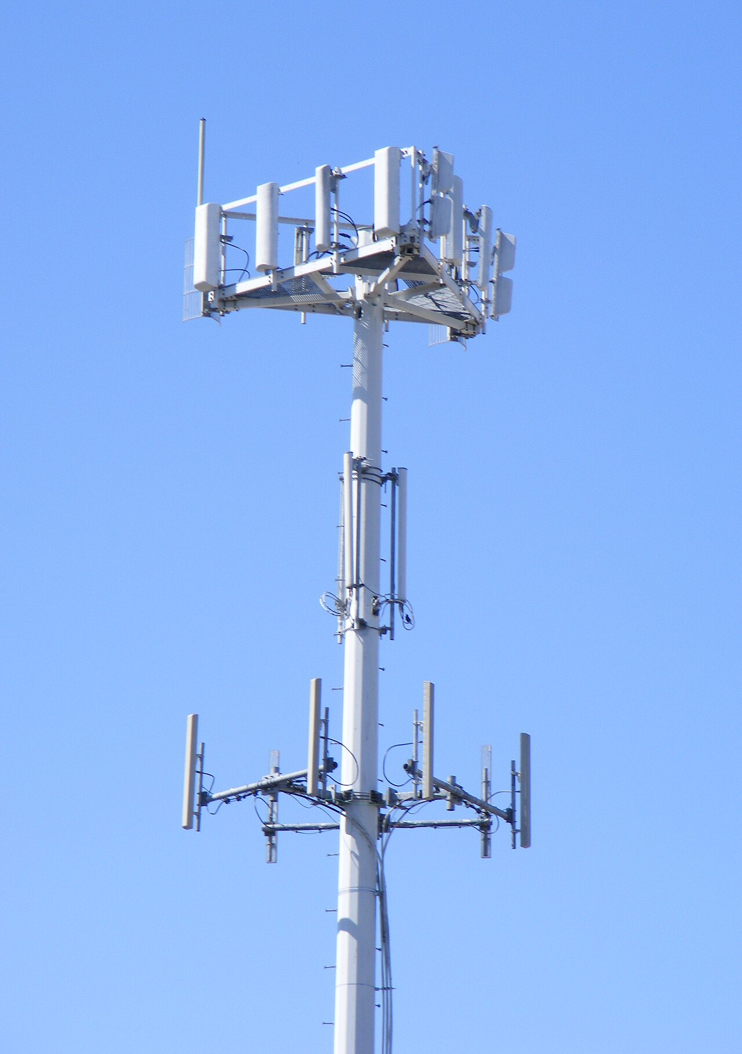
Signal Symphony: From Command to Control
1. User Input
3. LoRa Communication
5. Data Feedback
User initiates irrigation command on smartphone application, setting duration and volume parameters via cloud.
The ESP32, acting as a gateway, communicates wirelessly via LoRa to a remote module situated near the motor controller.
The motor controller gathers data about water flow, pressure, and motor current sending data for performance monitoring on the app.
The command is transmitted through the internet to a cloud server, which queues the request for the destination ESP32.
The receiving LoRa module relays data to the motor controller, initiating pump activation according to received duration request.
The ESP32 compares data about water flow, pressure, and motor current to verify against pre-determined specifications on the app.
2. Cloud Transmission
4. Motor Activation
6. System Monitoring
2

Slide 4
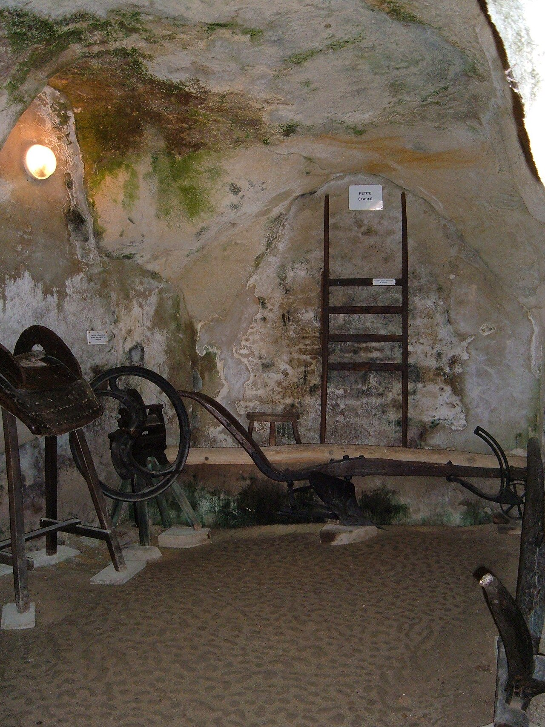
Evolutionary Leap: Manual vs. Smart Irrigation
Traditional System
Smart Irrigation System
Manual systems require constant human monitoring, leading to inefficiencies and inconsistent water distribution, costing time and money.
Water usage is often excessive and unregulated, resulting in water wastage and environmental concerns contributing to unsustainable farming.
Lacks remote control capabilities, necessitating physical presence for adjustments and increasing operational costs significantly.
Limited data collection makes analysis of water efficiency impossible hindering improvement of irrigation strategies on a farm.
Automated control optimizes water usage based on real-time soil moisture and weather data reducing waste and labor costs.
Remote monitoring and control via smartphone provide flexibility and enable immediate responses to changing environmental conditions.
Data analytics dashboard give farmers insights into water usage patterns and crop health, fostering informed decision-making.
The integration with LoRa technology allows the system to operate effectively in remote areas, offering a scalable and cost-effective solution.
VS
3

Slide 5
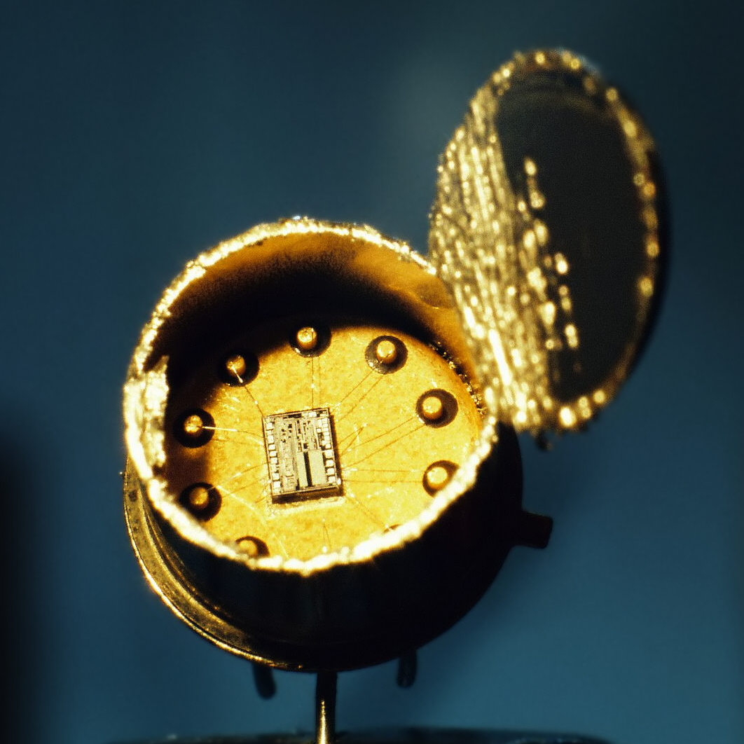
ESP32 & LoRa: The Dynamic Duo of Connectivity
Exploring the synergistic relationship between ESP32 and LoRa, enabling global accessibility, seamless long-range connection, and efficient data transmission in agricultural fields.
4

Slide 6
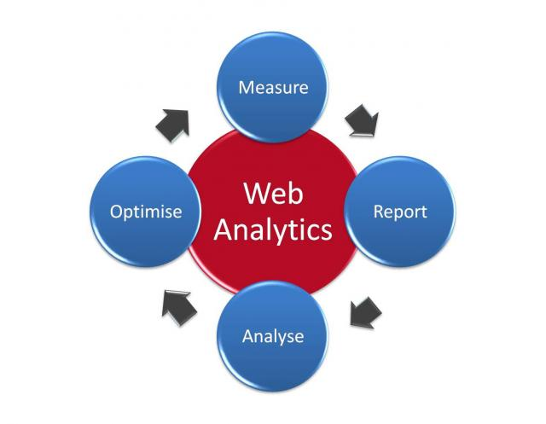
Sustainable Gains: Quantifying the Impact
45%
30%
Reduction in Water Consumption
Increase in Crop Yield
60%
Decrease in Labor Costs
5

