Slide 1
Decoding the Cosmos: The EW67 Signal Framework
COSMIC EXPLORATION THEME

Slide 2
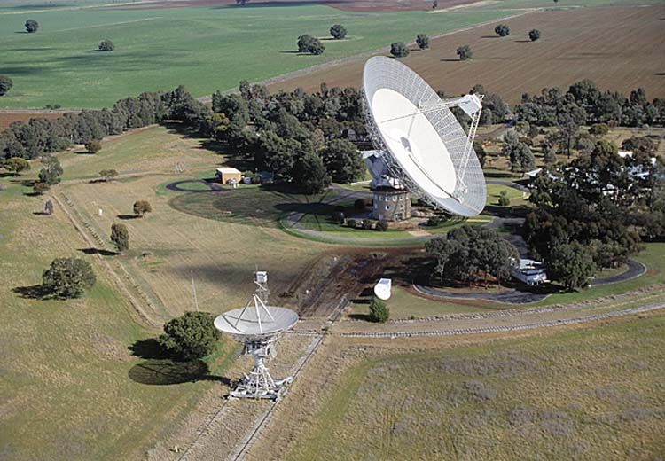
Unveiling EW67: A Hypothetical Beacon
Exploring the significance of a theoretical signal in the search for extraterrestrial intelligence.

Slide 3
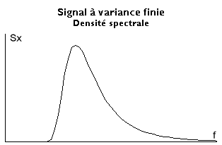
The Hypothetical Signal Defined
EW67 serves as a conceptual benchmark in SETI discussions, representing a set of generic characteristics rather than a specific, observed radio wave.
This placeholder allows researchers to theorize and model potential extraterrestrial signals without being constrained by the parameters of known celestial phenomena.
Unlike real observed signals, EW67 is a sandbox for testing signal detection algorithms and analyzing communication strategies from an unknown source.
The 'EW67' concept encapsulates key attributes such as signal strength, bandwidth, modulation, and frequency, aiding in the development of targeted search criteria.
Understanding EW67’s parameters helps scientists to prepare for the vast ambiguity inherent in actual extraterrestrial signals, enhancing the search process.
2

Slide 4
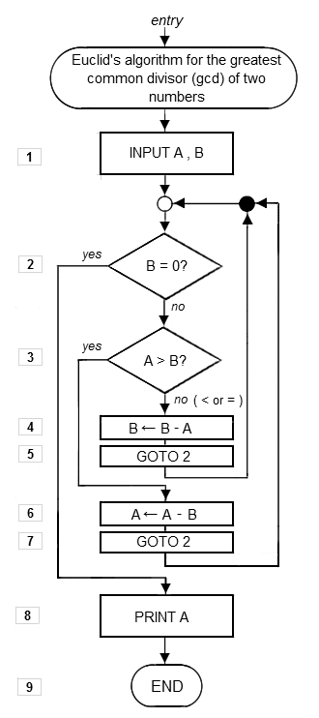
Role in SETI Research and Development
The 'EW67' construct greatly facilitates the development of search algorithms, signal processing techniques, and robust message decoding strategies applicable across SETI projects.
Acting as a measurable benchmark, EW67 allows researchers to test and optimize algorithms designed to sift through cosmic noise for structured signals.
Its adaptable nature enables exploration of various communication methods that extraterrestrial civilizations might employ, like pulsed or frequency-modulated broadcasts.
The EW67 simulations can be used to generate large datasets of artificial signals for training machine learning models, improving automated signal detection efforts.
By modeling hypothetical signals via 'EW67', SETI initiatives can hone their strategies and tools, becoming more effective in the global hunt for extraterrestrial life.
3

Slide 5
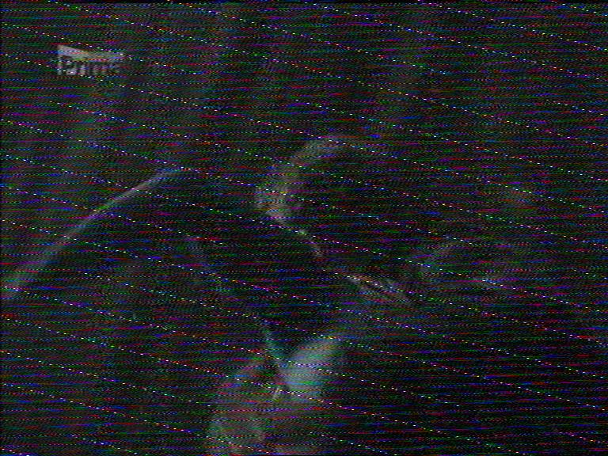
Confronting the Challenges of Signal Verification
The crucial challenge in SETI lies in definitively proving the extraterrestrial origin of a potential signal, differentiating it from terrestrial interference.
Any signal resembling 'EW67’ could potentially be created by natural cosmic events such as pulsars, or human-made sources, increasing the difficulty in confirmation.
Rigorous verification protocols must be applied, including cross-verification from multiple observatories and detailed analysis for intentional patterns.
Advanced signal processing techniques are essential to filter out noise and resolve the signal's true origin, preventing false positives from interfering signals.
Statistical models are needed to quantify the unlikeliness of the signal being randomly generated, strengthening the claim of its extraterrestrial origins.
4

Slide 6
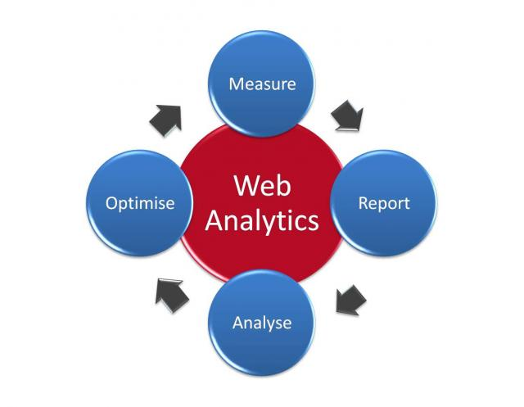
Statistical Tools for Extraterrestrial Signal Assessment
Applying advanced analytics to filter out the irrelevant and amplify the significant in SETI.

Slide 7

Key Metrics in SETI Signal Analysis
98%
0.01%
Noise Reduction
False Positive Rate
10^20
4.5x
Analyzed Frequencies
Signal Clarity Increase
6

Slide 8

“
"The discovery of even the simplest life elsewhere would fundamentally alter our understanding of biology and our place in the universe." -- Dr. Jill Tarter, SETI Institute
-- Dr. Jill Tarter, SETI Institute
7

Slide 9

Signal Detection: Matched Filter vs. Machine Learning
Matched Filter
Machine Learning
The matched filter is a linear time-invariant filter designed to provide the maximum signal-to-noise ratio for a known signal shape.
This method is exceptionally good at finding signals with a predefined structure when the noise characteristics are well-understood.
Its effectiveness diminishes when faced with unknown or unpredictable signal modulations and noise environments that deviate from assumptions.
Machine learning offers adaptive signal detection capabilities, facilitating recognition of intricate patterns, and differentiating genuine signals from complex terrestrial noises.
It can learn and improve its detection capabilities over time through exposure to diverse datasets, effectively adapting to new and unexpected signal types.
Requires substantial training data and computing resources, and may return 'black box' results that pose challenges around interpretability and verification.
VS
8

Slide 10

Evolution of Signal Verification Techniques
1960s
2000s
Early visual inspection methods initiated by Project Ozma, relying on analog equipment and basic signal analysis.
The development advanced algorithms for radio frequency interference mitigation, crucial for distinguishing artificial signals.
Adoption of Fast Fourier Transforms (FFT) and digital signal processing techniques for enhanced signal analysis.
Incorporation of deep learning models to automatically classify and verify signals, greatly improving automation and precision.
1980s
Present
9

Slide 11
“
"The quest to find extraterrestrial intelligence is a long-term endeavor that requires patience, persistence, and ingenuity." -- Paul Allen
-- Paul Allen
10

