Slide 1
Python's Core Data Structures: Lists, Tuples, Dictionaries, and Sets
DATA STRUCTURES DEEP DIVE THEME

Slide 2
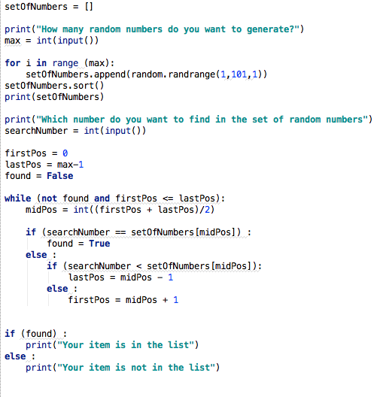
Unlocking Python's Potential Through Data Structures
An exploration into how lists, tuples, dictionaries, and sets empower efficient data management.

Slide 3

Lists: Dynamic and Versatile Data Containers
Lists in Python are ordered, mutable collections capable of holding elements of diverse data types, offering flexibility in data storage.
Defined using square brackets, lists allow for dynamic modification, including adding, removing, or changing elements after creation, enabling real-time updates.
Lists support indexing and slicing, granting access to specific elements or sub-lists based on their position, facilitating granular data manipulation.
The mutability of lists makes them ideal for scenarios where data needs to be frequently updated or reordered, such as managing a queue of tasks.
List comprehensions provide a concise way to create new lists based on existing iterables, enhancing code readability and efficiency when transforming data.
2

Slide 4

Tuples: Immutable and Secure Data Sequences
Tuples are ordered, immutable collections similar to lists but defined using parentheses, offering data integrity through their unchangeable nature.
The immutability of tuples makes them suitable for representing fixed collections of items whose values should not be altered, ensuring data consistency.
Tuples are often more memory-efficient than lists due to their static size, reducing overhead in memory management, especially in large datasets.
Tuples can be used as keys in dictionaries because of their immutability, enabling the creation of complex data structures that require stable identifiers.
Named tuples, accessible through the `collections` module, enhance code readability by allowing access to elements using meaningful names instead of indices.
3

Slide 5
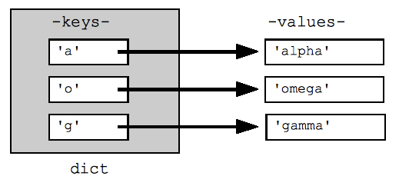
Dictionaries: Efficient Key-Value Data Repositories
Dictionaries are unordered collections of key-value pairs, providing efficient data retrieval based on unique keys, making them ideal for lookup operations.
Defined using curly braces, dictionaries offer fast access to values through their corresponding keys, akin to indexing in lists but with more descriptive identifiers.
Dictionary comprehensions allow for the concise creation of new dictionaries from existing iterables, simplifying data transformation and filtering processes.
Dictionaries are essential for implementing data structures like hash tables and JSON objects, highlighting their role in data serialization and deserialization.
The `get()` method allows for safe retrieval of values, returning a default value if the key is not found, preventing unexpected errors during program execution.
4

Slide 6

Sets: Unique and Unordered Element Collections
Sets are unordered collections of unique elements, useful for tasks such as removing duplicates and performing mathematical set operations, enhancing data integrity.
Defined using curly braces or the `set()` constructor, sets ensure that each element is unique, automatically eliminating duplicates during creation, simplifying data cleansing.
Sets efficiently support operations like union, intersection, difference, and symmetric difference, streamlining set-based data analysis and comparison tasks.
Frozen sets are immutable versions of sets, suitable for use as keys in dictionaries or as elements in other sets, extending the utility of set operations.
Sets are often used in scenarios where uniqueness and membership testing are critical, such as ensuring no duplicate user IDs or identifying unique URLs in web crawling.
5

Slide 7
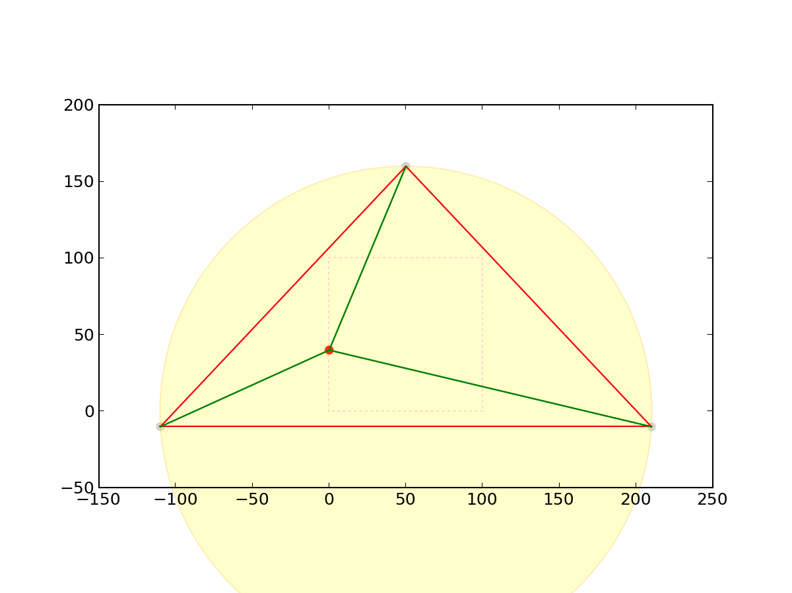
Lists vs. Tuples: Mutability and Performance Trade-offs
Lists
Tuples
Mutable: Elements can be added, removed, or modified after creation, providing flexibility in dynamic data management.
Potentially Slower: Dynamic resizing can lead to performance overhead, especially with frequent modifications.
Use Cases: Ideal for scenarios requiring frequent data updates, such as managing queues, stacks or growing datasets.
Immutable: Elements cannot be changed after creation, ensuring data integrity and preventing accidental modifications.
Potentially Faster: Immutability allows for optimizations, often resulting in faster iteration and memory efficiency.
Use Cases: Suitable for representing fixed collections of data, such as coordinates, database records, or dictionary keys.
VS
6

Slide 8

The Impact of Efficient Data Structure Choice on Performance
25%
15%
Average Speed Increase When Using Sets for Membership Testing
Memory Saved by Using Tuples Instead of Lists for Static Data
2x
99%
Faster Data Retrieval with Dictionaries Compared to Linear Searches
Reduction in Duplicate Entries When Using Sets
7

Slide 9

Evolution of Python Data Structures and Their Applications
1991
2000s
Python 1.0 introduces Lists and Tuples, establishing fundamental ordered data collections.
Sets are added, facilitating mathematical set operations and ensuring uniqueness in element collections.
Dictionaries are incorporated, enabling efficient key-value storage and retrieval for broader applications.
Continued optimization and increased utilization in data science, web development, and machine learning.
1990s
Present
8

Slide 10

“
"Python is an experiment in how much power programmers want to give to users." -- Guido van Rossum
Understanding and leveraging Python's data structures is key to harnessing this power and creating efficient, maintainable code, as intended by its creator.
9

Slide 11
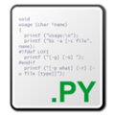
Mastering Data Structures for Efficient Python Development
Effective selection and utilization of Python's data structures represent a critical skill for improving software performance, reliability and overall design.

