Slide 1
Unleashing Electric Potential: A Deep Dive into Motor Dynamics
ELECTRIC BLUE THEME

Slide 2
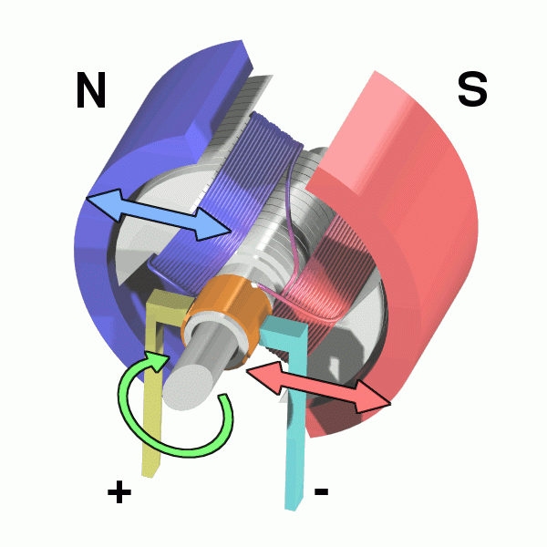
The Heart of Motion: Understanding Electric Motors
Exploring the fundamental principles that power our modern world through electric motor technology.

Slide 3
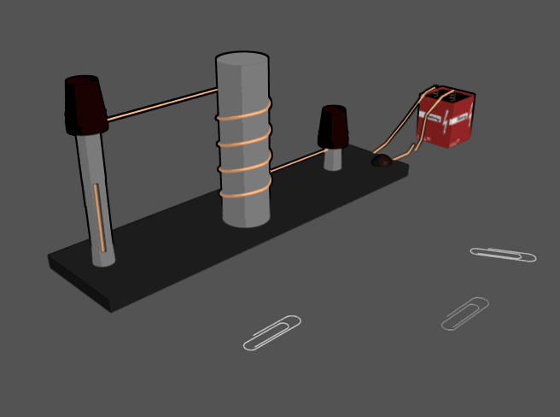
Harnessing Electromagnetism: Induction and the Lorentz Force
The electromagnetic induction principle is critical, as it facilitates the conversion of electrical energy into mechanical energy within the motor.
An electric current, when passing through a conductor within a magnetic field, experiences a Lorentz force, which is the basis for motor operation.
The magnitude of the Lorentz force is directly proportional to the current's strength, the length of the conductor, and the magnetic field's intensity.
Practical applications are seen in industries by precise control systems because by manipulating current and magnetic fields, we achieve tailored motor output.
Without electromagnetic induction and the Lorentz force, modern electric motors providing millions of device across various industries would not exist.
2

Slide 4
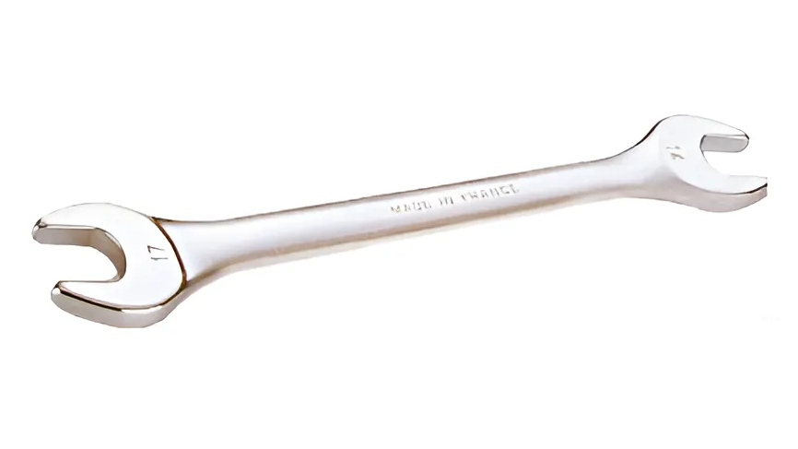
From Force to Rotation: Deciphering Torque Generation
The force generated on the conductor creates torque, which serves as the rotational force propelling the motor's shaft, thus generating mechanical power.
A typical motor design often incorporates multiple conductors strategically positioned to maximize the combined torque output for enhanced efficiency.
Torque is influenced by the force magnitude and the distance from the rotation axis, with a greater distance leading to higher torque output at same force.
High-torque motors typically employ larger conductors and stronger magnetic fields to generate significant rotational force for demanding applications.
Advanced torque control techniques involving sophisticated algorithms allow precise adjustment of motor speed and power, optimizing performance in various scenarios.
3

Slide 5
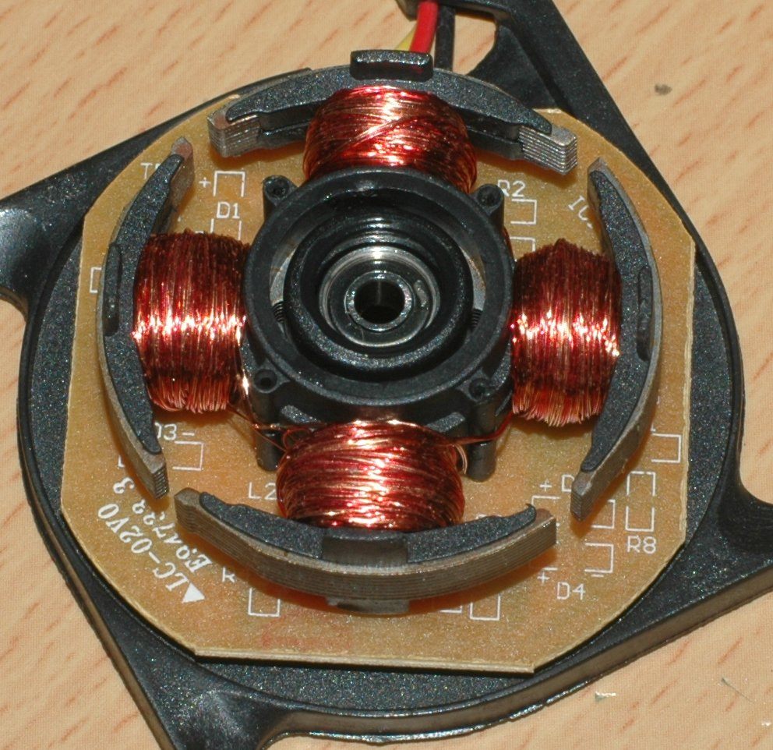
Anatomy of an Electric Motor: Components and Functionality
An electric motor generally consists of a stator, the motor’s stationary component, alongside a rotor represented by the rotating portion.
The stator typically houses field windings, which are responsible for creating the magnetic field essential for driving the motor's rotation.
The rotor interacts with the stator's magnetic field, leading to the generation of torque causing rotation, as electrical energy converts to mechanical energy.
Commutation devices, such as brushes or electronic switches, regulate current flow, ensuring continuous rotation by maintaining correct current and field relation.
Advanced motor designs incorporate sensors and control systems, offering enhanced accuracy, enabling real-time adjustments for optimized performance and stability.
4

Slide 6
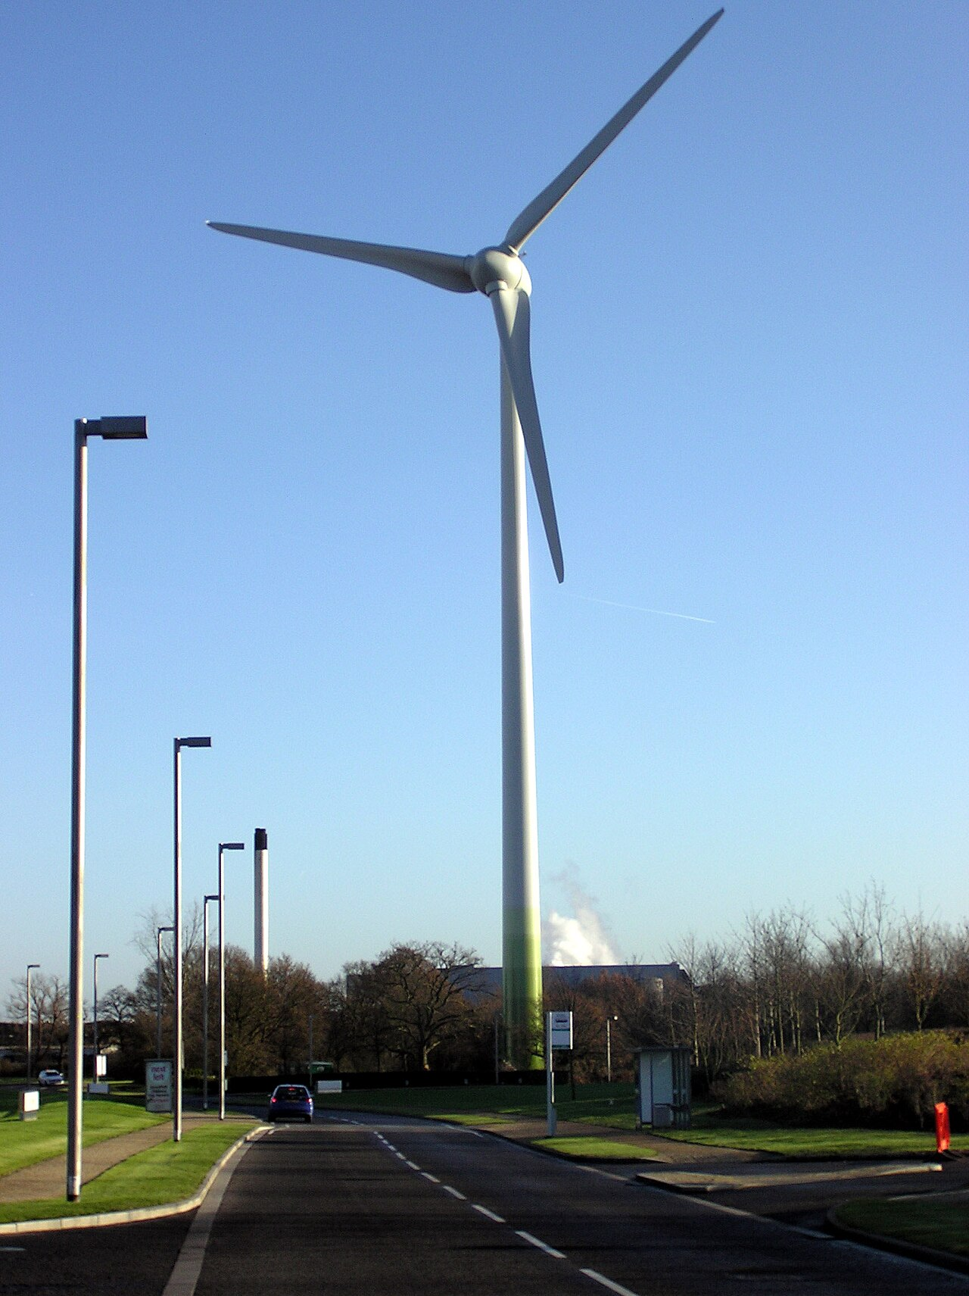
Efficiency and Applications
Optimizing motor performance for various industries, from robotics to renewable energy systems.

Slide 7
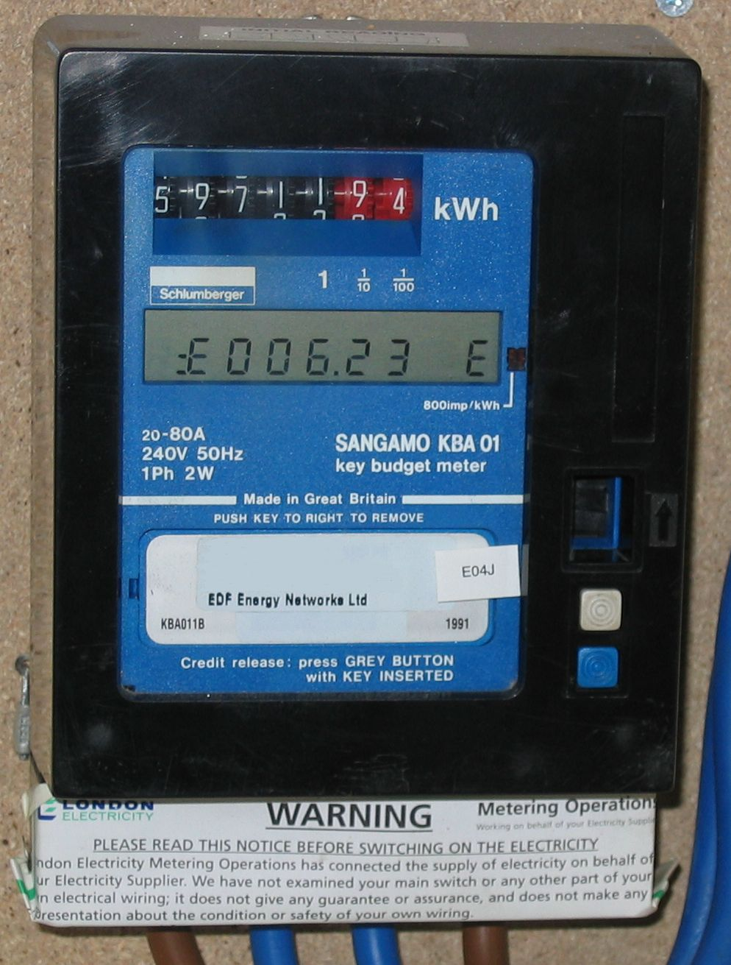
Electric Motor Efficiency: A Statistical Overview
92%
$30B
Average Motor Efficiency
Global Motor Market Value
25%
15 Years
Energy Savings with Upgrades
Typical Motor Lifespan
6

Slide 8

“
Electric motors are not just components; they're the enablers of a sustainable and efficient future, driving innovation across various sectors.
-- Elon Musk
7

Slide 9
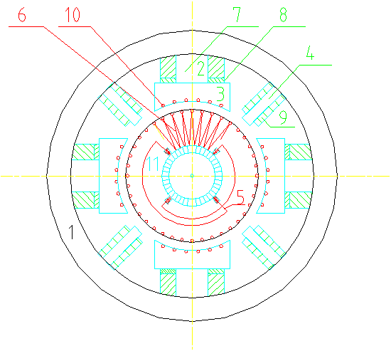
AC vs DC Motors: A Head-to-Head Comparison
AC Motors
DC Motors
AC motors are favored for high-power applications due to their efficient power transmission and ability to sustain constant speeds.
Their robust design allows them to withstand harsh industrial environments, therefore requiring minimal maintenance and improving system uptime.
Employing frequency inverters grants precise speed control, which proves beneficial in diverse operations, from manufacturing to renewable energy.
DC motors are known for delivering substantial torque at low speeds, thus an ideal choice for electric vehicles and robotics.
Simple control mechanisms provide easy and accurate speed regulation, which facilitates applications such as servo systems and consumer electronics.
They use brushes and commutators, which require regular maintenance to operate reliably, even under taxing conditions, resulting in downtime.
VS
8

Slide 10
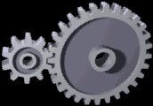
Evolution of Motor Technology
1821
1960s
Present
Michael Faraday constructs the first device to demonstrate the conversion of electrical energy into mechanical energy.
The development of semiconductor devices allowed for sophisticated electronic control of motor speed and torque.
Smart motors deliver real-time monitoring, predictive maintenance, and integration with IoT platforms for maximum process performance.
Invention of the first practical AC motor revolutionized industrial power distribution and applications.
Deployment of high-efficiency motors to reduce energy consumption and environmental impact during motor operation.
1880s
2000s
9

Slide 11
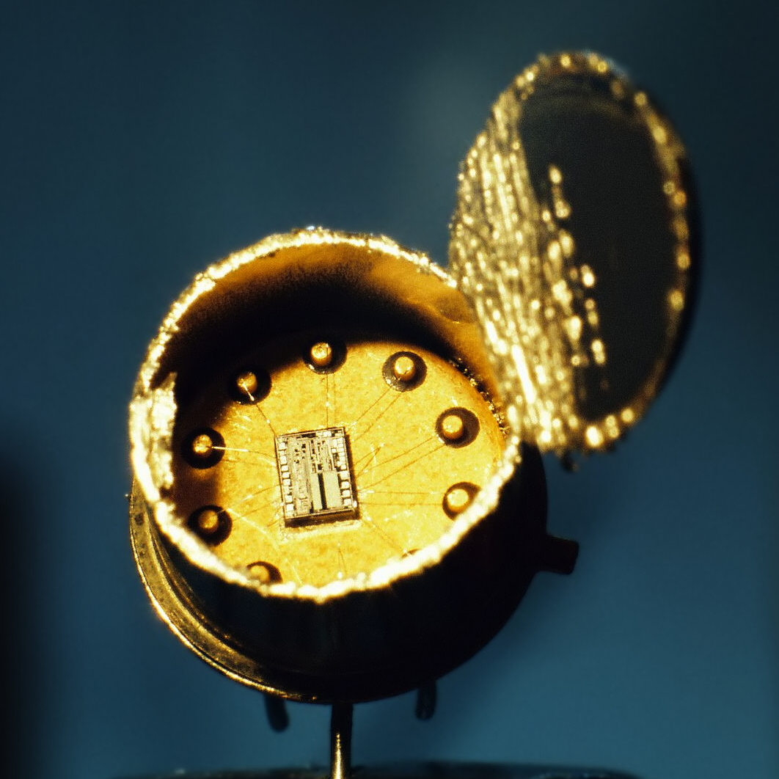
Future Trends in Electric Motor Technology
Advanced materials like carbon fiber and nanocomposites are lowering weight, improving power-to-weight ratios in high-performance applications.
Wireless power transfer and contactless motor designs are eliminating the need for physical connections, enhancing system reliability drastically.
Integration of advanced AI algorithms optimizes energy use by monitoring and adjusting motor performance in real time based on environmental conditions.
Development is pushing toward miniaturized micro-motors useful in medical and robotics applications, extending their applicability and utility.
Collaborative research between industry and academia accelerates groundbreaking developments in high-efficiency designs to create powerful new options.
10

