Slide 1
The Electrifying World of Motors and Transformers
ELECTRICAL ENGINEERING THEME

Slide 2
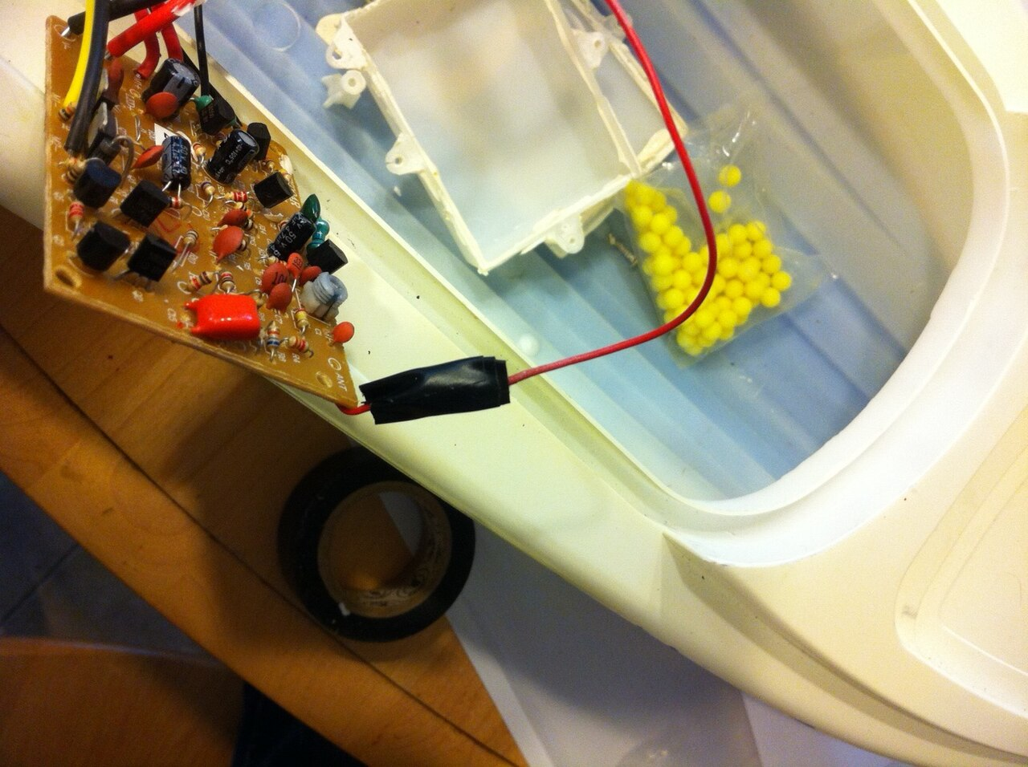
Unlocking Electrical Power: Motors & Transformers
A deep dive into the essential components that drive our modern world.

Slide 3
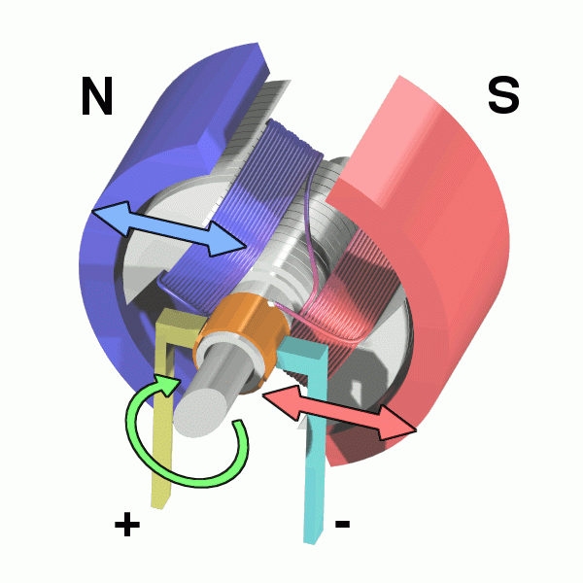
From Electric Current to Motion: How Electric Motors Work
Step 1
Step 3
Step 5
Applying voltage to the motor windings generates a magnetic field around the coil.
This interaction creates a rotational force, known as torque, causing the motor's rotor to spin.
The continuous switching of current maintains the magnetic field alignment, ensuring seamless and consistent rotation.
The magnetic field interacts with a permanent magnet or another electromagnet within the motor.
As the rotor turns, a commutator or electronic controller reverses the current direction cyclically.
Step 2
Step 4
2

Slide 4

The World of Motors: A Comparative Analysis
Understanding the strengths and weaknesses of different motor types is crucial for selecting the right motor for a specific application.

Slide 5
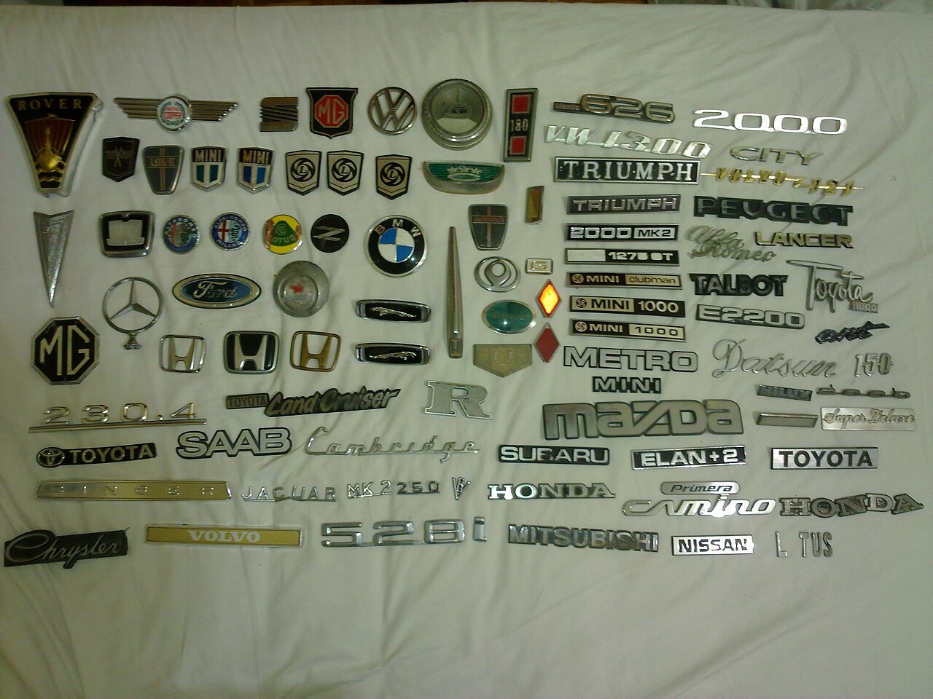
Motor Types: DC vs. AC, Stepper vs. Servo
DC Motors
AC Motors
DC motors offer straightforward speed and torque control, making them suitable for variable-speed applications like power tools and toys.
These motors typically use brushes to commutate the current, which can lead to wear and require periodic maintenance.
DC motors can be easily powered by batteries, enabling their use in portable devices and remote-controlled systems.
Efficiency generally peaks between 60% to 80%, varying by the specific design and operational load.
AC motors boast higher efficiency and reliability due to their brush-less design, reducing maintenance demands and costs.
Synchronous AC motors provide precise speed control, crucial for applications like timekeeping and high-precision machinery.
Induction AC motors automatically adjust speed based on load, simplifying control in many industrial applications.
Achieving efficiencies up to 95%, three-phase AC motors are commonly employed in heavy industrial environments.
VS
4

Slide 6
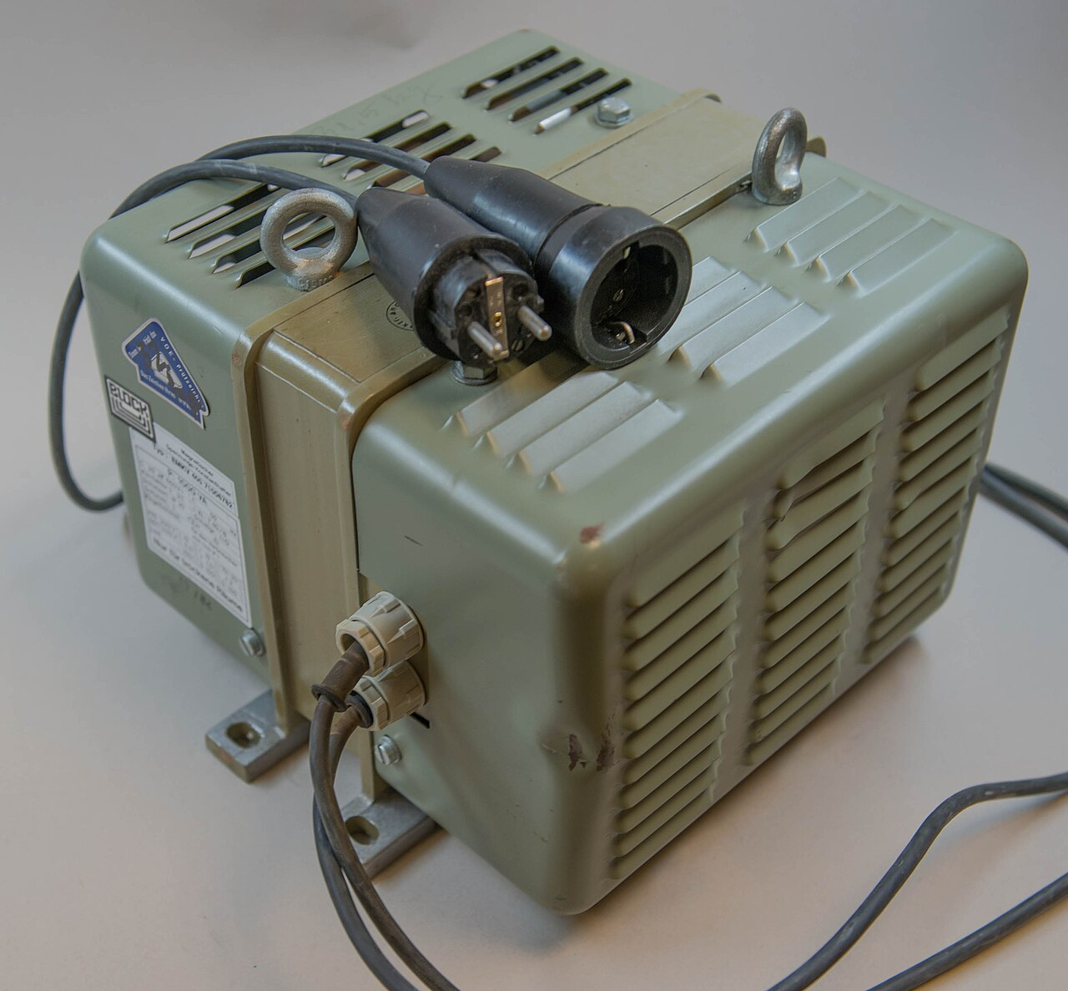
Transformers: The Unsung Heroes of Power Delivery
Exploring how transformers efficiently transfer electrical energy, making long-distance power transmission and device compatibility possible.

Slide 7
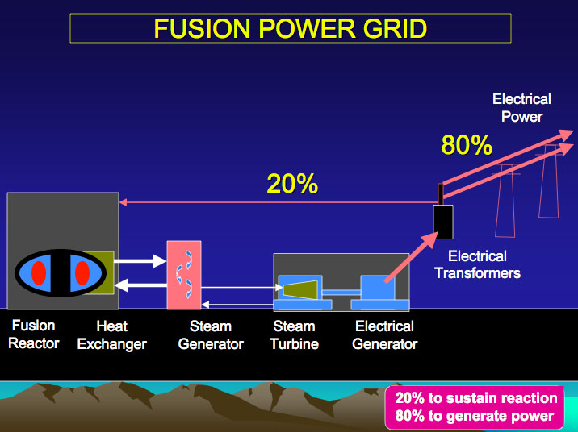
Electromagnetic Induction: The Heart of Transformer Action
98-99%
70%
Typical Transformer Efficiency
Global Power Transmitted via Transformers
50+
40%
Years Average Transformer Lifespan
Reduction in Transmission Losses with HVDC Transformers
6

Slide 8
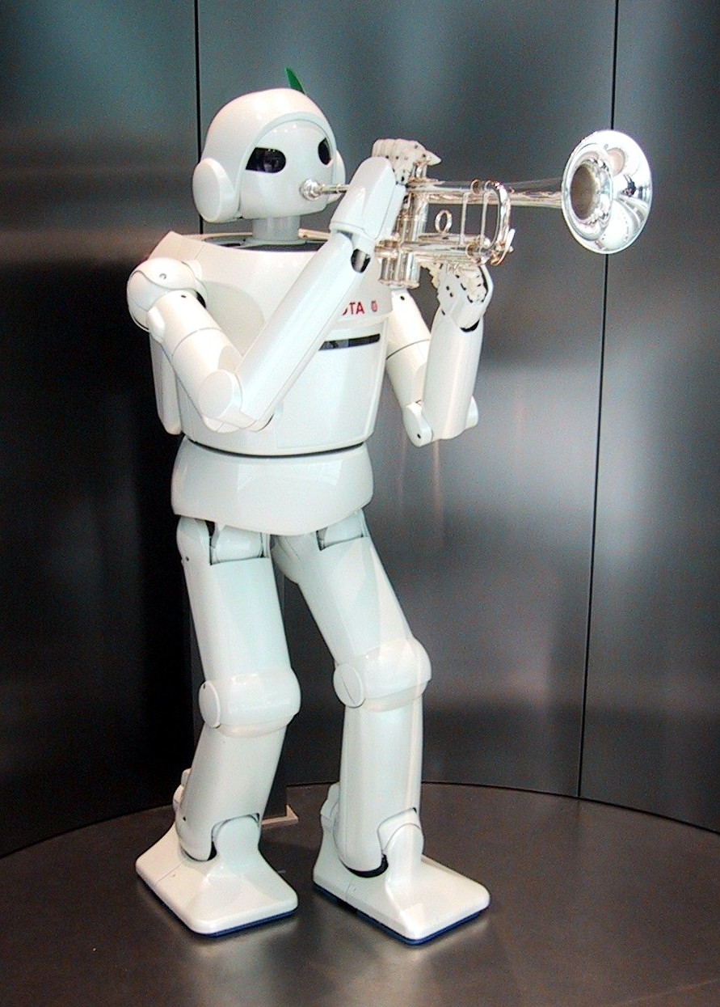
Motors in Action: Powering Our Everyday Lives
A look at the diverse applications of electric motors, from improving home comfort to enabling advanced transportation systems.

Slide 9
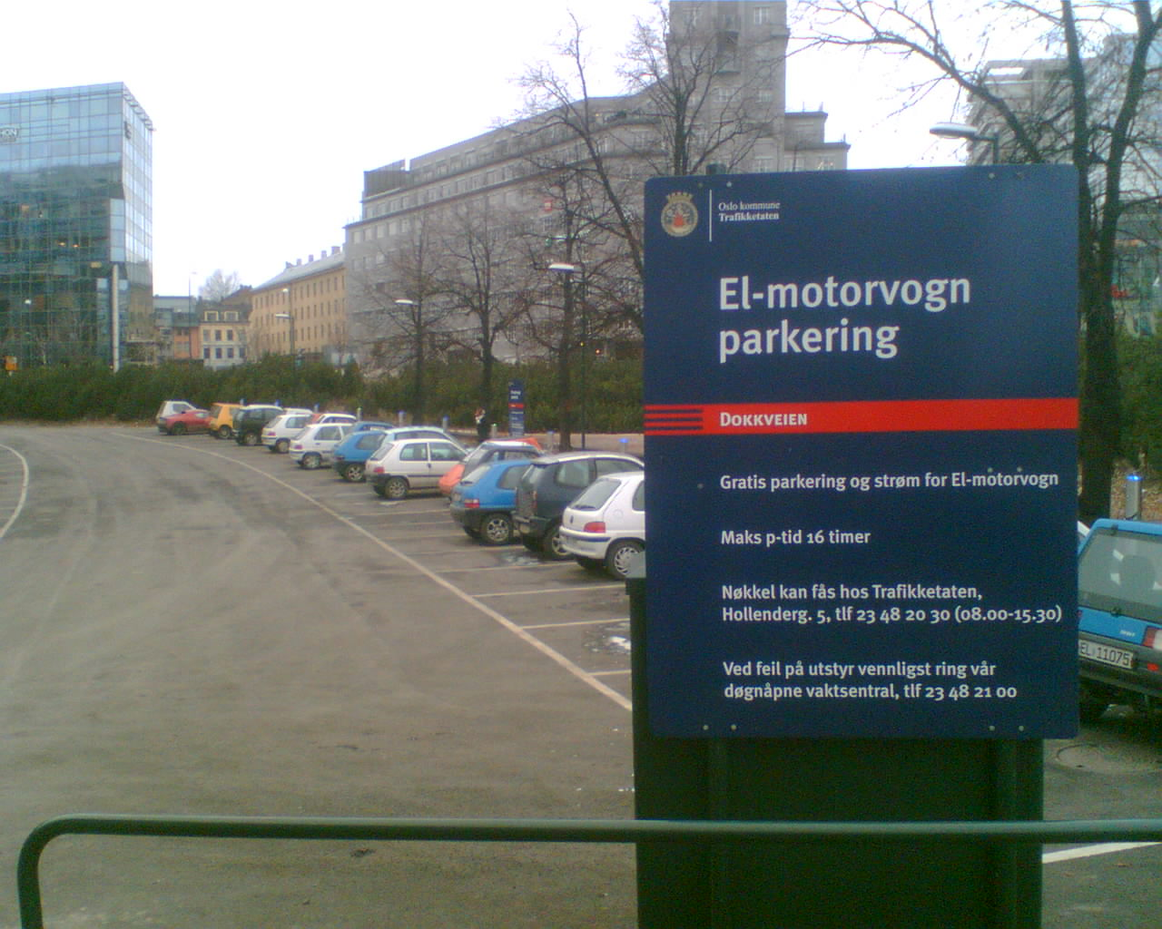
Ubiquitous Motor Applications: From Fans to Vehicles
Electric fans use motors to circulate air, providing cooling and ventilation in homes, offices, and industrial spaces, improving comfort and air quality.
Water pumps driven by motors ensure efficient water distribution for irrigation, municipal water supply, and industrial cooling systems.
Electric vehicles employ powerful motors to deliver instant torque and acceleration, revolutionizing transportation with cleaner and more efficient alternatives.
Modern HVAC (Heating, Ventilation, and Air Conditioning) systems depend on electric motors to control airflow, temperature, and humidity, ensuring energy-efficient climate control.
Industrial automation relies heavily on electric motors to drive conveyor belts, robotic arms, and manufacturing equipment, enhancing productivity and precision.
8

Slide 10
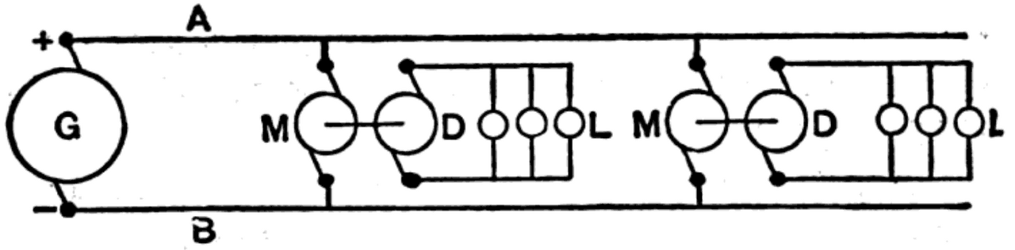
Transformers Transforming Our World
Exploring where and how transformers ensure the safe, efficient delivery of electrical power, keeping our devices running and our cities lit.

Slide 11

Transformer Applications: Powering Transmission Grids and Gadgets
Transformers are pivotal in power transmission across distribution grids, stepping up voltage for efficient long-distance transfer before stepping it down for local use.
Mobile chargers use compact transformers to convert high-voltage AC power from wall outlets into low-voltage DC power suitable for charging smartphones and laptops.
High-voltage direct current (HVDC) systems utilize specialized transformers to facilitate the efficient transmission of electricity over extremely long distances, minimizing losses.
Household appliances such as microwave ovens and televisions incorporate transformers to adjust voltage levels to meet the specific requirements of their internal components.
Industrial machinery often relies on transformers to provide stable and regulated power, ensuring reliable operation of sensitive equipment like CNC machines and robotic systems.
10

