Slide 1
Electric Motors and Transformers: Powering Modern Innovation
ELECTRICAL ENGINEERING THEME

Slide 2
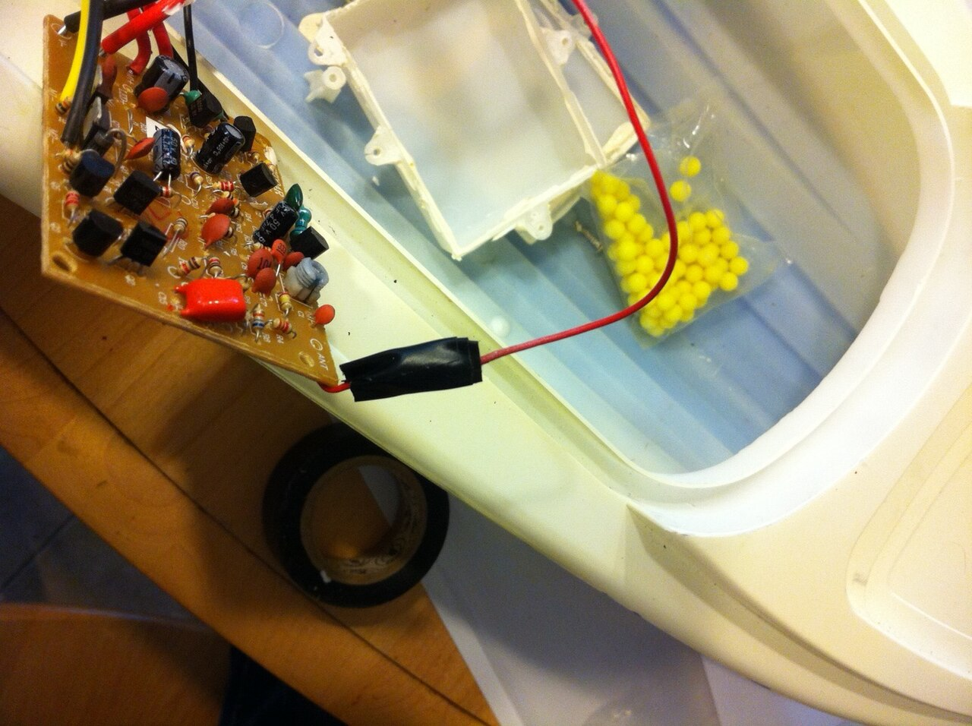
Fundamentals of Electromechanical Systems
Exploring the essential principles of electric motors and transformers, the backbone of modern technology.

Slide 3
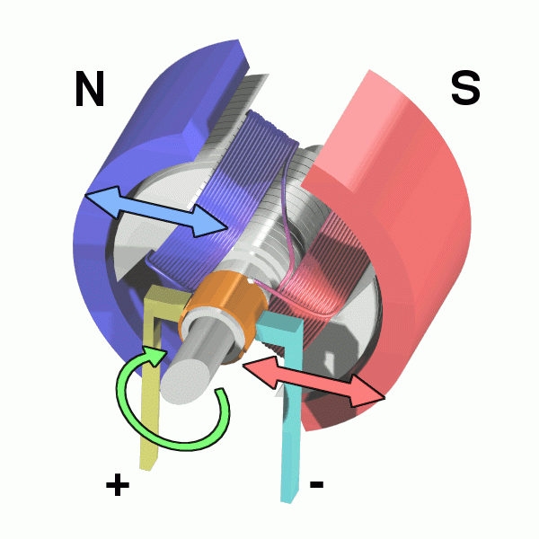
Navigating the World of Electric Motor Types
AC Motors
DC Motors
AC motors are primarily used in applications requiring constant speed, such as fans, pumps, and compressors, due to their stable performance.
These robust motors excel at handling powerful loads with high energy conversion rates, making them suitable for industrial environments.
AC motor speed is dictated by the power supply's frequency, which may require additional components for precise speed control, impacting total cost.
DC motors, known for their excellent starting torque and easy speed control, are often employed in automotive applications and variable-speed machinery.
These motors can achieve high speeds and immediate response times, making them suitable for tools like drills and electric screwdrivers.
The presence of brushes in DC motors necessitates regular maintenance and can contribute to electromagnetic interference, limiting their application in sensitive devices.
VS
2

Slide 4
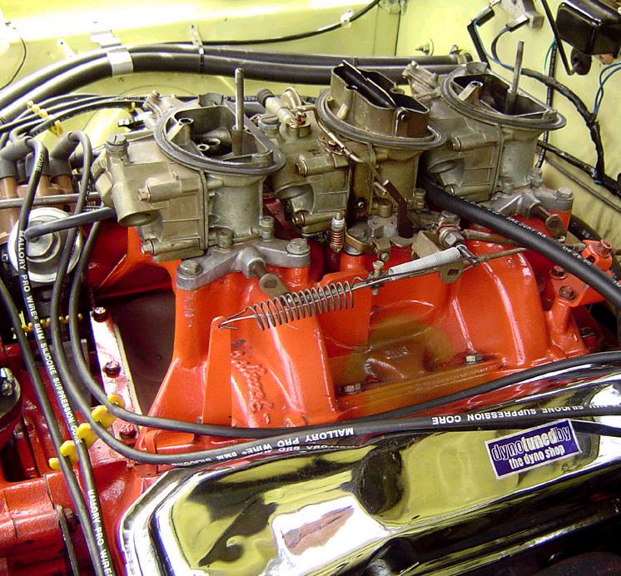
Unveiling the Electric Motor's Working Principle
Electric motors operate on the principle of the Lorentz force, where a current-carrying conductor in a magnetic field experiences a force, causing rotation.
The motor's shaft is connected to the rotor, which contains windings that interact with the magnetic field generated by the stator to produce torque.
Commutators are critical components in DC motors, switching the current direction to continually drive the rotor, although they increase complexity and maintenance.
High-efficiency motors are designed to minimize energy losses due to winding resistance, friction, and magnetic core losses, improving overall performance and reducing costs.
Advancements in materials science, such as improved magnetic alloys and insulation, enhance the performance and longevity of modern electric motors across various applications.
3

Slide 5
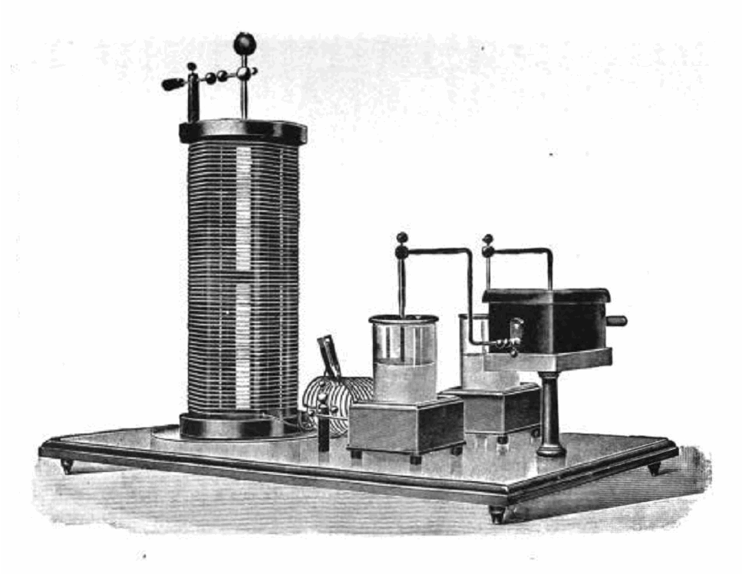
Decoding the Transformer's Core Function
Transformers operate based on Faraday's Law of electromagnetic induction, transferring electrical energy between circuits through magnetic fields generated by AC voltage.
An alternating current in the primary coil creates a fluctuating magnetic flux, which induces a voltage in the secondary coil proportional to the turn’s ratio.
Core materials, usually laminated silicon steel, are essential to enhance the magnetic flux linkage between coils while minimizing eddy current losses and improving efficiency.
The efficiency of transformers typically ranges from 95% to 99% in large power transformers, reflecting optimized designs to minimize core losses and copper losses in the windings.
Insulation methods, such as oil cooling or resin casting, provide thermal management and electrical insulation crucial for the reliability and longevity of transformers in high-voltage applications.
4

Slide 6
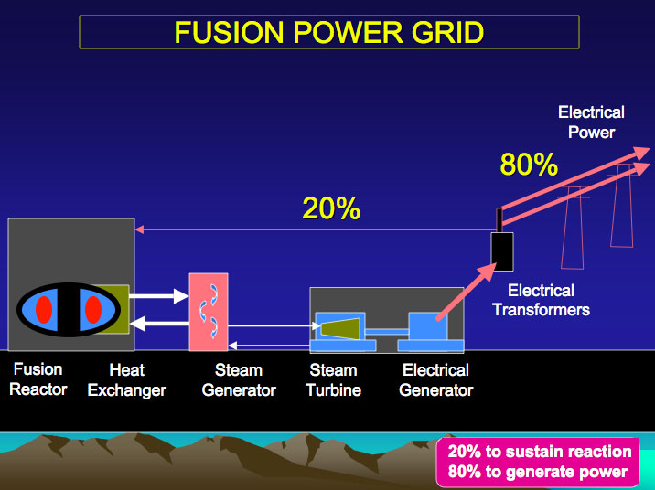
Diverse Applications and Types
Exploring the wide range of applications for electric motors and transformers in different sectors.

Slide 7

Ubiquitous Applications of Electric Motors
Electric motors are essential components in numerous household appliances, powering devices like refrigerators, washing machines, and air conditioning systems for daily convenience.
Within the automotive sector, electric motors are increasingly used in electric vehicles and hybrid vehicles, providing efficient propulsion and regenerative braking capabilities.
Industrial applications widely utilize electric motors in pumps, compressors, and conveyor systems, driving manufacturing and production processes with precision and reliability.
The integration of advanced control systems allows for precise management of motor performance, optimizing energy consumption and enabling intelligent automation in smart factories.
The global market for electric motors is projected to reach $200 billion by 2025, driven by increasing demand for energy-efficient solutions and the growth of electric mobility.
6

Slide 8
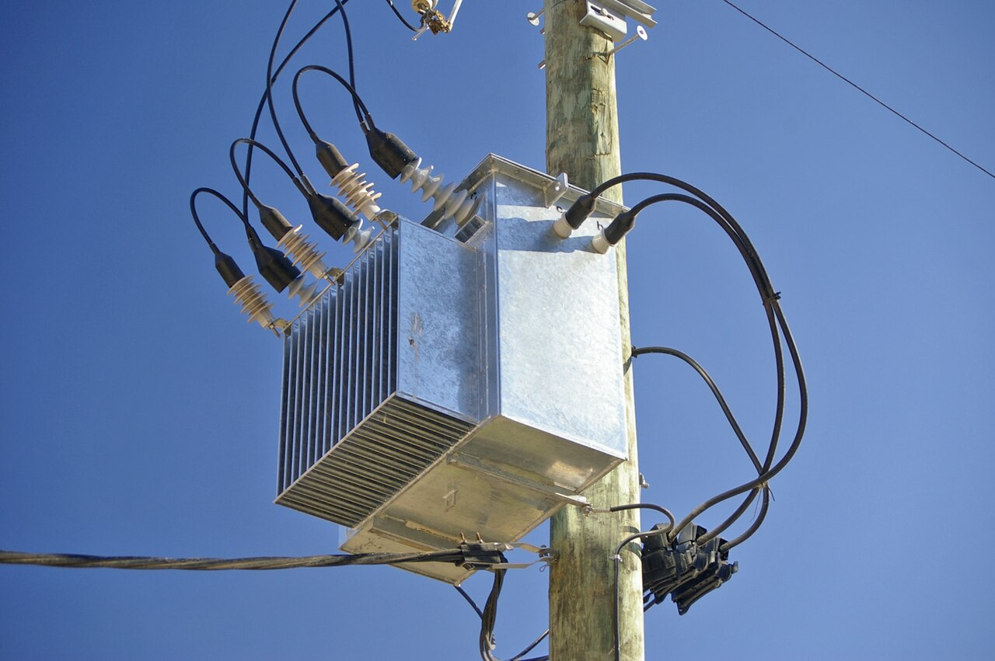
Comparing Transformer Types: Functionality and Utility
Step-Up Transformers
Step-Down Transformers
Step-up transformers increase voltage from primary to secondary, crucial for long-distance power transmission to reduce current and minimize I²R losses.
These transformers are integral to power generation at power plants, boosting the voltage for efficient grid distribution over extensive networks.
Step-up transformers typically feature a higher secondary-to-primary turns ratio, reflecting their function in amplifying voltage for specific applications.
Step-down transformers decrease voltage, making high-voltage electricity safe for use in residential and commercial settings, such as in distribution substations.
These transformers are commonly found in electronic devices, reducing voltage from mains to levels suitable for components like microchips and displays.
Step-down transformers are designed with a lower secondary-to-primary turns ratio, crucial for decreasing voltage while maintaining power levels appropriately.
VS
7

Slide 9
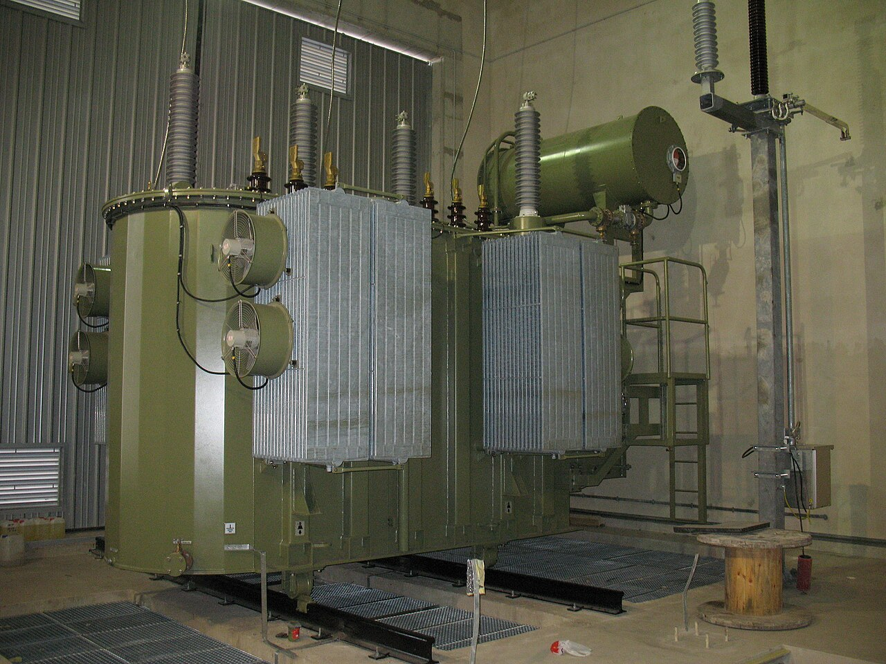
Wide-Ranging Applications of Transformers
Transformers are integral to power grids, ensuring the efficient and safe transmission of electricity from power plants to residential, commercial, and industrial consumers via voltage regulation.
Mobile chargers utilize miniature transformers to convert mains voltage to levels suitable for charging portable devices like smartphones, tablets, and laptops securely.
Industrial systems rely on transformers for various purposes, including voltage matching for equipment, isolation for safety, and power conditioning to maintain stability.
High-frequency transformers enable compact power supplies for modern electronics, improving efficiency while reducing size and weight, critical in portable devices.
Smart grid technologies are increasingly integrating advanced transformers with sensors and communication capabilities, enhancing grid management and enabling predictive maintenance.
8

Slide 10
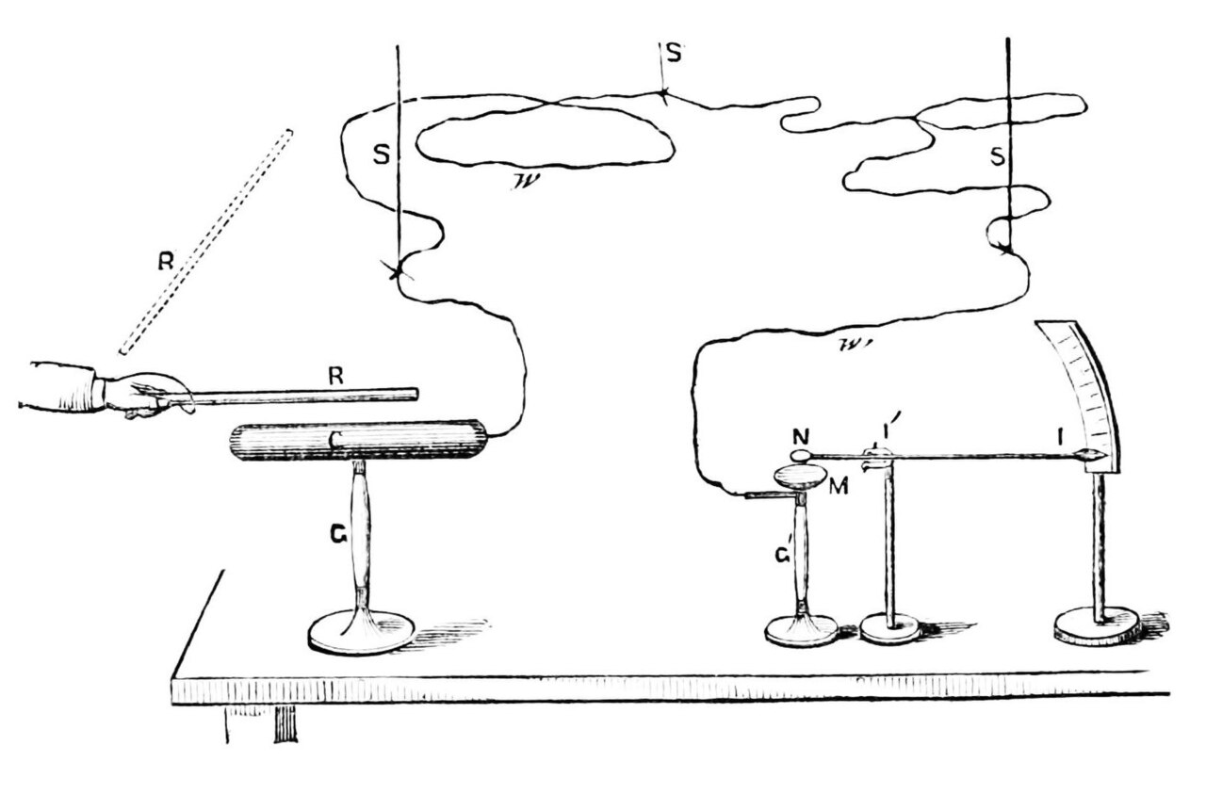
Key Performance Metrics in Electromechanical Systems
98%
92%
Transformer Efficiency
Motor Energy Efficiency
0.95
5%
Power Factor
Total Harmonic Distortion
9

Slide 11

“
"The continuous innovation in electric motors and transformers is essential for achieving sustainable energy solutions and driving the next industrial revolution." -- Dr. Emily Carter, Energy Science Expert
10

