Slide 1
India: A Rapidly Evolving Landscape
INDIAN HORIZONS THEME

Slide 2

India: Unveiling the Dynamic Giant
A journey into the heart of a nation undergoing unprecedented transformation.

Slide 3

India's Surging Economic Momentum
7.5%
6.8%
GDP Growth Rate (2020)
Projected GDP Growth (2024)
5th
$3.5 Trillion
World's Largest Economy
Nominal GDP
2

Slide 4
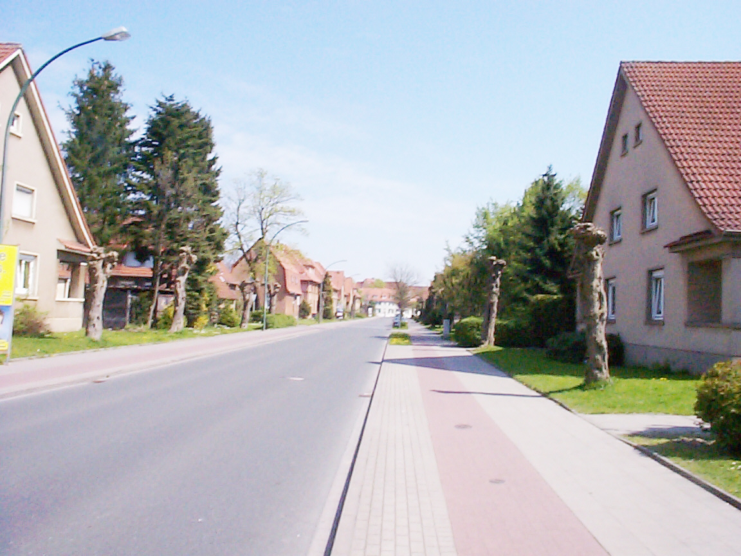
Demographic Powerhouse: India's Population Trends
1.7 Billion
1.4 Billion
Projected Population (2050)
Current Population (2024)
25%
27
Global Youth Population
Median Age
3

Slide 5

India's Thriving Tech Startup Ecosystem
50 Unicorns
3rd
Tech Startups
Largest Startup Ecosystem
$100 Billion+
62,000+
Startup Funding (2014-2024)
Active Startups
4

Slide 6
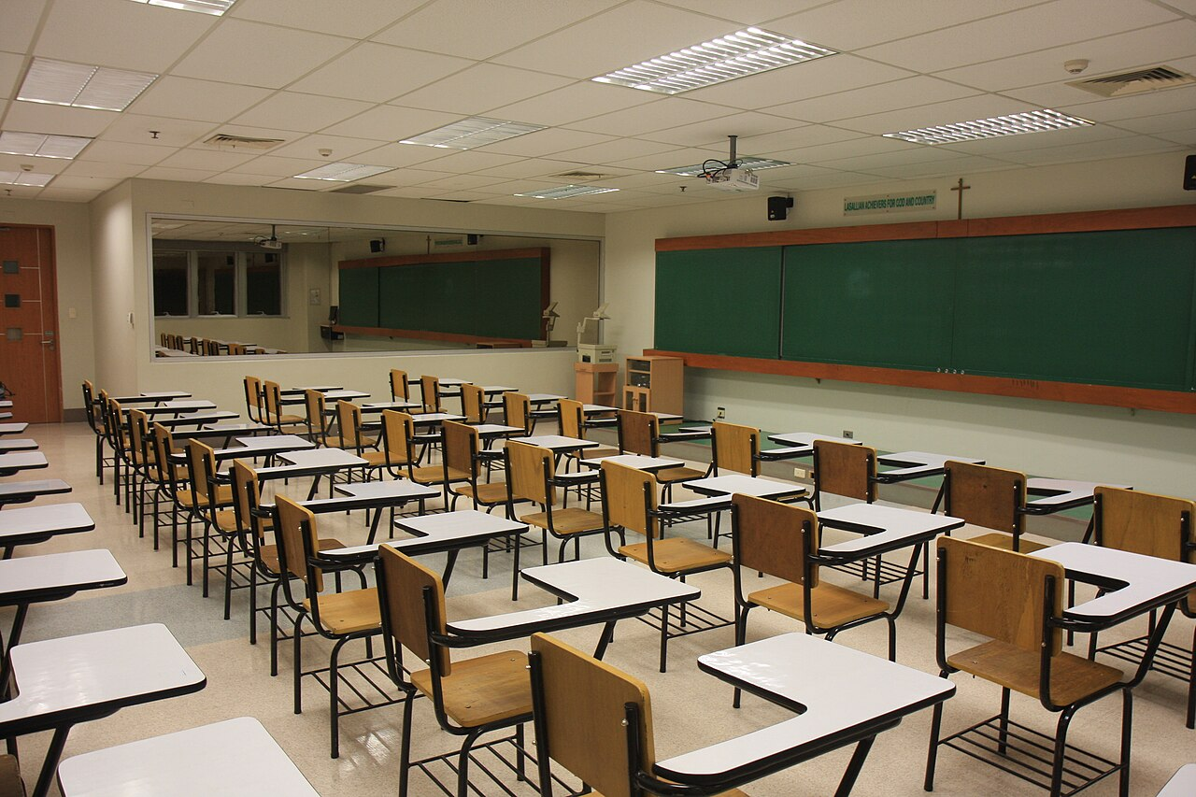
Linguistic Advantage: English Proficiency in India
370 Million
2nd
Native English Speakers
Largest English-Speaking Population
10%
Growth
Population Speaks English
Increasing Fluency
5

Slide 7
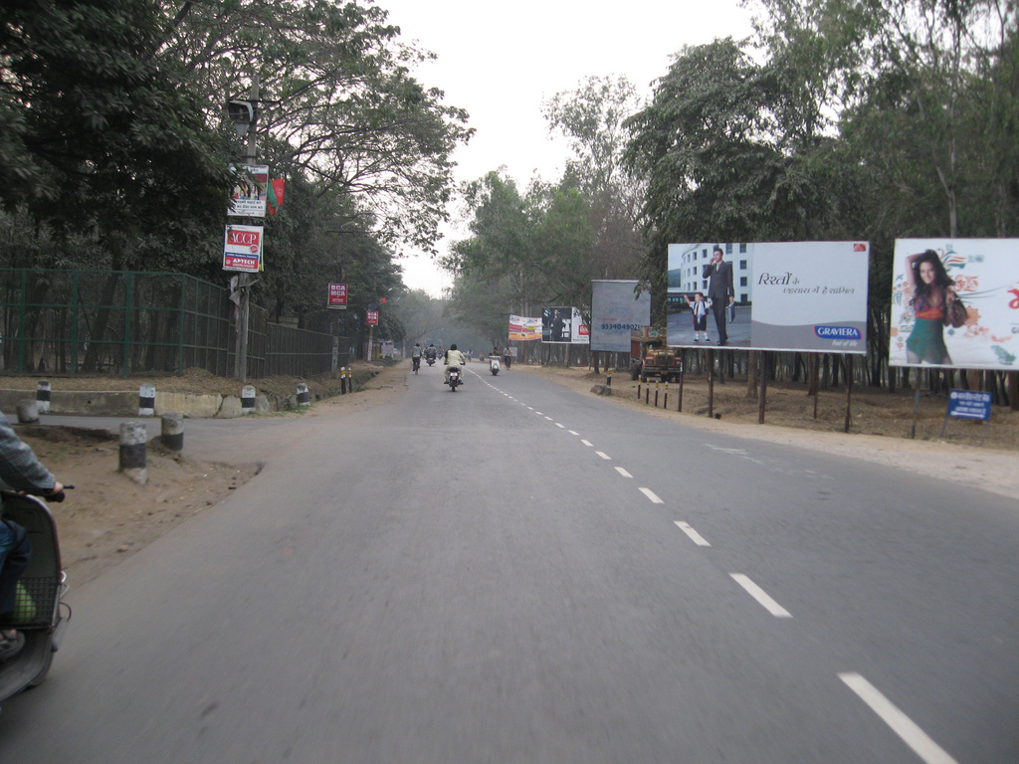
Infrastructure and Global Connectivity
Enhancing transportation networks to support economic growth and international trade.

Slide 8
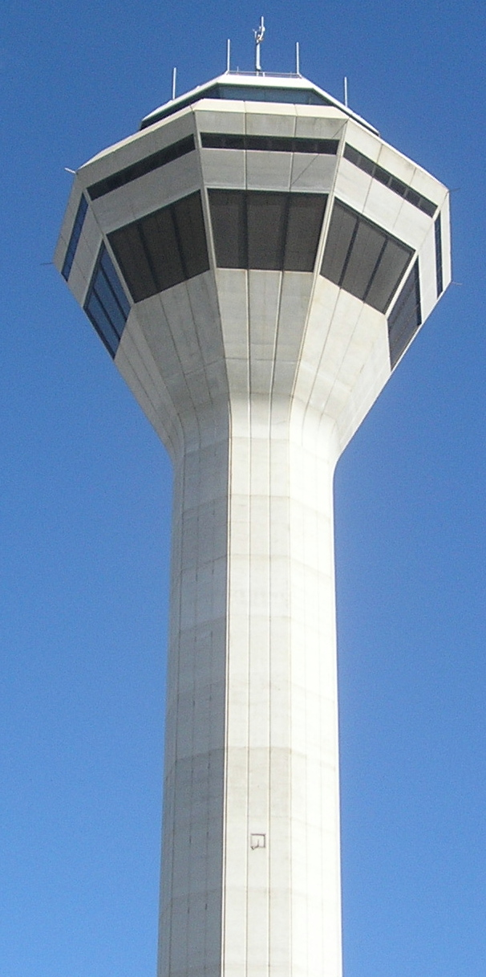
India's Expanding Transportation Infrastructure
300 Airports
600 Ports
operational in India
Major and Minor Ports
13,000 Km
4th
National Waterways
Largest Rail Network
7

Slide 9
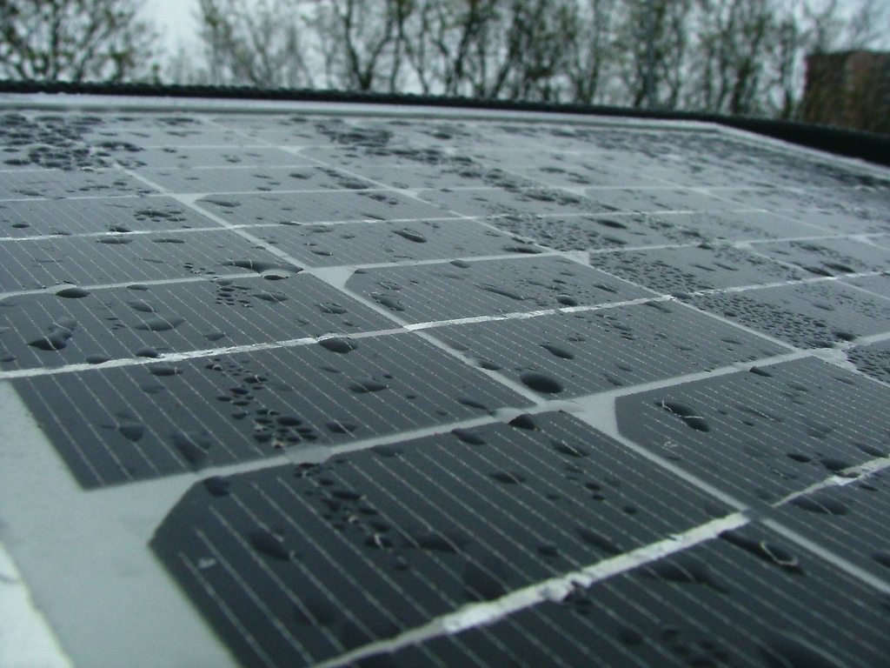
Renewable Energy Ambitions: Powering a Sustainable Future
40%
500 GW
Renewable Energy Target (2030)
Non-Fossil Fuel Capacity (2030)
175 GW
Solar
Renewable Energy Capacity (2022)
Leading Renewable Source
8

Slide 10
Key Insights into India
With over 1.3 billion people, India represents a significant consumer market and a key player in the global economy, offering diverse opportunities.
As the third-largest economy based on purchasing power parity (PPP), India's economic influence continues to grow on the world stage.
India's strategic geographic location makes it a pivotal link between the East and the West, fostering trade and cultural exchange.
India's rich cultural heritage and democratic values contribute to its soft power, enhancing its international relations and global standing.
The increasing urbanization and technological advancement drive innovation and create a dynamic environment for businesses and entrepreneurs in India.
9

