Slide 1
Exploring the Multifaceted Nation of India
INDIGO EXPLORER THEME

Slide 2

Unveiling India's Complex Tapestry
A journey through India's history, geography, economy, and society, revealing its vibrant culture and global impact.

Slide 3
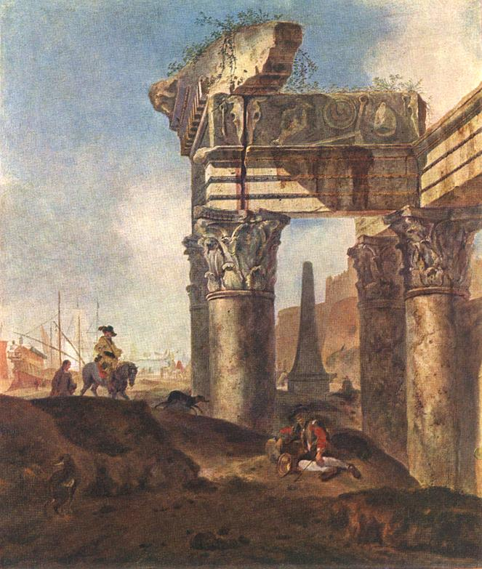
Ancient Echoes: India's Historical Foundations
The Indus Valley Civilization laid the groundwork for Indian society as early as 3300-1700 BCE, showcasing advanced urban planning and trade networks, influencing culture.
The Mauryan Empire, under rulers like Ashoka, unified much of the Indian subcontinent in the 3rd century BCE and promoted Buddhism, significantly shaping the nation’s ethical landscape.
The Gupta Empire, often hailed as India's Golden Age (4th-6th centuries CE), saw remarkable advancements in science, mathematics, astronomy, and art, establishing a cultural high point.
The Mughal Empire, established in the 16th century, left an indelible mark through its architecture, administration, and cultural synthesis, evidenced by iconic structures like the Taj Mahal.
British colonial rule, beginning in the 18th century, brought about significant socio-economic and political transformations, ultimately leading to India's independence in 1947 and the partition.
2

Slide 4
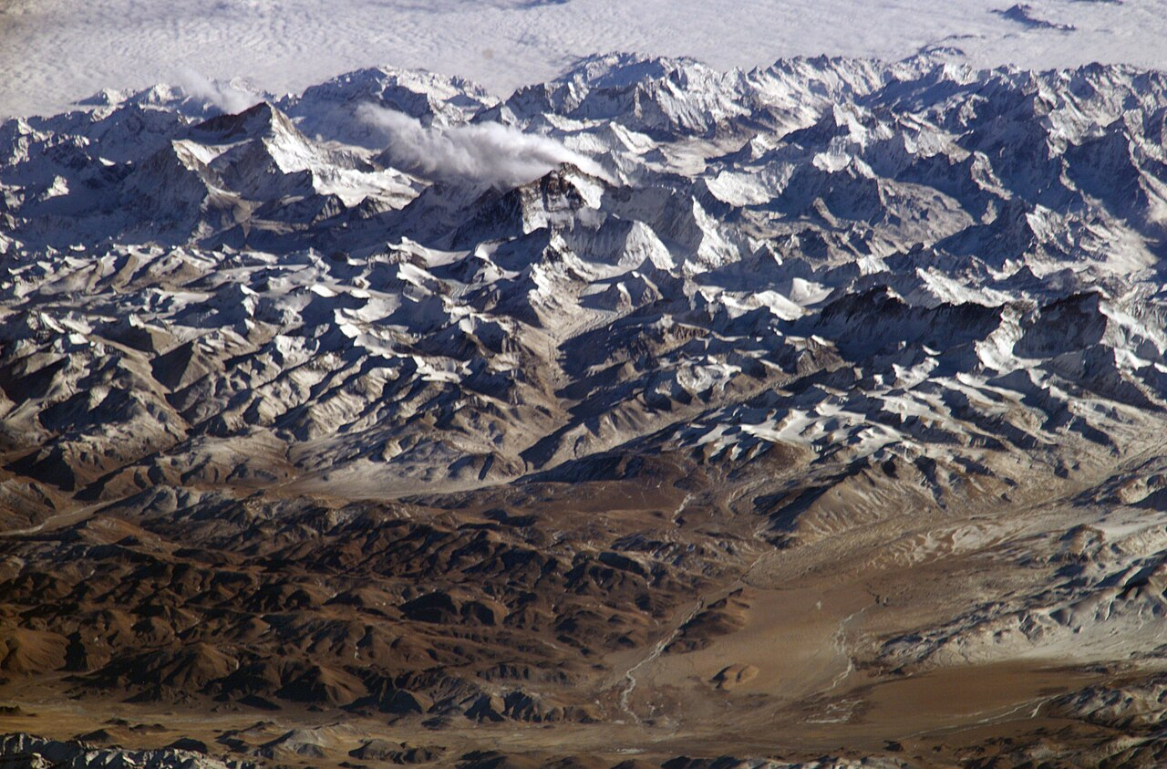
Mapping the Majesty: India's Geographical Diversity
The Himalayan mountain range in the north forms a natural barrier and source of numerous rivers, significantly impacting climate, water resources, and biodiversity in surrounding nations.
The Indo-Gangetic Plain, a fertile stretch of land, supports a large agricultural population, contributing significantly to India's food security and economic activities.
The Thar Desert in the northwest presents unique ecological challenges and opportunities, influencing local livelihoods and requiring specialized adaptation strategies for survival.
The Indian coastline, extending over 7,500 kilometers, plays a vital role in trade, fisheries, and tourism, impacting the nation's economy and international relations.
The Ganges River, revered as sacred, serves as a crucial water source for millions but faces significant pollution challenges, demanding immediate environmental remediation efforts.
3

Slide 5
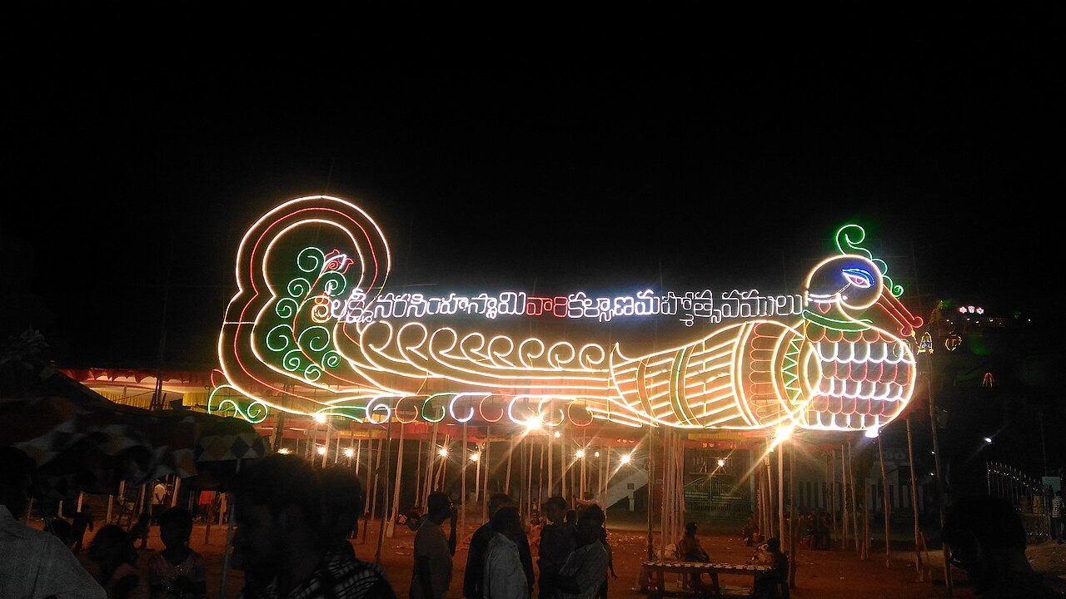
Economic Vitality: Key Indicators Shaping India
7.2%
$3.7 Trillion
GDP Growth Rate (2023)
Nominal GDP
50%+
1.4 Billion
Services Sector Contribution
Total Population
4

Slide 6

“
India is the cradle of the human race, the birthplace of human speech, the mother of history, the grandmother of legend, and the great-grandmother of tradition. Our most valuable and most instructive materials in the history of man are treasured up in India only.
-- Mark Twain
5

Slide 7
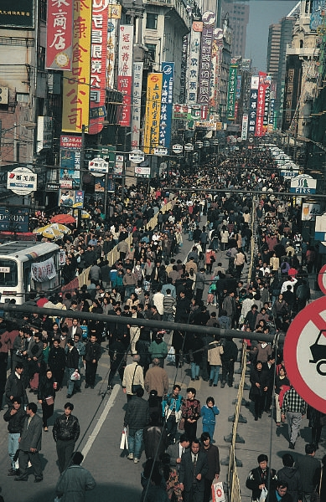
Societal Strands: The Complexities of Indian Life
India's caste system, although officially outlawed, continues to impact social mobility and equality, presenting ongoing challenges for achieving inclusive development and social justice.
The country's linguistic diversity, with over 22 officially recognized languages, shapes regional identities and influences communication, education, and political landscapes across the zones.
Rapid urbanization is transforming Indian cities, leading to both economic opportunities and challenges related to infrastructure, housing, and environmental sustainability and community resources.
India's demographic dividend, with a large youth population, presents potential for economic growth but requires significant investments in education, skills training, and job creation programs.
The rise of the middle class is driving consumer spending and economic transformation, reflecting changing lifestyles and aspirations but also increasing income inequality.
6

Slide 8
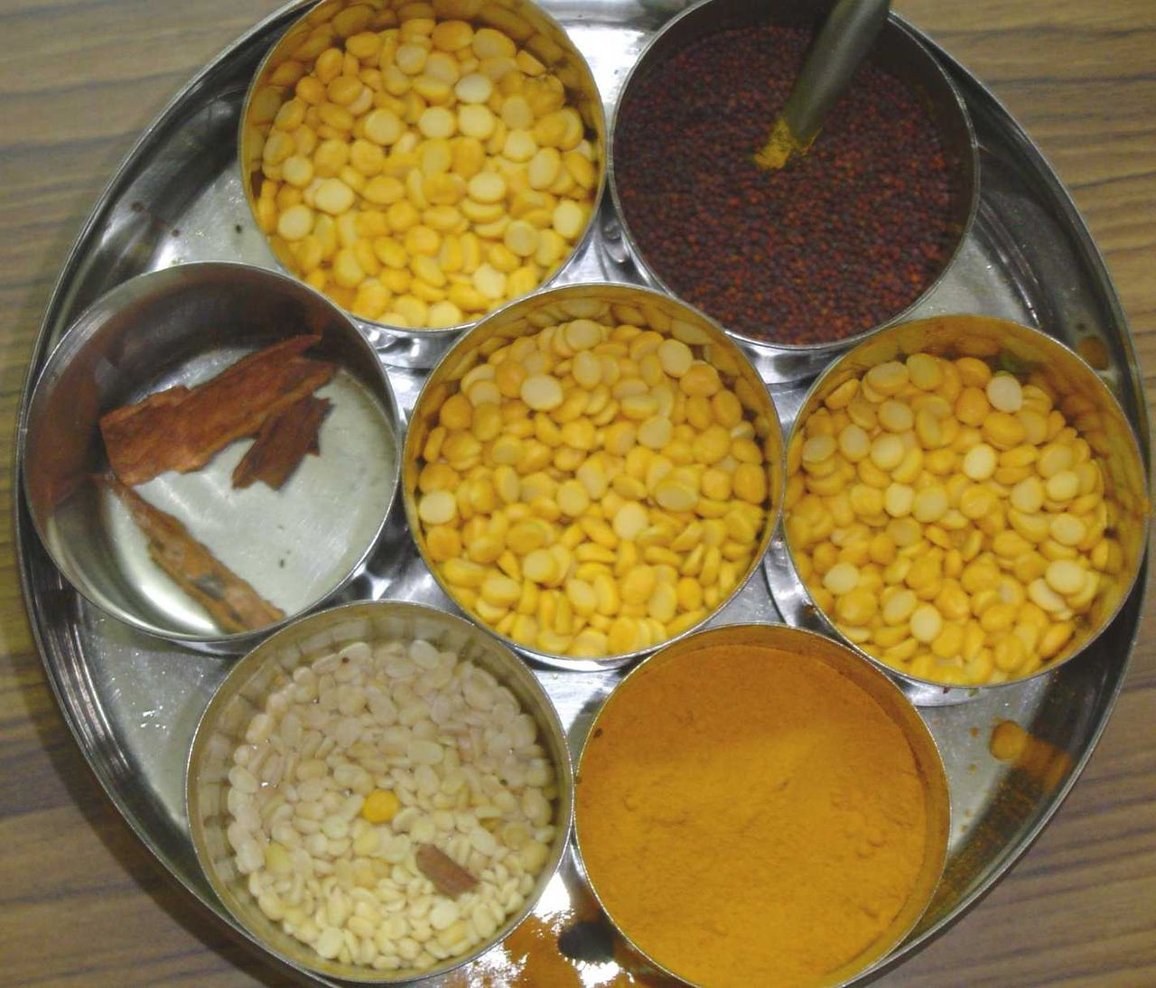
India's Cultural Heritage & Modern Economy
Exploring the intersection of India's rich cultural past and its dynamic economic present, showcasing its unique position on the global stage.

Slide 9
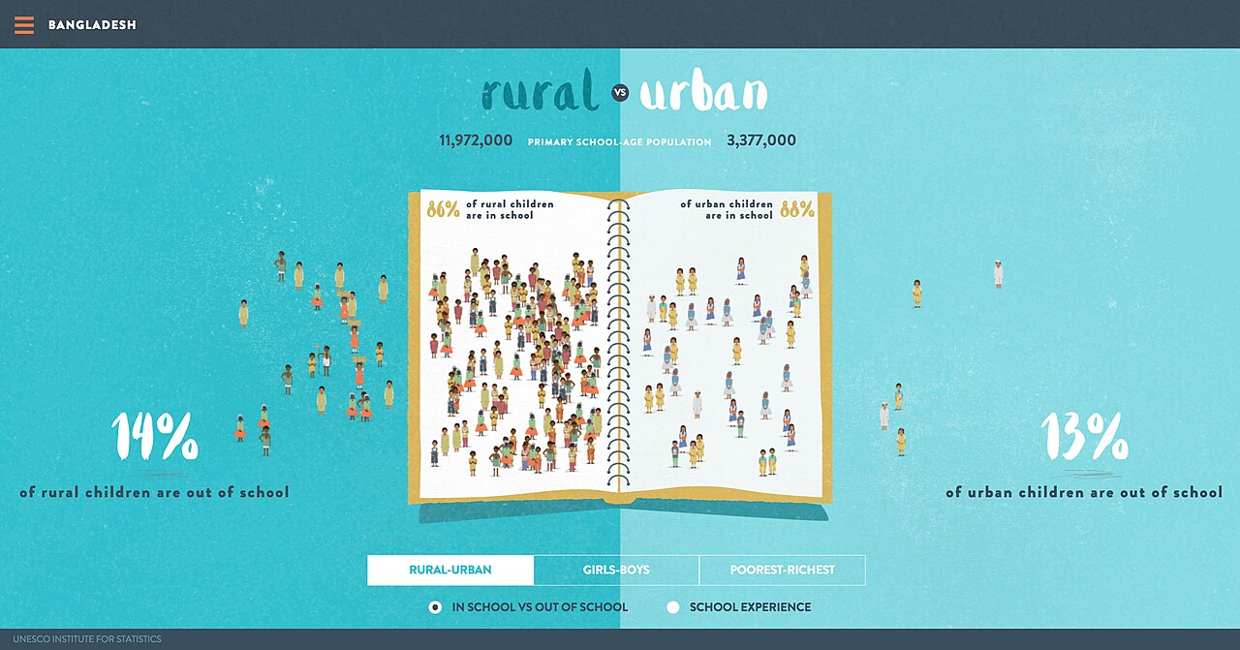
Rural vs. Urban India: A Tale of Two Worlds
Rural India
Urban India
Emphasis on agriculture as the primary economic activity, supporting livelihoods for a significant portion of the population, however impacting income.
Traditional social structures and cultural practices are deeply ingrained, influencing daily life, community dynamics, and inter-personal relationships.
Limited access to advanced education, healthcare, and infrastructure poses challenges for socio-economic advancement, inhibiting rural populations.
Lower levels of income and consumption patterns drive different economic priorities and influence the scale of consumer-driven development.
Dominated by industries, services, and technology sectors, driving economic growth and generating employment that is diverse.
More cosmopolitan and diverse population, exposed to global influences and exhibiting more modern lifestyles, trends and culture.
Greater access to education, healthcare, and infrastructure facilitates individual and community development, expanding opportunities.
Higher income levels and consumerism drive economic activity, influencing trends, growth and demand for innovation and resource management.
VS
8

Slide 10

India's Economic Evolution: A Historical Perspective
1947-1991
2000s
Present
Post-Independence Era: Focused on socialist policies, import substitution industrialization, and public sector dominance shaped slow growth.
IT Boom and Service Sector Growth: Emergence as a global IT leader fueled growth, job creation, and increased service sector contributions in India
Digital India and Startup Ecosystem: Driving innovation, entrepreneurship, and technological disruption, fostering a dynamic and inclusive economy.
Economic Liberalization: Initiated market reforms, reduced trade barriers, and encouraged private investment, spurring economic growth.
Infrastructure Development: Investments in transportation, energy, and communication boosted connectivity and efficiency, enhancing industry efficiency.
1991
2010s
9

Slide 11

India's Global Footprint: Influencing the World
India's growing economic and political influence is reshaping global dynamics, contributing to discussions on trade, climate change, and international security and diplomacy.
The Indian diaspora, spread across the globe, contributes significantly to their host countries' economies and fosters cultural exchange, innovation, and international collaboration.
India's soft power, derived from its culture, traditions, and values, strengthens its diplomatic ties and promotes international cooperation, cultural exchange, and collaboration.
The country's commitment to sustainable development and renewable energy is gaining global recognition, influencing international discussions on environmental protection and resource management.
India's role in international organizations, such as the UN and G20, reflects its growing importance in addressing global challenges and shaping international norms and policies collaboratively.
10

