Slide 1
Revolutionizing Irrigation: A Smart Agriculture Solution
SMART AGRICULTURE THEME THEME

Slide 2
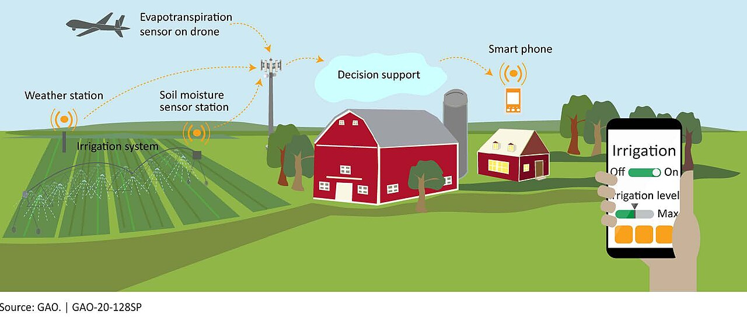
Smart Irrigation: Reimagining Agriculture
An innovative approach to optimize water usage and improve crop yields through intelligent automation.

Slide 3
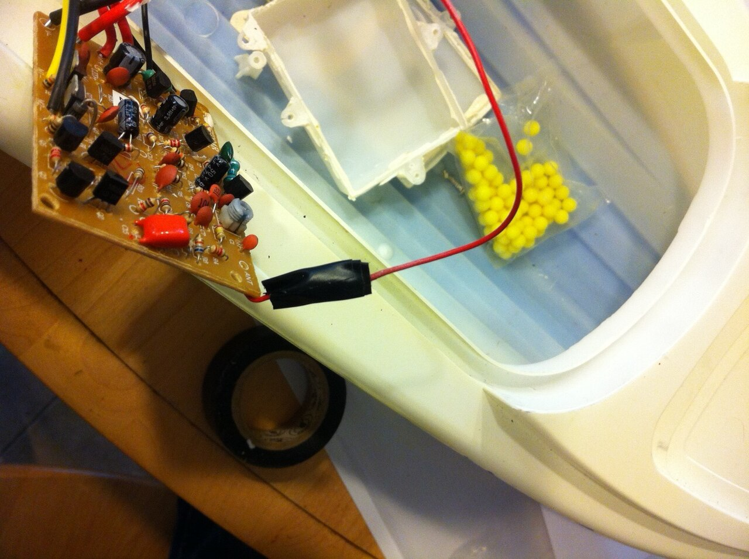
System Architecture: Command and Data Flow
This flowchart illustrates how commands and data travel between the user's phone, the ESP32 gateway, the LoRa radio system, and the motor.
2

Slide 4
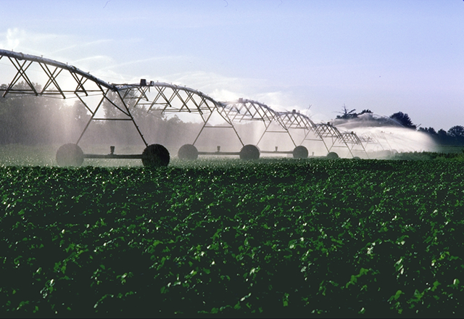
Smart Irrigation vs. Traditional Methods: A Feature Comparison
Smart Irrigation System
Traditional Manual Irrigation
Remote control capabilities allow users to manage irrigation from anywhere, providing unprecedented flexibility and convenience.
Automated scheduling based on real-time sensor data ensures optimal water usage, minimizing waste and conserving resources efficiently.
Integrated alerts and notifications promptly inform users of any issues such as leaks or pump failures, enabling quick response.
Data analytics offer detailed insights into irrigation performance, assisting in making data-driven decisions to improve crop yield.
System adapts to weather conditions, adjusting watering schedules automatically
Manual operation necessitates physical presence for turning on/off water, demanding substantial time and effort from the farmer.
Water wastage is common due to the lack of precise control and inability to adjust to fluctuating weather or soil conditions.
Delayed detection of problems can lead to substantial water loss, crop damage, and increased operational expenses.
Limited data insights make it challenging to optimize irrigation strategies, hampering informed decision-making and resource allocation.
Fixed schedules that may not adapt to fluctuating conditions
VS
3

Slide 5
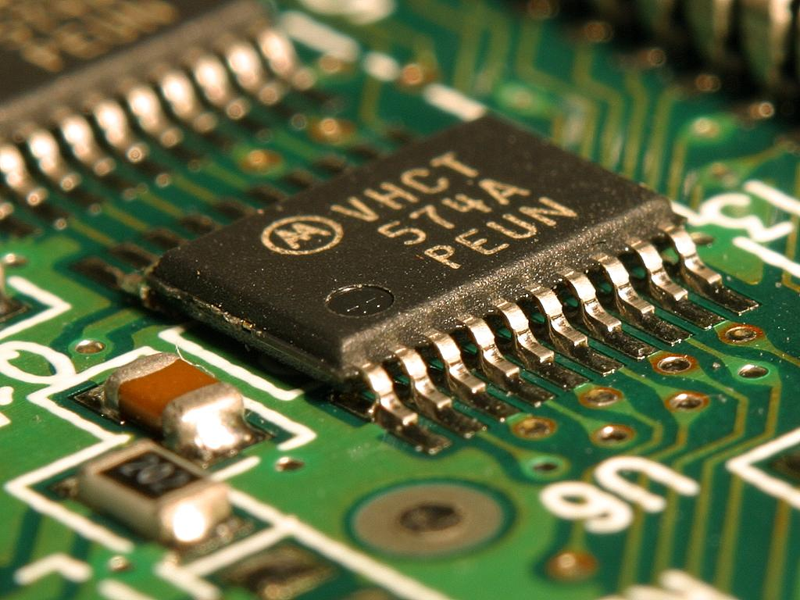
Core Components of the Smart System
Detailed exploration of the ESP32 and LoRa technology powering the intelligent irrigation solution.

Slide 6
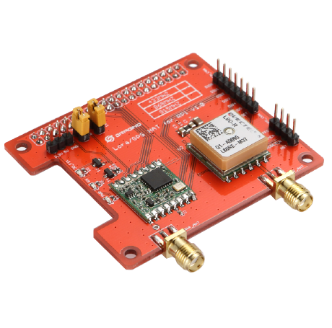
ESP32 and LoRa: Powering the Smart Gateway
The ESP32 serves as the central processing unit, managing data flow, executing commands, and enabling Wi-Fi connectivity for remote access.
LoRa (Long Range) radio technology provides reliable, low-power communication over long distances, essential for rural agricultural environments.
The combination of ESP32 and LoRa enables real-time monitoring and control of irrigation systems, even in areas with limited infrastructure.
Firmware Over-The-Air (FOTA) updates ensure the system remains secure and updated with the latest enhancements and bug fixes, minimizing downtime.
Security features such as encryption and authentication protocols protect against unauthorized access and ensure the integrity of the system's data.
5

Slide 7

Precision Irrigation: Advanced Control Features
Timers enable automated scheduling of irrigation cycles, optimizing water usage based on crop needs and environmental conditions for maximizing efficiency.
EEPROM resume capabilities ensure irrigation continues seamlessly after power outages, preventing crop damage and water loss by resuming operations.
Global access allows farmers to monitor and control irrigation systems remotely from anywhere with an internet connection, providing unparalleled convenience.
Sensor integration allows for real-time data collection on soil moisture, temperature, and humidity, enabling data-driven irrigation decisions improving outcomes.
Data logging capabilities provide detailed insights into water usage and system performance, supporting continuous improvement and resource management decisions.
6

Slide 8
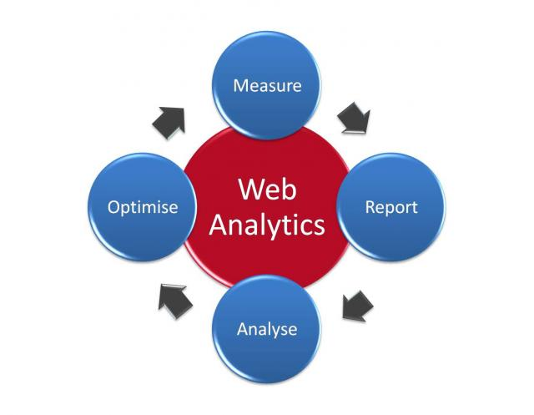
Quantitative Improvements: Measuring the Impact
45%
30%
Water Conservation
Energy Efficiency
20%
$500/acre
Increase in Crop Yield
Annual Savings
7

Slide 9

Evolution of Irrigation Systems: A Historical Perspective
6000 BC
19th Century
Present
Early irrigation practices in Mesopotamia and Egypt utilize canals and ditches to divert water to crops, marking the beginning of agricultural irrigation.
Development of sprinkler systems and mechanized pumps to deliver water more evenly and efficiently over larger areas, revolutionizing irrigation techniques.
Smart irrigation systems integrate sensors, data analytics, and remote control capabilities to optimize water usage and improve crop yields, enabling sustainable and efficient agriculture.
Introduction of the Persian wheel and other mechanical devices to lift water, allowing for more efficient irrigation in various terrains and conditions.
Drip irrigation systems are introduced, delivering water directly to plant roots, minimizing water loss and maximizing efficiency, revolutionizing agriculture.
15th Century
Late 20th Century
8

Slide 10

Addressing Farmer's Risks: Enhanced Safety and Reliability
The system mitigates snakebites and electrical shocks through remote operation, reducing the need for manual intervention in hazardous environments.
Motor burnout prevention is achieved through real-time monitoring of motor performance and automatic shutdown mechanisms, increasing equipment lifespan.
Over-irrigation is prevented by using soil moisture sensors and automated controls, optimizing water usage and preventing crop damage from water saturation.
Remote diagnostics allow for quick identification and resolution of issues, minimizing downtime and ensuring continuous operation, improving functionality.
Early warnings mitigate frost damages due to automatic sprinklers and real-time temperature information, improving overall yield for crops and vegetation.
9

Slide 11

“
"Smart irrigation systems are not just about saving water; they're about empowering farmers with the knowledge and tools they need to make informed decisions and ensure sustainable agricultural practices for future prosperity."
-- Dr. Anya Sharma, Agricultural Technology Expert
10

