Slide 1
Python: Versatile Programming for Modern Problems
TECH GRADIENT THEME

Slide 2
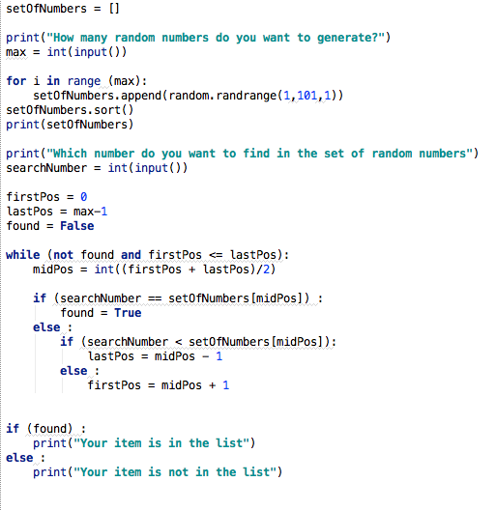
Unveiling Python's Power and Potential
A comprehensive overview of Python's features, applications, and community, designed to showcase its versatility and impact in various fields.

Slide 3
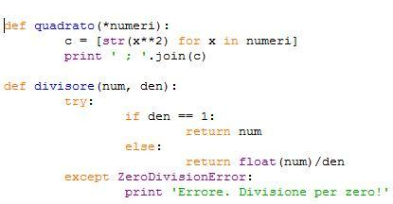
The Heart of Python: Syntax and Core Features
Python's syntax emphasizes readability, employing indentation to define code blocks, making it notably easier to learn, understand, and maintain even for large-scale projects.
Dynamic typing in Python allows variables to change type during runtime, which offers greater flexibility but requires more careful testing to avoid runtime errors.
Python supports multiple programming paradigms, including object-oriented, imperative, and functional styles, allowing developers to select the best approach for each task.
List comprehensions provide a concise way to create lists, offering a more readable and often faster alternative to traditional loops for list generation and manipulation.
Python's extensive standard library reduces the need for external dependencies in many common tasks, enabling developers to write more efficient and portable code.
2

Slide 4

Python's Impact Across Industries
Exploring how Python is transforming web development, data science, and other fields, driving innovation and efficiency.

Slide 5
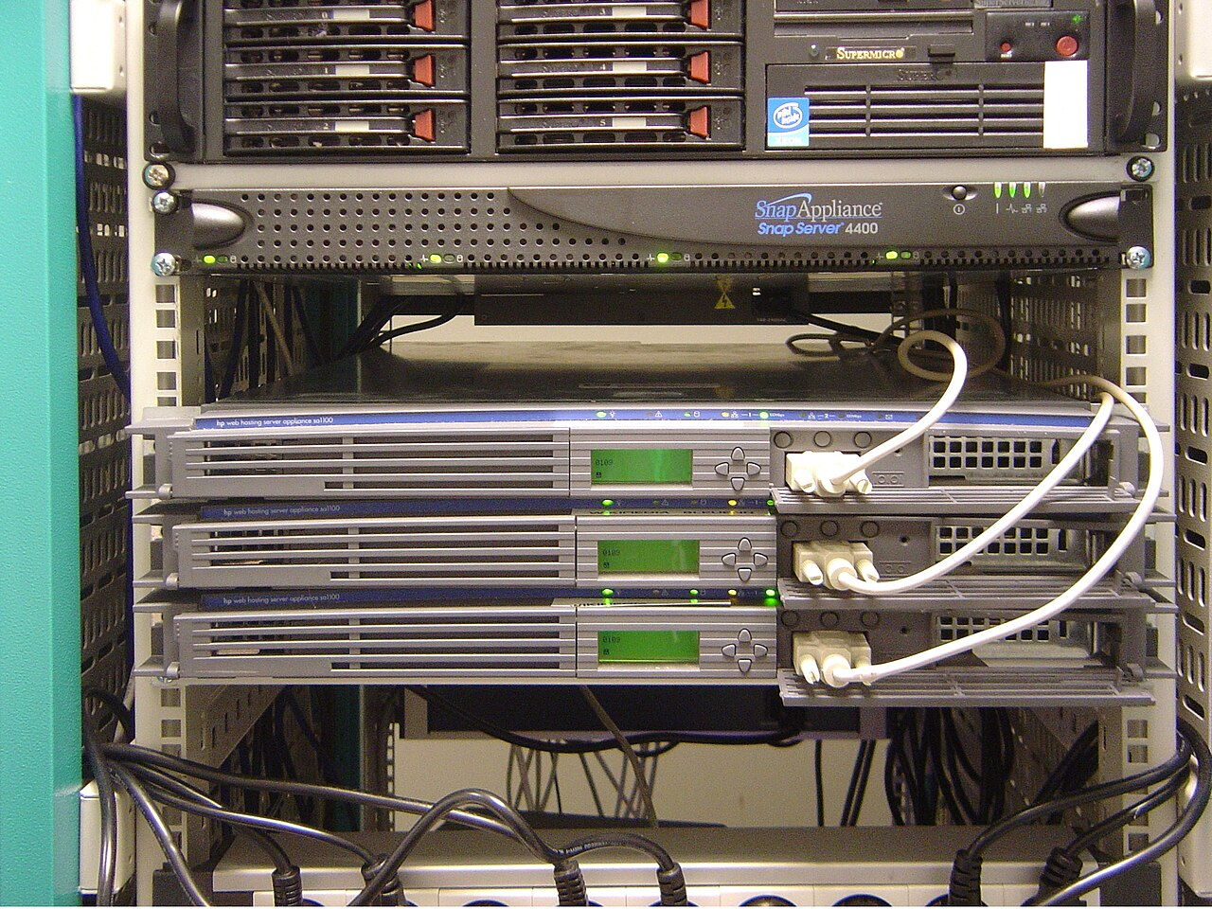
Python's Wide Embrace: Key Application Domains
Python is extensively utilized in web development, particularly via frameworks like Django and Flask, which facilitate the rapid creation of resilient web applications with complex features.
Its robust data analysis and manipulation capabilities via libraries like Pandas and NumPy position Python as a dominant tool in data science and machine learning projects.
Python's scripting abilities and automation libraries make it invaluable in system administration and DevOps, streamlining tasks such as configuration management and deployment.
In the realm of scientific computing, Python offers libraries like SciPy and Matplotlib, enabling researchers and engineers to conduct simulations, modeling, and data visualization effectively.
Python's versatility also extends to game development, where it is used for scripting gameplay logic and creating tools, often integrated with game engines like Pygame and Unity.
4

Slide 6
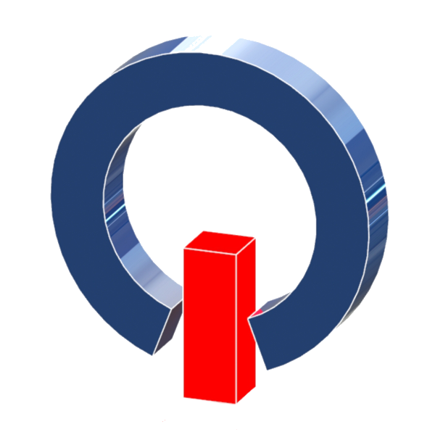
Community and Resources
How the Python community contributes to a supportive environment for learners and experienced professionals.

Slide 7

Thriving Ecosystem: Community and Support Networks
Python features a thriving and proactive community, providing vast amounts of documentation, tutorials, and supportive forums for individuals at various skill levels.
The Python Package Index (PyPI) hosts a vast collection of third-party libraries, enabling developers to seamlessly integrate pre-built functionalities into their projects, enhancing productivity.
Python benefits from extensive corporate backing from major companies like Google and Microsoft, which actively contribute to Pythons development and promote its usage within their ecosystems.
Local Python user groups and international conferences offer Python developers opportunities to network, exchange ideas, and collectively tackle intricate challenges.
The emphasis on community-driven development facilitates rapid innovation and ensures Python remains responsive to evolving technological trends and the changing needs of its users.
6

Slide 8
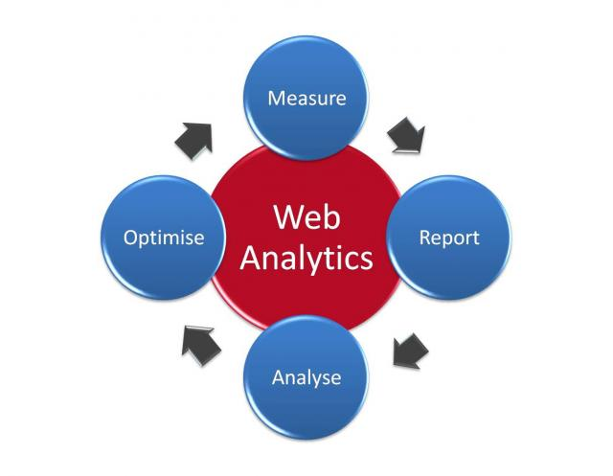
Python by the Numbers: Key Metrics
8.2M+
43%
Python Developers Worldwide
Growth in Python Use (Past 5 Years)
300K+
2nd
Packages on PyPI
Most Popular Language (GitHub)
7

Slide 9

“
“Python has been key to our success at Google; it’s one of our three official languages. Its strengths – readability, extensive libraries, and strong community – allow us to innovate quickly and efficiently.”
-- Guido van Rossum, Python Creator & Former Google Engineer
8

Slide 10

Python vs. Java: A Comparative Look
Python
Java
Python boasts a simpler syntax, facilitating faster development and easier readability, making it ideal for prototyping and scripting.
With dynamic typing, Python enables flexible code generation but may necessitate more extensive runtime testing, increasing developer responsibility.
Python supports multiple programming paradigms, including functional and object-oriented programming, providing versatile problem-solving approaches.
Java utilizes static typing, catching type-related errors at compile time for enhanced safety and better performance in large-scale applications.
Java's verbosity leads to expanded codebases but improves explicitness, favoring complex projects that benefit from strong structure and maintainability.
Java’s performance-optimized virtual machine (JVM) fosters efficient execution of compiled code, suitable for high-intensity enterprise solutions needing speed.
VS
9

Slide 11

Python's Journey: A Timeline of Innovation
1991
2008
Present
Python 0.9.0 is released, introducing core features like classes, inheritance, and exception handling, laying the groundwork for its object-oriented capabilities.
Python 3.0 addresses fundamental design flaws, breaking backward compatibility but paving the way for future improvements and cleaner syntax.
Python maintains its position as a leading language for web development, data science, and machine learning, propelled by ongoing contributions and a vibrant community.
Python 2.0 introduces list comprehensions and garbage collection, enhancing code conciseness and memory management, attracting more developers.
Python 2 reaches its end-of-life, marking a full transition to Python 3 and ensuring continued security updates and improved language features.
2000
2020
10

