Slide 1
Smart Irrigation Revolution: Remote Safety and Resource Efficiency
VERDANT AUTOMATION THEME

Slide 2

Bridging the Divide: Smart Irrigation for a Safer Tomorrow
Harnessing ESP32 and LoRa to revolutionize agricultural practices, ensuring farmer safety and optimizing resource utilization through remote and precise control.

Slide 3
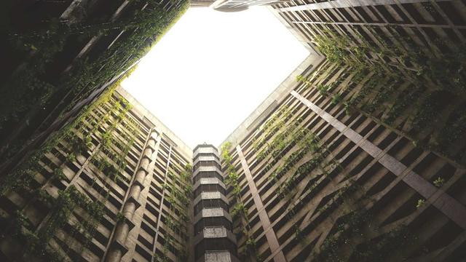
System Architecture: From Smartphone to Sustainable Field
The system utilizes a smartphone app to send commands via Wi-Fi or 4G to an IoT cloud platform, which then relays instructions to a gateway equipped with LoRa radio technology.
The LoRa signal transmits the commands over long distances (up to 15km) to a receiver connected to a relay, which in turn activates the agricultural motor or pump in the field.
A field feedback loop monitors the motor's operating status and environmental conditions through sensors, transmitting this data back to the user via LoRa for real-time updates.
The entire process is designed to create a closed-loop system where every action is monitored to ensure optimal farm conditions while simultaneously helping farmers stay informed and safe.
By integrating global internet connectivity with long-range radio communication, farmers gain unprecedented control over their irrigation systems, reducing manual labor and increasing efficiency.
2

Slide 4
Revolutionizing Farming: Traditional vs. Smart Irrigation
Conventional Manual Starter
Proposed Smart System (ESP32 + LoRa)
Control requires a physical manual switch at the site, inherently limiting operational range and demanding physical presence.
Human safety is at risk due to potential snakebites and electrical shocks, particularly during nighttime operations in remote fields.
Maintenance is reactive, addressing issues only after a failure occurs, resulting in downtime and potential crop damage.
Offers global remote control via smartphone, providing unlimited reach and eliminating the need for physical presence.
Ensures zero physical risk to the farmer, allowing for control from the safety of their home or any remote location.
Enables predictive maintenance through logs and alerts, preventing failures and minimizing downtime, resulting in consistent irrigation.
VS
3

Slide 5

Addressing Real-World Challenges: Alleviating the Farmer's Burden
Examining the direct impact of this technology in mitigating lethal and financial risks faced by farmers, focusing on snakebite prevention, infrastructure protection, and resource efficiency.

Slide 6

Mitigating Risks: Snakebites, Motor Burnout, and Water Waste
Rural regions often receive electricity only at night, forcing farmers to navigate dark, wet fields, increasing their vulnerability to venomous snakes, with India reporting roughly 58,000 snakebite deaths annually.
Traditional manual starters lack protection against "dry running," leading to motor burnouts costing farmers INR 5,000 to 10,000 per incident, a significant financial strain for small farms.
Manual operation results in substantial over-irrigation, with up to 50% of pumped water wasted through runoff, exacerbating water scarcity and increasing operational costs for farmers.
This smart irrigation system eliminates the need for hazardous field trips, protecting farmers from snakebites and electrical hazards by enabling remote control from safer locations.
The system's intelligent protection mechanisms prevent dry running, safeguarding motors from burnout and reducing maintenance costs by automatically cutting off the power supply when needed.
5

Slide 7
Quantifying the Impact: Efficiency and Savings
40%
35%
25%
1.75
Reduction in Labor Monitoring Pumps
Reduction in Power Bills
Average Crop Yield Increase
Years Average ROI Period
6

Slide 8

Behind the Tech: Global Access and Precision Timing
Exploring the technical components of the smart irrigation system, including ESP32 global internet access, long-range field connection via LoRa, and precision timing logic for optimized water usage.

Slide 9

Technical Foundation: ESP32, LoRa, and Precision
Replacing standard remote modules with ESP32 enables bridging the LoRa network to the internet at zero server costs, leveraging free-tier IoT platforms like ESP RainMaker and Google Firebase.
ESP RainMaker, a native Espressif solution, offers seamless global cloud access without requiring maintenance, simplifying the management of irrigation systems for farmers.
LoRa radio, utilizing Chirp Spread Spectrum (CSS) modulation, provides reliable long-range field communication, penetrating dense crops and buildings up to 15 km without signal degradation.
Hardware timers ensure precise ON-time management with 1Hz timer interrupts, maintaining an error margin is less than 0.1s, contributing to consistent and controlled irrigation cycles.
In the event of a power failure, remaining time is saved in non-volatile memory (EEPROM), allowing the system to resume the irrigation countdown exactly where it left off once power is restored.
8

Slide 10

“
"Smart irrigation technologies are not just about saving water; they are about empowering farmers with the tools they need to thrive in an increasingly challenging environment."
-- Dr. Anya Sharma, Agricultural Technology Researcher
9

Slide 11

Conclusion: A Sustainable Future Through Connectivity
The integration of ESP32 and LoRa represents a pivotal advancement in sustainable agriculture, addressing critical safety and resource management challenges faced by modern farmers globally.
This system not only protects farmers from life-threatening biological hazards like snakebites but also ensures the efficient and responsible use of scarce water and energy resources.
By providing precise control and real-time monitoring capabilities, this technology empowers farmers to adapt to changing environmental conditions and optimize crop yields for long-term sustainability.
The adoption of smart irrigation systems is projected to increase significantly in the coming years, driven by the growing need for resource-efficient and climate-resilient agricultural practices.
This innovative approach serves as a model for bridging the digital divide in rural communities, enabling access to advanced technologies that promote economic growth and improve the quality of life.
10

