Slide 1
Smart Irrigation for a Safer, More Sustainable Future
VERDANT AUTOMATION THEME

Slide 2

Reimagining Agriculture
Bridging the gap between modern technology and traditional farming practices to enhance farmer safety and resource efficiency.

Slide 3

Core Concept: Smart Irrigation Architecture
The system utilizes an ESP32 to connect to the internet, relaying commands via LoRa to remotely control agricultural motors, ensuring efficient communication.
A key element is the integration of a feedback loop where motor operating status and sensors provide real-time updates to the farmer's smartphone via the gateway.
This innovative system eliminates the need for costly server infrastructure by leveraging free-tier IoT platforms, reducing barriers to adoption for small farmers.
The LoRa radio's Chirp Spread Spectrum (CSS) modulation ensures signal penetration through dense crops up to 15 km, fostering robust communication even in remote areas.
By leveraging the Internet of Things (IoT) and long-range communication technologies, farmers can remotely manage their irrigation systems from anywhere in the world.
2

Slide 4

Leap Forward: Smart vs. Traditional Irrigation
Conventional Manual Starter
Proposed Smart System
Control is limited to a physical switch at the site, which necessitates farmers visiting the field for operation.
The operating range is restricted by physical reach, demanding farmers to be physically present near the motor.
High risk of snakebites and electric shocks are a significant concern during manual operation, particularly at night.
Manual timing logic requires on-site visits to start or stop irrigation, leading to potential inefficiencies.
Maintenance is typically reactive, occurring after failures rather than proactively preventing them.
Farmers gain global remote control via their smartphones, enhancing accessibility and convenience regardless of location.
Unlimited global reach through internet and LoRa connectivity liberates farmers from physical proximity constraints.
Zero physical risk as farmers can control operations from home, mitigating dangers such as snakebites and electric shocks.
Automatic countdown timers with 1Hz accuracy facilitate precise irrigation cycles, minimizing water wastage and maximizing efficiency.
Predictive maintenance, with alerts preventing failures, reduces downtime and increases system reliability.
VS
3

Slide 5

Addressing the Farmer's Real-World Challenges
This innovation directly confronts lethal and financial risks faced by agricultural workers, improving their lives and livelihoods.

Slide 6

Alleviating Critical Risk Factors for Farmers
With roughly 58,000 snakebite deaths occurring annually in India, this system eliminates dangerous trips to fields, especially at night when snakes are most active.
Manual starters lack protection causing motor burnout, costing farmers INR 5,000 to 10,000 in repairs, while this system includes automatic cutoff features.
Manual irrigation leads to significant water wastage, with runoff potentially wasting up to 50% of pumped water, which this technology mitigates through precision.
Implementing this system helps reduce the risk factors threatening the livelihood of farmers, and it also contributes to environmental sustainability through water conservation.
This automated system promotes responsible water use and environmental protection by optimizing irrigation schedules based on real-time data and predefined parameters.
5

Slide 7

Technical Foundation: Access and Precision
By substituting the remote module with an ESP32, the system bridges the LoRa network to the Internet without incurring server costs, vital for cost-conscious farmers.
ESP RainMaker allows seamless global cloud access without maintenance, offering a practical solution for remote connectivity in agricultural settings.
Google Firebase delivers a real-time database with latency below 1.5 seconds, enabling swift motor response and immediate system feedback.
The system's hardware timers, using 1Hz interrupts, provide accurate countdown timing with errors less than 0.1 seconds, which improves irrigation management.
The incorporation of EEPROM ensures that countdown timers are resilient to power failures, preserving precise timing and preventing cycle interruptions.
6

Slide 8
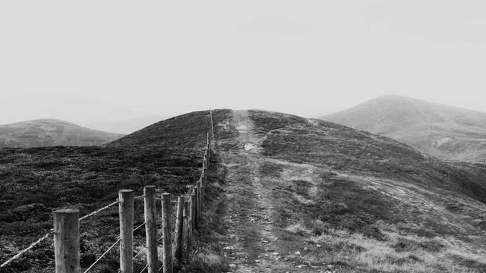
Quantifiable Impact: Significant Improvements
30-50%
25-40%
Water Conservation
Energy Efficiency
20-30%
1.5-2 Years
Crop Yield Increase
Typical ROI Payback
7

Slide 9

“
"Smart irrigation technologies are not just about conserving water; they are about empowering farmers to make data-driven decisions for a more sustainable and profitable agriculture."
-- Dr. Anya Sharma, Agricultural Technology Expert
8

Slide 10

Smart Irrigation: From Innovation to Adoption
2020
2026
Early adoption of precision irrigation techniques begins to gain traction in developed nations.
Widespread use is projected to reduce water waste and increase crop yields globally, particularly in water-scarce regions.
Increased integration of IoT and sensor technologies allows for real-time monitoring and automated adjustments.
2023
9

Slide 11

The Dawn of the Automated Farm
This system offers a 'Global Bridge' for sustainable agriculture, safeguarding farmers from biological risks while promoting efficient water and energy management.
The integration of these tools transforms traditional farming into a technology-driven practice, ensuring sustainability, increasing yields and improving livelihoods.
The system’s open-source nature encourages community-driven innovation, allowing continued improvements and broader accessibility to the technology.
Policy support is critical for widespread implementation, especially in developing nations, with governments and NGOs facilitating adoption and education.
By protecting farmers from harm and maximizing resource use, the combined ESP32 and LoRa system represents a fundamental tool for 21st-century agriculture.
10

