Slide 1
Smart Irrigation: A Technological Shift for Global Agriculture
VERDANT AUTOMATION THEME

Slide 2
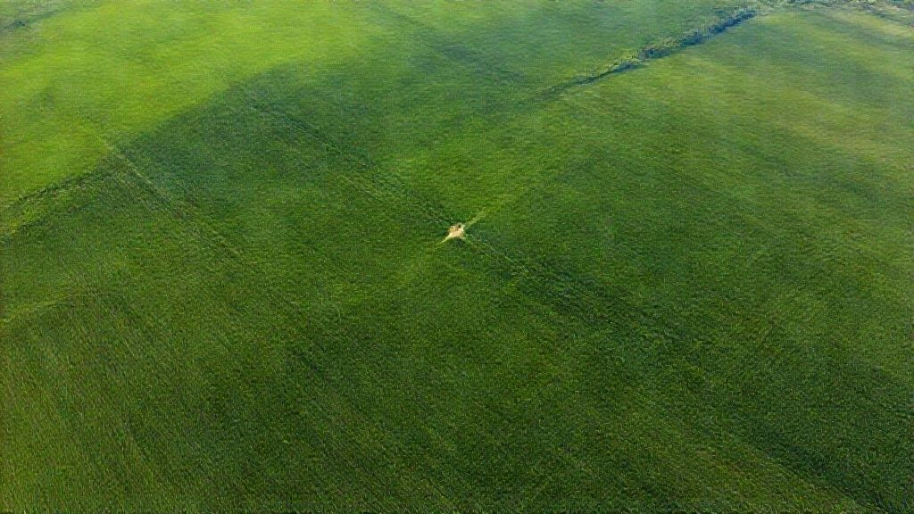
Bridging the Divide: Modern Smart Irrigation
Harnessing ESP32 and LoRa for remote control, safety, and precision in agriculture.

Slide 3
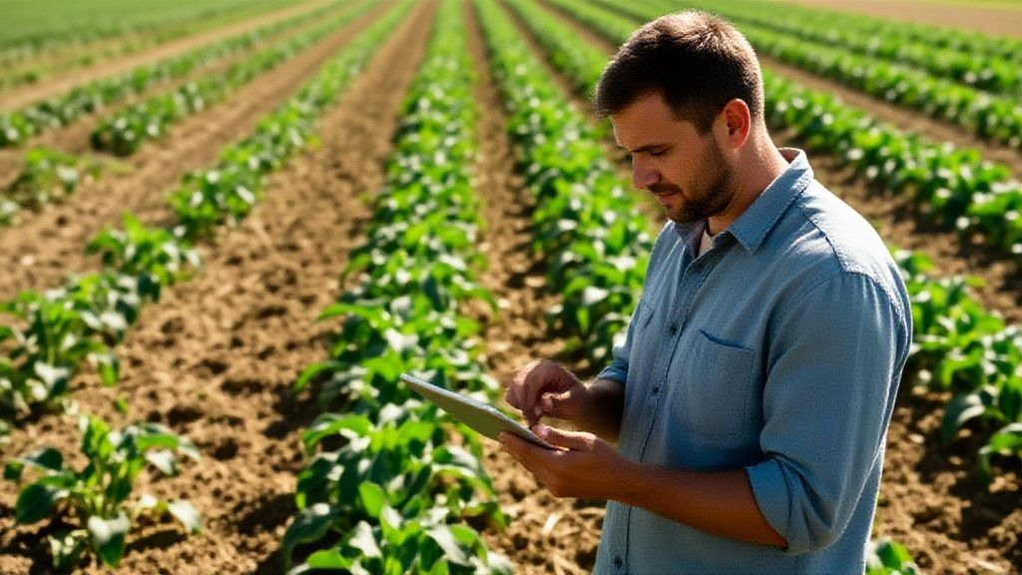
The Agricultural Imperative: Addressing Critical Challenges
Smart irrigation systems address critical issues of farmer safety and resource management by allowing control of remote motors via smartphone technology.
This innovative approach uses ESP32 Internet technology in tandem with LoRa long-range radio, enabling broad connectivity across vast agricultural landscapes.
The integration of these technologies significantly reduces the need for farmers to physically visit remote fields, mitigating risks such as snakebites and electrical hazards.
By leveraging remote control capabilities, farmers enhance their operational efficiency and ensure optimal resource utilization, contributing to more sustainable agricultural practices.
It is estimated that precision irrigation technologies, like the described system, could improve global crop yields by up to 15% while reducing water consumption by 20% over the next decade.
2

Slide 4
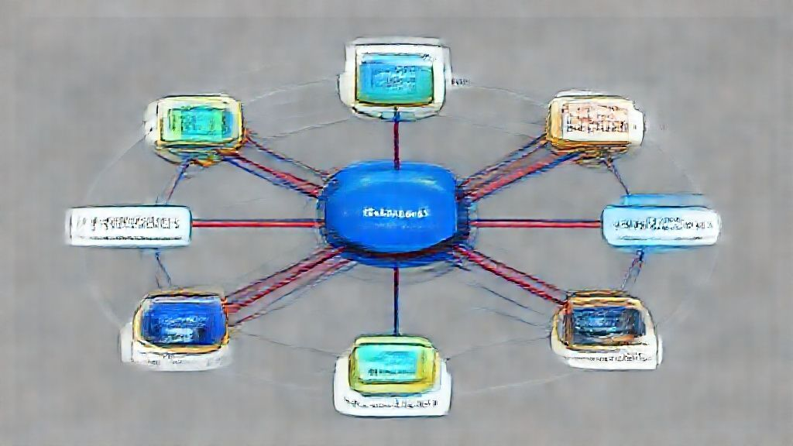
System Architecture: A Seamless Signal Path
The system architecture establishes a reliable signal path from the user's mobile application to the agricultural motor through several key components.
Commands initiated via a smartphone app are transmitted to an IoT cloud platform like RainMaker or Firebase, which acts as the internet bridge.
The gateway then receives these commands and forwards them to the field via LoRa radio signals, which can reach up to 15 kilometers in optimal conditions.
Upon receiving the signal, the receiver triggers a relay that activates the agricultural motor, initiating the desired action, such as starting or stopping irrigation.
The integration includes a feedback loop where sensors report the motor’s operating status back to the user, ensuring real-time monitoring and control capabilities.
Advanced versions of these systems incorporate machine learning algorithms to predict potential equipment failures and optimize water usage based on weather patterns and soil conditions.
3

Slide 5

Evolution of Irrigation: Smart vs. Traditional Systems
Traditional Manual Starter
Proposed Smart System (ESP32 + LoRa)
Control is limited to physical on-site operation, requiring manual intervention for any adjustments or interventions.
Reliance on manual operation increases the risk of human exposure to environmental hazards such as snakebites and electrical shocks.
Manual timing logic often leads to resource inefficiencies, resulting in over-irrigation and unnecessary water wastage.
Maintenance is primarily reactive, addressing issues only after a failure occurs, leading to increased downtime and repair costs.
Offers global remote control via smartphone, facilitating adjustments from any location with internet connectivity.
Eliminates physical risks by enabling control from a safe distance, protecting farmers from environmental dangers.
Automatic timers enhance precision, preventing over-irrigation and conserving significant amounts of water.
Enables predictive maintenance by logging data and alerting users to potential failures, minimizing downtime and operational costs.
VS
4

Slide 6

Alleviating burdens: Addressing Farmer Challenges
How modern smart irrigation systems directly reduce deadly risks and financial burdens.

Slide 7
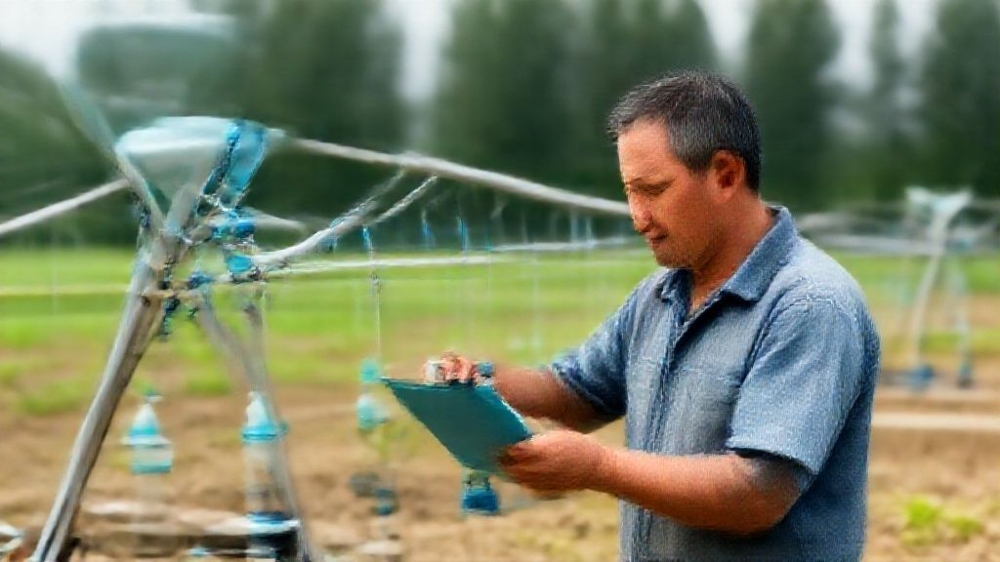
Triple Threat: Combating Lethal and Financial Risks
This agricultural technology directly mitigates three primary risks faced by farmers: snakebites, infrastructure destruction, and resource inefficiency, leading to better outcomes.
The snakebite crisis, particularly severe in regions with nocturnal electricity access, can be mitigated by remote operation, reducing the need for hazardous night field trips.
Infrastructure destruction, stemming from issues like dry running, is addressed through automated systems that prevent equipment burnout, saving farmers repair costs.
Automated systems can reduce water waste by up to 50% through controlled operation, which optimizes irrigation based on real-time data and reduces over-irrigation.
Globally, adoption of these smart irrigation systems are projected to reduce agricultural water consumption by 15% and increase crop yield by 10% over the next five years.
6

Slide 8
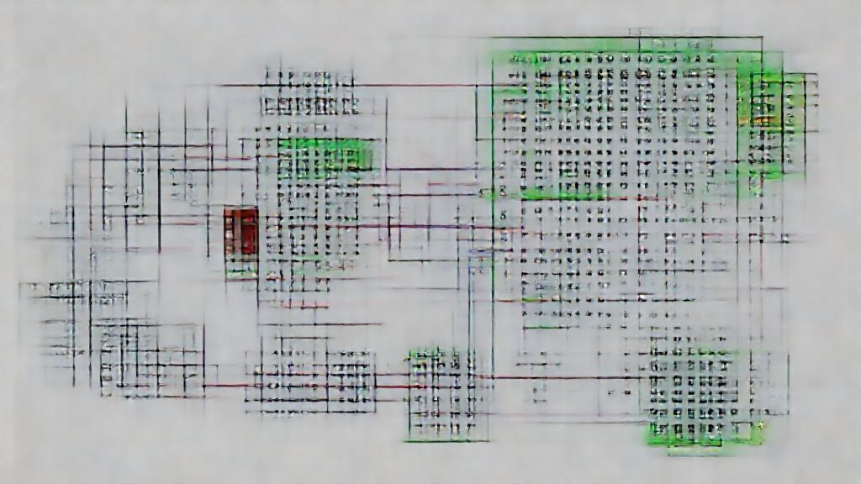
Technical Foundation: Core Technologies for Precision
The combination of global internet access (ESP32 Gateway) and long-range field connection via LoRa, facilitates precision irrigation timing.
The ESP32 Gateway allows for seamless bridging of the LoRa network to the internet, leveraging free-tier IoT platforms to minimize server costs and maintenance.
LoRa’s ability to penetrate dense crops and buildings over distances of 15 km ensures connectivity, especially in rural environments where Wi-Fi access is limited.
Precision timing logic via hardware timers maintains accuracy within 0.1 seconds, supported by a countdown timer that guarantees precise control, enhancing water management.
EEPROM resume functionality offers the additional resilience to power outages by saving operation data when power fails to allow for seamless service when power resumes.
7

Slide 9
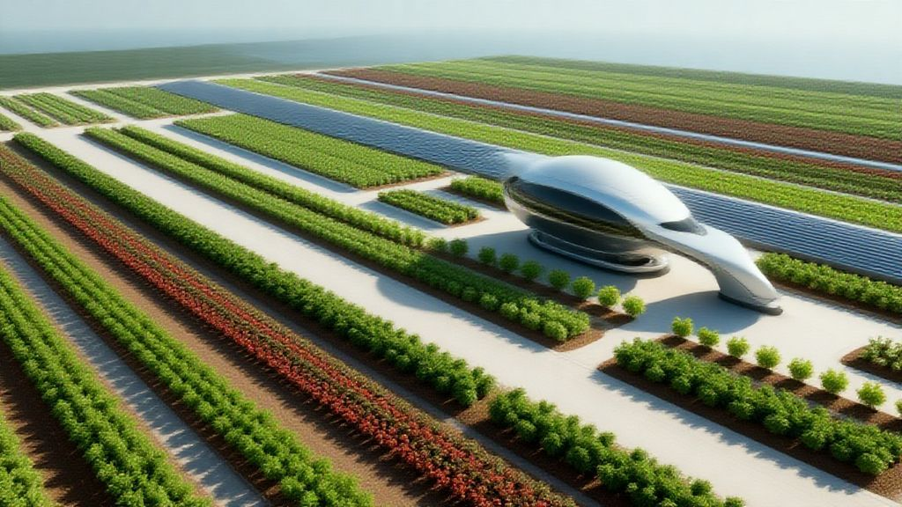
“
"The convergence of IoT technologies in agriculture has the potential to revolutionize resource management and enhance farmer safety, driving us towards a more sustainable and efficient future in farming."
-- Dr. Anya Sharma, Agricultural Technology Researcher
8

Slide 10
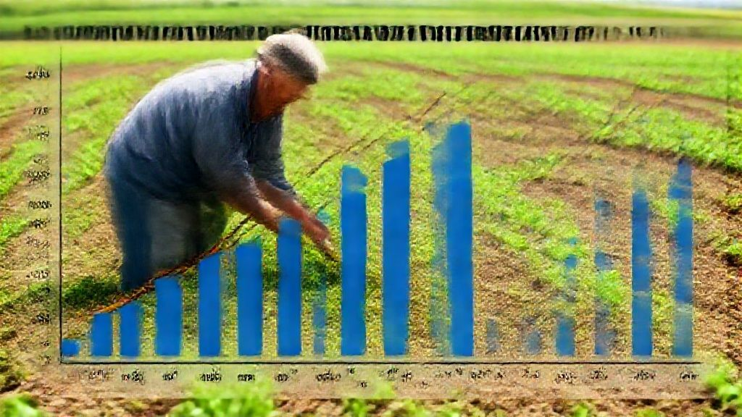
Quantifiable Impact: Real-World Improvements
30-50%
25-40%
Water Conservation
Energy Efficiency
20-30%
1.5-2 Years
Crop Yield Increase
ROI Payback Period
9

Slide 11
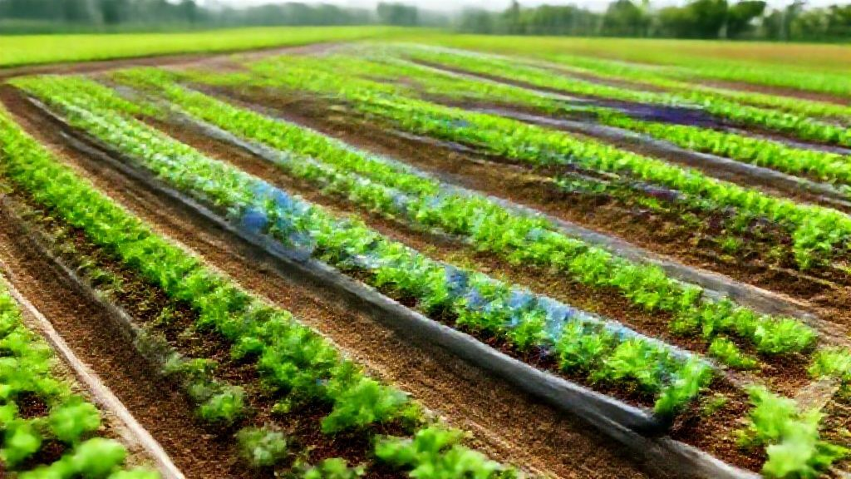
Charting the Future: A Sustainable Agricultural Technology
Integrating ESP32 and LoRa technologies establishes a global bridge, promoting sustainability in agriculture and improving lives.
This system protects farmers from physical and biological hazards while promoting the efficient use of essential resources such as water and energy.
By effectively minimizing risk and maximizing resource efficiency, this system forms a crucial part of the toolkit for modern, sustainable farming practices.
The adoption of similar technologies globally could reduce the farming industry's carbon footprint by up to 10% within the next decade through efficient resource use.
Further innovations will likely include integrating AI-driven predictive analytics to enhance water and energy management even further and to meet the emerging demands of 21st-century farms.
10

