Slide 1
Visualizing the LoRa Motor Starter Project: A Comprehensive Overview
WIRELESS CONTROL SYSTEM THEME

Slide 2

LoRa-Enabled Motor Control: A Graphical Journey
Exploring the architecture, safety protocols, signal flow, and hardware components of our LoRa motor starter project through visual diagrams.

Slide 3
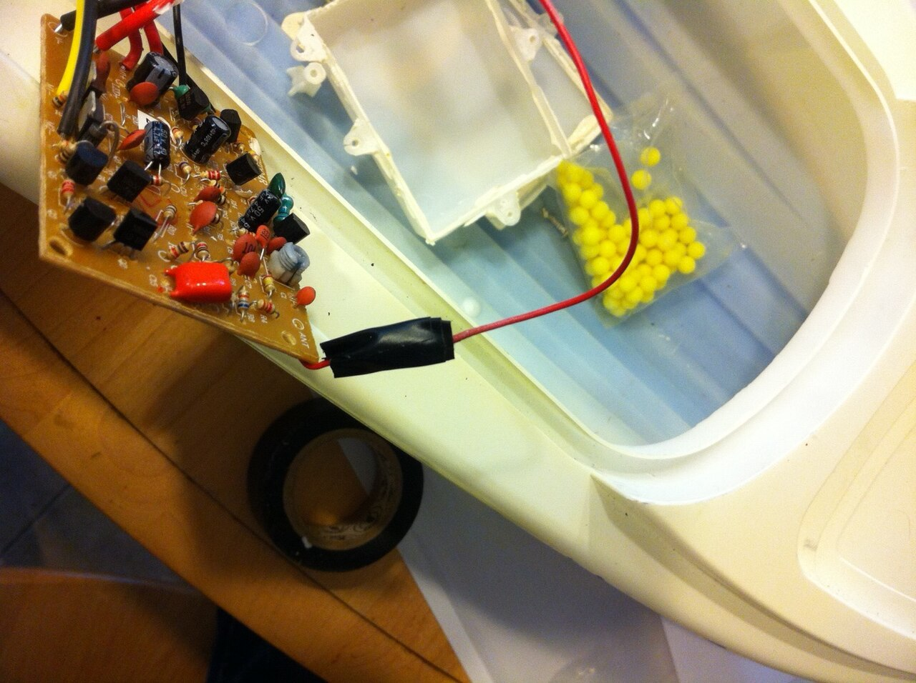
System Architecture: Connecting User, LoRa, and Motor
The system architecture diagram illustrates a tiered structure: a user sends commands via a LoRa transmitter to a receiver linked to a microcontroller.
This microcontroller processes signals, activating a relay module that manages AC motor power which is supplied through the power supply unit enabling remote motor control.
A crucial aspect is the bi-directional communication, where the motor's operational status (e.g., RPM, temperature) can be fed back to the user for real-time monitoring and adjustments.
Implementing secure encryption protocols within the LoRa communication is vital for preventing unauthorized access and maintaining secure operational control preventing system compromise.
Utilizing this architecture, remote adjustments in agricultural irrigation systems can be efficiently made based on real-time weather data and soil moisture levels enhancing resource conservation.
2

Slide 4
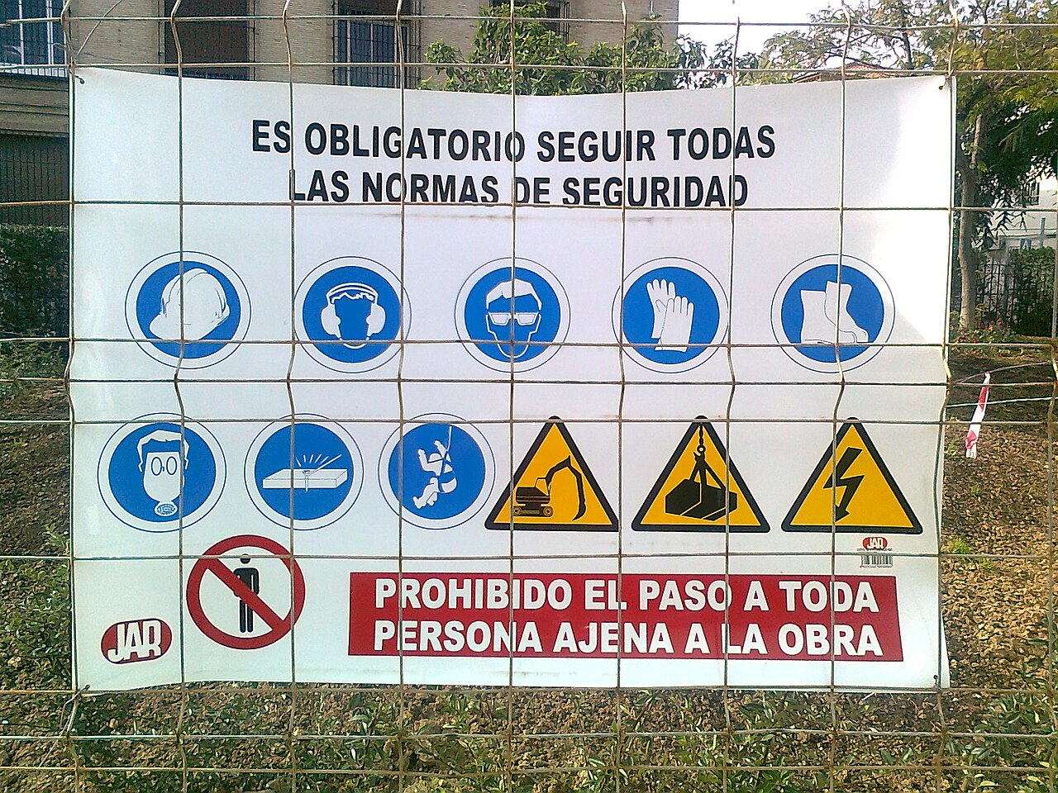
Safety and Operational Integrity
Critical safety protocols form the backbone ensuring safe and dependable operation.

Slide 5
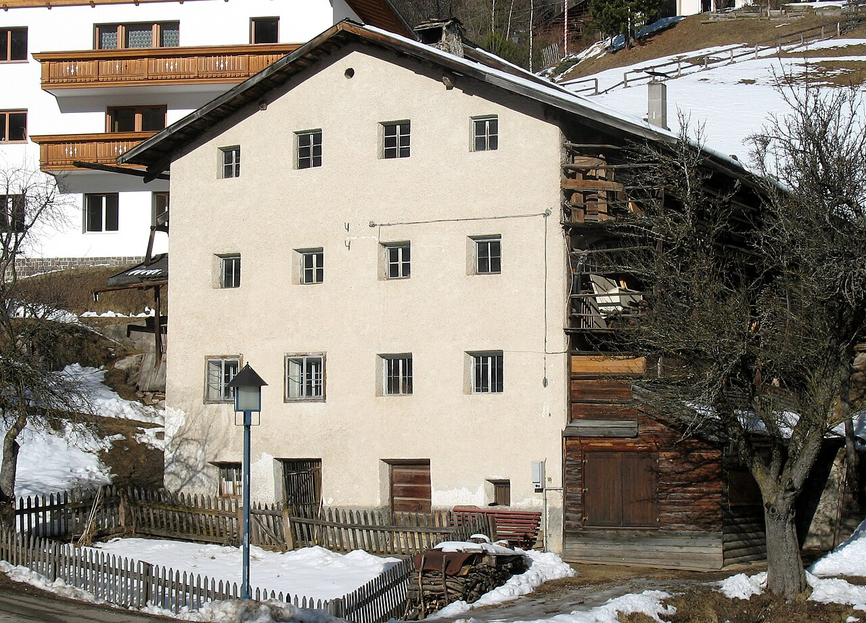
Safety & Control Flow: Prioritizing Safe Motor Operation
The control flow diagram ensures sequential safety checks: the system verifies power availability and LoRa signal integrity before activating the relay module for motor operation.
If either power is unavailable or the LoRa signal is compromised, the process halts, preventing unintended or uncontrolled motor activation which maintains system integrity.
Incorporating an emergency stop function that overrides all other commands is critical to allow immediate shutdown of the motor in case of malfunctions or dangerous situations.
Regularly scheduled maintenance checks are crucial for ensuring the ongoing integrity of safety systems and extending the longevity and dependability of the motor control setup.
Implementing overcurrent protection and thermal monitoring can automatically stop the motor if dangerous conditions are detected, preventing damage and ensuring user safety.
4

Slide 6
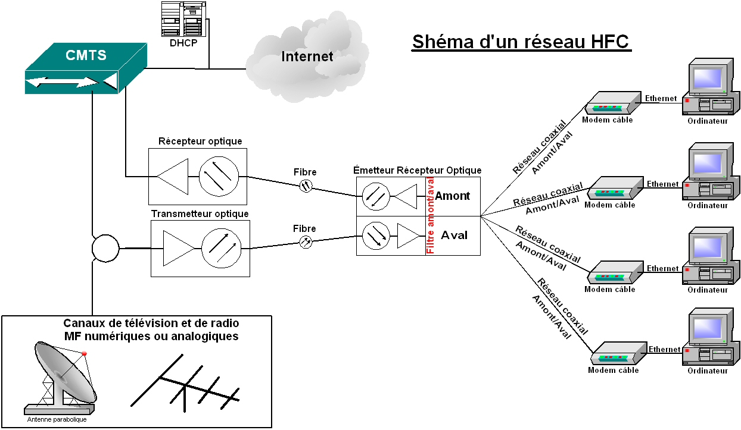
Signal Flow: The Motor's Communication Sequence
User
LoRa Receiver
Relay
Initiates Start/Stop Command
Validates Signal Integrity
Controls Motor Power
Sends LoRa Data Packet
Triggers Relay ON/OFF
Motor Operation
LoRa Transmitter
Microcontroller
Motor
5

Slide 7
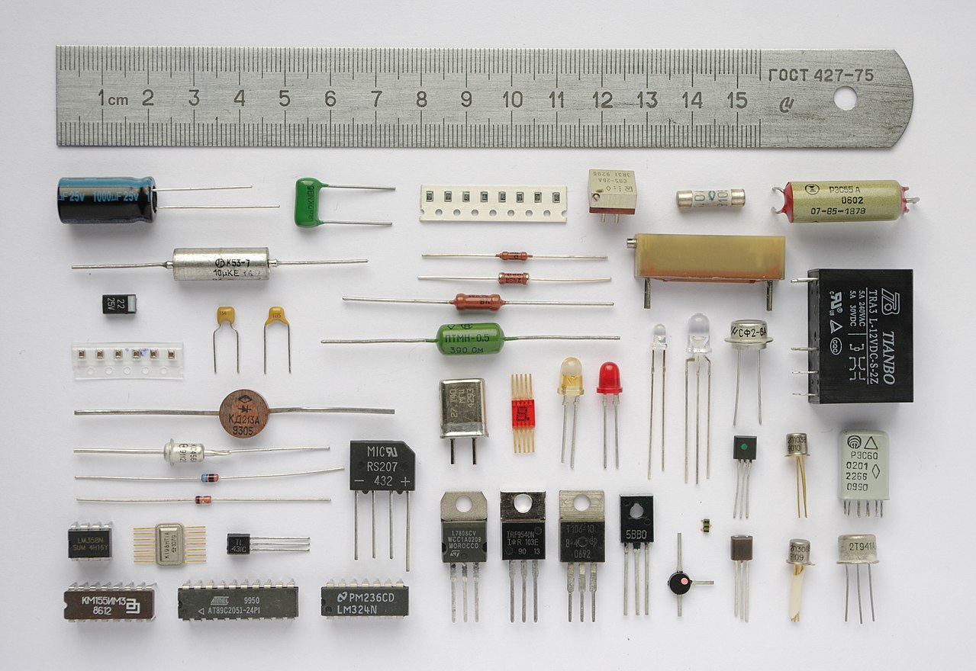
Hardware Architecture
Components and their integration, establishing the essential foundation for the controller.

Slide 8
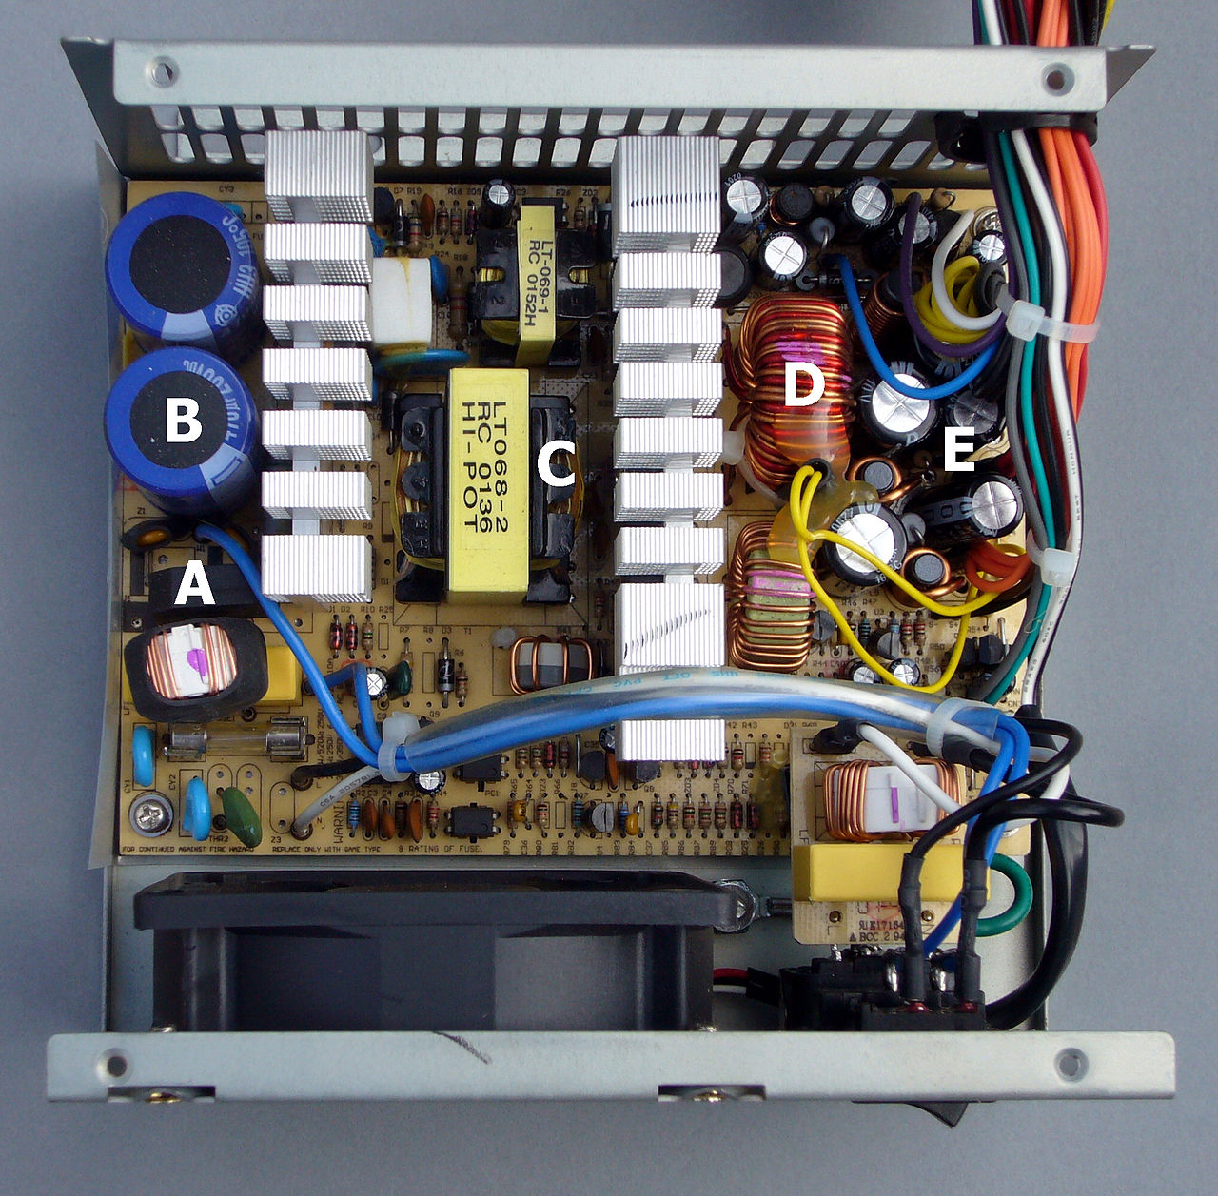
Hardware Block Diagram: Key System Components
The hardware block diagram highlights the interaction between the power supply, Arduino paired with a LoRa transmitter, the receiver, a relay module, and the motor load.
The Arduino paired with LoRa transmitter sends wireless signals to the paired receiver and the microcontroller assesses that before controlling the relay module to supply the needed electrical energy to the motor.
Implementing a modular hardware design allows for easy replacement and upgrades to individual components such as the LoRa module without requiring whole system modification.
Integrating surge protection mechanisms into the power supply and relay module will help protect the hardware from voltage spikes or power surges and extend the life of components.
Selecting industrial-grade components such as the relay module helps to guarantee continuous operation under harsh environmental conditions that may exist in industrial settings.
7

Slide 9
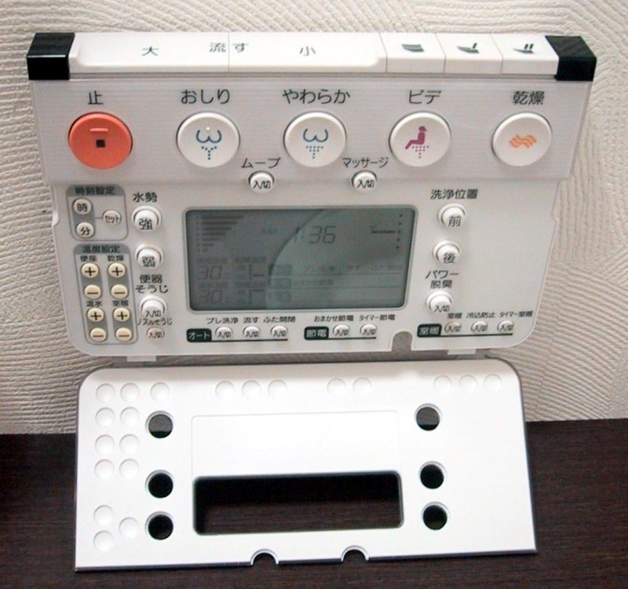
Operating State: Transitioning Between Safe Operations
99.9%
±1%
System Uptime Target
Voltage Stability
10 km
LoRa Range
8

Slide 10
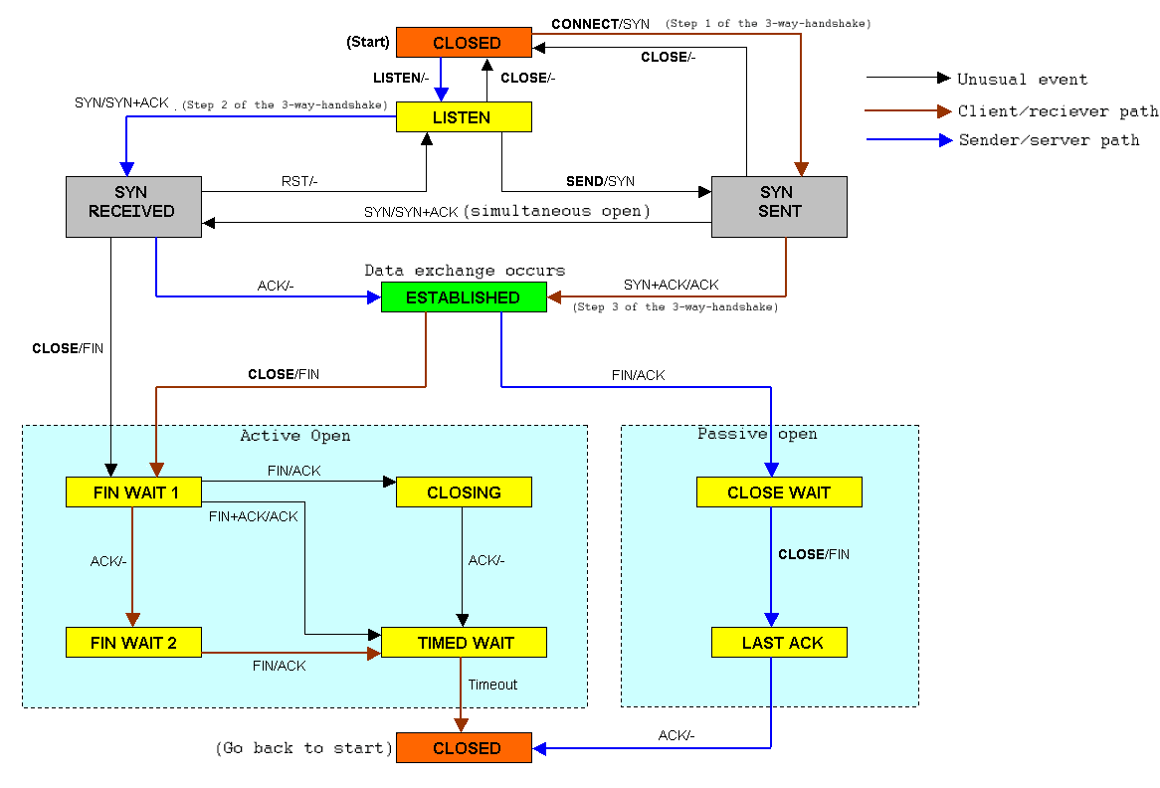
State Diagram: Safe vs. Unsafe Operating Modes
Safe Operation
Unsafe Operation
Includes the idle phase, waiting for commands while continuously monitoring power.
Requires successful safety checks before transitioning to the running phase.
Facilitates a smooth transition back to 'Idle' after receiving a 'Stop' command.
Maintains continuous monitoring which leads to immediate shutdown in the case of critical anomalies.
Occurs when safety checks fail or critical errors are detected during operation.
Automatically shuts down the motor, preventing further damage or hazardous situations.
Requires a manual reset and thorough inspection before restarting to ensure system safety.
Notifies users through connected network regarding the unsafe condition which may require human intervention.
VS
9

Slide 11

“
“The beauty of LoRa technology lies in its ability to provide long-range, low-power communication, making it ideal for remote motor control in various industrial and agricultural applications.”
-- Dr. Evelyn Reed, Wireless Systems Engineer
10

