Slide 1
Horizon Kernel: A Deep Dive
TECHNO BLUE THEME

Slide 2

Unveiling the Horizon Kernel
An introduction to the core components and innovative architecture of the Horizon Kernel, designed for advanced machine learning and AI applications.

Slide 3

System Overview: Dissecting the Horizon Kernel
This diagram illustrates the core modules of the Horizon Kernel, including the inference engine, memory manager, and communication interface, to show their spatial arrangement.
The inference engine is the central processing unit responsible for executing machine learning models with optimized performance and decreased system slowdown.
The memory manager facilitates efficient allocation and deallocation of resources, mitigating memory leaks and supporting larger models for complex jobs.
The communication interface handles data exchange between the kernel and external systems, emphasizing low-latency and high-bandwidth networking capabilities.
2

Slide 4
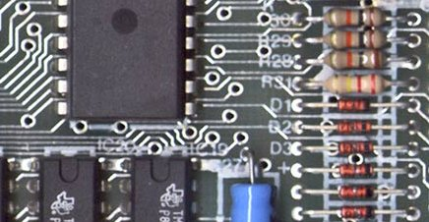
Horizon Kernel Architecture: Layers of Innovation
The architecture encapsulates modular design, which enhances reusability and maintainability, enabling iterative enhancements based on new market demands.
At its base, the hardware abstraction layer provides compatibility with various hardware platforms, allowing the kernel to be deployed across heterogeneous devices.
The model management layer handles the loading and deployment of AI models, enabling efficient versioning and A/B testing for performance optimization.
Integrated debugging tools allow real-time tracking of kernel activity, identifying bottlenecks and enabling efficient optimization for improved performance.
3

Slide 5
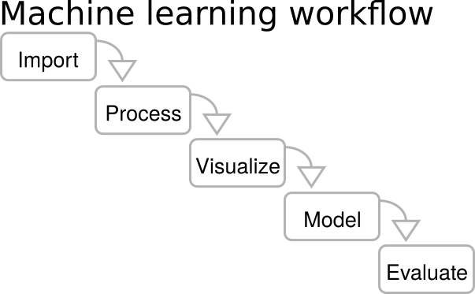
The Continuous Learning Loop
Step 1: Data Acquisition
Step 3: Validation and Testing
Step 5: Performance Monitoring
The kernel collects and pre-processes real-world data from diverse sources, preparing it for training and refinement of existing models.
Trained models are rigorously tested against validation datasets to ensure generalization and prevent overfitting, which degrades reliability.
The kernel continuously monitors the performance of deployed models, tracking key metrics and identifying areas for further optimization and refinement.
Using the acquired data, the kernel retrains machine learning models, adapting to new patterns and behaviors to improve prediction accuracy.
Validated models are deployed into the live environment, integrated seamlessly with existing systems to start impacting real-time decision-making tasks.
Step 2: Model Training
Step 4: Model Deployment
4

Slide 6
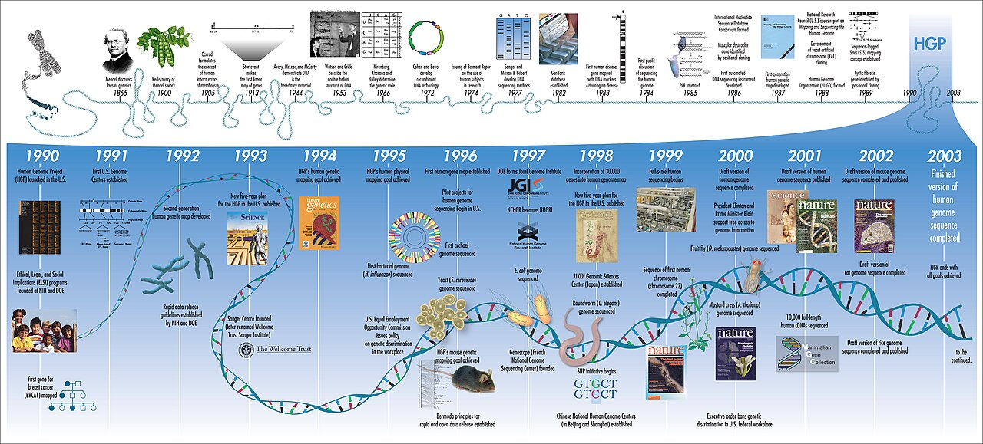
Accelerated Development: The 90-Day Build Plan
Week 1-4: Foundation
Week 9-12: System Optimization
Establishing core architecture, defining the key interfaces, and conducting initial proof-of-concept testing to evaluate core functionality.
Optimizing kernel performance through profiling, implementing caching strategies, and reducing memory footprint to meet stringent performance requirements.
Integrating core modules such as inference engine and memory manager, ensuring seamless data flow and efficient resource allocation among components.
Conducting comprehensive testing and validation to ensure stability, reliability, and adherence to specified performance benchmarks for optimal end-user experience.
Week 5-8: Module Integration
Week 13: Testing and Validation
5

Slide 7

Key Performance Indicators (KPIs) for the Horizon Kernel
The inference speed reflects the kernel's ability to process data and make predictions quickly, directly correlating to real-time decision-making capabilities.
Resource utilization gauges the efficiency of memory and computational resources, reducing overall operational costs and promoting eco-friendly practices.
Model accuracy tracks the performance of deployed models, ensuring alignment with business goals while continuously adapting to evolving data patterns.
System uptime measures the reliability and stability of the kernel, crucial for maintaining continuous operation and preventing service interruptions that impact consumers.
6

Slide 8

Agent vs. Horizon Kernel: A Performance Showdown
Typical Agent
Horizon Kernel
Offers limited scalability due to monolithic architecture, making them unsuitable for large-scale deployments in heavy duty enterprise.
Higher latency in processing data, thus impacting real-time decision-making and delaying responses that customers demand.
Limited support for heterogeneous data sources that can complicate integration with diverse systems in an ecosystem.
Offers enhanced scalability with modular architecture, better suited for handling large volumes of data in sophisticated applications.
Provides lower latency driven by optimized inference engine, making the kernel superior for real-time processing with fast response times.
Supports diverse heterogenous data sources, simplifying integration of data from various sources and enterprise software for business solutions.
VS
7

Slide 9

World Model Research: Bridging Simulation and Reality
Traditional Approaches
Horizon Kernel Advancements
Relies on pre-defined rules and static environments which can fail to capture the complexity and dynamics of the real world systems.
Struggle to generalize across evolving conditions limiting their applicability in uncertain, non-steady state conditions.
Can be computationally expensive thus inhibiting the speed and efficiency of predictive modeling over dynamic situations.
Uses real-time data integration from sensors and IoT devices increasing the accuracy of world model behavior in complex scenarios.
Utilizes machine learning algorithms to adapt to new conditions by improving the prediction and generalization across diverse environments.
Allows for scalable simulations which support exploration of diverse what-if scenarios to improve business optimization and risk management situations.
VS
8

Slide 10

Model Context Protocol: Ensuring AI Coherence
The Model Context Protocol provides a standardized framework for encapsulating contextual information of AI models, ensuring reusability and transparency.
The protocol facilitates seamless model integration across various platforms, promoting operational efficiency and adaptability to evolving system needs.
It enables enhanced auditability of AI decisions, allowing for in-depth analysis and compliance with regulatory requirements while providing consumer assurances.
The protocol enhances the reliability and robustness of AI systems by explicitly defining model assumptions and limitations, which improves safety.
9

Slide 11

The Horizon is Here
The Horizon Kernel represents the next evolution in adaptive and accelerated machine learning, improving AI performance across domains.

