Slide 1
Crafting Your Path: A Personal Development Plan
ACADEMIC ASCENT THEME

Slide 2

Embarking on Self-Discovery
Your journey toward personal and academic excellence begins now.

Slide 3
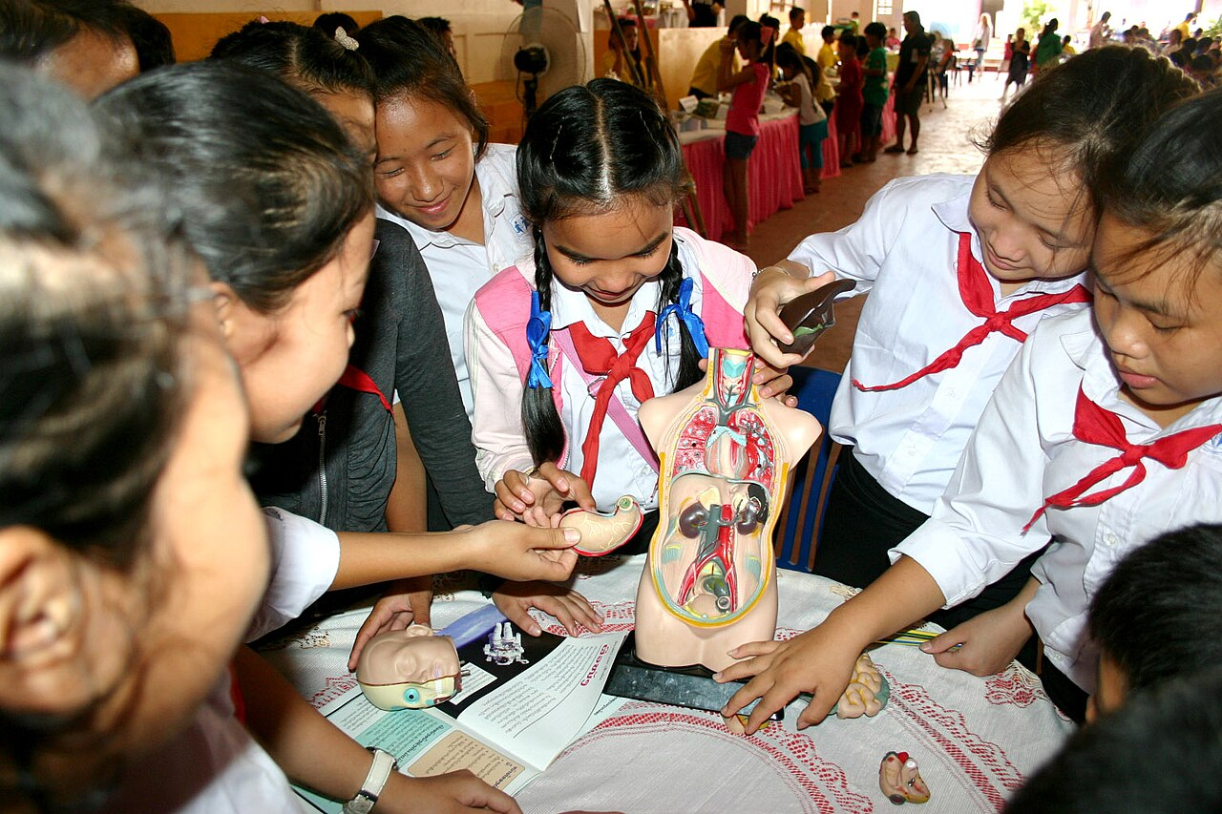
Deconstructing the Self: A Detailed View
Understanding oneself involves dissecting various aspects, including strengths, weaknesses, opportunities, and challenges, to form a holistic view.
Strengths are internal capabilities that give advantages, weaknesses are internal limitations, opportunities are external conditions, and challenges are external threats that need to be addressed.
Effective self-understanding helps align personal goals with realistic potential, fostering a sense of purpose and direction within the academic environment.
Reflecting on past experiences and feedback is crucial to identifying recurring patterns and hidden biases that may influence decision-making processes.
Regular self-assessment enables continuous improvement and encourages a growth mindset by recognizing areas where focused development can yield significant results.
2

Slide 4

Measuring Your Ambition: SMART Goal Dashboard
85%
3.7
Goal Completion Rate
Avg. GPA Target
12
6
Weekly Study Hours
Months to Graduation
3

Slide 5
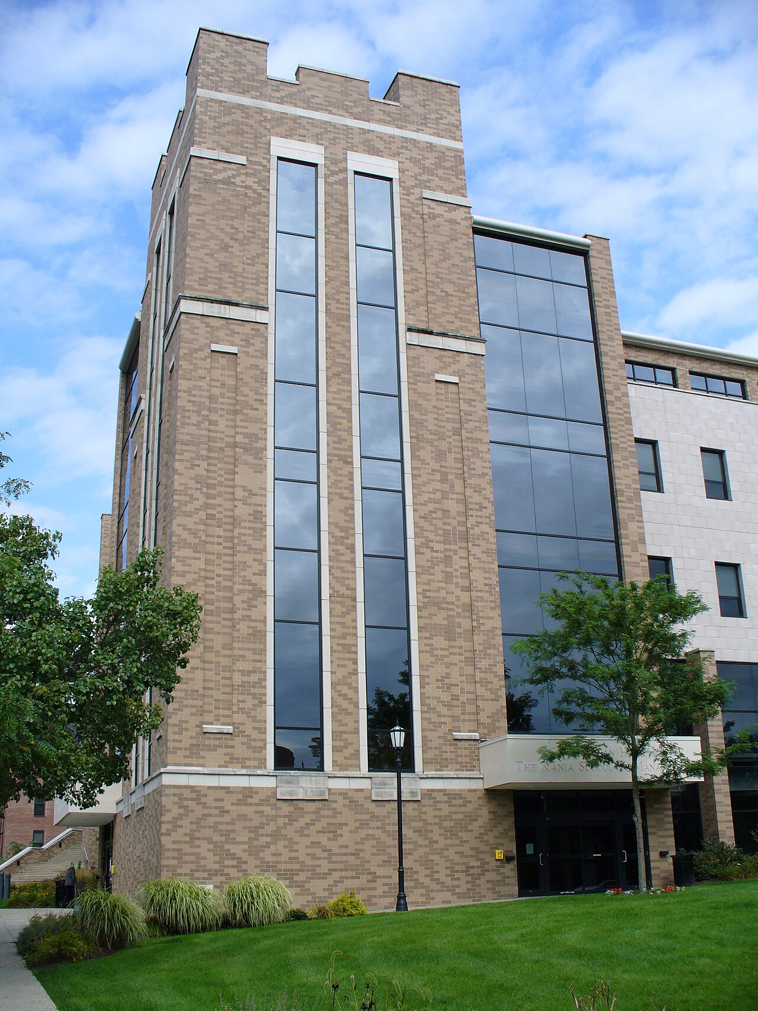
Navigating the University Ecosystem: A Resource Roadmap
4

Slide 6
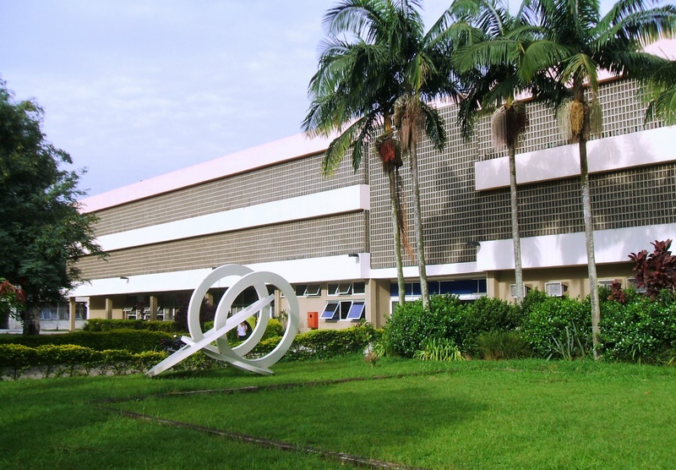
Enriching Your Experience: Co-Curricular Evolution
5

Slide 7
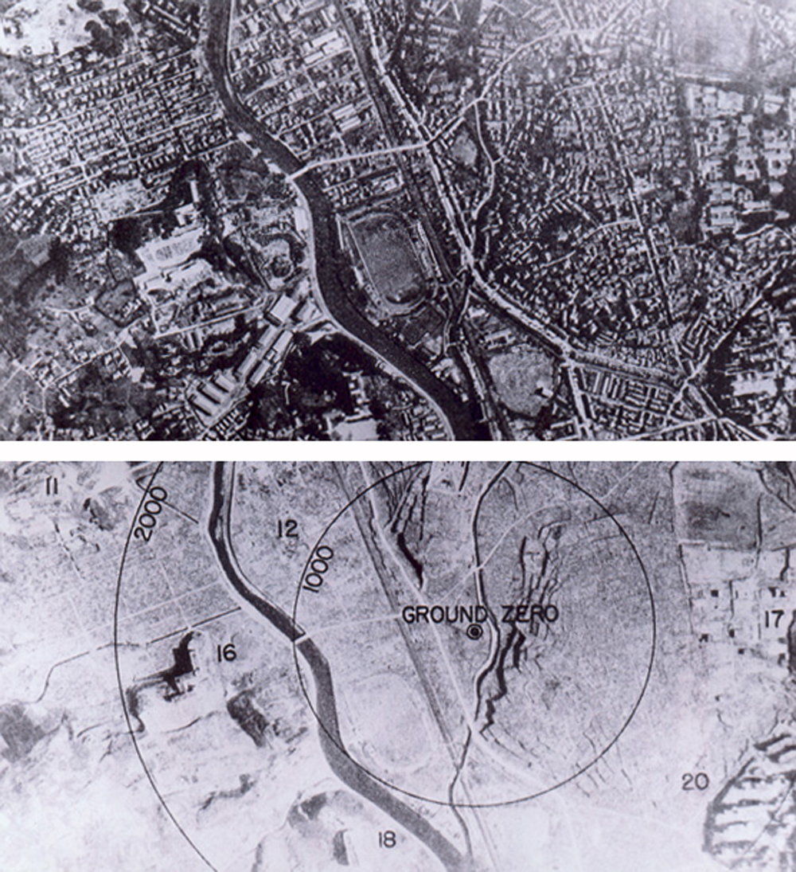
Then and Now: Reflecting on Your Transformation
Starting Point
Current Growth
Limited self-awareness and unclear academic goals.
Minimal engagement in co-curricular activities and limited network.
Uncertainty about career direction and personal values.
Strong self-understanding and well-defined SMART goals.
Active participation in diverse extracurricular activities.
Clear career vision aligned with personal values.
VS
6

Slide 8
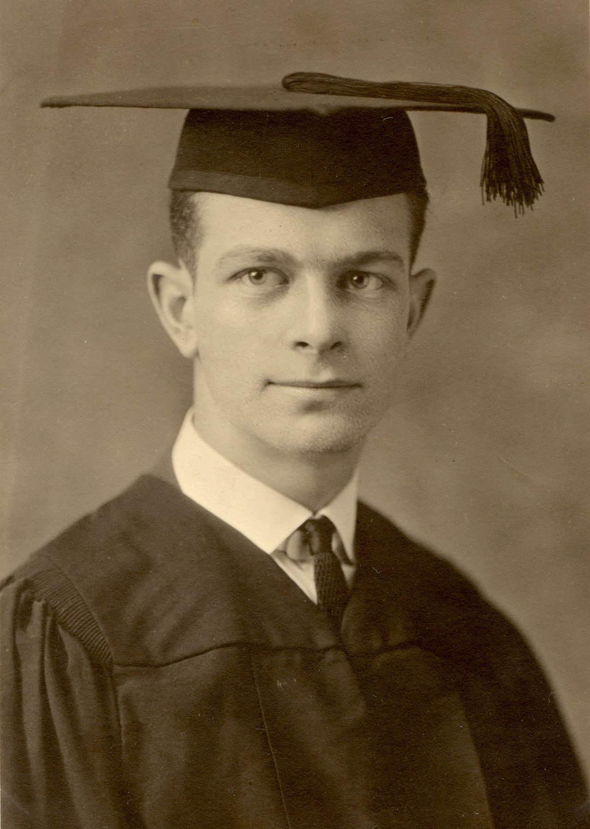
Concluding Your Ascent
Summarizing key accomplishments and planning future endeavors.

Slide 9
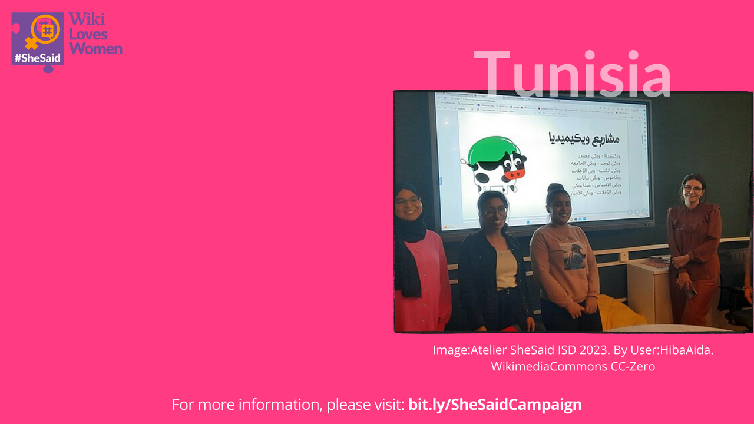
Key Goals and Planned Activities: A Concise Overview
Achieving a 3.8 GPA in computer science by dedicating at least 20 hours per week to focused study and collaborative projects with peers.
Securing an internship at a technology company by actively networking at career fairs and tailoring my resume to highlight relevant skills and experience.
Developing leadership skills through active participation in the university's student government, contributing to policy discussions and community initiatives.
Enhancing communication abilities by attending public speaking workshops and volunteering as a tutor, improving clarity and confidence in articulating ideas.
Maintaining a healthy work-life balance by incorporating regular exercise, mindfulness activities, and social interactions to prevent burnout and promote well-being.
Seeking out mentorship opportunities with experienced professionals in the tech industry with the goal of gathering insight and guidance through the field.
8

Slide 10
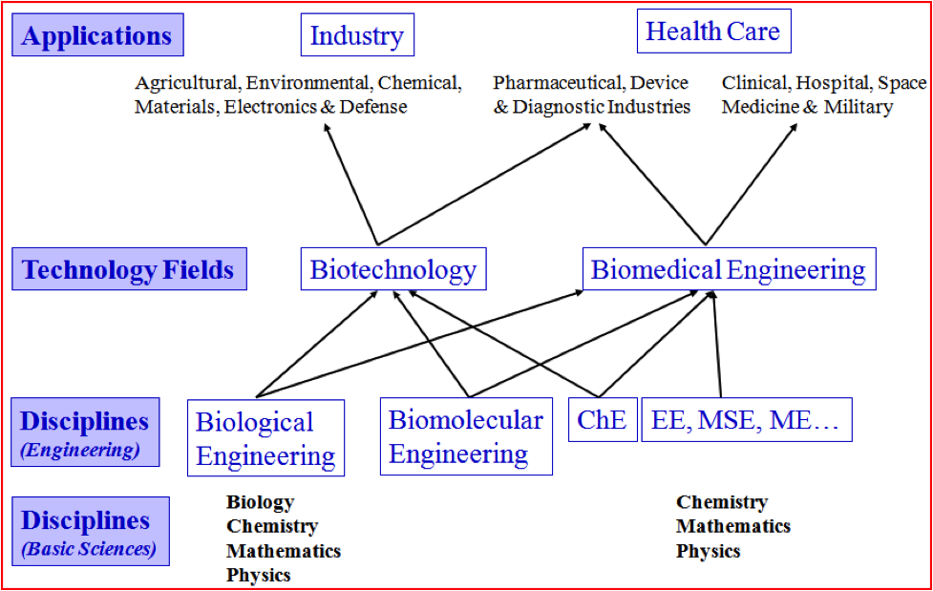
Aligning Development with Destination: Career Trajectory
Aligning personal development with career goals involves identifying the skills and experience required for your desired career path and actively working towards acquiring them.
Begin by researching the roles and responsibilities of professionals in your target field to understand the specific competencies and qualifications sought by employers.
Assess your current skill set against these requirements and create a plan to bridge any gaps through targeted learning experiences, such as online courses or internships.
Network with professionals in your industry to gain insights into career paths, industry trends, and potential opportunities for advancement and professional development.
Continuously refine your resume and cover letter to highlight relevant skills and achievements that demonstrate your suitability for specific job openings you are interested in.
Consider enrolling in advanced degree programs, certifications, or industry-specific training to enhance your credentials and increase your competitiveness in the job market.
9

Slide 11
Charting Your Course: The Growth Roadmap
Year 1
Year 3
Establish a strong academic foundation by focusing on core courses and building relationships with professors.
Develop leadership skills by participating in student organizations and taking on leadership roles.
Explore potential career interests through internships and part-time jobs.
Prepare for graduation by networking with potential employers and refining resume/cover letter.
Year 2
Year 4
10

